Slide 1
Preserving Online Evidence
St. Mary’s University
Homecoming CLE
March 22, 2013
Wilhelmina Randtke
Electronic Services Librarian and Associate Professor
Sarita Kenedy East Law Library
wrandtke@stmarytx.edu

Slide 2
Agenda
Uses for web archives
Overview of website components
Overview of ways to capture websites
Resource list for electronic evidence issues
More technology; Not as much law
Goal = understand technology well enough to assess problems

Slide 3
Uses of Web Archives
External
Investigate a case
Litigation support
Monitor jury social networking
Internal
Records retention requirements
Show that regulatory requirements were met (ie. this notice was posted on these dates)
Know what promises the company made

Slide 4
Custody Battle!
Notes:
This is what we tend to think of when we think of web archives: people are stupid on social networking. My first experience with web archives and law was when at a hearing baby’s daddy whipped out new photos of baby’s momma. She was pregnant again had beer in one hand, joint in the other, and a man flashing a gang sign was hugging her.
Photo by zippaparazza! Licensed http://creativecommons.org/licenses/by-nc-nd/2.0/ collected from http://www.flickr.com/photos/zipporah/2898210818/sizes/o/in/photostream/

Slide 5
Custody Battle!
Notes:
But we are probably too focused on social networking, because the ways people are stupid on social networking are much easier to explain quickly, and can tend to be funny.
Photo by Vato Bob, downloaded from http://www.flickr.com/photos/45665234@N00/4366052571 Licensed under http://creativecommons.org/licenses/by/2.0/

Slide 6
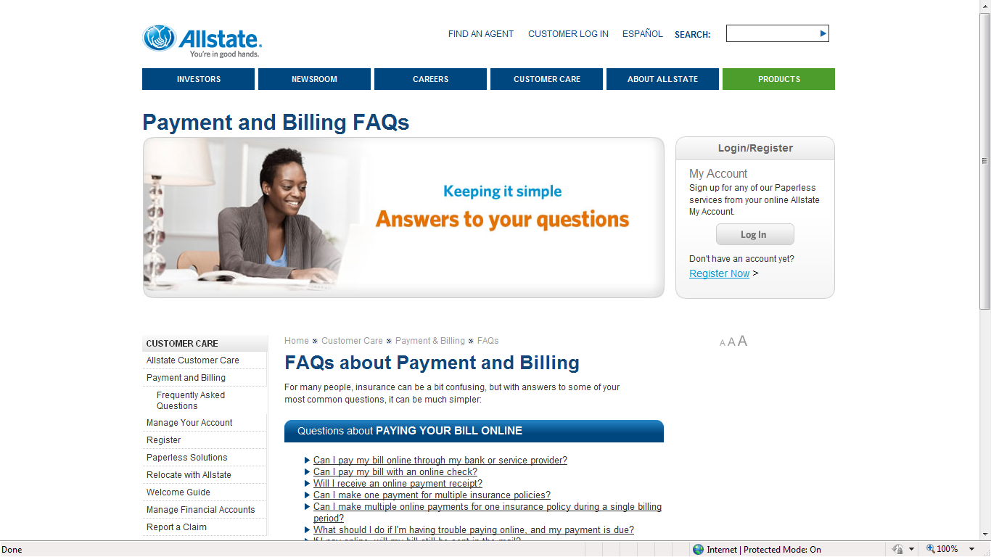
Coverage Dispute
Notes:
Really, much less interesting websites are important.
Many important legal activities in our daily lives are done through websites. To apply for government benefits, will probably use an online form, not a paper application. To apply for a job will probably use an online form, not a paper application.
My husband when he changed car insurance to Texas, did it all online. The policy showed up on his screen. He did a click through to get to the contract.
Let’s say in an insurance coverage dispute, there is a situation where, if the bill wasn’t paid, then insurance coverage lapsed. If it was, then the person is covered. Was the bill paid? You might look at guidance documents on the insurer’s website to find out.

Slide 7
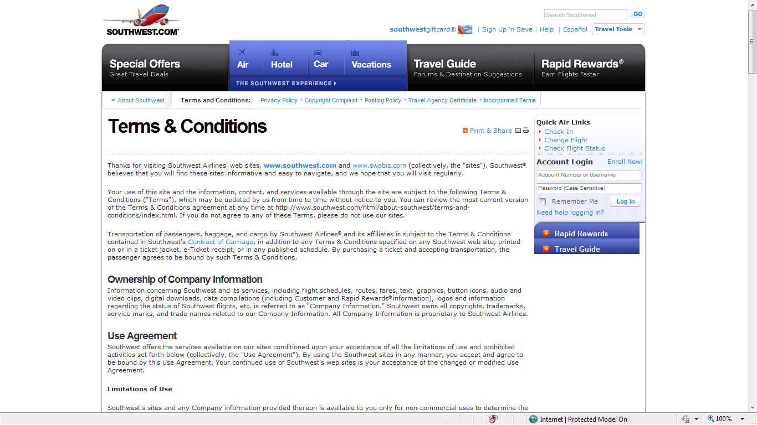
Mergers, Class Actions: so many promises online
Notes:
When you make a transaction online, most of the information is made available to you through websites. Even if there is a confirmation email, it will often have a link.
One huge area where web archives matter are when a company hasn’t kept track of promises it made to customers. This is common when there is a merger or acquisition.

Slide 8
warranty information, product specifications, ratings
Product Liability
Notes:
Many many companies that manufacture or sell products will put safety ratings on their websites. There may even be a safety rating on the product page where you make a purchase. In product liability, if the manufacturer made a claim of safety, that matters.

Slide 9
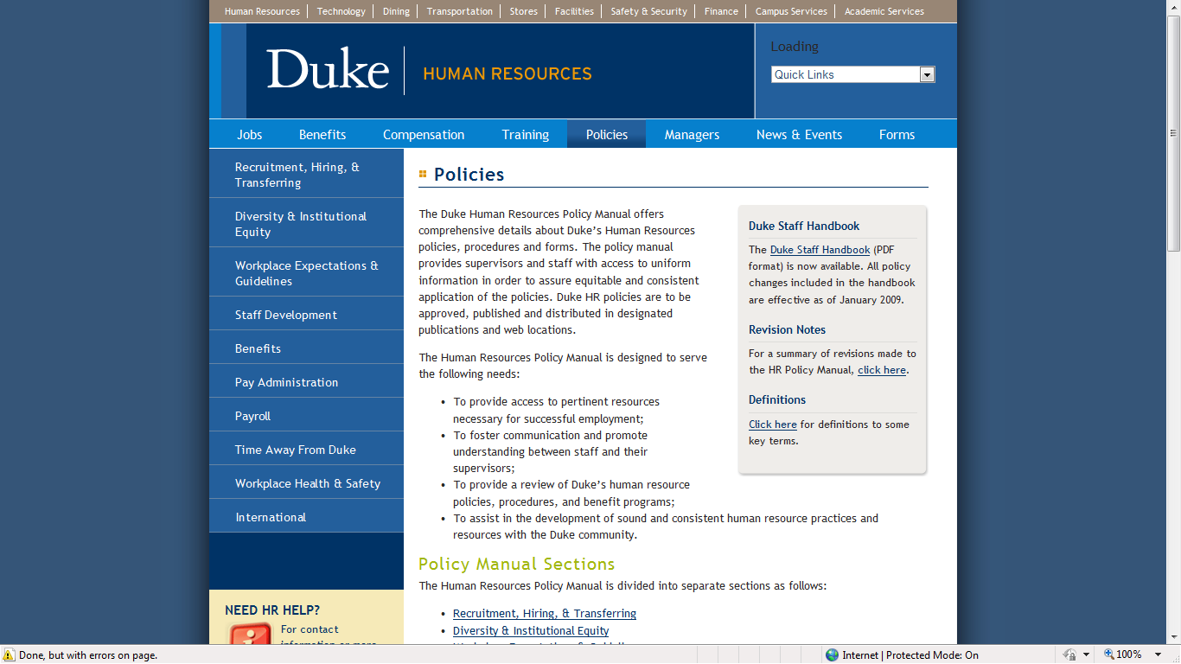
Employment: Compliance and litigation
Notes:
Click link, and scroll down. Lots and lots of policies.
No matter who you represent, policies matter. If you represent Duke, you better have records of what was posted here when. If IT made a mistake, that’s your problem. If you made a change, but didn’t keep the old policy, and you had incoming employees sign off to reading that older policy, then you may have a problem enforcing anything.
This type of information – policies and procedures – are commonly kept in intranets and parts of the web that aren’t publicly accessible. If you are in house counsel, or representing a company, then that information is something you should think about keeping records of.

Slide 10
Curiosity
Notes:
It’s also sometimes good to just be able to quickly make a copy of a website on the spur of the moment. This year, the Romney Campaign accidentally had a victory website go live. As far as I know, no one scraped it

Slide 11
Uses of Web Archives
External
Investigate a case; collect documents before discovery
Litigation support
Monitor jury social networking
Internal
Records retention requirements
Show that regulatory requirements were met (ie. this notice was posted on these dates)
Know what promises the company made

Slide 12
A little background on web architecture
Static HTML
Versus
Database and BLOB
Notes:
Now we’ll completely switch gears and get a little technology background.

Slide 13
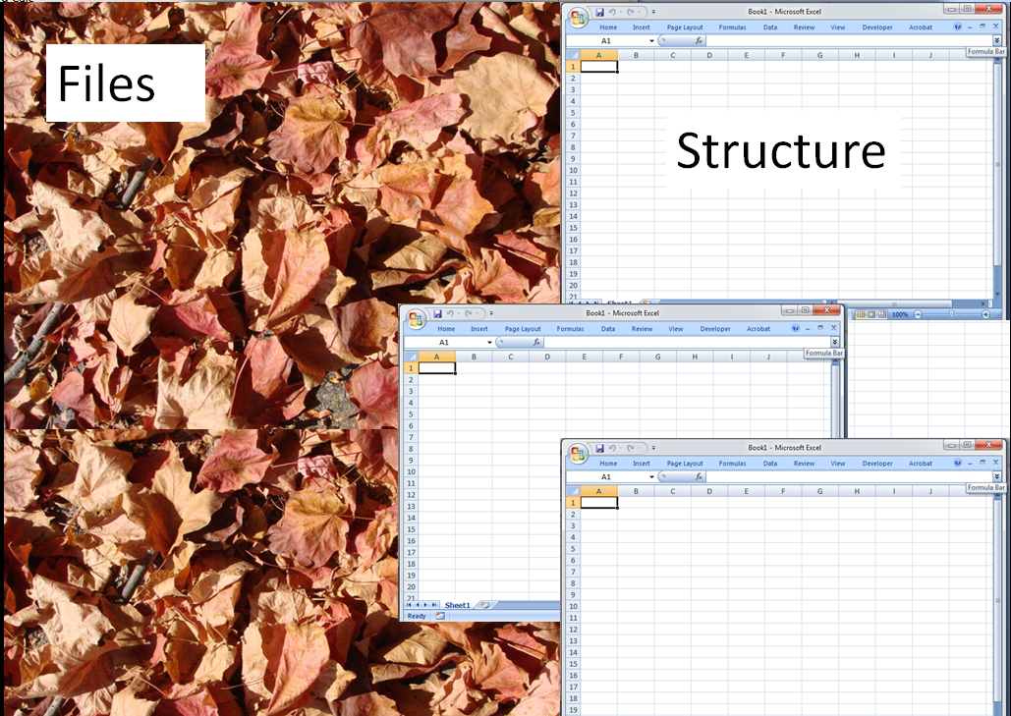
Static HTML: as leaves on a tree
CMS: as leaves separate from tree
Notes:
This is an analogy to help explain web site architecture. Hopefully, it will help to understand and also to try to build analogies you can use to explain this to others.

Slide 14
Static HTML
Picture static HTML as leaves on a tree. Each leaf touches a branch. Following branches finds all leaves.
Notes:
Photo of the tree is from http://www.geograph.org.uk/photo/128245 . This is licensed http://creativecommons.org/licenses/by-sa/2.0/ and was taken by Keith Havercroft.
FTP into randtke.com , and check that I can

Slide 15
Static HTML
Looks like files and folders on your computer. Tour of backend of randtke.com .
Visualize this as leaves on a tree. You can find each and every leaf by following branches from the stem.
You can find each and every page on the site by following links from the homepage.

Slide 16
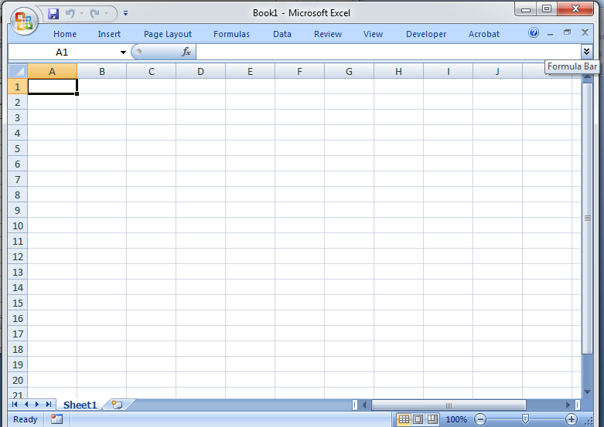
Files
Structure
Database and BLOB
Notes:
Image is from http://rosalinestock.deviantart.com/art/Leaf-Pile-66562601 . Licensed as http://creativecommons.org/licenses/by/3.0/ photo by RosalineStock.
For database and BLOB, the structure is a bunch of tables of information. They all reference one another. They can’t store files, just text and numbers. They have information about where to find files.
Files can be anywhere in the world.
For you to copy the structure, you probably need backend access. Even someone good at this cannot reverse engineer.

Slide 17
Database and BLOB
Database = like many spreadsheets that all reference each other
textual information lives here
Most actual web pages don’t read from a file at all. Instead, information is pulled from the database, on the fly, to make the webpage.
BLOB = Binary Large Object
= a bunch of files; .pdf, .docx, .jpeg etc – these live in the BLOB

Slide 18
Files
Structure
Notes:
Image is from http://rosalinestock.deviantart.com/art/Leaf-Pile-66562601 . Licensed as http://creativecommons.org/licenses/by/3.0/ photo by RosalineStock.
For database and BLOB, the structure is a bunch of tables of information. They all reference one another. They can’t store files, just text and numbers. They have information about where to find files.
Files can be anywhere in the world.
For you to copy the structure, you probably need backend access. Even someone good at this cannot reverse engineer.

Slide 19
Table for documents
Docket Number | Title of document | Date filed | Kind of Document | Where is the file | Description
1 | Petitioner’s Brief | Jan 2, 2003 | Brief | here.pdf | Blah blah
1 | Respondent’s Brief | Dec 29 2002 | Petition | hereagain.pdf | Words
2 | Amicus Brief by Jim |  | Brief | overthere.pdf | Blah
2 | Petitioner’s Brief | Jan | Brief | inhere.pdf | Maybe full text
2 | Order |  | Order | there.html
Table for the court cases
Docket number | Court | Date filed
1 | Supreme court | 2002
2 | Appeals court | 2005
3 | Trial court | 1998
Docket number | Name | Type
1 | Bob | Defendant
1 | Joe | Defendant
1 | Mary | Plaintiff
2 | Jenny | Defendant
Notes:
This is a really simple database. Database design is a very specialized technical skills. Even most web developers never do it, and don’t really understand it.
The two things to get about this are:
The files live separate from all the information about the files.
and
2) The database is complex and you never see it when you browse the site. You may or may not see all the files that exist; you will only see the files you get a link to.
This is an illustration of a simple database. Each spreadsheet holds some information about court cases, organized around the docket number. This has to be in multiple spreadsheets because this lets you for example list multiple defendants and multiple plaintiffs (or multiple petitioners and multiple respondents). Any webpages you might see built around this database will be pages made on the fly by the web site. For example, you search the docket number, or an incoming link feeds the docket number to the webpage. Then the server makes a page about that case. For docket number 1, it tells you the court system, the date filed, it lists the defendants and plaintiffs, and it gives a list of every document available for the case with a hyperlink to the document. There is no webpage on the server. Instead, there are just spreadsheets and they are not stored as files.
So, it isn’t something you can copy, unless the web developer sets up a server for you on your own equipment and moves the entire thing over. You also could probably not easily explain this to a judge.
The one thing to take from this is that the spreadsheets reference one another. Then the website pulls information from the pages

Slide 20
Files
Structure
Notes:
Tour of stmarylaw.org
Image is from http://rosalinestock.deviantart.com/art/Leaf-Pile-66562601 . Licensed as http://creativecommons.org/licenses/by/3.0/ photo by RosalineStock.
Remember:
The files live separate from all the information about the files.
and
2) You don’t see this structure when you browse. You can’t recreate it without inside help. You will only be able to see information pulled from both these; you probably won’t see everything when you go to get the site.

Slide 21
Most websites today
Best possible representation
You can’t make a perfect copy of most modern websites.
Think of taking a picture, not making a copy.
Notes:
Today most websites look like this. You can’t make a copy. You can only “take a photo”. You take something that has a database structure, and you make a static picture of it.
You can never recreate the website perfectly, unless you have a web developer work closely with the web developer for the site.
When you think about evidence preservation, don’t think about copying. You probably can’t make a copy. Instead think about photographing. If there is an intersection and a traffic accident occurred, you could try to measure everything and build an exact 3D model, and recreate it in a room. You would run into the same problem as when trying to recreate a website – you just can’t recreate it. Instead, think about taking a photograph of the intersection, taking some photos from different angles, and getting enough that you can later give someone an accurate mental image of what was there.
Usually, think in terms of taking a photo. But also think, “What other information is important?” and think about how to record that in an organized way.

Slide 22
Web architecture background Information embedded in files.
What is easy to loose or delete?
Links
Dynamic objects: scrolling bars, image carousels, video
http://www.prb.state.tx.us/ (scrolling bar along right)
Information embedded in objects
Image metadata
Demo: http://www.photos.stmarylaw.org and http://exifdata.com/
PDF metadata
Demo http://www.prb.state.tx.us/ (random PDF)
Notes:
This is something that goes along with “What is important?” The webpage isn’t just the static image. Instead, hyperlinks go somewhere.

Slide 23
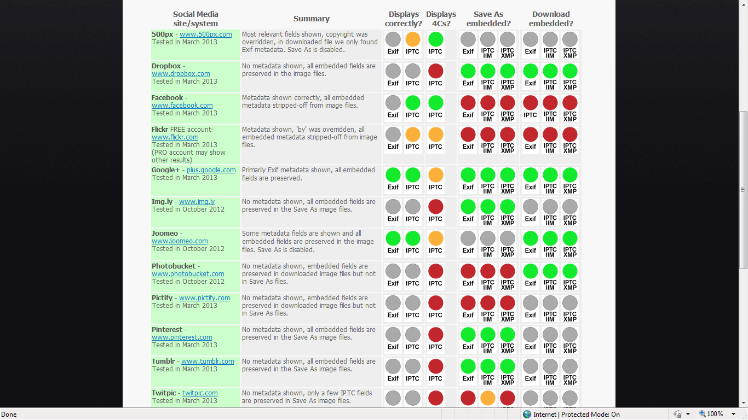
Embedded metadata and Social Media
http://www.embeddedmetadata.org/social-media-test-results.php = Social Media sites: photo metadata test results
Notes:
http://www.embeddedmetadata.org/social-media-test-results.php = Social Media sites: photo metadata test results

Slide 24
Special concerns for legal evidence
Evidence is often used years after it’s collected
How do you show your files years later?
Choose stable file formats.
Hosted solutions may be discontinued, or become unavailable.
Authenticating evidence
Almost no IT fields focus on this. IT support cannot help you with this leg.
Check the index and footnotes in an evidence manual. So far, most law is under Federal Rules of Evidence.
Notes:
Evidence is often used years after it’s collected. When you do a records deposition on paper documents, you can authenticate that and then that deposition is good as long as you need in that court case. The paper documents are still going to be readable next year. Computer files aren’t like that. When you save the file, stop and think, is the software to read this going to be available when I go to trial. Many popular formats from 10 years ago now require you to go way back in time and run Windows XP and then run software on that to open the file. You can’t predict the future, but do have this as a concern.
If you collect evidence and you need a cloud hosted tool to read and review that evidence, then be very afraid. When cloud based software gets discontinued, it is often on short notice and you will not have the alternative of just running your old copy, because you won’t have an old copy to run. One area we’ll go into today is hosted tools for web archiving. These have huge advantages over screen shots and printouts, but anything cloud based is inherently unstable.
So, use the cloud based tools to plan your cases, but then use your in-house software to keep what you plan to use later.

Slide 25
Special concerns for legal evidence
Evidence is not the only purpose of collecting information
Often knowing that a document exists, lets you know to seek that document in discovery.
Knowledge can give you good leads.
Speed and collecting material quickly can be useful. Some material will certainly disappear from public view, once something blows up or as someone tries to correct a bad situation.
Notes:
Remember also, that having something perfectly admissible is not the goal in collecting most factual information. Depositions and interrogatories have a component of nailing down facts, but also a component of being open ended and finding new leads.
If you have a copy of an organization’s website, then you can easily check for changes in the site, you can run searches for documents, and then once you find something you would like to nail down, you can go about getting that document in other ways.
Example, if there is a sexual harrassment case, and the supervisor in question has a company blog with maybe some sexual imagery or demeaning comments, just scrape that immediately. You know that once something gets to HR they’ll review and remove offending items (they may have to preserve those, but it’s not right to expect something really inappropriate to be left out where it will be seen and continue to harm). Demo something from mysogonist tech list somewhere.
Demo ScanCafe website with no photos of black people – if I wanted to sue for affirmative action, then I might want to know that this was the case.

Slide 26
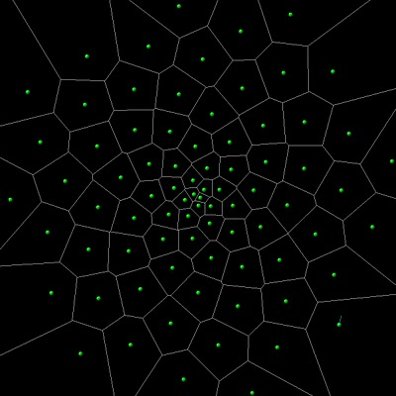
Web Archiving Tools
Notes:
Image from http://www.xdr.com/dash/blog/index.php?m=11&y=10 by Dave Ashley Licensed as http://creativecommons.org/licenses/by/3.0/

Slide 27
Web Archiving Tools
Print it out
Plain old printout
Screen capture
Print to PDF
Grab targeted sets of documents
DownloadThemAll
Grab an entire website
WinHTTrack
Webwhacker
Subscription services

Slide 28
Simple Web Archiving Tools: Print it out
Advantages
Client can do this
Very little training or technology skill
Disadvantages
Labor intensive – must go one page at a time
Can be hard to organize – you need a plan, otherwise you will have a pile of unlabeled files
Doesn’t get everything
Ways to Print:
Print it out onto paper
Screen Capture
Print to PDF

Slide 29
Printing the page out onto paper.
Least techy option
The printout is more concrete and often easier to label and organize than a file.
Copies remain decades into the future.
Any client who has social networking, etc, should be able to manage printing without instructions.
Notes:
Not much can go wrong with this approach. Even someone with really bad technology skills can get the printout, and they will know that they made the copy and be able to find it again. They can write notes on the back.
If you have a very non-technically savvy client, you can tell them to bring a printout. Don’t give instructions on how to make one. If they see something juicy online, then they probably saw it with the assistance of someone who can also help with printing. If you have a technically savvy client who just isn’t comfortable with screen captures and

Slide 30
Printing instructions
Print the page out onto paper.
Check the page and make sure it printed correctly, and everything you need is there.
Staple any print outs together.
Label the printouts – make a coversheet, or write in pencil on the back of the page the following information: the date you printed the pages, a short description of what you printed out.

Slide 31
Screen Capture
Advantages
Shows the exact same screen the person saw; no distortions.
Less techy people can do this.
Disadvantages
Lots of information is lost
Ex: Is that a link? Where does the link go?
If a page takes up more than one screen (ie. page down), then you really can’t get much this way.

Slide 32
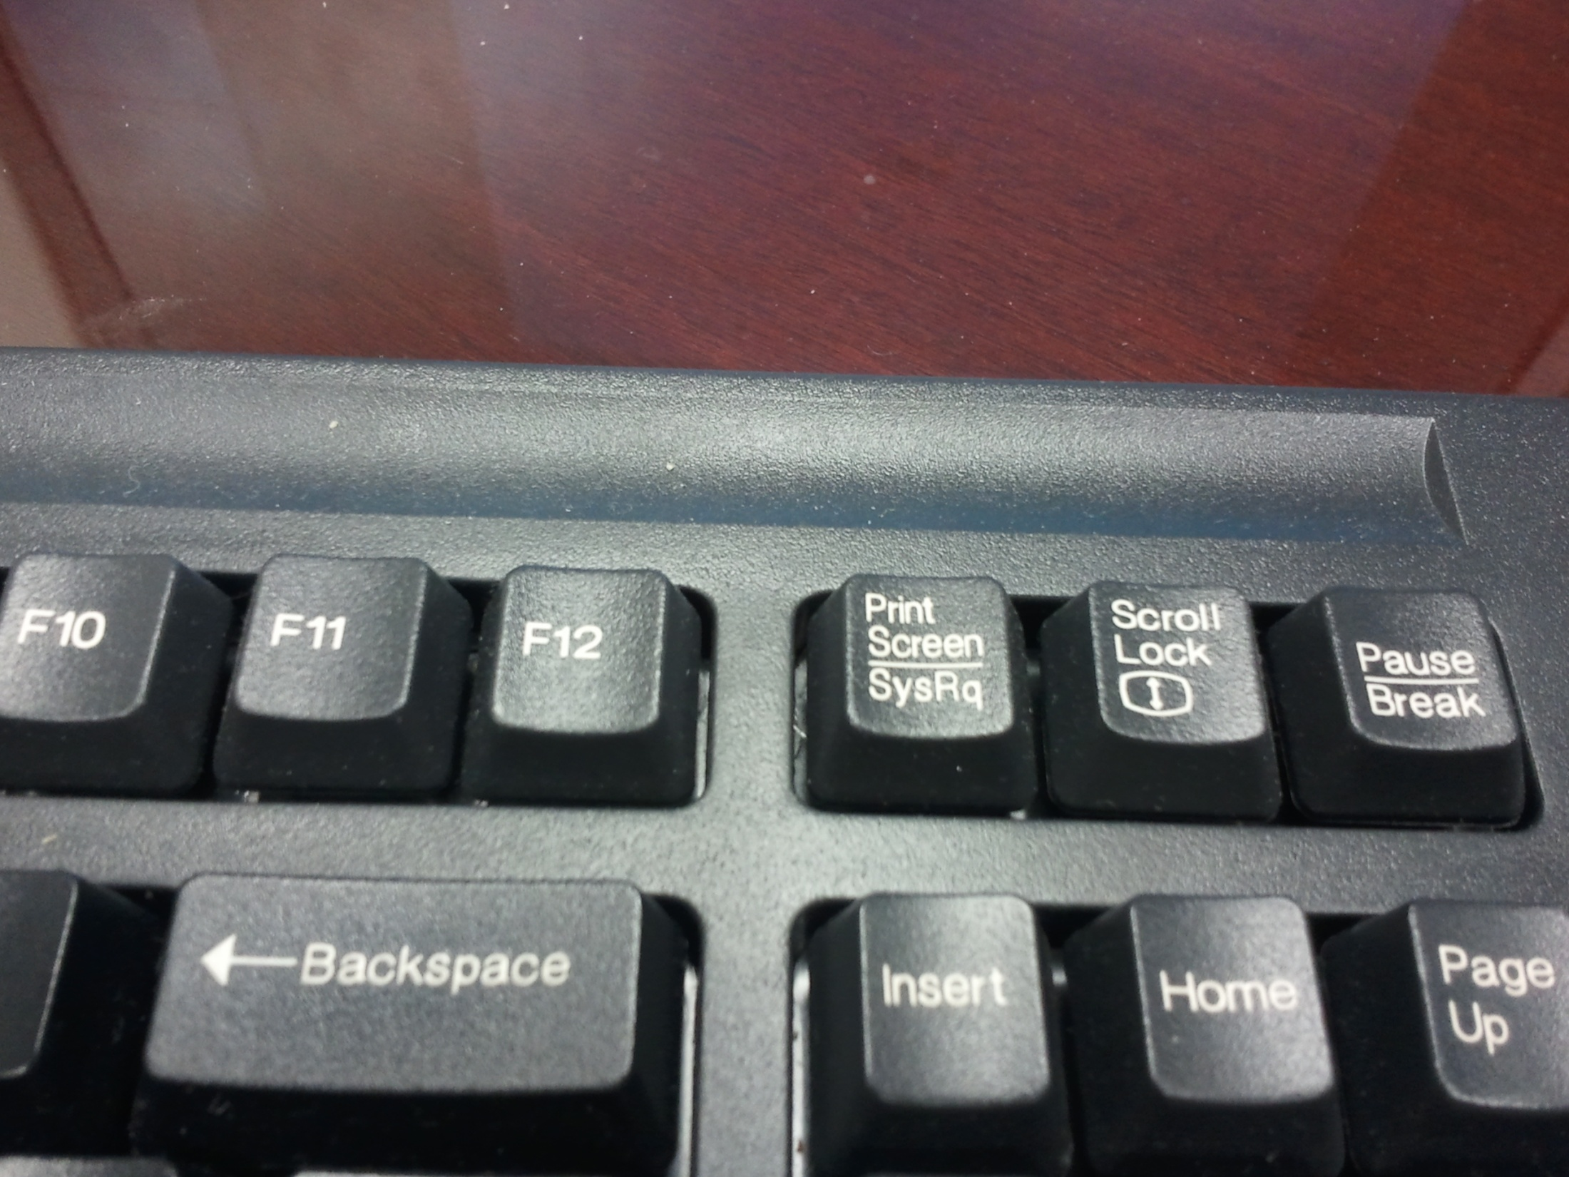
Screen Capture

Slide 33
Screen Capture instructions Windows
Press the “Print Screen” button on your keyboard.
Open Microsoft Paint.
Press Ctrl+V (Windows). The screen capture should appear in the Paint file.
Save the Paint file. Use a name that reminds you what it is – date, words about what’s in the picture, etc.
Keep a log of files. Write a list of file names, and write short notes on what is in each file: The date you took the screen shot, and what it’s a picture of.

Slide 34
Screen Capture instructions Mac
Press the Command+Shift+3 on your keyboard.
Open Paintbrush.
Press Cmd+V. The screen capture should appear in the Paintbrush file.
Save the Paintbrush file. Use a name that reminds you what it is – date, words about what’s in the picture, etc.
Keep a log of files. Write a list of file names, and write short notes on what is in each file: The date you took the screen shot, and what it’s a picture of.

Slide 35
Print to PDF
Advantages
Easy to do. Less techy people can do it.
Preserves more information than other printing methods.
Hyperlinks are preserved. Embedded objects, like images, are preserved.
Easy to print to paper and attach as Exhibits later.
PDF metadata can show tampering or lack thereof.
Disadvantages
The least technical option (PDFmyURL) may be difficult for the least techy people.
Format is different than a webpag

Slide 36
Print to PDF
Demo printing a webpage.
http://randtke.com/
Demo http://pdfmyurl.com/
randtke.com/

Slide 37
Print to PDF Instructions for Paralegals and Employees
(First, check that the person has a PDF print driver installed. If not, then install CutePDF, and check that you can print and select “Cute PDF” as a printer.)
(Make one print out of a page on the person’s computer, and check that hyperlinks in the PDF are still active.)

Slide 38
Print to PDF Instructions for Paralegals and Employees
Go to the website you want to print.
Press Print.
When the Print screen pops up, look at what printer is selected. Change this to the PDF printer. *
The computer will ask you to choose a file name and location. Choose the correct folder on your computer. Use a name that reminds you what it is – date, words about what’s in the picture, etc.
Keep a log of files. Write a list of file names, and write short notes on what is in each file: The date you took the screen shot, and what it’s a picture of.
* If you are using Cute PDF, the printer name will be “Cute PDF”. Do the process once on the person’s computer, and put the name of the printer into the instructions.

Slide 39
Print to PDF Instructions for PDFmyURL
Go to the website you want to print.
Select the URL for this page, and copy it.
Go to www.pdfmyurl.com
Paste in the URL for the page you want to make a PDF of, and click ?????? to make the PDF.
The computer will ask you to choose a file name and location. Choose the correct folder on your computer. Use a name that reminds you what it is – date, words about what’s in the picture, etc.
Keep a log of files. Write a list of file names, and write short notes on what is in each file: The date you took the screen shot, and what it’s a picture of.
Notes:
Important: PDFmyURL won’t get material on websites that require a login. So, it won’t get Facebook pages, if those pages require you to be logged in to look at the page.

Slide 40
Collecting targeted sets of documents
DownLoadThemAll
= Firefox extension for downloading all the items linked on a page.
Demo on purchasing forms at http://www.window.state.tx.us/procurement/tools/proc_forms/index.html
Demo on Railroad Commission videos at http://www.texasadmin.com/txrail.shtml
Notes:
This is good for places where a large dump of documents are available for download all from the same page. You could right click on each one, and then save them to disk, but with DownLoadThemAll, it’s easy to do a one-click grab and get all of them. Then stick them in a labeled folder.
This is good for volatile organizations. For example, where policies get changed a lot and the older versions of policies are removed so that people don’t Google in and become confused. Or - doesn’t happen in Texas – when you have a new governor, you grab the things you use regularly off state agency web pages. So, if you regularly work with a set of documents on an agency website, and a new agency head is appointed, you might grab those just for insurance, in case changes mean cleaning up the website.

Slide 41
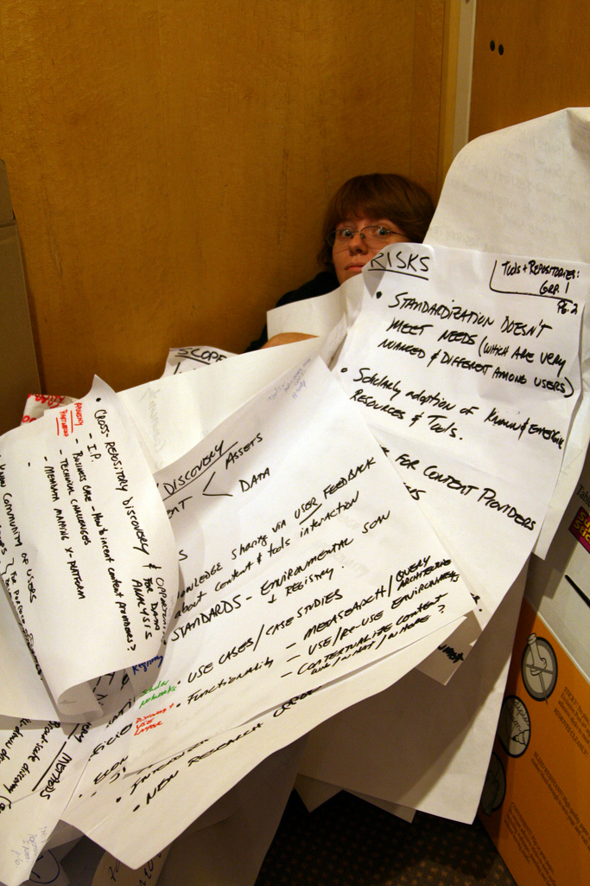
Collecting an entire website
Notes:
Image from http://www.flickr.com/photos/projectbamboo/2951078712/sizes/l/in/photostream/ by projectbamboo. Licensed as http://creativecommons.org/licenses/by-sa/2.0/ .

Slide 42
Most websites today
Best possible representation
Remember, you can’t make a perfect copy of most modern websites.
Think of taking a picture, not making a copy.
Notes:
Today most websites look like this. You can’t make a copy. You can only “take a photo”. You take something that has a database structure, and you make a static picture of it.
You can never recreate the website perfectly, unless you have a web developer work closely with the web developer for the site.
When you think about evidence preservation, don’t think about copying. You probably can’t make a copy. Instead think about photographing. If there is an intersection and a traffic accident occurred, you could try to measure everything and build an exact 3D model, and recreate it in a room. You would run into the same problem as when trying to recreate a website – you just can’t recreate it. Instead, think about taking a photograph of the intersection, taking some photos from different angles, and getting enough that you can later give someone an accurate mental image of what was there.
Usually, think in terms of taking a photo. But also think, “What other information is important?” and think about how to record that in an organized way.

Slide 43
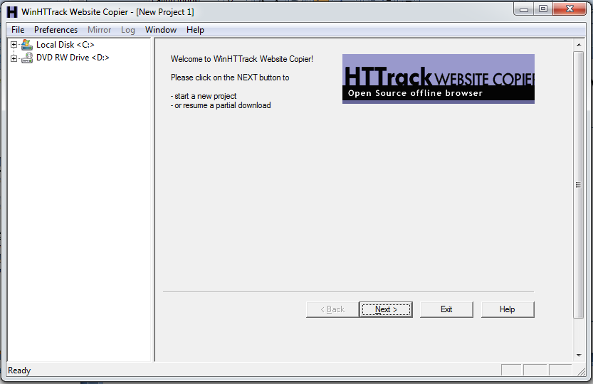
Desktop tool for grabbing a website: WinHTTrack
Notes:
Demo WinHTTrack
Hypothetically, I’m working with a client in an employment discrimination action against Scan Café (this is an online company). I notice that all their samples of work on their website are photos of white people, except for one historic photo of a black man, and their photo of employees in the Scan Café center some of whom appear a little more tan.
That’s a good website to grab, because the picture of the website really shows this.
Demo: Set up the program to grab the website and start grab. Show completed grab off CD. Show embedded timestamp in HTML.
Ways I’ve used this: Largely insurance or backups of things other people change.
I came from Florida. There we get new governors, sometimes, not like Texas. When a new governor comes in, every single state agency’s website will change. Agency websites I would use for research were good for me to take a picture of, because then if a big chunk of material went unavailable for several months, I could still get to that material. There are a lot of cases where you know a change is coming, and you may want to nail down what’s there.
Now for work, I will scrape and make a copy of the entire university’s website every once in a while, because the web developer left in October, and won’t be replaced, and it’s not really a legal thing, but I just like to have a backup.

Slide 44
Instructions Pointers
You should work through tutorials to know what’s possible, and then either you or your paralegal sets the program up and makes the capture.
After a capture, look through files to see what’s has and hasn’t been captured.
Important points to focus on:
You can choose whether or not to capture files that are one link away from the target website.
You can embed a timestamp in each HTML file saying when it was captured.
You can enter multiple other domain names (URLs) to treat as being on the same server.
Notes:
WinHTTrack is complicated to where it’s not a good idea to try and give instructions to someone outside your office. Instead, know what is possible, then configure the program, then check your files to make sure you got what you wanted.
For IT versus legal skills, it’s better to have a paralegal learn this than IT. Then you can say, “Here’s the issue. Take 30 minutes and find what you can about this company.” And the paralegal will know what’s relevant.

Slide 45
Collecting an entire website
Notes:
All these self-collection tools we looked at have a big positive and a big negative. All these tools let you quickly copy documents. What don’t they do?
Image from http://www.flickr.com/photos/projectbamboo/2951078712/sizes/l/in/photostream/ by projectbamboo. Licensed as http://creativecommons.org/licenses/by-sa/2.0/ .

Slide 46
Collecting an entire website
Make a filing system.
Notes:
All these self-collection tools we looked at have a big positive and a big negative. All these tools let you quickly copy documents. What don’t they do?
They don’t organize documents for you. An older tool for downloading entire website, WebWhacker, did this and had a nice sorting searching and indexing system. But the last release was in 2007, and only had guidance for Windows XP.
Lawyering is about
Making an argument
Research, so you know what the law is
Business management (this is where records management goes, none of these tools lend themselves to it)
Image from http://www.flickr.com/photos/projectbamboo/2951078712/sizes/l/in/photostream/ by projectbamboo. Licensed as http://creativecommons.org/licenses/by-sa/2.0/ .

Slide 47
Collecting an entire website
Recommendations:
For printouts, screenshots, and PDFs, make a filing system that is consistent and that you understand (incorporate into your current casefiles)
For entire websites: Burn to CD or DVD and label the CD or DVD. Use these for your reference, but not as a final display.
Notes:
All these self-collection tools we looked at have a big positive and a big negative. All these tools let you quickly copy documents. What don’t they do?
CD and DVD = much easier to label and refer back to – now it’s one thing and not thousands of files. Cannot accidentally change the information.
Demo: DVD of entire St. Mary’s University website: It is a little more than 6GB, it fits on a double density DVD (those hold 8 GB), and I can write a label on it and stick it in a drawer. So, for less than $2 I made a personal copy of everything that’s posted. I don’t plan to use it, but if there were a catastrophic IT failure here then I have it, if I ever have a personnel issue where I want to look at my older faculty handbook then I can do that. And that’s something university counsel would want to do as well.
Image from http://www.flickr.com/photos/projectbamboo/2951078712/sizes/l/in/photostream/ by projectbamboo. Licensed as http://creativecommons.org/licenses/by-sa/2.0/ .

Slide 48
Subscription Services
Advantages
Expertise. Usually do a better job at capturing pages than you can hope to do on your own.
Expertise. A web archiving service will understand authenticity issues, and be prepared to explain those.
Disadvantages
Hosted services can be discontinued. How long will your litigation last? When you authenticate, try to authenticate a file you can control and maintain.

Slide 49
Subscription Services
List of these is maintained at http://en.wikipedia.org/wiki/Web_archiving#On-demand
Reed Archiving
Smarsh
Hanzo Archives
Iterasi
Web archiving service in the legal field:
Also, any services that focus on corporate compliance.
Notes:
Actiance; Autonomy; Gnip; Hanzo Archives Hearsay; NextPoint; SocialWare; SocialLogix; and X1 Discovery.

Slide 50
Subscription Services:
General Features
Web console: You login, select which pages to archive, and retrieve archived pages from specific dates.
Option to schedule archiving for specific pages on a regular basis (daily, weekly, monthly, etc)
Technical support: Someone can explain to you why something is or isn’t captured.

Slide 51
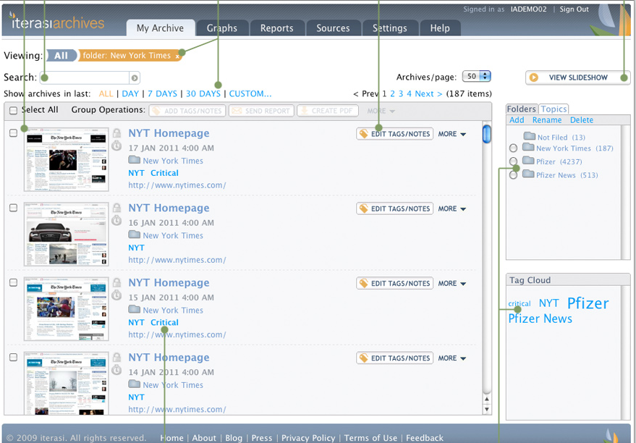
Notes:
This is a screenshot of Iterasi. I contacted some companies for demos, and pretty much the features you’ll see here are features you should expect to see in a paid web archiving service.

Slide 52
Benefits of Hosted Solutions
Professional technical staff are available to explain things to you, or to testify about what the records mean.
Provide a much better organization system than you can do on your own: search, folders, friendly user interface, etc.
You can’t accidentally edit your files. Once in, they are locked in as the webpage looked on that date.

Slide 53
Special Concerns for Hosted Web Archiving
What if service is discontinued?
Litigation may take years, decades
What options do you have to export your files? Have some one with technology skills look at the export.
What are your usage requirements?
Total size of archive (individual pages vs entire websites)
Perspective: entire St. Mary’s University website is about 6 GB scraped; entire Scan Café website is about 72 MB scraped.
Think about using both styles of data

Slide 54
Evidence Resources
David A. Schlueter, Texas Evidentiary Foundations (2011).
Short section on web archiving.
Lawrence Morales II, Symposium: Social Media: Social Media Evidence: “What You Post or Tweet Can and Will be Used Against You in a Court of Law”, 60 The Advocate 32 (Fall 2012).
Good coverage of admissibility and social media; has Texas cases to the extent possible (most law is federal).
Paul R. Rice, Electronic Evidence Law and Practice (2nd ed. 2008).
Older, but has a good section on web page authentication and sections on all kinds of other media.

Slide 55
Preserving Online Evidence
St. Mary’s University
Homecoming CLE
March 22, 2013
Wilhelmina Randtke
Electronic Services Librarian and Associate Professor
Sarita Kenedy East Law Library
wrandtke@stmarytx.edu

