Slide 1
AI Misinformation Detection: An Active Learning Activity for the Information Literacy Classroom
Kevin J. Reagan & Wilhelmina Randtke
Presented at Teaching and Learning with AI, Orlando, FL, July 23, 2024.
https://creativecommons.org/licenses/by/4.0/
Notes:
Intro: Mina goes first - Kevin will introduce topic and begin with activity

Slide 2
Abstract
The ACRL Framework for Information Literacy in Higher Education—a curriculum for academic librarians—was a response to voluminous, unreliable information. Furthermore, existing lesson plans for teaching the ACRL Framework are transferable to teaching research and AI in a world where AI creates misinformation. By situating the ACRL Framework into the context of recent information literacy history, the authors will situate AI misinformation into a larger discourse and provide a hands-on approach to teaching students what hallucinations are, as well as how to ascertain a source’s reality and provenance.
Notes:
(not reading this; this is for someone looking at the slides later on the conference website, or institutional repository)

Slide 3
Today’s Learning Objectives
By the end of this session, participants should be able to:
Replicate or adapt the presented lesson plan in the classroom
Articulate how AI misinformation fits into the greater history of information literacy
Express the challenges of AI misinformation to students
Notes:
Kevin
I always begin with learning objectives, and that holds true in my presentations. I feel like it helps everyone know what to focus on… By the end of this session, you should be able to adapt this presentation for your own purposes, articulate how AI misinformation fits into the greater history of information literacy, and express the challenges of AI misinformation to students

Slide 4
Session Outline
Activity Context
Learning activity
AI Misinformation & the ACRL Framework
Q & A
Image credit: Joaquim Alves Gaspar, CC BY-SA 3.0 <http://creativecommons.org/licenses/by-sa/3.0/>, via Wikimedia Commons
Notes:
Kevin
And if you’re the type of person who enjoys previews and outlines, this is for you…. We will begin with the activity context, go into the learning activity, and then Mina will follow up with the more technical end of AI, concluding with a Q & A session, of course.

Slide 5
Some “Librarian” Terms
One-Shot Session
Information Literacy
ACRL Framework
Research consultation
Notes:
Kevin
For those who are not librarians, this slide is for you. We will be using these terms throughout the sessions. These make sense to librarians, but likely not everyone else. One shot sessions are when instructors invite librarians to to teach library skills for a particular assignment or assignments. Information literacy…. It’s used a lot, but here, it’s the set of skills to identify an information need and find information relevant to that information need. For instance, it’s when you know you need a peer-reviewed academic journal article or a new sources for whatever you’re looking for…. Other librarians, don’t come for me for oversimplifying this… That’s my elevator pitch. the ACRL Framework is a set of dispositions that librarians look for or measure when assessing information literacy. Finally, the research consultation…. For some lirarains, this is when a study meets with a librarian to work out a research topic and find sources.

Slide 6
Activity Context
Walk-in research consultation
Normalize AI disclosure
Use after a typical one-shot session
Not for advanced AI users
Notes:
Kevin
About three semesters ago, a student walked in and asked for help finding a journal article; they had a citation, including an author, date, and title, so the transaction should have been simple, right? Wrong. As I searched for the source, I realized that the author was, in fact, real, and article in question aligned with the author’s research agenda. Further, the journal was also real. Nonetheless, I was unable to find the specific article in the journal, even though I was looking in the indicated volume and issue. I asked a coworker to double check my work… because we all have those days. After telling the student the article does not exist, they seemed a little defensive… I gleaned two major takeaways from the interaction. 1. As facilitators and teachers of research, librarians are in a position to normalize AI in the research process. 2. Librarians are uniquely situated to teach ethical AI use so that students are comfortable with detecting AI misinformation.

Slide 7
Activity Instructions
Groups receive a folder with citations
Two real citations; one fake citation
Ascertain which source is the fake.
Reveal suspect and show evidence of innocent suspect
Notes:
Kevin
Before I distribute the top secret folders, I’ll provide instructions. I learned to do that from students because one they see top secret on the folder, they tune out everythin

Slide 8
Learning Objectives:
Student Learning Objectives & Instructions
“Your librarian needs your help in cracking the case of the AI imposter. You have been given classified intel about the three citations in question, and it is your duty to conduct a thorough investigation to find the suspect. Be prepared to present how you ruled out your suspects and ascertained the imposter.”
See lesson on LibGuide: https://georgiasouthern.libguides.com/ai_literacy
Recall how to find to find a journal article by author name, journal name, or article title.
Discuss the limitations of using artificial intelligence to find scholarly sources
Notes:
Kevin

Slide 9
Let the Investigations Begin
Solve the case of the unsolved AI misinformation! Also, be prepared to discuss how you might adapt this activity in your classroom.
For digital dossiers, see https://georgiasouthern.libguides.com/c.php?g=1380906&p=10211384
Notes:
Kevin

Slide 10
Limitations, Resources Student Reactions
Limited experience with AI
Exacerbating the digital divide?
Students get into the investigator vibe
Time: I typically do this when an instructor gives me two sessions with their classes
Notes:
Kevin

Slide 11
ACRL Framework:
A response to online misinformation
The ACRL Framework was designed to address voluminous information and misinformation: “[T]he rapidly changing higher education environment, along with the dynamic and often uncertain information ecosystem in which all of us work and live, require new attention to be focused on foundational ideas about that ecosystem.” (ACRL, 2016, 7).
mikemacmarketing, CC BY 2.0 <https://creativecommons.org/licenses/by/2.0>, via Wikimedia Commons
Notes:
(Mina)
The classroom lesson you all just did is a lesson plan for teaching information literacy. The lesson plan is about artificial intelligence. Ultimately, it’s also about teaching information literacy. Information literacy is the basis for library instruction. This is background about information literacy and the ACRL Framework. The ACRL Framework was a response to technological changes, and provides a relevant way of approaching teaching artificial intelligence.

Slide 12
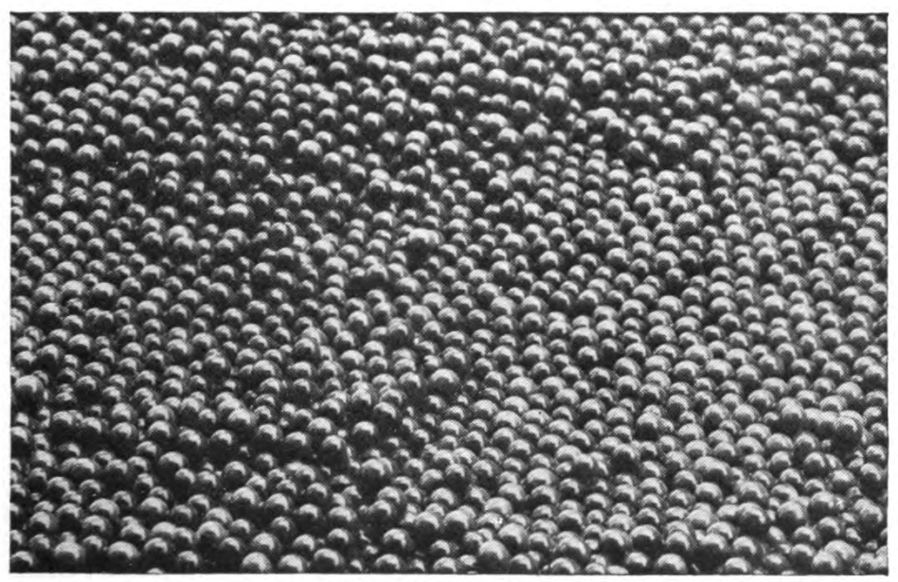
AI and the Information Ecosystem
Image by Dr. Lasse Rempe, from https://commons.wikimedia.org/wiki/File:Exponential_Parameter_Space.png
Notes:
(Mina)
This is about the history of the ACRL Framework and why it’s a good fit for addressing artificial intelligence misinformation.
A longer term trend from technology, and especially from widespread internet access, is changes in the information ecosystem. Research many decades ago might have been locating the resources that exist about a topic, then reviewing them. The change with new electronic media - cheaper paper printing, radio, television, the internet - is that there is now way more information. Research now is more about finding the good resources and filtering out many many not-so-on-point resources. It’s a long term change. And it’s a change that took place over the past 50 or more years (with changes from the internet and computers coming mostly in the past 40 years).
Librarians have long taught the research process. Even 40 years ago, that research process had shifted from finding a piece of scarce information - maybe finding a specific citation, or a book about a topic - to filtering out the best information from a flood of information.
With generative artificial intelligence, that’s a continuation of those past trends. Computers are writing information. That means more resources created.

Slide 13
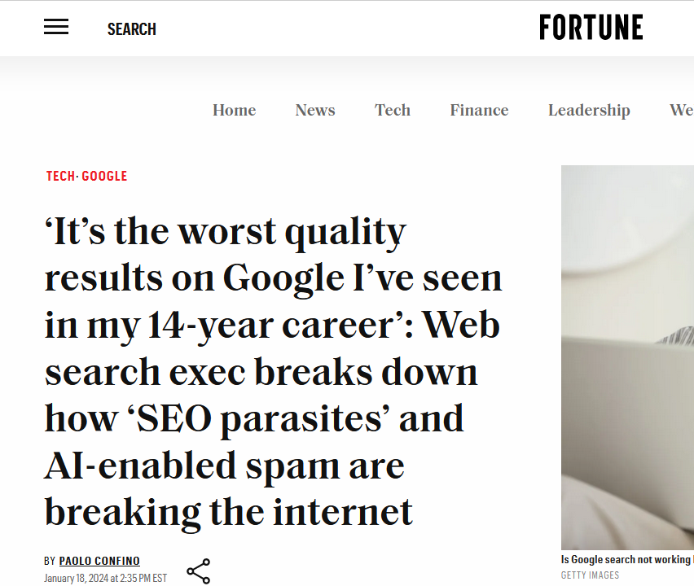
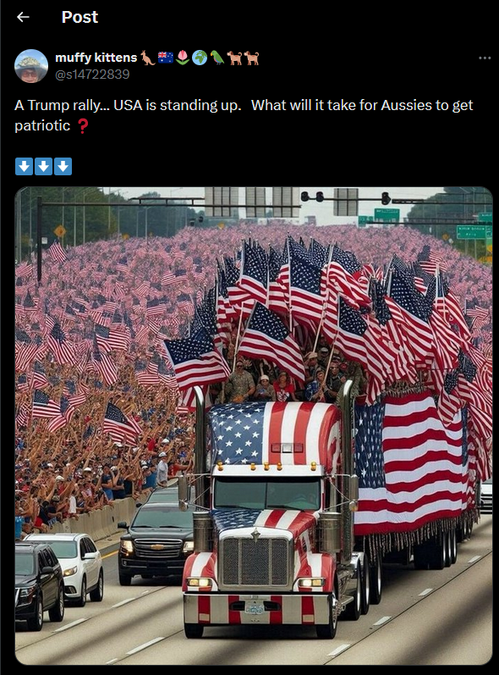
Today: Online misinformation and AI
Notes:
(Mina)
Generative artificial intelligence makes it faster and easier to post online content. We already have an internet in the U.S. which is mostly motivated by capitalism. That’s not the only mindset. Back in the 1980s, the birth of the internet was as a military tool. It might be possible to have religiously motivated internet, or an education motivated internet. We don’t live in that world. We live with an internet where everything is about money and targeted advertising, and engagement to show how effective the advertising will be. As a result, the generative artificial intelligence content online is posted with a goal of engagement, not truth.
Also see https://x.com/theFordon/status/1765763935104344526 .

Slide 14
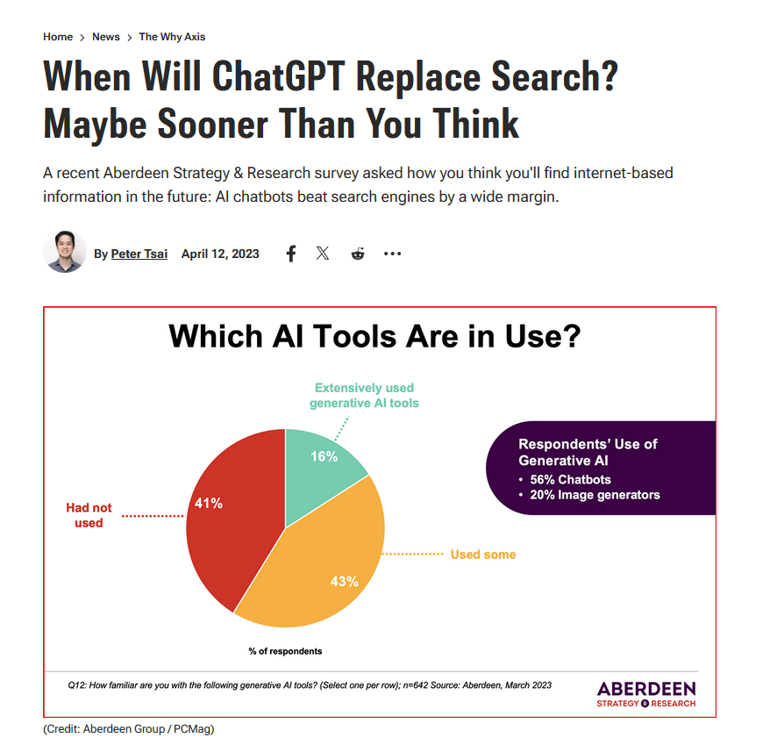
Today: Misinformation from Chatbots
Misinformation can come by someone directly interacting with a generative AI, or by finding misinformation online.
Notes:
(Mina)
There’s also the possibility of individuals using a chatbot in lieu of a search engine.
The dangers of both kinds of misinformation - misinformation created and posted online, and information that a person retrieves manually by using a chatbot - are similar. Each person gets highly personalized misinformation, and it’s not necessarily possible for anyone outside of these large tech companies to have a big picture view of what information people are getting.

Slide 15
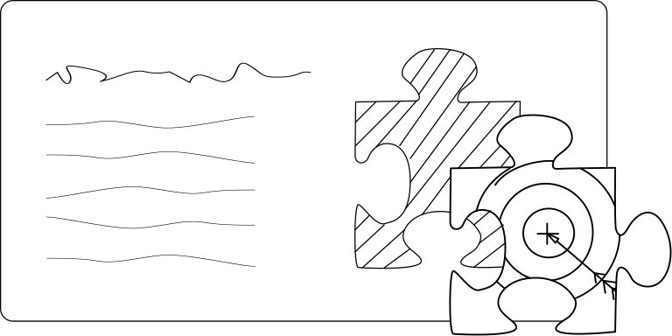
Established use of AI: Microtargeting
Image by Michelle Dahlmanns, from https://commons.wikimedia.org/wiki/File:HD@DH.nrw_Einsatz_von_Grafiken_2.svg
Notes:
(Mina)
To start, I want to go a little into past trends in artificial intelligence, going back about 10 to 15 years ago.
Microtargeting is where the internet and the websites you use know information about you, and show you items more of interest to you.
Demographic targeting has always been part of advertising - knowing address someone lived at, age, gender, and basic demographic information has been part of advertising in the past. What became the norm with cookies, surveillance, and logins online, is building profiles of people and targeting to a very specific level.

Slide 16
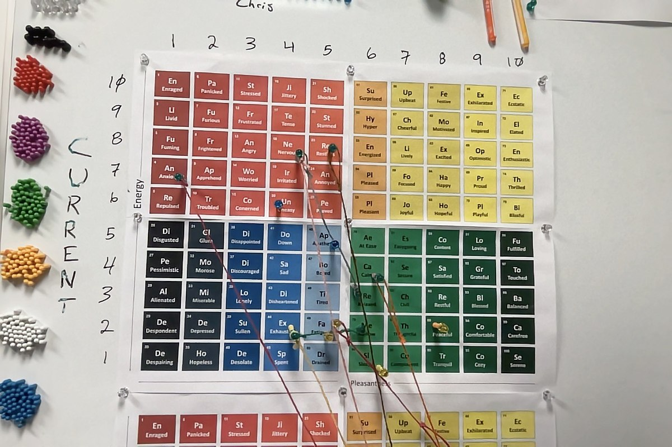
Established use of AI: Emotion detection
Image by Chriscantrell1989, from https://commons.wikimedia.org/wiki/File:Photo_on_2-3-23_at_10.12_PM.jpg
Notes:
(Mina)
Emotion detection involves looking over a set of data and determining the emotion of the speaker. From there, you also can change the emotions or show content that changes someone’s mood.
Already getting established even in 2003, see https://dl.acm.org/doi/10.1016/S0167-6393%2802%2900070-5 .
Recognizing emotion based on text someone writes: Boiy, E., & Moens, M.-F. (2009). A machine learning approach to sentiment analysis in multilingual Web texts. Information Retrieval Journal, 12(5), 526–558. https://doi.org/10.1007/s10791-008-9070-z
Recognizing emotion based on cell phone use patterns: Burns, M. N., Begale, M., Duffecy, J., Gergle, D., Karr, C. J., Giangrande, E., & Mohr, D. C.
(2011). Harnessing Context Sensing to Develop a Mobile Intervention for Depression.
Journal of Medical Internet Research, 13(3), 11. https://doi.org/10.2196/jmir.1838

Slide 17
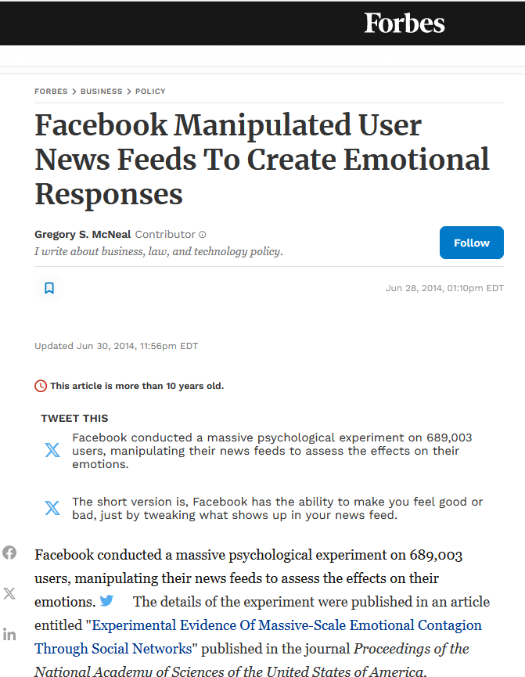
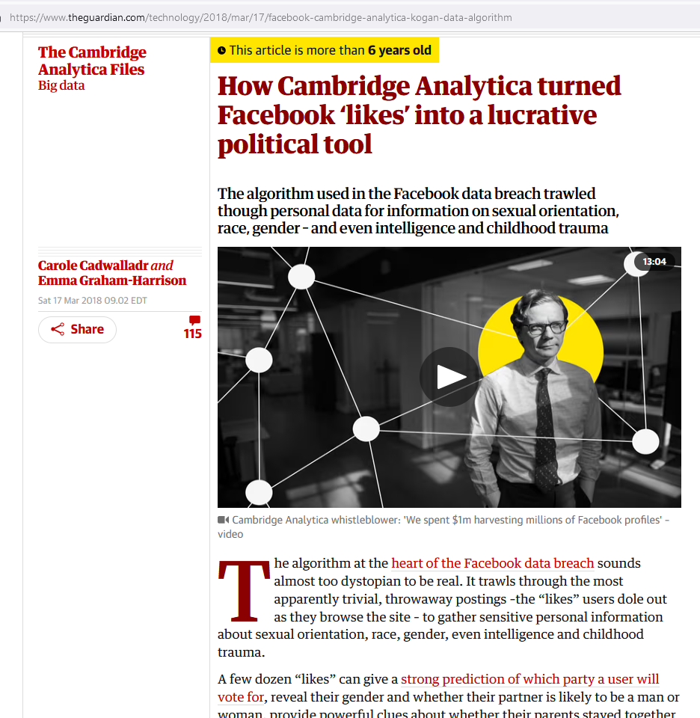
Established use of AI: Behavioral Modification
Notes:
(Mina)
Following on microtargeting, so collecting information about someone in order to do very targeted ads, and emotion detection, new applications of technology began to include behavioral modification.
Here, there are some headlines. There is the “Facebook makes you sad study”. The slide shows a news article, which is about a study published in the Proceedings of the National Academy of Sciences of the United States of America in 2014 - 10 years ago. It describes manipulating the news feeds of Facebook users, then monitoring their posts, in order to be able to change their emotional state. As a result of some of this experimentation, and some of the applications coming out about things, in 2016 the Belgian government warned citizens not to use reaction buttons on Facebook and warned about privacy violations. https://www.independent.co.uk/tech/facebook-reactions-belgian-police-warn-citizens-not-to-react-to-posts-on-social-media-a7027786.html
There also was the Cambridge Analytic scandal and lawsuit, which involved using behavioral data and behavioral modification on Facebook to change voting behaviors in the 2016 U.S. presidential primaries and election.
The point here is that by 2014, microtargeting and behavioral modification by manipulating what people see online, was pretty established. There also was awareness of this, with news articles, and lawsuits coming out about it. For librarians, because we work with research and search, these changes in the information ecosystem were definitely front and center. In 2014, there was an apparent need for information literacy to address technology trends which included misinformation.
Cites:
https://www.pnas.org/doi/full/10.1073/pnas.1320040111
https://www.forbes.com/sites/gregorymcneal/2014/06/28/facebook-manipulated-user-news-feeds-to-create-emotional-contagion/#2bf11db15fd8

Slide 18
Introducing the ACRL Framework for Information Literacy in Higher Education
Predecesor: Information Literacy Competency Standards for Higher Education (2000)
Adopted in 2016
Set up dispositions for students: information literacy as a process
DJ Palyeado, CC BY-SA 4.0 <https://creativecommons.org/licenses/by-sa/4.0>, via Wikimedia Commons
Notes:
Mina

Slide 19
Misinformation, content farms, and artificial intelligence
The ACRL Framework was designed to address voluminous information and misinformation: “[T]he rapidly changing higher education environment, along with the dynamic and often uncertain information ecosystem in which all of us work and live, require new attention to be focused on foundational ideas about that ecosystem.” (ACRL, 2016, 7).
mikemacmarketing, CC BY 2.0 <https://creativecommons.org/licenses/by/2.0>, via Wikimedia Commons
Notes:
(Mina)
In the earlier section, talking about applications of artificial intelligence, I tried to keep to things that are about 10 years old or older. There is a current increase is speed, how much content someone can create with generative artificial intelligence and how fast, and in having websites where a person can make an account and one-at-a-time have a computer make little writings or art. Nevertheless, what we are seeing now has been available for decades. It’s just newly in the popular mind now. (Or with some of the current uses, like chatbots, now the speed has increased to where a student with a last minute assignment can use it, rather than having a long run time.)
I put there a quote from the introduction section of the ACRL Framework. The Framework is a response to more voluminous, and less reliable online information. That was in the context of human written information with lots of pressure from algorithms. It’s been decades now that content online is written for search engine optimization and engagement rather than truth, and essentially written for algorithms.
With generative artificial intelligence, that’s a natural extension of past online information trends. For a website with unvetted content written for search engines, in the past that’s been done by content farms with paid bloggers abroad or underemployed people in the US doing low paid writing gigs. In the future, that will include chatbot generated content on blogs, on websites, and coming out of the chatbot. The source of the content doesn’t matter super much. In the past, we had people writing for algorithms and engagement rather than truth, and going forward we will have people and artificial intelligence writing for algorithms and engagement rather than truth. The ACRL Framework was designed to teach research in this current information ecosystem. The ACRL Framework has been around since 2016, there are lots of polished lesson plans out there, and they either already cover or can be easily adapted to artificial intelligence.

Slide 20
Sources
Association of College and Research Libraries (ACRL) (2000). Information Literacy Competency Standards for Higher Education. Chicago, IL: American Library Association. https://alair.ala.org/server/api/core/bitstreams/ce62c38e-971a-4a98-a424-7c0d1fe94d34/content
Association of College and Research Libraries (ACRL) (2016). ACRL Framework for information literacy for higher education. Chicago, IL: American Library Association. https://www.ala.org/acrl/sites/ala.org.acrl/files/content/issues/infolit/framework1.pdf
Boiy, E., Moens, MF. (2009). A machine learning approach to sentiment analysis in multilingual Web texts. Information Retrieval, 12, 526–558. https://doi.org/10.1007/s10791-008-9070-z
Burns, M. N., Begale, M., Duffecy, J., Gergle, D., Karr, C. J., Giangrande, E., & Mohr, D. C. (2011). Harnessing Context Sensing to Develop a Mobile Intervention for Depression. Journal of Medical Internet Research, 13(3), 11. https://doi.org/10.2196/jmir.1838
Cadwalladr, C., and Graham-Harrison, E. (2018, March 17). How Cambridge Analytica turned Facebook ‘likes’ into a lucrative political tool. Guardian.com . https://www.theguardian.com/technology/2018/mar/17/facebook-cambridge-analytica-kogan-data-algorithm
Confino, P. (2024, January 18). ‘It’s the worst quality results on Google I’ve seen in my 14-year career’: Web search exec breaks down how ‘SEO parasites’ and AI-enabled spam are breaking the internet. Fortune.com . https://fortune.com/2024/01/18/why-is-google-search-so-bad-spam-links-seo-ai-algorithm/
Douglas-Cowie, E., Campbell, N., Cowie, R., and Roach, P. (2003). Emotional speech: Towards a new generation of databases. Speech Communication, 40(1-2), 33-60. https://doi.org/10.1016/S0167-6393(02)00070-5
Hatem, R., Simmons, B., & Thornton, J.E. (2023). A call to address “AI hallucinations” and how healthcare professionals can mitigate their risks. Cureus, 15(9). https://doi.org/10.7759/cureus.44720
McNeal, G.S. (2014, June 28). Facebook Manipulated User News Feeds To Create Emotional Responses. Forbes.com . https://www.forbes.com/sites/gregorymcneal/2014/06/28/facebook-manipulated-user-news-feeds-to-create-emotional-contagion/
Reagan, K.J. (2024). AI literacy: a toolkit for educators & students. Georgia Southern University: University Libraries. https://georgiasouthern.libguides.com/ai_literacy
Tsai, P. (2023, April 12). When will ChatGPT replace search? Maybe sooner than you think. PCMag.com . https://www.pcmag.com/news/when-will-chatgpt-replace-search-engines-maybe-sooner-than-you-think

Slide 21
AI Misinformation Detection: An Active Learning Activity for the Information Literacy Classroom
Kevin J. Reagan & Wilhelmina Randtke
Presented at Teaching and Learning with AI, Orlando, FL, July 23, 2024.
https://creativecommons.org/licenses/by/4.0/

