Slide 1
GIL User Group Meeting
Georgia Southern University
Georgia Southern University
Introduction to Open Source Community Governance
Wilhelmina Randtke & Justin Barnett / 13-14 May, 2024
Notes:
Introductions:
Wilhelmina Randtke, Georgia Southern University Libraries
Justin Barnett, Georgia Southern University Libraries
We’ll be talking about open source community governance and how it impacts you, focusing on FOLIO as an example since a lot of the audience here will be working with it.

Slide 2
What We’ll Be Talking About
Ways to contribute with open source
Specific ways of communicating with open source communities
Specifics of how FOLIO uses some of those methods
How to write up and explain a software issue
Notes:
JUSTIN
—--------------------------
By the end of this presentation, we hope you are able to see how working with open source software communities differs from privately-developed software from vendors, and have an idea of how you can responsibly and effectively advocate for fixes and/or improvements in FOLIO. We’re not going to spend a lot of time talking about how proprietary software works, but expect you’ll have a baseline understanding based on your previous experiences you can draw on for comparison.

Slide 3
How to Contribute to an Open Source Community
Time-Based
Committees
Bug reports
Feedback on in-development features
Testing software releases
Contributing code
Writing/revising the instruction manual
Money-Based
Membership fees to the organization coordinating the open source software community.
  (Usually, some committees are open to organizational members only.)
Hiring a consultant to build out a new feature and walk it through.
Notes:
MINA
—--------------------------
Usually an open source community will have a formal governance structure. There’s usually some kind of entity that controls the official releases and coordinates things. That could be a university, a foundation specifically for that piece of software (or for software to support a field).
Ways to participate tend to be oriented around time commitments. So, showing up to meetings, submitting bug reports, giving feedback on in-development features.
Something really important about that is that those time based ways to participate include lots of things that are not contributing code. Time studies on software developers show that a software developer spends about 70% of their time writing specs and testing, rather than writing code. It’s a valuable contribution to do something like very clearly define how a menu, button, or workflow should work because that’s a goal someone can work towards and test against. It’s a valuable contribution to write instructions, because with an instruction manual, other people can learn how to use the software and there can be users at all.
Ways to participate tend to be less oriented around fee based. The two commons ways money drives software development in open source platforms are: (1) There can be a voluntary membership fee for joining the organization that coordinates the piece of software. Typically, membership in some committees is completely open, while membership in a steering committee or other high level committee is open to employees of members only. Or (2) someone using the software can hire a consultant to build out a feature and walk that feature through, or multiple customers can pool money and pay to have a feature built out.
This presentation focuses a bit more heavily on time commitment oriented ways to participate, partly, because that is something any attendee, as an individual, can do. Also, because organizational membership tends to give access to some closed committees, and really that’s more effective if the money commitment is combined with the time commitment.
Open source softwares will vary along the spectrum of how centrally controlled they are. These are the general traits.

Slide 4

Community and Technical Aspects
Water Ripples, by Piotr Siedlecki
Notes:
MINA
—--------------------------
For an open source platform, there typically are community and technical aspects to that software. Technical for it to exist and do what it’s supposed to do, and community for people to be able to use it.
Typically, an open source community has two key positions: community lead and technical lead. When the platform gets to the point of hiring an employee, the goal is usually to focus on one of those two roles, have a paid employee as either community lead or technical lead, and then to have a committed and involved volunteer do the other role.
Public domain pic from here https://www.publicdomainpictures.net/en/view-image.php?image=92546&picture=water-ripples

Slide 5
Committees by Another Name
Overview of the FOLIO SIGs
What is a “SIG”? Special Interest Groups
Subject experts on different aspects of librarianship
Meetings to determine [better] ways for FOLIO to handle aspects, or dealing with bugs / problems in the current workflow and fixing them.
Why to attend?
If you want to get involved shaping the development of FOLIO or see changes made to how it does something.
What are they NOT for?
Help and support. Individually, members may be helpful, but these are not Q&A sessions or training workgroups; look in documentation, contact the mailing list, or hop on Slack.
Notes:
JUSTIN
—--------------------------
FOLIO Special Interest Groups
Special Interest Groups - composed of experts on various aspects of the platform - are one of the best ways to learn and get involved in specific aspects of FOLIO. While joining them as a member may ask you to attend meetings and contribute regularly, many of them welcome questions and concerns, when they are routed appropriately.
Attending special interest groups has you contributing to a group of specialists on the respective topics, which will often give you an idea of where development in the respective sphere is going in the future, as well as allow the expression of concerns around the system and workflows that relate.
Most meet 1/week on average

Slide 6
List of Active Special Interest Groups
Acquisitions
App Interaction
Consortia
ERM
Implementers
Metadata Management
Open Access
Privacy
Reporting
Resource Access
Support
Systems Operations
User Management
Workflow
Learn more about SIGs and get involved at:
https://folio-org.atlassian.net/wiki/…/Special+Interest+Groups
Notes:
JUSTIN
—--------------------------
21 official SIGS
Accessibility: Inactive, last updated 2021
Acquisitions: Active Meets 1.5 times / week
App Interaction: Active Meets 1 / week
Consortia: Active Meets 1 / 2 weeks
Data Migration: Dissolved in fall 2023
ERM: Active Meets 1 / 4 weeks
Forum Facilitators: Inactive, last updated 2017
Implementers: Active Meets 1 / week
Internationalization: Inactive, on hiatus since 2023
Linked Data: Merged into Metadata Management
Metadata Mgmt: Active Meets 1/ week
Open Access: Active Meets 1/ month
Privacy: Active, timeline private
Public Library: Inactive since 2020
Reporting: Active Meets 4/ month
Resource Access: Active Meets 2/ week
Resource Management: Deprecated 2021 for Acquisitions, ERM, and Open Access
Support: Active Meets 1/ week
Systems Operations: Active Meets 1/ week
User Management: Active Meets 1/ week
Workflow: Active Meets 1/ month
13 (14? private) are active currently.

Slide 7





Specific Communication Tools
Notes:
JUSTIN
—--------------------------
The next part of this presentation goes into four specific communication tools: GitHub (and Git), Slack, Confluence, and Jira. All of these are common methods for communicating in the open source space, and many in active use by the FOLIO development teams. To get us started, here’s Mina, to talk about GitHub and the Git language.

Slide 8
GitHub
Showcasing targeted public contributions: emphasis on public and publishing unique contributions.
Development vs Operations: GitHub is oriented towards development, not much for operations.
More of a publishing platform than a working tool.
  GitHub release vs TarBall release.
  git language vs GitHub website
Notes:
MINA
—--------------------------
This is a bit about GitHub in general, not necessarily in the FOLIO LSP community.
First off, GitHub is a public facing way to showcase code. Git, the language, is something you can run on your own computer, or an internal server. At Georgia Southern, it’s technologically possible for all of us to install Git Bash, which is regular Windows software, and then all use git to push and pull with a repository on the R drive. No one in the wider world would ever see any of that. Most activity with git actually is private within organizations. Because, when you post things publicly, you have to be really careful about scrubbing the database password from config files, and screening for personal info, etc. For cloud hosted git, GitHub is oriented around showcasing specific pieces of code. Up until recently, GitHub limited to only 3 private repositories on a free-of-charge account. Meanwhile, Atlassian BitBucket is another leading cloud hosted place to store git repositories. BitBucket is only paid accounts, and the default is for git repositories in BitBucket to be private. Culturally, most software development is not happening on public GitHub. In reality, most software development is happening in private repositories.
Who here has heard about development vs operations? Development is writing code for other people to use. Operations is running code to support day-to-day operations. Most code is actually people doing operations, so running code to support their projects and work. Meanwhile, GitHub is about development and the publishing aspect of code.
I’m going to talk a little about the GitHub release vs a tarball release. Who here knows what a tarball release is?
Basically, any complex piece of server hosted software is going to have supporting libraries. A supporting library for a piece of software might be something like a commonly reused set of code that lets someone upload a file and then that file goes on the server. That’s not really specialized, and probably if you were writing code you would pick a popular library and reference it instead of writing your own. Same thing for email handling, so the software sending out emails - you probably would not write that from scratch and instead would pick a popular library and reference it instead of writing your own. With running that software on a server, you need all those supporting libraries for the software to run. With showcasing that software on GitHub, typically only the parts that are unique would be posted, and then there might be an install manual that says if you install from GitHub to grab x, y, and z supporting libraries. Meanwhile, to let someone grab it and go and get a stable release, typically those would be done as a tarball package where you download that package and you have all the unique code plus the supporting libraries.

Slide 9
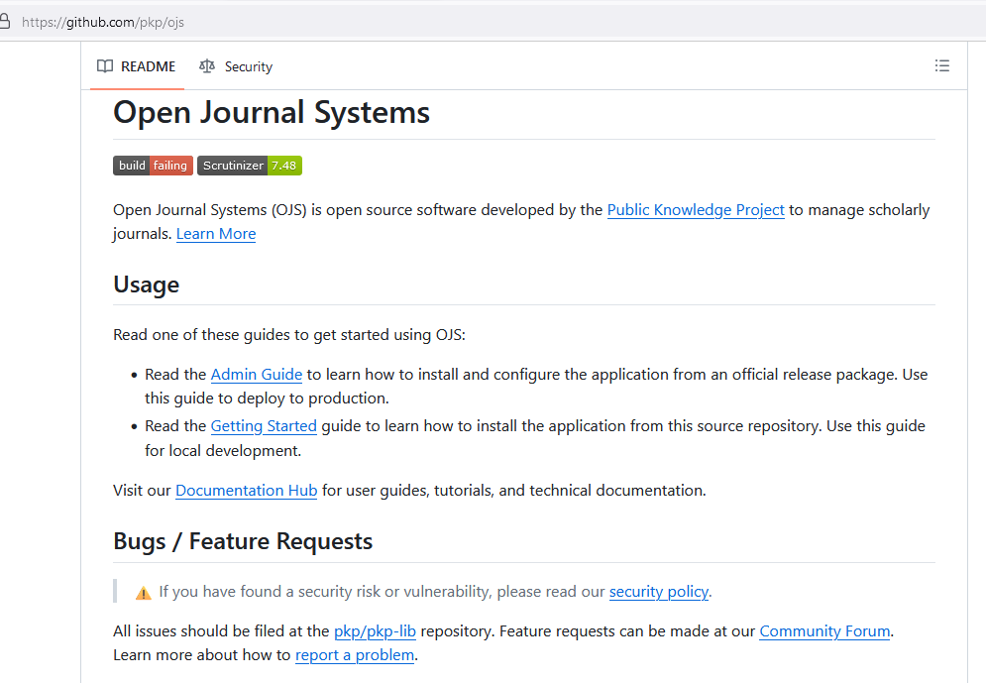
Tarball
release
vs
GitHub
Notes:
MINA
—--------------------------
This is the GitHub page for Open Journal Systems.
That “Usage” header has a good break down of the GitHub release vs the tarball release. Under “Usage”, it has two bullet points. Bullet 1 tells you to configure from the official release package to install on production. For production, use the tarball release with lots of supporting libraries. Bullet 2 tells you that if you are looking to do development work on your computer, you can grab from GitHub, then you can follow instructions to install supporting libraries, and then do development on your computer.
You can take git and overlay and connect a tarball release on your server to a public GitHub repository, but also, if you are just running software, you don’t need to version with git. Then, you don’t need a GitHub unless you are using it to showcase and share out contributions. For example, if I were running an open source platform, and I did a theme for Georgia Southern University Libraries with the Georgia Southern branding, I might want to version it, but there’s no reason to share it out.
Also, with actual installs and releases being scheduled and done with tarball releases, the way you get code into an open source product is a several months long process where it works through a review process, gets tested as a part of a release, then goes into a release.

Slide 10

GitHub website
vs git language
icebergs on body of water under blue and white sky at daytime, by Tina Rolf
Notes:
MINA
—--------------------------
Git is a pretty dominant language for versioning files. Meanwhile, GitHub is a publishing platform. Even for a project with a strong GitHub presence, most of the application code is probably not on GitHub. So that’s what GitHub is not.
Picture from https://wallpapers.com/wallpapers/5k-hd-glacier-5xdfhm460of20hvx.html (attribution required)
NOTE: Existing image not actually owned by Wallpapers.com and they can’t give permission to use; replaced with:
https://unsplash.com/photos/icebergs-on-body-of-water-under-blue-and-white-sky-at-daytime-yuF2B5Zyz88 (full free license for commercial/noncommercial)

Slide 11
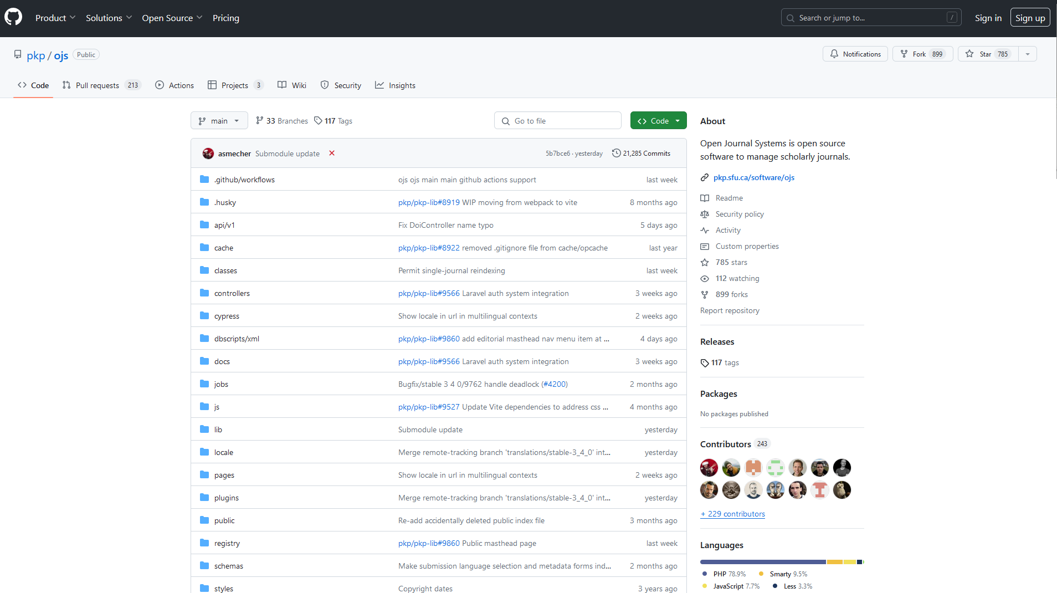
Notes:
MINA
—--------------------------
Meanwhile, you can use GitHub to see some social aspects around code.
Date of last update. If it’s recent and you are on the actual main piece of code, then likely the code is maintained regularly. If it’s last updated 6 years ago, that could be a bad sign.
You can pull up profiles for people and organizations.
You can browse to who forked and who starred.
(You can see activity, but you can’t tell who is NOT active, because most actual coding, maintenance, and use of software is not done by publishing.)

Slide 12
Slack
What is it?
Group real-time text-based communication, texting-style
Slack ‘instances’ are called Workgroups, and collect multiple channels (discussion topics) around a shared theme.
What is it good for?
Quick discussions and pointers towards specific resources
Getting an idea of who is involved in particular aspects of a project.
Notes:
JUSTIN
—--------------------------
Slack is a semi-asynchronous real-time chat client that centers around dedicated "workspaces" - collections of related discussion rooms and chat threads. While it supports some live voice chat, it primarily is a large-group messaging platform that stands out for its organization/threading of topics and ability to search for information within it.

Slide 13

https://slack-invitation.folio.org/
https://slack-invitation.folio.org/
https://slack-invitation.folio.org/
Notes:
JUSTIN
—--------------------------
Slack requires an invite to any given workgroup - in the case of FOLIO, that invite is publicly available - just go to this address here and you’ll be prompted to join their Slack workgroup. If you have the application installed, it’ll even pop it open for you.

Slide 14
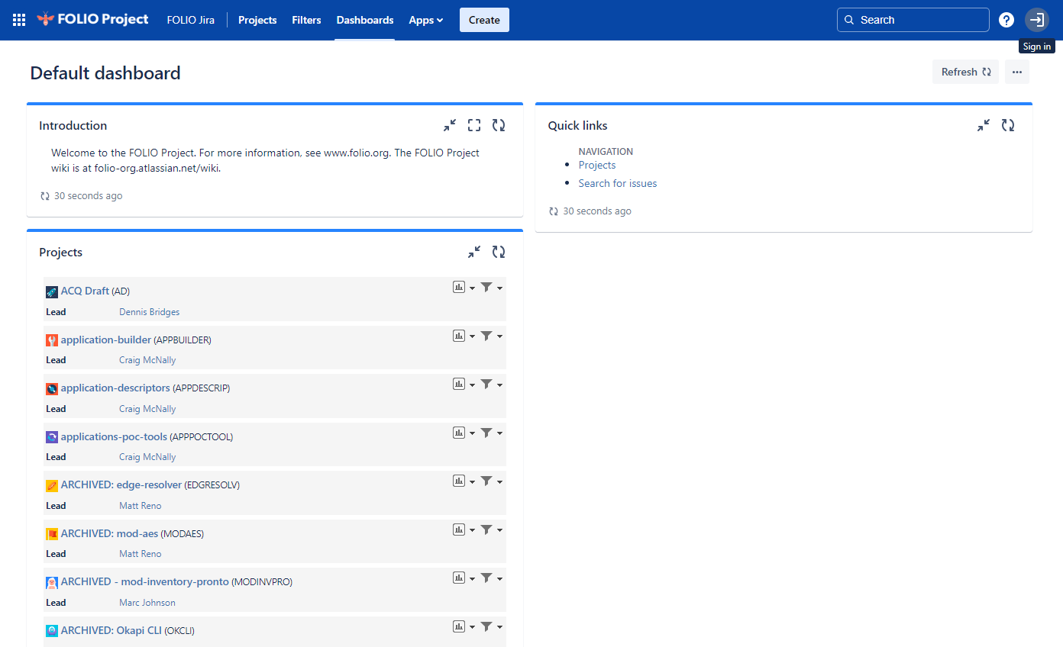

Atlassian tools: Confluence
Confluence = Atlassian’s wiki software.
Used for posting public information / documentation.
Where to sign up for FOLIO LSP’s Confluence
https://folio-org.atlassian.net/wiki/login.action?os_destination=/spaces/COMMUNITY/overview
Notes:
MINA
—--------------------------
Beyond, a website, open source software will generally have some kind of web presence for the wider community (and new comers) to participate in. Some will have meeting notes in Google Docs, or on GitHub. FOLIO has the community documents in Confluence which is wiki software.
I put a screenshot of https://issues.folio.org/secure/Dashboard.jspa , which is the sign up page for the FOLIO LSP Confluence. From there you can click the “sign in” link in the top right corner to register an account.

Slide 15
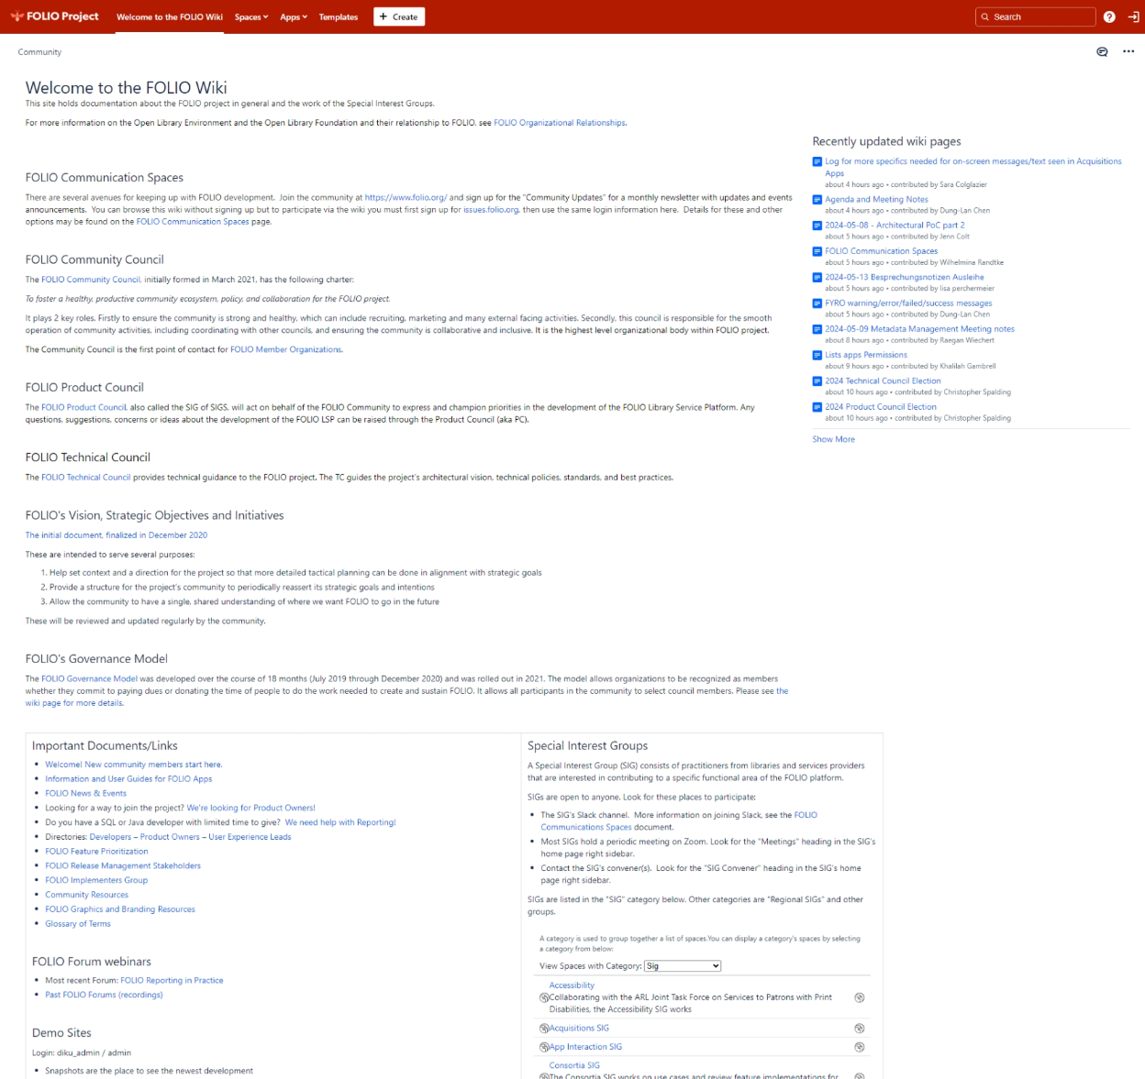
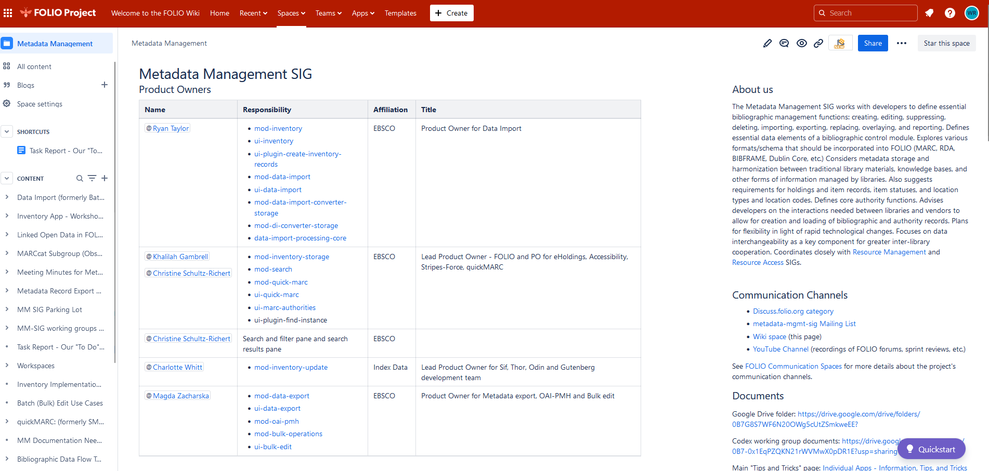
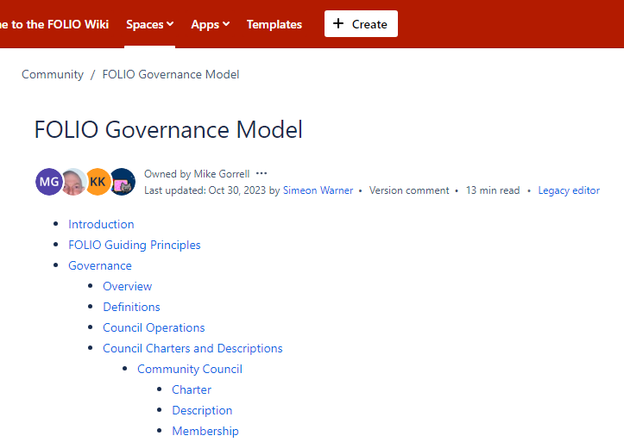
Notes:
MINA
—--------------------------
Here are some of the resources in the FOLIO LSP Confluence wiki. Basically, it’s the community organizing pages there. And, after you have registered for Confluence, you can edit any of them.
All the SIGs for FOLIO maintain meeting notes here.
You can see everything on the wiki without a login. If you want to “watch” a page (ie. get alerts about edits) or if you want to edit a page, then you can make an account.

Slide 16

Atlassian tools: Jira
What is it?
Bug-tracking, issue tracking, project management software
Your help-ticket version of interacting with many large open source projects
Getting Started
issues.folio.org; login as per Confluence
Notes:
JUSTIN
—--------------------------
Jira is, from a front-end, public user perspective, a bug-tracking/reporting system for software platforms. It enables users to communicate in structured ways with developers and report problems so that they can be replicated, identified, and fixed.
When working with open source projects, meaningful bug reporting is often the only way things get fixed - there’s rarely a staffed Quality Assurance team running tests and trying to break it. When you’re using open source software, you’re getting something other people have contributed to at what’s often a very low cost, but part of the implied social contract there is that you contribute, even if it’s just by writing up a problem when you have one. If we can repurpose a different message, “if you see something, say something”. If you don’t, nobody may ever know… and whatever problem you’re having won’t get fixed.
So, how do you do this? Well, let’s talk about getting started with the FOLIO Jira system.
You’ll see the URL listed in the slide above, as well as a QR code - that will bring you to the Jira management system for FOLIO. It uses shared login with Confluence, so you should be able to get in the same way you just did. Here’s what you’re going to see inside:

Slide 17
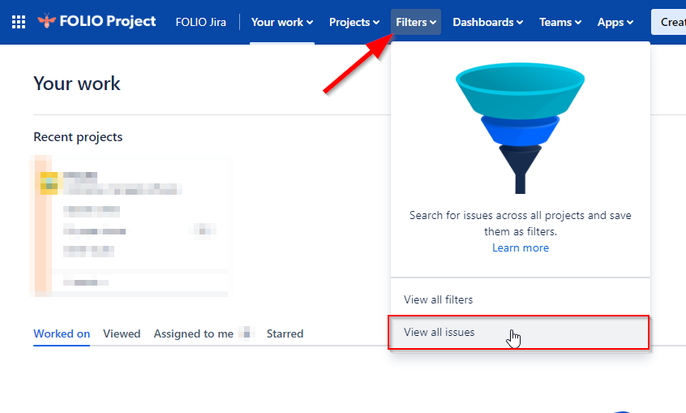
Jira - Searching for Information
Projects - groups of related concerns about specific aspect
of the software
Filters - ways of looking at reported issues, or making new ones
Notes:
JUSTIN
—--------------------------
Projects: Different Jira groups are going to be set up differently with projects; because FOLIO is a massive system with many interconnected parts, it makes heavy use to compartmentalize. Which means that you’re seeing an overwhelming list of almost 300; how to even know where to go? For FOLIO, there is a module-to-project-name-leader table that helps you figure out what part of the system you’re having a problem in and which project it’ll be in Jira.
Filters: This is where you’ll want to go to find out if there’s a known problem, or report it if there isn’t. As a new user, this is the section you’re going to be most concerned with. Let’s take a look {CLICK}.

Slide 18
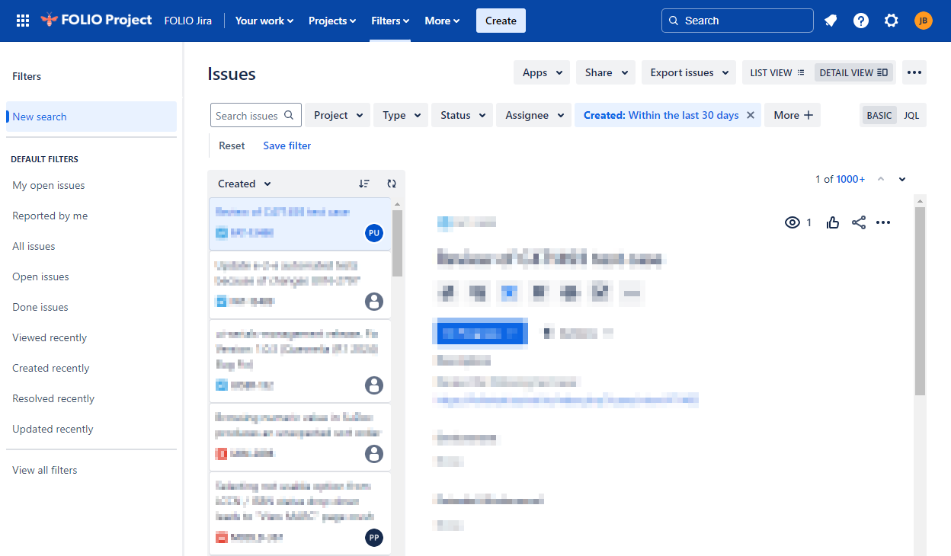
Jira - Searching for Information
Projects - groups of related concerns about specific aspect
of the software
Filters - ways of looking at reported issues, or making new ones
Notes:
JUSTIN
—--------------------------
The Issues page lets you sort problems in a lot of ways - by time, by which project they’re associated with, by type: are they a bug? A suggestion? A catastrophic meltdown (they call it ‘epic’). You can also see who is working on them, and by default, it’s going to show recent problems that are still “open”, meaning they haven’t been solved or addressed. That search box? That’s where you’d want to try to see if you can find your problem. We have a lot of librarians here, so I’m not going to spend much time talking about good ways to use words when searching, but make an earnest effort to find out if what isn’t working for you is reported here. Because if not, you get to WRITE ABOUT IT.

Slide 19
How to
Write It Up
Overview: I pressed the “lemonade” button, but I got lemons which proceeded to burn my house down.
Steps to Reproduce:
First, I did this on {page} clicking this
Then I… include pictures if necessary.
Expected Results: I thought I would get a cool, refreshing drink.
Actual Results: Combustible lemons came out, then lit themselves on fire.
Additional Information: I am very sad about this. It impacts me because [I live in my house]…
URL: Here’s where you can see the vending machine that dispensed flaming lemons.
Interested parties: Attn: @firemarshal @caveJohnson @evilVendingMachineCo
documenting problems like a pro
Notes:
JUSTIN
—--------------------------
So, if there isn’t an issue you can find that looks like the one you’re having, it’s time to create a post talking about yours. It probably seems of little significance, but writing a good report about the problem you’ve had is one of the most valuable things you can do to contribute to an open source community. It’s not simply “well, this broke,” though - you want your report to contain as many details about what you did as possible, so someone in development can actually try to recreate what happened to you and use that like forensic evidence leading back to the why it happened.
FOLIO has a suggested template, and you can see a shortened example to the right here. You want to include a general overview of the problem, and then specific details as to what exactly you were doing, step-by-step. Often, this is a good place to check what version of the software you are using and include it; if it’s unclear, it might help to at least say where you’re reporting from. URLs and screenshots are great, as long as the URLs are ones other people can access (and not behind your login systems). At the end

Slide 20
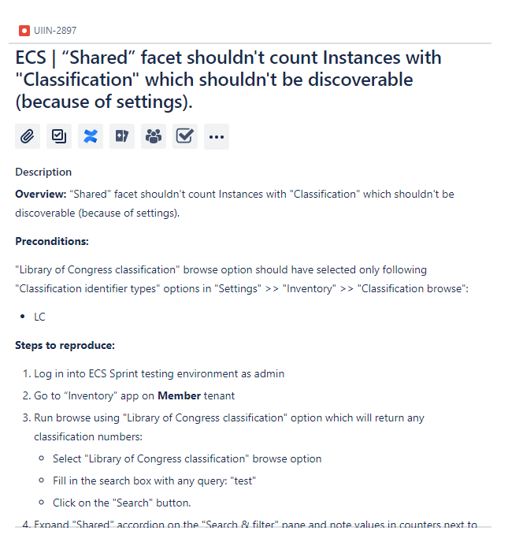

Issue Example
Notify People
FOLIO Module/JIRA project-Team-PO-Dev Lead responsibility matrix
Notes:
JUSTIN
—--------------------------

Slide 21
If you only do one thing…
Notes:
MINA
—--------------------------

Slide 22
Sign up for Slack. You can ask tech support questions here.
Recommended Video Playlist for a FOLIO LSP Community Overview
  Fundamentals of the FOLIO Community: https://www.youtube.com/watch?v=imOEbCbE5EU (30 minutes)
  FOLIO—Introduction to Special Interest Groups: https://www.youtube.com/watch?v=72RhdlEWH4w (12 minutes)
  FOLIO Communication Tools: https://www.youtube.com/watch?v=7vfA3qCMFGw (12 minutes)
  FOLIO Development Lifecycle: https://www.youtube.com/watch?v=9R8kohmP9D8 (10 minutes)
  FOLIO Wiki and Issue Tracker Overview: https://www.youtube.com/watch?v=evQrip0T3Ek (45 minutes)
Notes:
MINA
—--------------------------
Possibly put a slide saying if you only do one thing, sign up for Slack.
Possibly link out to:
Recommended Video Playlist for a FOLIO LSP Community Overview
Fundamentals of the FOLIO Community: https://www.youtube.com/watch?v=imOEbCbE5EU (30 minutes)
FOLIO—Introduction to Special Interest Groups: https://www.youtube.com/watch?v=72RhdlEWH4w (12 minutes)
FOLIO Communication Tools: https://www.youtube.com/watch?v=7vfA3qCMFGw (12 minutes)
FOLIO Development Lifecycle: https://www.youtube.com/watch?v=9R8kohmP9D8 (10 minutes)
FOLIO Wiki and Issue Tracker Overview: https://www.youtube.com/watch?v=evQrip0T3Ek (45 minutes)

Slide 23
Thank you for having us.
Questions?

Slide 24
GIL User Group Meeting
Georgia Southern University
Georgia Southern University
Introduction to Open Source Community Governance
Wilhelmina Randtke & Justin Barnett / 13-14 May, 2024

