Slide 1



AI-Powered Learning: Blending AI with Active Learning in the Information Literacy Classroom
Kevin Reagan & Wilhelmina Randtke
Georgia International Conference on Information Literacy
April 19th, 2024
Notes:
Kevin: Hello everyone. Thank you for coming to our presentation today.My colleague and I are very excited to share our presentation about active learning and artificial intelligence with you all. My name is Kevin Reagan, and I am an Instruction & Outreach Librarian at Georgia Southern University. In my role, my primary focus is serving as the library liaison to the University’s English Department on the Statesboro campus.
Mina: I’m Wilhelmina Randtke. I’m Head of Libraries Technologies and Systems at Georgia Southern University. My primary role at Georgia Southern is supporting in-building and online technologies in support of teaching and research through the Libraries.

Slide 2
Abstract
The ACRL Framework for Information Literacy in Higher Education was a response to more voluminous and less reliable information. Existing lesson plans for teaching the ACRL Framework are readily transferable to teaching research and AI in a world where online content is written by AI, hallucinations and all. This presentation steps through existing published lesson plans for teaching the frames (with citations and links!), and applies these lesson plans to teaching AI.
Notes:
KEVIN If you’re someone who likes to know what’s ahead, here’s your synopsis. This presentation will situate the the creation of the ACRL framework within a greater context, offer steps to incorporate AI into your classroom or assignments, and then highlight some active learning activities that concurrently teach AI literacy and competency.

Slide 3

ACRL Framework: A Long History, Lots of Lesson Plans
Predecesor: Information Literacy Competency Standards for Higher Education (2000)
Adopted in 2016
Set up dispositions for students: information literacy as a process
DJ Palyeado, CC BY-SA 4.0 <https://creativecommons.org/licenses/by-sa/4.0>, via Wikimedia Commons
Notes:
KEvin Let’s begin our journey into active learning with AI with some context. Just like all aspects of life, the study and teaching of information literacy has a rich history. Although we certainly cannot cover all of it, one important face to note is that its predecessor, the Information Literacy Competency Standards for Higher Education, was similar to the ACRL Framework in that it tried to establish habits and dispositions to look for when evaluating a student’s information literacy skills. This trend – teaching students actions they can take to improve their information literacy skills – is important because it is applicable to an AI-permeated information landscape.

Slide 4

Misinformation, content farms, and artificial intelligence
The ACRL Framework was designed to address voluminous information and misinformation: “[T]he rapidly changing higher education environment, along with the dynamic and often uncertain information ecosystem in which all of us work and live, require new attention to be focused on foundational ideas about that ecosystem.” (ACRL, 2016, 7).
mikemacmarketing, CC BY 2.0 <https://creativecommons.org/licenses/by/2.0>, via Wikimedia Commons
Notes:
(Mina)
I put there a quote from the introduction section of the ACRL Framework. The Framework is a response to more voluminous, and less reliable online information. When the Framework was finalized and published in 2016, that was in the context of human written information with lots of pressure from algorithms. It’s been decades now that content online is written for search engine optimization and engagement rather than truth, and essentially written for algorithms.
With generative artificial intelligence, that’s a natural extension of past online information trends. For a website with unvetted content written for search engines, in the past that’s been done by content farms with paid bloggers abroad or underemployed people in the US doing low paid writing gigs. In the future, that will include chatbot generated content on blogs, on websites, and coming out of the chatbot. The source of the content doesn’t matter super much. In the past, we had people writing for algorithms and engagement rather than truth, and going forward we will have both people and artificial intelligence writing for algorithms and for engagement rather than truth. The ACRL Framework was designed to teach research in this current information ecosystem. The ACRL Framework has been around since 2016, there are lots of polished lesson plans out there, and a significant chunk of those lesson plans either already cover or can be easily adapted to artificial intelligence.

Slide 5
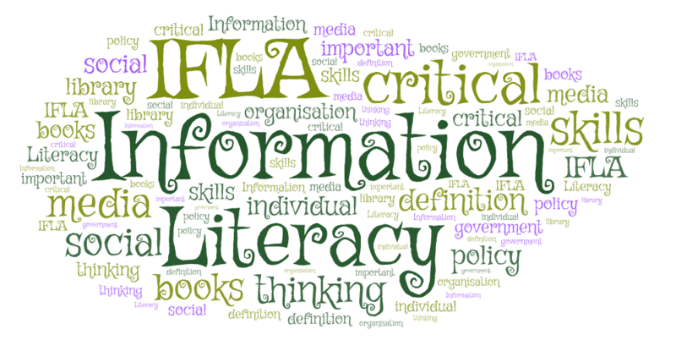
The ACRL Framework
The Frames:
Authority Is Constructed and Contextual
Information Creation as a Process
Information Has Value
Research as Inquiry
Scholarship as Conversation
Searching as Strategic Exploration
WordArt.com, CC0, via Wikimedia Commons
Notes:
Kevin: If you work in higher education and are attending this conference, there is a great chance that you’ve heard of the ACRL Framework for information literacy. As Wilhelmina discussed, this Framework was not created in a vacuum, and the social forces that influenced the creation of the Framework are not entirely different from those at play in a world where artificial intelligence can produce information – whether accurate or inaccurate – faster than people. The difference now is that, whereas content farms engendered the creation of the Framework, algorithms capable of mimicking authority, information creation processes, and reliable information are what we face.
For the purpose of this presentation, think of AI-powered learning in two different, non-mutually exclusive ways: Using artificial intelligence in a lesson plan & active learning that encourages students to learn about the data privacy issues. Moreover, regarding research, humans interacting with artificial intelligence-generated content is not completely new. There’s not a major difference between people interacting with content farm blogs and AI hallucinations.

Slide 6
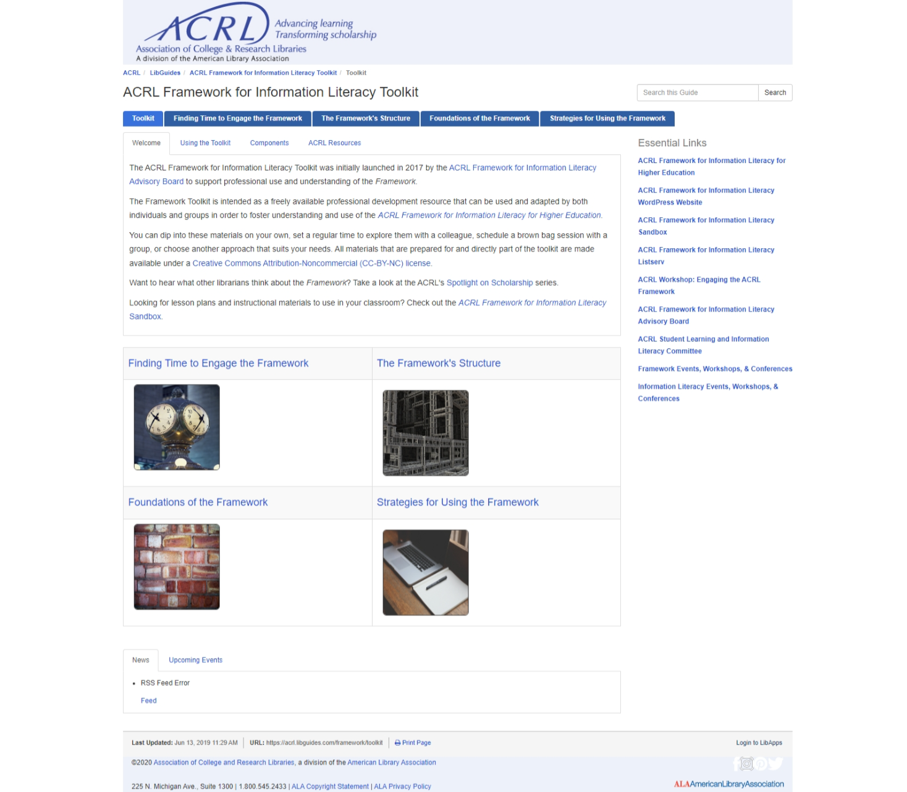
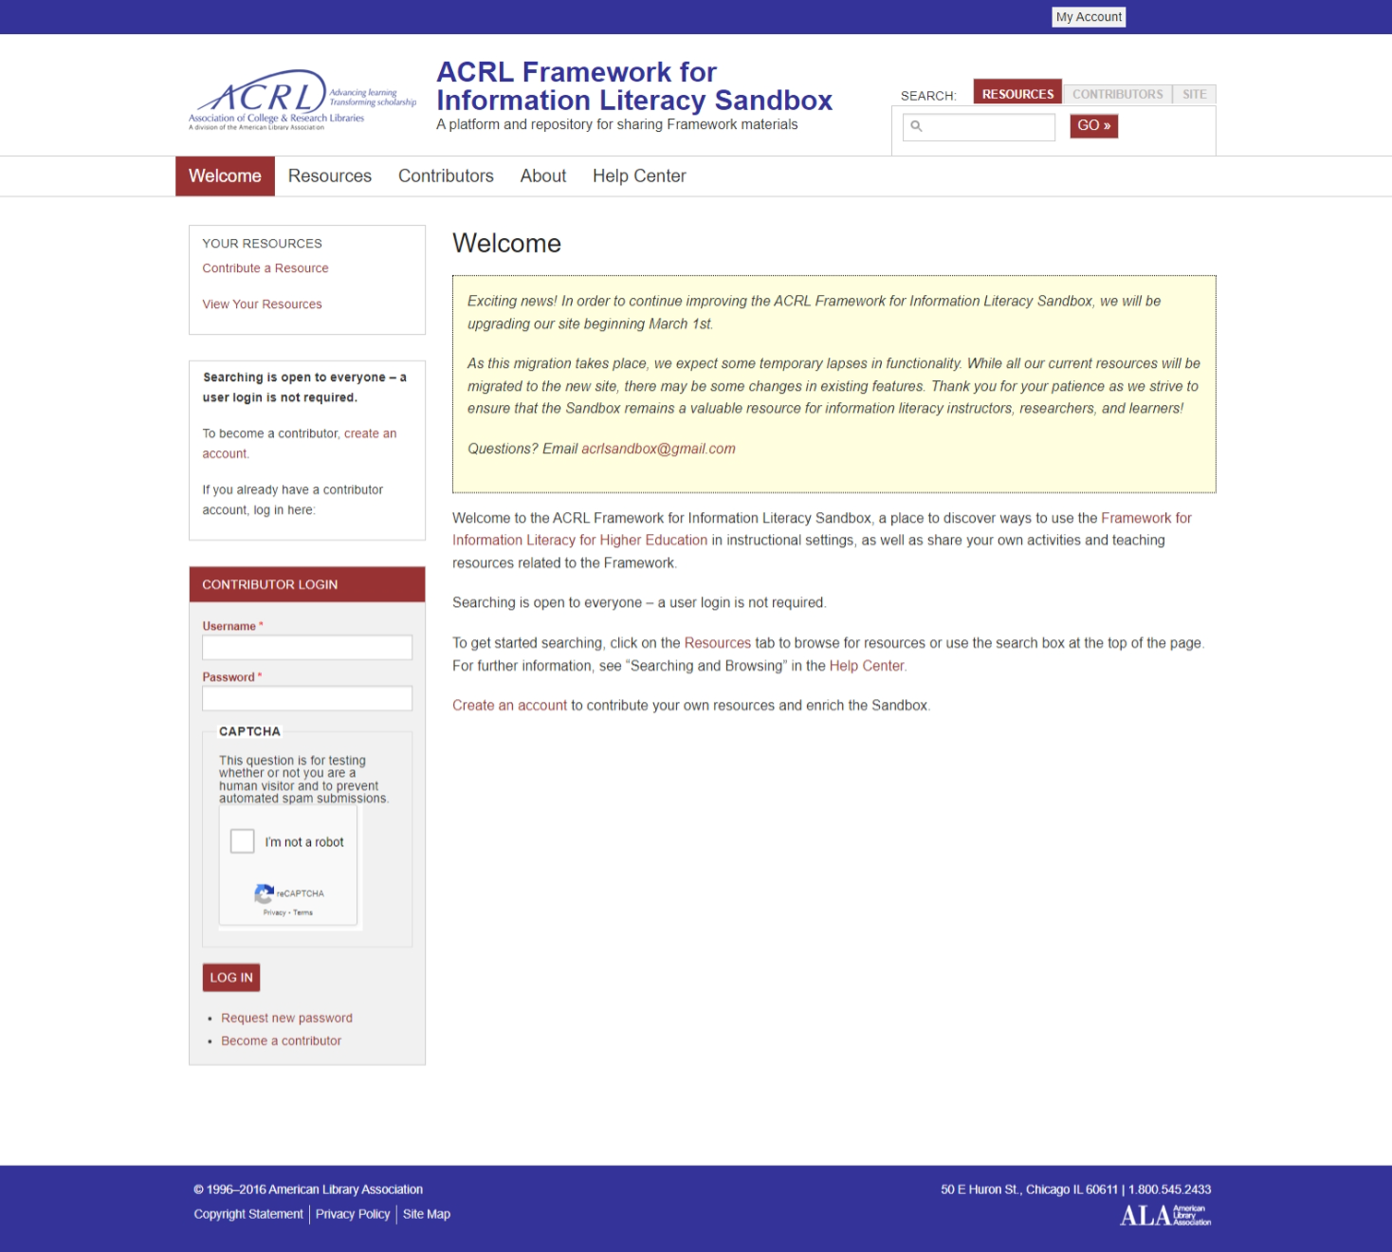
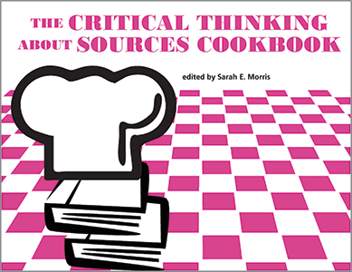
Cookbooks & Toolboxes = Lesson Plans Galore
Notes:
Mina R.
The ACRL Framework represents a mature framework with tons of existing lesson plans.
The Framework was launched in 2016, and rather than being long in the tooth from being several years old, it’s actually good that it’s been around a while, because now there are all these lesson plans which are published.
Where to find lesson plans? The ACRL has websites - the ACRL Framework for Information Literacy Toolkit; the ACRL Framework for Information Literacy Sandbox; an ACRL Cookbook (which is a whole book of lesson plans with lesson plans instead of recipes), and even information literacy textbooks.
A core part of this presentation is that we went through existing sources for lesson plans for teaching information literacy - so a mature field that has been fleshed out for years. We read those existing lesson plans, and selected existing plans which adapt well to teaching artificial intelligence.
Artificial intelligence involves algorithms writing content. Information literacy is a response to a need to navigate content written for algorithms. It’s a natural progression in the information ecosystem, and the Framework carries over well for dealing with new artificial intelligence based tools and accelerating changes in the information ecosystem. Lessons designed for dealing with content farms and the attention economy either directly address artificial intelligence, or adapt smoothly to teaching artificial intelligence.
In short, there are many lesson plans and many of them are relevant and in fact are plug-and-play for teaching artificial intelligence.

Slide 7

Strategies for teaching artificial intelligence in the classroom
Acceptance: AI is here to stay - 1956
Identify why and how students are likely to use AI in your classroom
Deploy active learning activities to encourage the ethical use of AI
Use HuggingChat: Does not require login
Mam'Gobozi Design Factory (MDF), CC BY-SA 4.0 <https://creativecommons.org/licenses/by-sa/4.0>, via Wikimedia Commons
Notes:
(Kevin) Prior to describing the various active learning lesions, I want to address a question that commonly arises when I speak to my faculty members about incorporating AI into active learning: How do you do it?
First, and I don’t know if this is an isolated perception that I’ve encountered or if it’s common elsewhere, but AI has simultaneously been here and is here to stay. Many of my colleagues believe AI will suffer the fate of the iPod shuffles and become obsolete sooner than later. Though AI can trace its history back to the 1930s, many cite the 1956 Dartmouth Summer Research on Artificial Intelligence as the starting point of AI. Some strongly disagree with starting in 1956, but that’s not the focus of today’s session.
Second, know how and why students want to use AI in your classroom or assignments. Whether you want to believe it or not, there is a great chance your students are using AI in your classroom. Try not to be in denial. Step 3 using active learning activities to teach students how to use AI ethically in your classroom or on an assignment. Guided sessions can teach students how to use AI ethically in the classroom AND in the workforce. Finally, when incorporating AI into the classroom, don’t assume students already have an account with an interface like ChatGPT and respect privacy concerns. There will be more on this later. But Hugging chat, an AI chatbot, does not require a login for immediate access and allows some queries to be made before prompting users to create a free account. Perplexity is another option, but we recommend Hugging Chat for a variety of reasons, and I’ll turn it over to Mina to explain why.
—

Slide 8
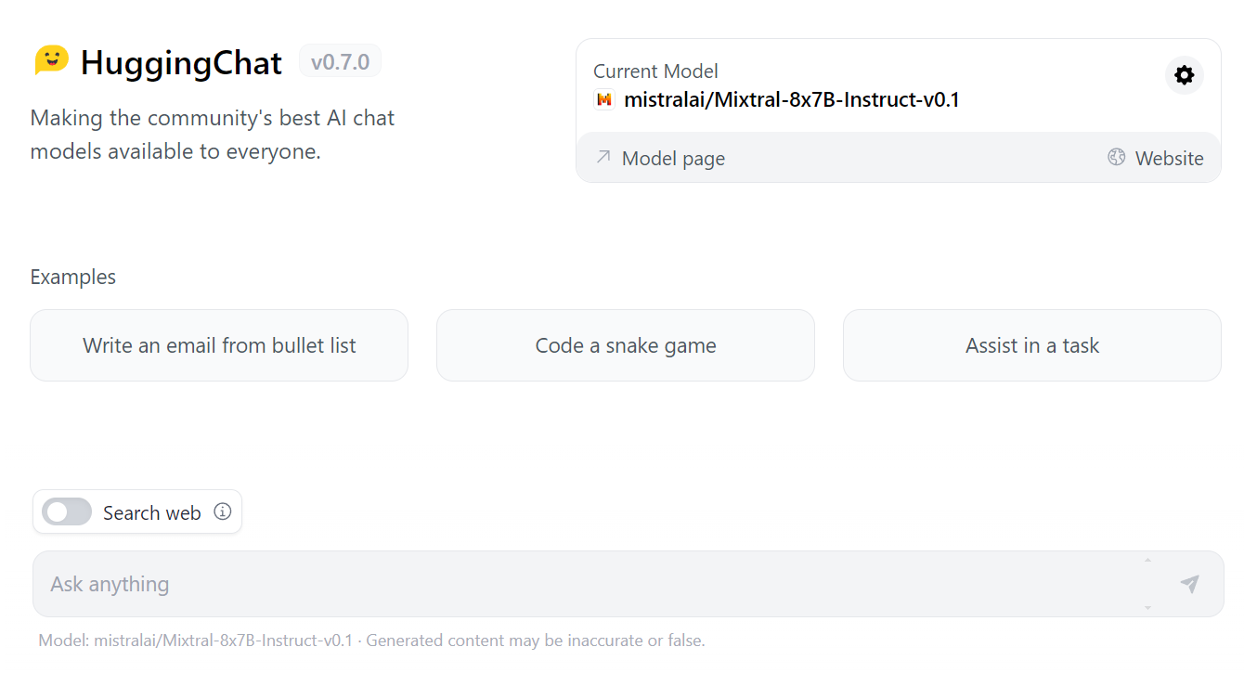
Hugging Chat
Notes:
W.R.
This is a bit of expansion on the recommendation to use Hugging Chat. Most of the chatbots that are out there and getting lots of buzz - ChatGPT, Bard (now renamed to Gemini), Claude, and others - they have limited free of charge access, heavier use requires a paid plan, and even the free-of-charge use requires registration. There are serious privacy concerns with registration, because these chatbots also are likely doing A/B testing and collecting data and learning from the users as the users type into the chatbot.
This is a plug for two things: First off, not requiring students to use a tool which requires registration and tracking. And, Second off, a plug for HuggingChat, which, as of Spring 2024, is an online chatbot which is both open and full featured. HuggingFace, the company which makes HuggingChat, allows open source access to their chatbot code, and you can download their trained models. And, if you don’t want to download and run all the code, they have an online chatbot. Two things make it great for classes. (1) It does not require registration nor login to use. So, if you do a classroom lesson with this, that reduces these large companies collecting data or doing surveillance on your students. And (2) it shows the version number right on the homepage. As you read through various lesson plans about artificial intelligence, or even maybe today at this conference, you may have heard a tip to check back right before class and make sure any demos with a chatbot still work. That’s because ChatGPT and other cloud hosted chatbots will push out updates on a rolling basis, which cause the software to behave differently. That breaks applications using the API, and it can break a lesson plan. With HuggingChat, they do update it regularly. They also have more transparency in that they post the version number right on the homepage (!! point out version number on screen !!). So, you can make a note in your lesson plan about what version you tested the lesson plan with, and then shortly before class, you can check the website to know whether or not HuggingChat has been updated.
So, it is more respectful of student privacy - no registration required - and better logistically because you can quickly tell if the chatbot has been updated.
This is as of Spring 2024. Into the future, a single training round for a chatbot can be 10 million dollars in electricity alone. These artificial intelligence applications tend to be controlled by a handful of large corporations, and with steep financial needs, their business models can change. A good source for researching the financial and centralized corporate control aspects of artificial intelligence is the AI Now Institute. In Spring 2024, HuggingChat is a good option for classroom demos. In the future, the best option might change.
Another online chatbot which does not require login is Perplexity.ai .

Slide 9

Authority is Constructed & Contextual & Information Creation as a Process
ZODIAC Test (Reagan, 2024a).
Hidden Layer: Intellectual Privacy and Generative AI (Hartman-Caverly, 2023).
Card games to teach how machine learning algorithms work (Bell & Talboom, 2023)
Rigo Peter, CC BY 4.0 <https://creativecommons.org/licenses/by/4.0>, via Wikimedia Commons
Notes:
KEVIN
Finally, we arrive at the lesson plans! From here, we will cover the lesson plans through the lens of the Framework. First up we have authority and info creation as a process. The first activity involves is a mnemonic that I created called the ZODIAC test. While it shares features common in other information evaluation frameworks such as the CRAAP test, the ZODIAC test offers flexibility and addresses information created by AI. The Z stands for Zooming into a given source, and this letter is the flexibility that I mentioned. Zooming in can mean a lot of different tasks, but there’s beauty in that because it allows for adoption for many different academic disciplines. Although I mostly work with composition students, I find that being able to adapt the Z for a gender studies course to be useful. I commonly use the Z to mean looking into whether the source being examined – whether it’s an academic journal, Tiktok video, or blog post – contains grammatical or formatting errors and references real events – as opposed to AI hallucinations. Again, this can be customized to whatever you want. The new few letters are common among just about all information evaluation tests: O is for other opinions/sources, d is for the date of publication or revision, I is for intended audience, and A is for authority of the author. The c, though, differs, in that it calls for students to check an author’s consistency. Checking for consistency can happen in a variety of ways, but I commonly challenge students to find a social media account of someone they fins authoritative and ask for them to see if they believe the indiviuudal has adopted AI to write content or posts. The key components to look for abrupt changes in grammatical or sentence structure. Now, in the classroom, I divide students into group, assign them a source, and have them go through each letter of the ZODIAC test to determin whether they think the source is credible.
The Hidden Layer Intellectual Privacy activity can be found on Penn State’s website and is designated as workshop to encourage critical thinking about the myriad ways in which AI impacts our right to collect, use, and disseminate our ideas. In the workshop, the author uses a term called augmented intelligence – or the impact Generative AI is having on human agency – and shows how the information AI prioritizes can impact decision making processes– and the activity gets a little philosophical, which, to me, is important.
I will not talk about this last one often because I feel like it is best read. It’s a book chapter, after all, though the Sparknotes version is that is utilizes playing cards to teach the ways in which algorithms make decisions based on patterns. It is

Slide 10

Searching as Strategic Exploration &
Research as Inquiry
Search tools comparison (Fitzgibbons, 2023).
Teaching prompt engineering with an analogy to shooting pool (Nesbitt & Stilwell, 2023).
The Case of the Unsolved Hallucination (Reagan, 2024a).
Artificial intelligence generated images of hands made by Dall-E 2 and featuring hallucinated extra fingers.
Notes:
(Mina)
We have citations on these. And there is a “References” slide at the end of the presentation! Here are 3 sample lessons you can pull up and use to teach artificial intelligence. These lesson plans were designed to teach either the frame “research as strategic exploration” or “research as inquiry” and they work well applied to artificial intelligence.
First, we have search tools comparison. Who here has taught a lesson where you have students use two different search engines to research the same topic? It’s pretty common - compare two search engines; compare a search engine and a database like academic search complete. With chatbots, that same lesson plan can be adapted to also ask a chatbot. Or, where a chatbot has been added to a search engine, such as Bing CoPilot, students can compare searching with and without the chatbot.
Next lesson is a lesson plan about teaching database and search engine techniques, adapted to prompt engineering. The lesson plan is to use an analogy to shooting pool. With a database or search engine, you would run the search, then your search results come in and you skim them and then tweak the search to get better results. Searching as strategic exploration. Similarly, with a chatbot and with prompt engineering, it is not just once and you are done. Instead, you would prompt, then review the results, then change your prompt to get better results closer to what you need.
The third lesson explores the tendency of generative artificial intelligence to hallucinate, or make things up. Students are given citations to 2 sources. One is a hallucinated source made up by artificial intelligence. The other is a real citation. Students have to research to find out which source really exists. Students break into groups, determine which is real, then share their findings. This can start a discussion about retrieving papers and source material from authoritative sources.

Slide 11

Scholarship as Conversation &
Information Has Value
AI Prompt Engineering (Reagan, 2024d)
Building Confidence in using AI to Generate Citations/Humans v. AI (Reagan, 2024b)
AI & Personal Information: An Investigation(Reagan, 2024c)
Riemogerz, Public domain, via Wikimedia Commons
Notes:
*****(Kevin) Go more in depth ***** Because these are lessons that I have developed and implemented, y’all will have to forgive me if I’m overly Zealous.
In the first lesson, AI Prompt Engineering, the lesson objectives are as follows: Identify Broad AI Prompts:
Students will recognize when AI prompts provide broad suggestions. Utilize Keywords Effectively: Students will select and use keywords generated by AI to conduct focused research. Recognize AI Limitations: Students will understand the limitations of relying solely on AI-generated keywords for research.
Steps for instructors:
Introduce Broad Topic: Provide students with a general topic using a collaborative word processor (e.g., fall of the Roman Empire, critical analysis of Shakespeare's The Tempest).
AI Keyword Generation: Instruct students to use AI to generate keywords related to the broad topic provided.
Narrowing the Topic: Based on the AI-generated keywords, guide students in narrowing down the topic to a suitable scope for an undergraduate paper, using AI as a resource if needed.
Topic Selection: Encourage students to develop up to three potential options for a narrowed research paper topic.
Steps for students
Objective Explanation: Understand that the goal is to narrow down a broad topic using AI-generated keywords.
Input Topic into AI: Input the given broad topic into a generative AI tool and request a list of keywords.
Topic Narrowing: Use the generated keywords to refine and narrow down the topic to a manageable scope for academic research. Optionally, develop two to three potential research topics.
Reflection and Sharing: Prepare to reflect on and share with the class how AI-generated keywords were utilized to arrive at a narrowed topic. Discuss any challenges or limitations encountered
Lesson BUilding Citations with AI Learning Objectives:
Identify the components of a citation for a given citation style.
Construct AI prompts that yield all elements of a citation.
Articulate the limitations of using AI to construct a citation.
Instructions for the Instructor:
This is a group activity where each group will be assigned a book, journal article, or magazine to cite using AI.
Divide students into groups and assign each group a source.
Instruct students to generate a citation for their given source using Hugging Chat AI or an AI of your choosing.
Have students transfer their citation to a collaborative word processor, such as Google Docs.
While students are citing their sources, check for errors but refrain from pointing them out. The goal is for students to identify the errors themselves.
Once groups have analyzed their sources, ask them to share their findings: what went well with the citation? What sort of errors did the AI make?
AI & Personal Information Commodication
Objective: Students will be able to identify and analyze the privacy and personal data clauses of various generative AI platforms, compare and contrast their policies, and form informed opinions about which platform gives users the most control over their data.
Learning Objectives:
Analyze AI to make informed decisions on which generative AI to use
Articulate how AI platforms commodify personal information
Justify ethical personal information use
Materials Needed:
Links to the data policies of several generative AI platforms (e.g., Google Bard, Hugging Chat, ChatGPT)
Access to computers or devices for student research
Note-taking materials (paper/pencil or digital tools)
Procedure:
Introduction (5 minutes): Begin by introducing the topic of AI and personal information. Explain that many AI systems collect and use personal data from users, often without their full knowledge or consent. Ask students if they have ever noticed ads appearing based on their recent online searches or social media posts. Discuss why this might happen and how companies may use personal data for targeted advertising or other purposes.
Research (20-30 minutes): Divide students into small groups (3-5 members each). Provide each group with links to the data policies of several generative AI platforms. Instruct students to carefully read and examine these policies, paying close attention to the privacy and personal data clauses. As they read, encourage students to take notes and highlight important points related to user data collection, storage, sharing, and protection.
Comparison and Analysis (20-30 minutes): After completing their individual research, have students come back together in their groups. Guide them through comparing and contrasting the different policy provisions across the platforms. Prompt students to discuss questions like: What types of data does each platform collect? How long do they store user data? Who has access to the data, both internally and externally? Do users have options to opt out of data collection, and if so, what limitations might those choices impose on usage? Are there any notable differences between the policies? If so, what implications could these distinctions have for users and their personal information?
Opinion Formation (15-20 minutes): Based on their analysis, instruct students to form an opinion about which platform provides users with the most control over their data. Encourage them to support their conclusions with specific evidence drawn from the policy documents. Remind students to focus not only on whether a particular platform offers more extensive protections but also on how effectively it communicates those safeguards within its policy.
Reflection and Sharing (10-15 minutes): Finally, ask volunteers to share their findings and opinions with the class. Facilitate a whole-group discussion around the similarities and differences observed among the policies and the potential consequences for users. Conclude by summarizing the importance of understanding AI data practices and encouraging students to remain vigilant about protecting their own personal information online.
— New script —
We’re at our last two frames: Scholarship as COnversation and Information Has Value
Now, if I seem overzealous about these lesson plans, it’s because I developed all three and absolutely love employing them in the classroom when I get the chance.
The first lesson plan teaches prompt engineering and teaches students how to recognize research questions that are too broad. To begin with this, students are given a topic and told that it is too broad. From there, students are instructed to use AI to generate keywords related to the broad topic. Based on the AI-generated keywords, students sysnthesize scholarly literature and are encouraged to narrow their broad topic to one that can be addressed in a research paper. Of course, this activity takes time, and I’ve only been able to use it in the classroom twice because I teach library one-shots, not a traditional lecture course. Nonetheless, the activity teaches students how to write good prompts, recognize when a research question is too broad, and encourages AI to be considered a research tool and NOT a researcher itself.
THis next lesson plan is by far my favorite one to use in the classroom. It was initially given the boring title of building in using AI to cite a source, but it has turned into a game called Humans v. AI. Students are divided into groups, and each group is given a source to cite. Now, the trick is that the source must be cited manually

Slide 12

Disclaimer: Digital Divide & AI Divide
Alan Turin9, CC BY-SA 4.0 <https://creativecommons.org/licenses/by-sa/4.0>, via Wikimedia Commons
Notes:
Kevin R
This slide is really more of a disclaimer than anything…. In library and information science’s scholarly literature of 2000s, the concept of the digital divide and its impact on learning was a prominent paradigm. Many of the issues raised in the early 2000s were left unresolved, and now, with open source generative AI, the divide is even greater. When incorporating AI or teaching about AI, please keep in mind that some students, due to various social forces at play, might not have a ton of experience or confidence in using AI. What we know is that the workforce of today and in the months or years to come will rely on generative AI, and those of us in education are uniquely situated to mitigate this divide.

Slide 13
Think-Pair-Share
Think of a lesson plan you commonly implement in your IL classroom. Think of strategies to connect the lesson to AI literacy. Bonus: How might you incorporate AI into the lesson?

Slide 14
References
Association of College and Research Libraries (ACRL) (2016). ACRL Framework for information literacy for higher education. Chicago, IL: American Library Association. https://www.ala.org/acrl/sites/ala.org.acrl/files/content/issues/infolit/framework1.pdf
Bell, M. and Talboom, L. (2023). More Than Just Algorithms: A Machine Learning Club for Information Specialists. In The Rise of AI: Implications and Applications of Artificial Intelligence in Academic Libraries (pp. 61-70). Association of College and Research Libraries.
Fitzgibbons, M. (2023). Concordia University Library, April 2023. Search tools comparison (jigsaw group activity). ACRL Sandbox. https://sandbox.acrl.org/library-collection/search-tool-comparison-activity
Fonseca, T., & King, M. (2000). Incorporating the Internet into Traditional Library Instruction. Computers in Libraries, 20(2), 38.
Hartman-Caverly, S. (2023). Hidden layer: Intellectual privacy and generative AI. ACRL Sandbox. https://sandbox.acrl.org/system/tdf/resources/HiddenLayer_LessonPlan_CCBYSA_HartmanCaverly_2023.pdf
Hugging Face. (n.d.). HuggingChat. Retrieved March 15, 2024 from. https://huggingface.co/chat/
Nesbitt, T. and Stilwell, K. (2023, October 4-6). AI and the Meta Poster [Conference presentation]. Georgia Library Conference, Athens, GA, United States. https://www.canva.com/design/DAFtJUH6kXU/IBErazVEjP_thvjN5ZoQOw/view
Reagan, K. (2024a). The ZODIAC Test. https://georgiasouthern.libguides.com/informationliteracyai
Reagan, K. (2024b). The Unsolved Case of the Hallucination. https://sandbox.acrl.org https://georgiasouthern.libguides.com/informationliteracyai
Reagan, K. (2024c). Building citations with AI. https://georgiasouthern.libguides.com/informationliteracyai
Reagan, K. (2024d). AI & Personal Information Commodification. https://georgiasouthern.libguides.com/informationliteracyai
Reagan, K. (2024e). Engineering AI prompts to develop keywords. https://georgiasouthern.libguides.com/informationliteracyai
Notes:
Mina: These are our references. If you registered for this conference, then you have been on the institutional repository. You probably registered through the Georgia Southern Digital Commons website, which is where the slides will soon be posted. After the conference, we will post the slides here https://digitalcommons.georgiasouthern.edu/ . And, you can get the references with links to ALL the lesson plans listed here.

Slide 15
Continuing the Conversation
We are interested in collecting more lesson plans using the ACRL Framework, which are easily adaptable to teaching artificial intelligence. If you have any to share, feel free to email us at kreagan@georgiasouthern.edu or wrandtke@georgiasouthern.edu to share.
Notes:
(no one presenting; informational only)
Mina to share this CFP in the chat on Zoom: https://librarywriting.blogspot.com/2024/04/call-for-chapters-ai-and-library.html CFP for the AI and Library Instruction Cookbook.

Slide 16
AI-Powered Learning: Blending AI with Active Learning in the Information Literacy Classroom
Kevin Reagan and Wilhelmina Randtke
Georgia International Conference on Information Literacy
April 19th, 2024

