Slide 1
Exploring the flip side of Explainable AI:
Unexplained expert systems and cultural acceptance for the unexplained
Wilhelmina Randtke, Head of Libraries Technologies and Systems, Georgia Southern University Libraries
Code4Lib Conference 2024, May 15, 2024, Ann Arbor, Michigan
Notes:
Good morning. I’m Wilhelmina Randtke. I use “Mina” for short, so that’s my “easy name”. I’m currently Head of Libraries Technologies and Systems at Georgia Southern University Libraries.
Today I’m talking about Explainable Artificial Intelligence. Artificial intelligence has a fluid meaning. At this time in history, society has embraced machine learning, which is inherently less explainable than past technologies for simulating human intelligence. This talk is about recent social changes which make us culturally more receptive to not getting an explanation.
Contact Information: wrandtke@georgiasouthern.edu

Slide 2
Abstract
Current buzz about artificial intelligence tends to present the excitement as coming from technological advances like speed to allow a real time conversation and better quality responses from chatbots and generative artificial intelligence. This talk explores how cultural expectations, rather than technology, may be what recently reached a tipping point to put artificial intelligence into the public spotlight. From a non-technological perspective, explainability is a major difference between machine learning and traditional software which encoded and applied logical rules. Popular acceptance and embrace of machine learning requires a comfort level with not having an explanation for why the software does what it does. This talk explores how past developments in how we interact with traditional software accustomed the general public to not getting an explanation, even for very explainable software. Technology tools like skip logic in forms prevent us seeing the big picture within a logical system. Cloud computing primed us to expect updates over time and accept constant changes outside our control to tools that we use daily. When even imminently explainable software is not explained, explainability no longer matters. This opens the way for the public to embrace machine learning.

Slide 3
The changing meaning of “artificial intelligence”

Slide 4
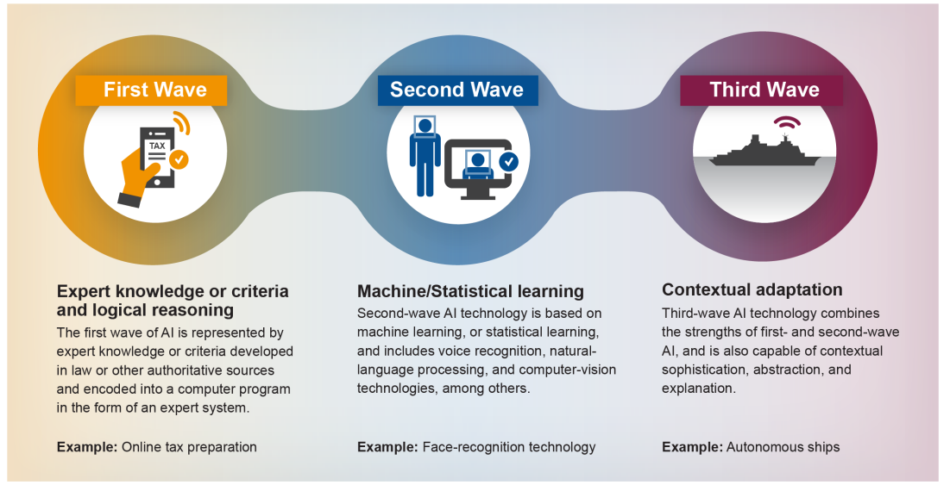
Machine learning is good at making a prediction, and bad at giving an explanation of why it did what it did.
Diagram from: Artificial Intelligence: An Accountability Framework for Federal Agencies and Other Entities, Government Accountability Office (GAO) (June 2021).
Notes:
This is a conceptual diagram of how the definition for artificial intelligence has changed over time. In the past, way back, expert systems was artificial intelligence. So, an Excel spreadsheet formula, or a flow chart for decision making, or a decision tree that is put into a computer program - that was artificial intelligence. The idea was that logic was the core of human intelligence. And now, machine learning, statistical learning - that is artificial intelligence in this current wave of hype. Machine learning is looking at a large set of data, finding patterns in the data, and using that to make predictions.
Fundamentally, a big difference here is explainability. If you use the expert system approach vs the machine learning approach, results and accuracy might be made to be similar between those two. Explainability is practically baked into an expert system. With machine learning, explainability for why it does what it does is just not easily achievable. For machine learning, the software is looking at lots of data in a training set, and finding patterns, and then using those patterns to make predictions in the new dataset. To understand why it got a specific result, you practically have to look at the training data yourself and analyze it, and you likely do not have time for that.

Slide 5
Explainable AI

Slide 6
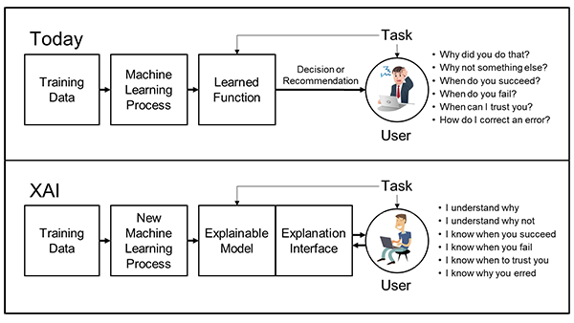
Regulation is coming
Diagram from:
Broad Agency Announcement Explainable Artificial Intelligence (XAI) DARPA-BAA-16-53, Defense Advanced Research Projects Agency (DARPA) (August 10, 2016).
Notes:
The concept of explainable AI is currently a buzzword. The reason for that is that the U.S. government is in the process of regulating artificial intelligence. The Department of Defense is the biggest funder of artificial intelligence research in the U.S. because of drones making autonomous kill decisions. So, much of U.S. policy about artificial intelligence is set by the Department of Defense.
This diagram dates to 2016 and to an initiative by the Department of Defence’s DARPA agency to set up a program for explainable AI. That program launched in 2017, but it’s more of a framework for thinking about ways to make software more explainable. Also, the 2021 appropriations bill for the Department of Defence includes within it the National Artificial Intelligence Initiative Act (NAIIA) of 2020. That has a 5 year rollout starting in 2021 for regulating artificial intelligence across all the industries in the U.S. So right now, we are in that window of time, when the US is determining whether and how to regulate all the artificial intelligence in all the industries.
Image from https://www.darpa.mil/attachments/DARPA-BAA-16-53.pdf .

Slide 7
Regulation is coming
European Union’s General Data Protection Regulation, Recital 71, enacted 2016:
Right to an explanation
“The data subject should have the right not to be subject to a decision, which may include a measure, evaluating personal aspects relating to him or her which is based solely on automated processing and which produces legal effects concerning him or her or similarly significantly affects him or her [. . .] In any case, such processing should be subject to suitable safeguards, which should include specific information to the data subject and the right to obtain human intervention, to express his or her point of view, to obtain an explanation of the decision reached after such assessment and to challenge the decision.” (emphasis added)
Notes:
Also, in 2016, the GDPR passed. It was effective in 2018, passed in 2016. Part of the GDPR is the right to an explanation. Someone subject to a decision, which is based solely on automated processing and which produces legal effects has the right to an explanation of that decision.
It doesn’t go into what an explanation is. Basically, that’s it.
Right now, there is a requirement in Europe for there to be explainable artificial intelligence. No definition of explainable.

Slide 8
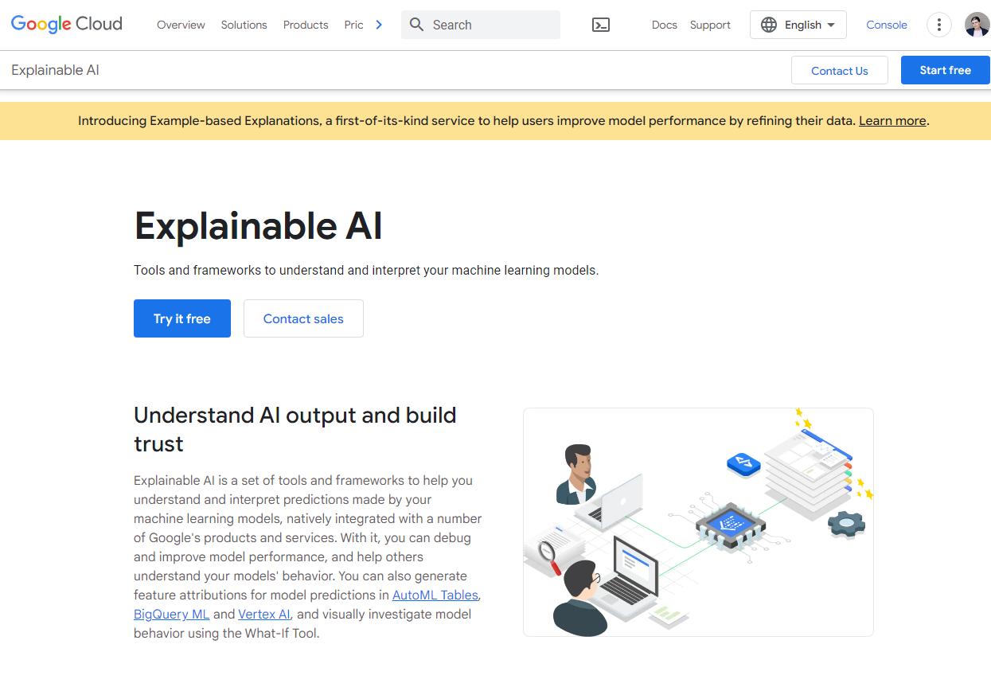
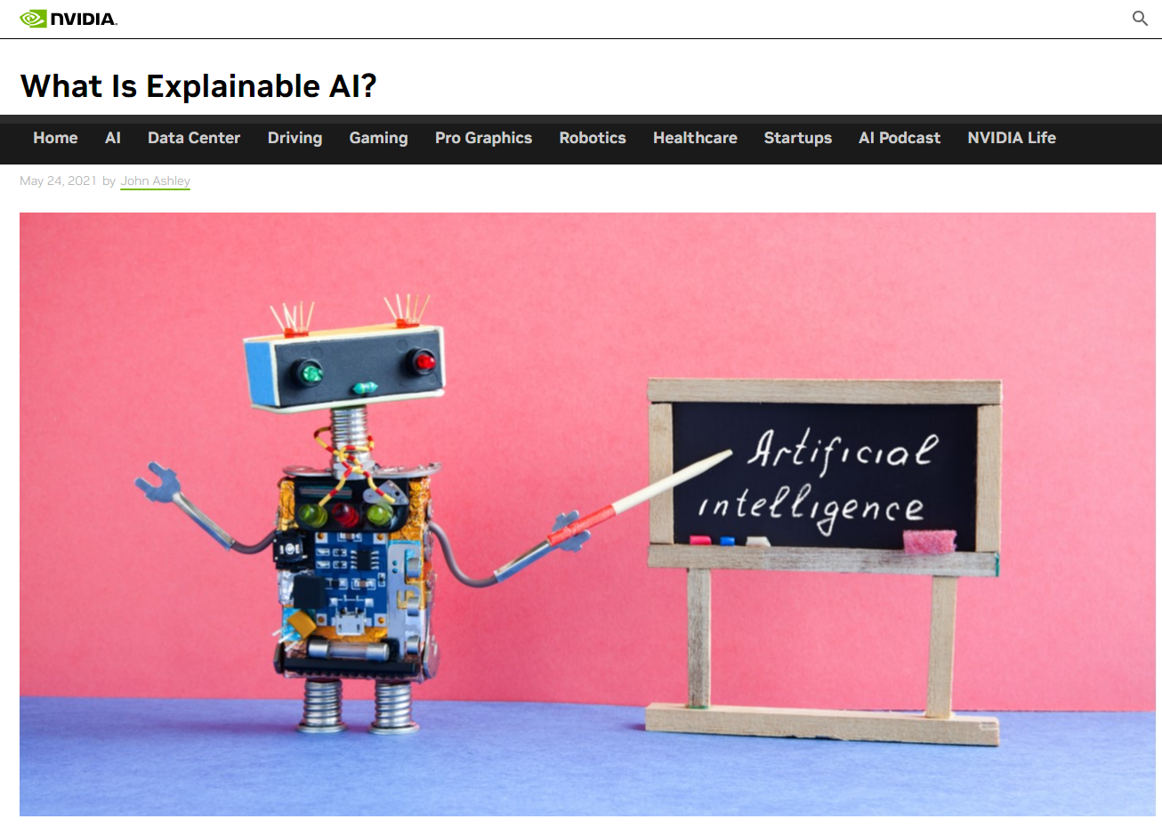
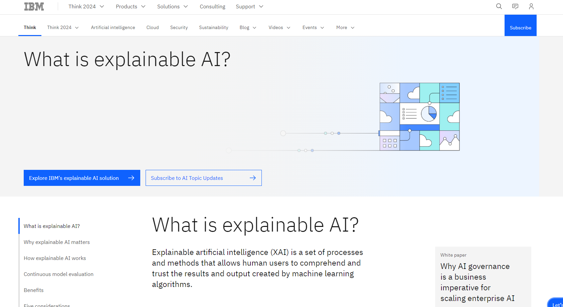
Avoiding regulation…
… self regulating
Notes:
The big companies now tend to have programs about “explainable AI”, partly as a way to avoid regulation and partly as a way to control the process and define what regulation will be.

Slide 9
Explainable AI
Notes:
Essentially there isn’t a definition for explainable AI. Instead, the explanation is required in the European Union. The United States is currently in the process of regulating to require it. And many big tech companies are advocating to define it, in order to control the industry.

Slide 10
Machine learning is good at making a prediction, and bad at giving an explanation of why it did what it did.
Diagram from: Artificial Intelligence: An Accountability Framework for Federal Agencies and Other Entities, Government Accountability Office (GAO) (June 2021).
Notes:
There is that fundamental difference between expert systems and machine learning: explainability is a big social difference between the two frameworks.
As a society, we’ve made the shift very recently to being enthusiastic about using machine learning. Artificial intelligence is a buzzword, it’s everywhere right now, and at this moment in time it means machine learning.

Slide 11
Machine Learning…
…not so new
Notes:
You might think that the technology is what’s new. But really, machine learning has been around for decades.

Slide 12
Machine Learning toolkits: Dates of public release
WEKA:
(Waikato Environment for Knowledge Analysis)
established circa 1997
MALLET
(Machine Learning for Language Toolkit)
established circa 2002
OpenNLP
established circa 2004
GATE:
(General Architecture for Text Engineering)
established circa 1995
RapidMiner
(formerly called Yet Another Learning Environment)
released for sale 2001
SPSS Modeler
(formerly called Clementine)
released for sale 1994
SAS
released for sale 1972
InfiniteInsight
(formerly KXEN)
released circa 1998
KNIME
released for sale 2006
… and many more
Notes:
These are common toolkits for machine learning in use today. And, as it happens, many of these toolkits are around 20 to 30 years old. That’s 20 years since a general release to the the public to where the general public could get the software and run it on a computer. SAS was released commercially in 1972 with applications in use since the 1960s.
The tech for machine learning existed when expert systems were state of the art for artificial intelligence.
History of MALLET is at https://web.archive.org/web/20221222150707/http://www.mimno.org/articles/malletplans/
Older toolkits:
- Clementine (cited in Proof in the Pattern. Nicholson, Scott. Library Journal. Jan2006 Net Connect, Vol. 131, p2-6.)
- SAS Enterprise Miner (cited in Proof in the Pattern. Nicholson, Scott. Library Journal. Jan2006 Net Connect, Vol. 131, p2-6.)
- Enterprise Miner (cited in A BASIC PRIMER ON DATA MINING. Chan, Carmen; Lewis, Bruce. Information Systems Management. Fall2002, Vol. 19 Issue 4, p56. 5p. DOI: 10.1201/1078/43202.19.4.20020901/38835.7 . )
- Intelligent Miner (cited in A BASIC PRIMER ON DATA MINING. Chan, Carmen; Lewis, Bruce. Information Systems Management. Fall2002, Vol. 19 Issue 4, p56. 5p. DOI: 10.1201/1078/43202.19.4.20020901/38835.7 . )
- Darwin (cited in A BASIC PRIMER ON DATA MINING. Chan, Carmen; Lewis, Bruce. Information Systems Management. Fall2002, Vol. 19 Issue 4, p56. 5p. DOI: 10.1201/1078/43202.19.4.20020901/38835.7 . )
- Scenario (cited in A BASIC PRIMER ON DATA MINING. Chan, Carmen; Lewis, Bruce. Information Systems Management. Fall2002, Vol. 19 Issue 4, p56. 5p. DOI: 10.1201/1078/43202.19.4.20020901/38835.7 . )

Slide 13
What is really new?
Culture and attitudes?
Notes:
I’m suggesting that cultural attitudes toward explainability are part of why machine learning is culturally accepted and hot right now.

Slide 14
Machine learning is good at making a prediction, and bad at giving an explanation of why it did what it did.
Diagram from: Artificial Intelligence: An Accountability Framework for Federal Agencies and Other Entities, Government Accountability Office (GAO) (June 2021).
Notes:
The meaning of “artificial intelligence” has changed from expert systems to machine learning.
What’s interesting here in this diagram is that they gave this really great example of an expert system - tax forms. Online tax forms are super explainable, meanwhile using them helps shift our mindset in the general public towards accepting a lack of explainability.

Slide 15
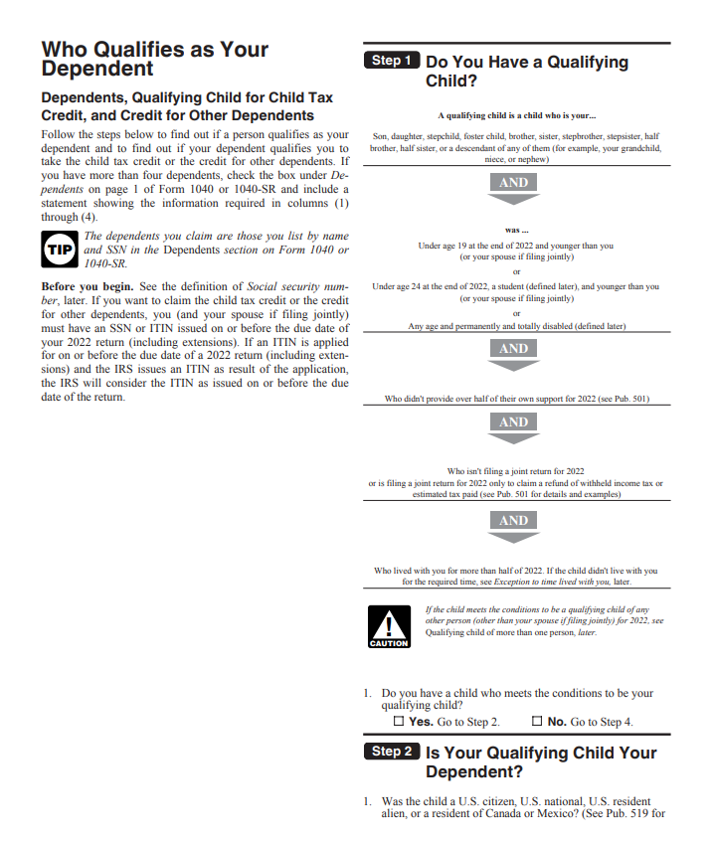
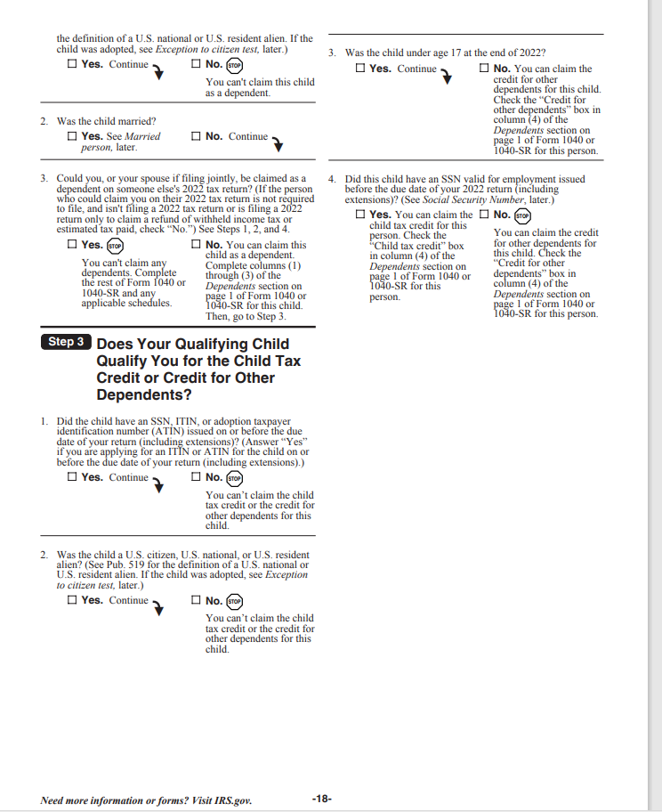
Machine learning is good at making a prediction, and bad at giving an explanation of why it did what it did.
Notes:
Forms and specifically skip logic in forms is a great example of older software, with explainability, but where bringing that form online hid the explainability. The process of bringing forms online removed transparency.
What’s great about tax forms is that the IRS still does a paper form. Here are instructions for the paper form in the background. These are posted to the IRS’s website. And, they have skip logic. The paper form will say, go to question 3, or go to question 5, and have you skip questions based on answers to previous questions. In paper, you can read the questions you skipped. When you take that paper form and you put it into an electronic questionnaire, just about always, the electronic questionnaire will apply the skip logic. Based on answers to questions, those earlier answers determine what questions you see next.
The IRS is a little unique in 2024 by even having the paper form. For most online forms, there isn’t transparency. For most online forms, there is no paper form, and there is no way for you to get the skip logic if you ask for it.

Slide 16
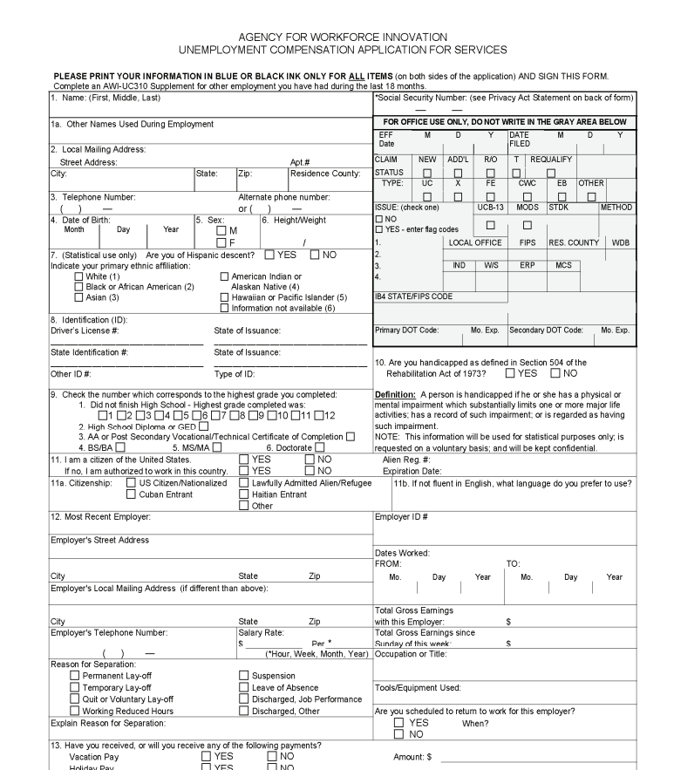
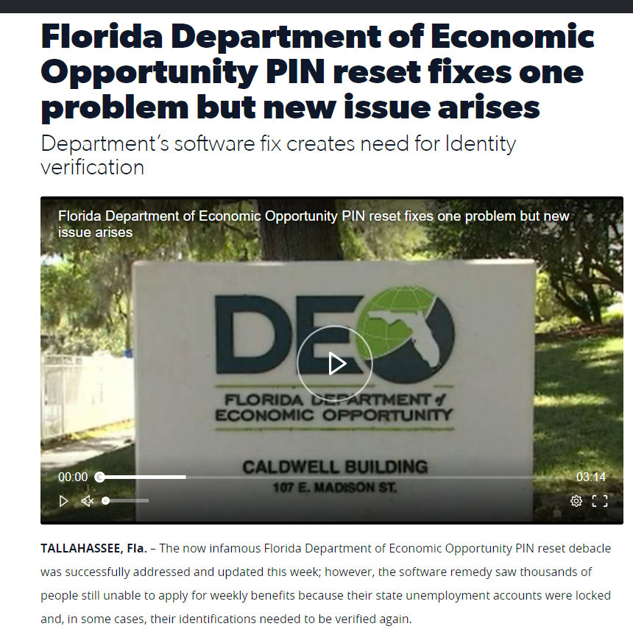
Forms going online: Pervasive, it’s all the forms
15+ years ago: Paper forms phased out
Today: No paper forms. At all.
Notes:
Imagine applying for unemployment compensation. In the online form, you fill the form, you put your social security number, and you had your one chance at that form. Whatever questions got skipped, you won’t even know about. No one sees the entire form.
People also can’t get the explanation.
States just don’t have paper forms.
This is an example from Florida. I’m from Florida originally. The screenshots to the left are from 2008. Back then, the paper form got published with the state, and anyone could go look at it. Advocacy groups could request changes, or a hearing.
Today, there is not a paper form.
And that’s not just Florida. That’s nationwide, where paper forms just don’t exist.
We saw this with tons of news coverage. With COVID quarantines, there was first off a wave of applications, where in March 2020, state computer systems went down from all the traffic, and many states made a paper form on an emergency basis to allow people to file. The states made the form for that emergency. It didn’t already exist. Then, with the weekly or biweekly claims form to certify still being unemployed, no paper forms, so there was a drip drip of problems that made the news what with such high unemployment during COVID quarantines.
This is not a “computers are bad, we need paper” thing. Instead it’s that the explanation has been gone for 15 years thing. In 2008, the forms were published, and each time it got changed, there was a public posting, it got published and there was a meeting about it. Today, there’s a computer form with skip logic, and there’s no way to ask and get all the questions.
Or think about a credit card application. Probably you did the last one online, and if there was skip logic, you had no way to see the whole process.
So, something that is explainable in software is not transparent.
A lot of expert systems are like that when we use them in daily life. They are explainable, but there is no way for a regular person using the software to get an explanation.
Paper weekly claims forms were never published these past 15+ years. See https://www.clickorlando.com/news/local/2021/08/06/thousands-of-florida-unemployment-accounts-blocked-by-deo-security-measure/

Slide 17
Notes:
Then there is cloud computing. With cloud based software, updates roll out and the interface changes without any control over when and how.
Image from https://commons.wikimedia.org/wiki/File:Unidentified_cloud_above_l%27%C3%8Ele-Tudy.jpg CC0.

Slide 18
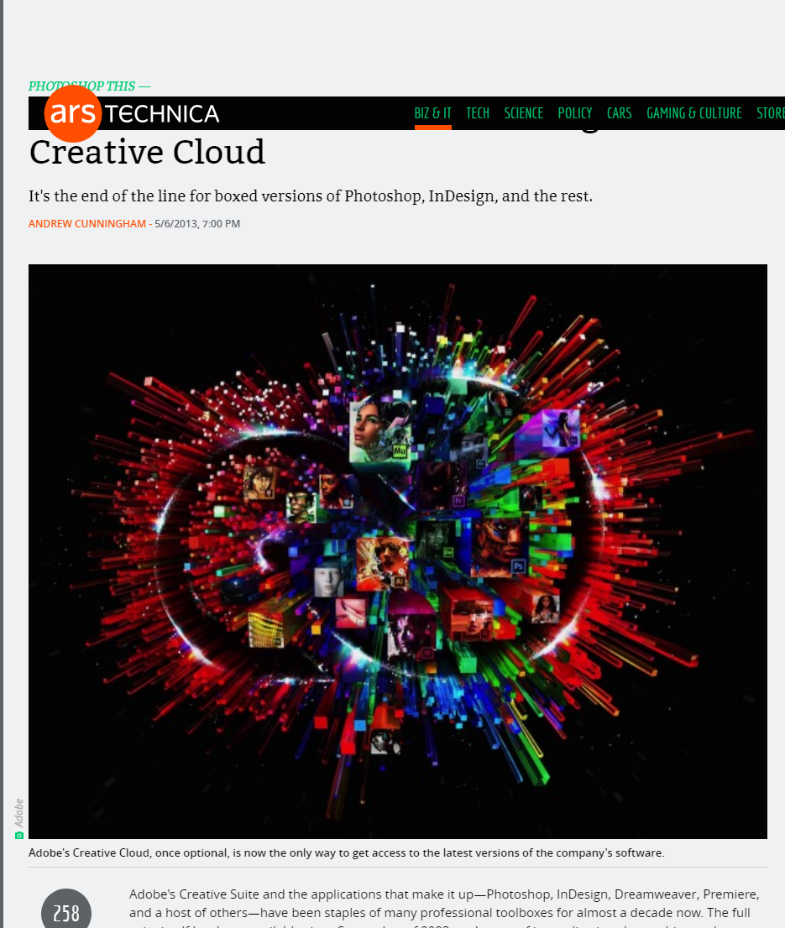
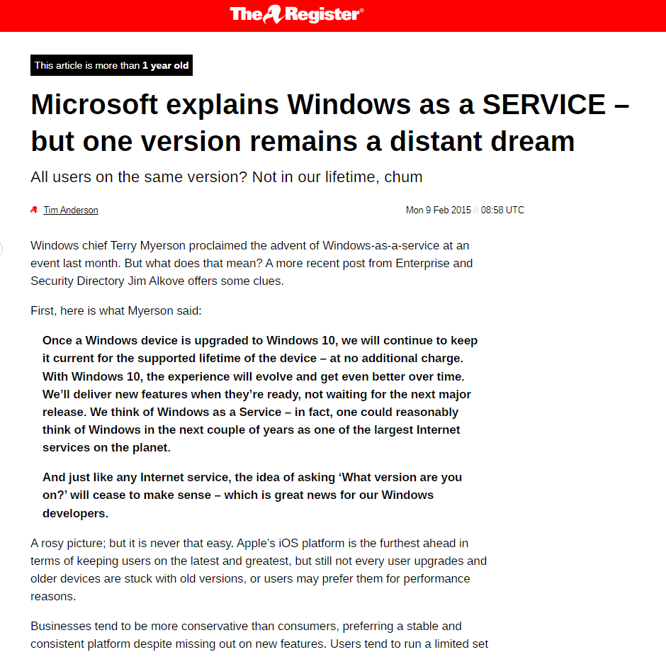
Notes:
Cloud computing is not just logging into a server and finding it changed, or even gone. It’s also the software we use on a daily basis. It’s been about 10 years now that Windows has required connecting to a cloud based account and pushing rolling updates. And it’s been about 10 years now, since Adobe phased out being able to buy and install software and replaced it with a continuously updated subscription. Just using a computer entails some uncertainty.
Being informed and getting an explanation isn’t part of the picture.

Slide 19
Machine learning is good at making a prediction, and bad at giving an explanation of why it did what it did.
Diagram from: Artificial Intelligence: An Accountability Framework for Federal Agencies and Other Entities, Government Accountability Office (GAO) (June 2021).
Notes:
Culturally, the way we interact with software for the past 20 years changed. In the modern world, regardless of whether software is explainable or not, we aren’t getting an explanation.

Slide 20
Exploring the flip side of Explainable AI:
Unexplained expert systems and cultural acceptance for the unexplained
Wilhelmina Randtke, Head of Libraries Technologies and Systems, Georgia Southern University Libraries
Code4Lib Conference 2024, May 15, 2024, Ann Arbor, Michigan
Notes:
Contact Information: wrandtke@georgiasouthern.edu

