Slide 1
Publicly posted project plans:
A taste of project management to better support cross functional projects in a large academic library
Wilhelmina Randtke, Head of Libraries Technologies and Systems, Georgia Southern University Libraries
American Library Association Core Project Management Interest Group Session, Virtual, July 11, 2024

Slide 2
Abstract
The Georgia Southern University Libraries Technologies and Systems Department provides core infrastructure underlying a large academic library with 64 employees, not counting student workers, spread across two cities. Most departments work within a single area of librarianship. Meanwhile the Libraries Technologies and Systems department supports many projects which impact multiple departments, including online services like the ILS configuration, interlibrary loan service, and the website. This presentation will describe use of project plans to coordinate communication about projects between people working in different departments, units, and roles and to keep things easy to follow for management. This will be presented in the context of some recent projects as examples, a server upgrade for the ILLiad interlibrary loan services, and a project to set up permissions in the ILS for emeritus faculty.

Slide 3
Background
Georgia Southern University Libraries
GSU is classified as an R2 Carnegie institution, offering doctoral degrees with high levels of research activity.
The main campus is in Statesboro, with a second location in Savannah and a third at the Liberty Center at Fort Stewart.
GSU has 708 Tenured and Tenure track faculty members.
The University Libraries have 64 employees, including all non-student employee roles.
As of Fall 2023, enrollment was 26,488 over three campus locations.
Notes:
This is a little bit about my background, and my current role. My previous role had been product manager for digital publishing software in Florida’s academic library consortium, and as product manager, I was project manager for software upgrades, migrations, and building out or launching new features in software. That was structured like a matrix organization with Project Management Body of Knowledge, to where I didn’t supervise people, but rather led projects where the team members had a functional lead and a project manager.
My current role is in a large academic library. The Georgia Southern University Libraries operate in 3 buildings across 2 cities, and it takes more than an hour to drive from one of Georgia Southern’s campuses to the other. The management structure is fairly hierarchical. Most substantive work is delegated to departments within the Libraries, and then there are also committees. The Libraries org chart shows department relationships, so that is the dominant framework. Many roles within the Libraries would only work with project management rarely, so there isn’t an organization wide culture of project management.
At my previous role, all team members would be familiar with project management processes. And I feel like a lot of mainstream software project management training comes from organizations like that. In my current role, familiarity of team members with project management can be highly variable. That’s likely the norm at most libraries - for involvement in projects to be less frequent.
I am head of Libraries Technologies and Systems at the University Libraries. In my current role, the department I lead supports all kinds of technologies. We work with supporting printing for students. We work with liaisoning with main campus ITS regarding technology issues including authentication (doing authentication means we are frequently involved in many different systems). We work to support any software platforms hosted on a server. This includes ILLiad interlibrary loan software, EZproxy software, and specialized software for a high density storage facility where robots get the books. We also do the big picture configuration settings for the integrated library system (also called library services platform).
The systems department is heavily slanted towards lateral coordination with main campus ITS and lateral coordination within the libraries.
The typical project here is fairly straightforward, as far as work goes. What is more complicated is that for any given project, at least some participants will work in a way that is non-routine for them. And for any given project, often there are many stakeholders who are loosely involved, and will have questions.
The one thing from PMBOK that I’ve latched onto here is trying to have a Project Plan for each project. The Project Plan helps me to inform participants’ supervisors and get approvals or have the supervisors in the loop about what is going on. And it helps me to explain the project to stakeholders.

Slide 4
Project Plan
Project plans at the libraries slant towards less formal/detailed.
“Project plans and documents demonstrate that the level of planning is appropriate for the project.” (PMBOK Guide, 2021).
“Simplicity--the art of maximizing the amount of work not done--is essential.” (Agile Aliance, 2001).
The main reason for the project plan at the GS Libraries is internal communication.
“The primary uses of the project plan are to document planning assumptions and decisions, facilitate communication among project stakeholders, and document approved scope, cost, and schedule baselines. A project plan may be summarized or detailed.” (PMBOK Guide, 2000).
Notes:
For project plans, in an organization which is less formally structured for project management, the project plan best serves as a communication tool. Formalities about how to structure the project plan are a bit much. Most participants in projects are working with Libraries systems maybe once or twice per year, and having a formal process or specialized software isn’t efficient. For the average participant in the libraries, by the time someone learns a detailed process, the project will be over, and the process won’t get used again for more than a year.
I put some quotes about fitting the level of complexity of the plan to the audience and needs for the project.

Slide 5
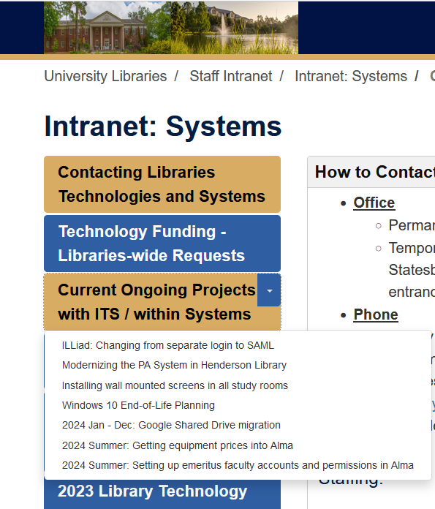
Easy to Find
The project plan can be linked from the intranet, get linked in emails, and get pulled up during meetings or conversations.
Notes:
The Georgia Southern University Libraries has a LibGuides intranet. For the Systems and Technologies page of that, the ongoing projects are posted to one area of that, and the completed projects are posted to another area. This lets people in the libraries learn to know where to go to find an overview of any project.
I’m also able to include a link to the project plan in any emails, and that way someone can quickly go to the overview information.

Slide 6
Parts
Executive summary (for big picture conversation and approvals):
Roles (project participants and roles)
Background
Details (for team members and closeout documentation):
Steps
Log
Possibly additional closeout information, if needed.

Slide 7
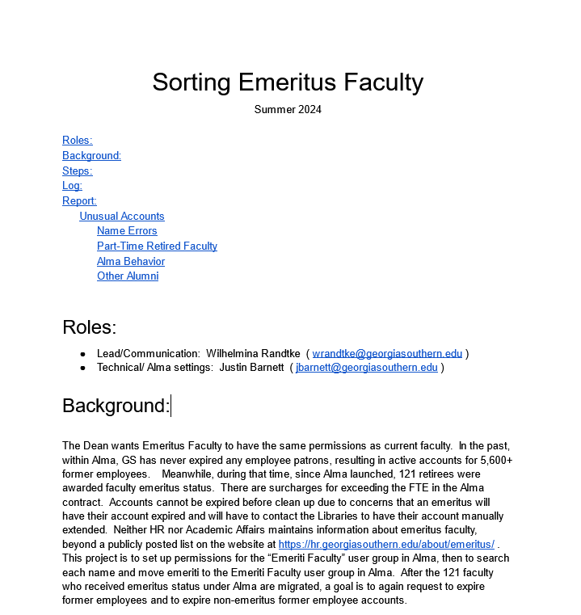
Project Plan:
Emeriti Faculty user group in the ILS
Notes:
Each project plan is one single Google Doc. A goal is to have a very concise summary in the form of “Roles” and “Background” section. That can be shown to peoples’ supervisors. And it lets me schedule to meet with anyone who I think should be in the loop, or whose employees will be involved. Essentially, “Roles” names the primary contact, and then names anyone who will be assigned tasks. Then “Background” gives a short summary of the project (1 to 3 paragraphs, with at a minimum the big picture goal of the project and why it’s occurring, and depending on the project, including more detailed statements about what is out of scope, in order to manage expectations and prevent scope creep). The goal is for “Roles” and “Background” to fit onto one page, or one screen, in case of doing a screensharing meeting.
“Roles” and “Background” typically wouldn’t change much. After the project gets scheduled, or there is a decision to do it, those would be locked in.
For some projects, where scope creep comes up, I will add a 3rd section to that executive summary area, with “FAQ” or frequently asked questions, which clarifies what is out of scope. Same thing for some projects where
Then, in a more formal project management arrangement, there might be tasks assignments, kanban boards, cards or tickets, and lots of detail. Libraries systems is not managing that workflow process. Instead, when we are tapping into skills from main campus, we will use their ticketing system. We do try to track that detailed information in the longer part of the document. The typical sections are “Steps”, which is a steps document for the work, and which can be updated as issues come up.

Slide 8
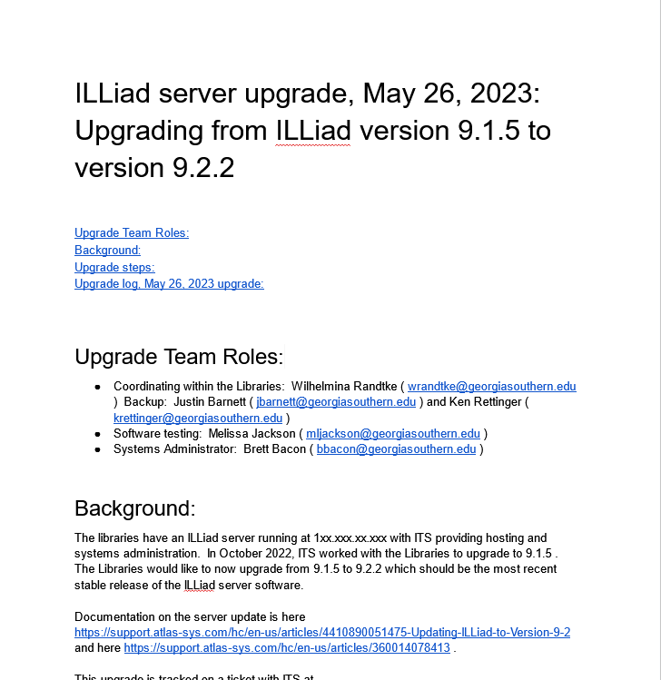
Project Plan:
ILLiad Server Upgrade
Notes:
This is another sample project plan. This is for a routine server upgrade. Routine upgrades is something commonly initiated by Libraries systems, where the Libraries are walking it through IT and are working with stakeholders to walk it through the libraries.
Similar to the other project plan, there is a “Roles” section and a “Background” section to be able to explain the project to anyone within the Libraries in terms of: What is the goal? and, What is the time commitment for or impact on specific employees?

Slide 9
Notes:
Really key things about these project plans is trying to keep that executive summary short. Even for complicated projects, people have the bandwidth that they have, and being concise is often better. When needed, like with the long data reports on the Emeritus faculty account set ups, we are able to “show the work” in the steps section and then in a log or data report.
I hope this helps you to find ways to do project management when you are in the hierarchical organization.

Slide 10
Sources
Project Management Institute (2000). A guide to the project management body of knowledge (PMBOK guide) (1st ed.).
Project Management Institute (2021). The standard for project management and a guide to the project management body of knowledge (PMBOK guide) (7th ed.).
Agile Alliance, Beck, K., Beedle, M., van Bennekum, A., Cockburn, A., Cunningham, W., Fowler, M., Grenning, J., Highsmith, J., Hunt, A., Jeffries, R., Kern, J., Marick, B., Martin, R.C., Mellor, S., Schwaber, K., Sutherland, J., Thomas, D. (2001). Principles behind the Agile Manifesto. https://agilemanifesto.org/principles.html

Slide 11
Publicly posted project plans:
A taste of project management to better support cross functional projects in a large academic library
Wilhelmina Randtke, Head of Libraries Technologies and Systems, Georgia Southern University Libraries
American Library Association Core Project Management Interest Group Session, Virtual, July 11, 2024

