Slide 1
Software Maintenance:
Planning a server upgrade - a library perspective.
Wilhelmina Randtke, Head of Libraries Technologies and Systems, Georgia Southern University Libraries
Melissa Jackson, ILL Librarian, Georgia Southern University Libraries
Georgia Library Association Conference, October 4-6, 2023, Athens, GA
Notes:
Wilhelmina and Melissa: introductions
Contact Information:
wrandtke@georgiasouthern.edu, mljackson@georgiasouthern.edu

Slide 2
Benefits of an Upgrade Plan and Testing Plan
Notes:
Wilhelmina
First off, why would you want to have a plan for upgrades and testing?

Slide 3
Benefits of planned upgrades and testing
Better service: Anything special that your library is doing will get attention early and comprehensively. (ex. something unique that we do is to have multiple locations in ILLiad for campuses in Savannah and Statesboro)
Better scheduling: You can plan out the time to do testing, instead of having unscheduled fixes later.
  Typically, schedule testing just after a planned change (ie. routine upgrade when Atlas does a release).
Notes:
Wilhelmina

Slide 4
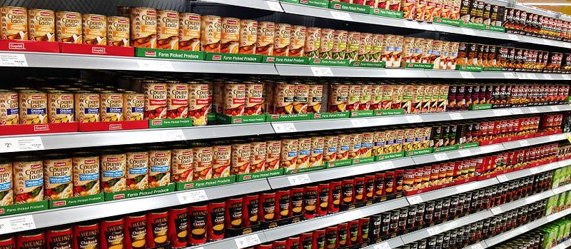
Upgrading and testing “off the shelf software”
Notes:
Wilhelmina
These same benefits apply to “off the shelf” software.
Pic from https://commons.wikimedia.org/wiki/File:Faced_products_on_a_supermarket_shelf.JPG (CC-BY-SA)

Slide 5
Examples of configured “off the shelf” software at Georgia Southern
ILLiad (customization = Add Ons, multiple OCLC symbols with separate databases for each campus)
Discovery Tool Primo VE (customization = facets on search are configured for our physical buildings and collections)
Student printing with PaperCut (customization = printing from PDF plus .docx, sending prints to a specific building)
Lots of off-the-shelf software with Georgia Southern’s special settings
Notes:
Wilhelmina
At Georgia Southern, we have lots of off the shelf software where we aren’t writing code or doing development, and we need that software, we configure it by clicking through settings.

Slide 6
Upgrade steps
Notes:
Wilhelmina
Upgrades will tend to follow a set of basic steps

Slide 7
Upgrade steps (for all software)
Prep (communication, disable logins, take the service offline)
Upgrade
Test
  If testing finds problems, fix problems.
  Once testing no longer finds problem, go live.
Launch
Testing will be different for every piece of software, and has to be planned by someone who understands how the software is used.
Notes:
Wilhelmina
Doing a server upgrade will have these basic steps.
Prep
Upgrade
Testing
Launch
IT can take the lead in Prep, doing the upgrade, and launching to the public.
Prep should have a similar framework no matter what software it is. For communication, it will always look similar: identify who will be impacted by down time, and let them know ahead of time.
For the upgrade - like the tech of working with the code and server - the vendor or the open source community will have steps posted, and someone with a technical background should be able to work through notes.
For testing…. There are certifications in software testing. A huge part of getting certified in software testing is training in how to talk to someone who uses the software and to find out what is important about that software. With IT, probably, you will have someone you are working with who doesn’t have formal training in software testing. And, if you do have someone with formal training in software testing, they may not have time to go and interview you about how you use the software.
Ultimately, this 3rd step, testing is an area where the librarians working with the software have to take the lead.
(That’s why there’s a little more about testing in this presentation.)

Slide 8
Definition of Software Testing
= make sure the software does what it's supposed to do, without doing anything extra
Notes:
Wilhelmina
Definition from IBM, What is Software Testing? available at https://www.ibm.com/topics/software-testing .

Slide 9
Who is talking about software testing?
Notes:
Wilhelmina
So… in an upgrade, out of those broad steps, software testing is the area where librarians have to lead.
In contrast… who is talking about software testing?

Slide 10
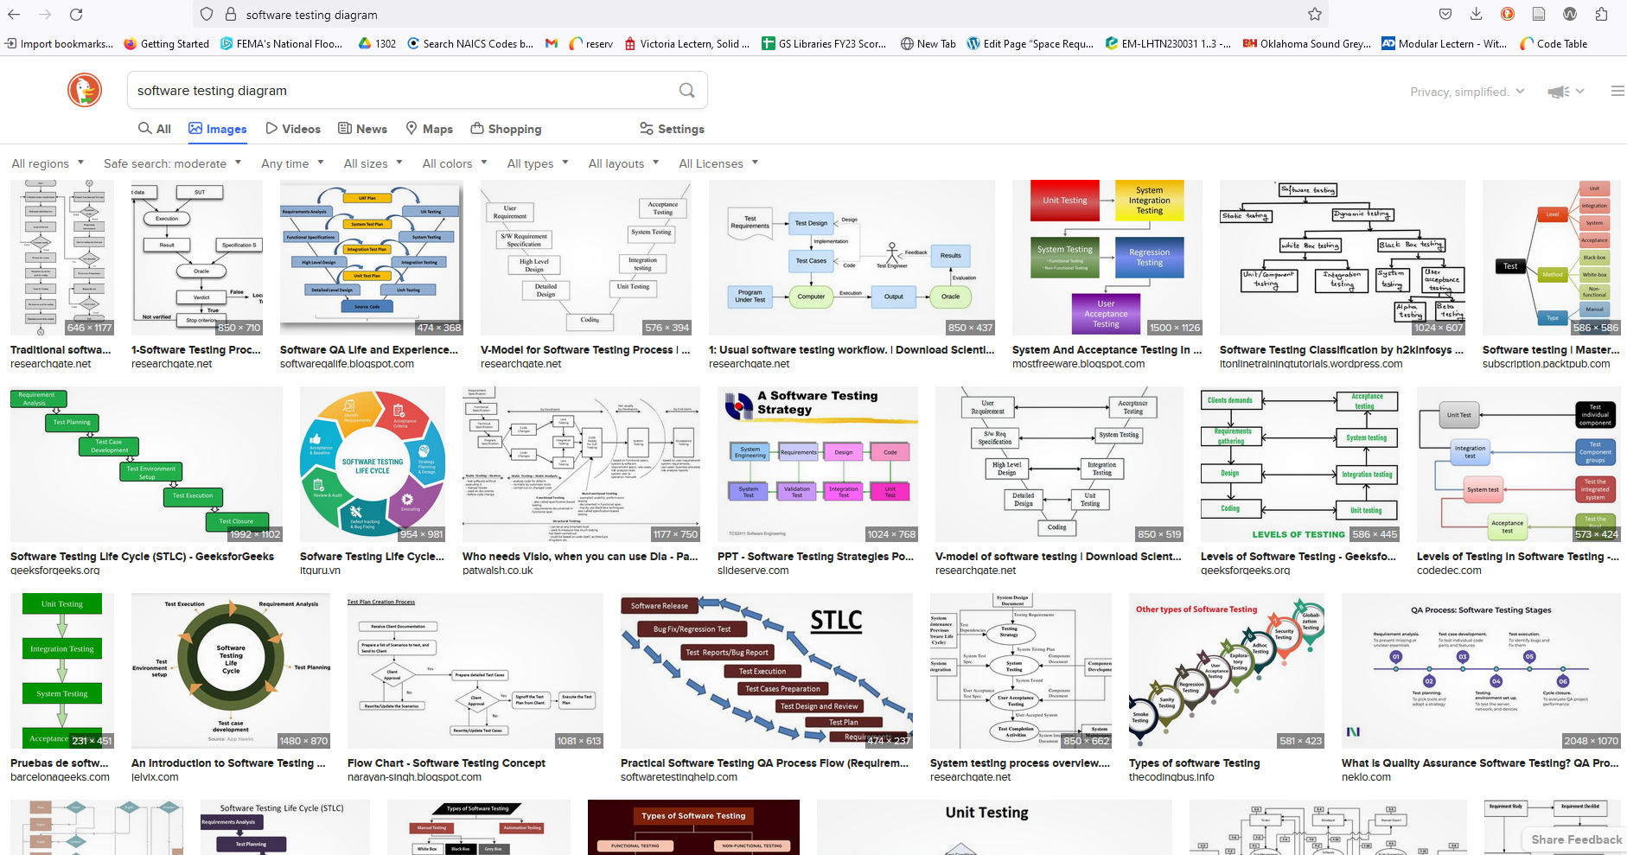
Who is talking about software testing?
Big complicated projects tend to post more info!
Notes:
Wilhelmina
As it turns out, big complicated projects are talking about software testing.
That is an image search for “software testing diagram”. These things are complicated, and if you pull them up and read them, each step actually breaks down into lots of steps.

Slide 11
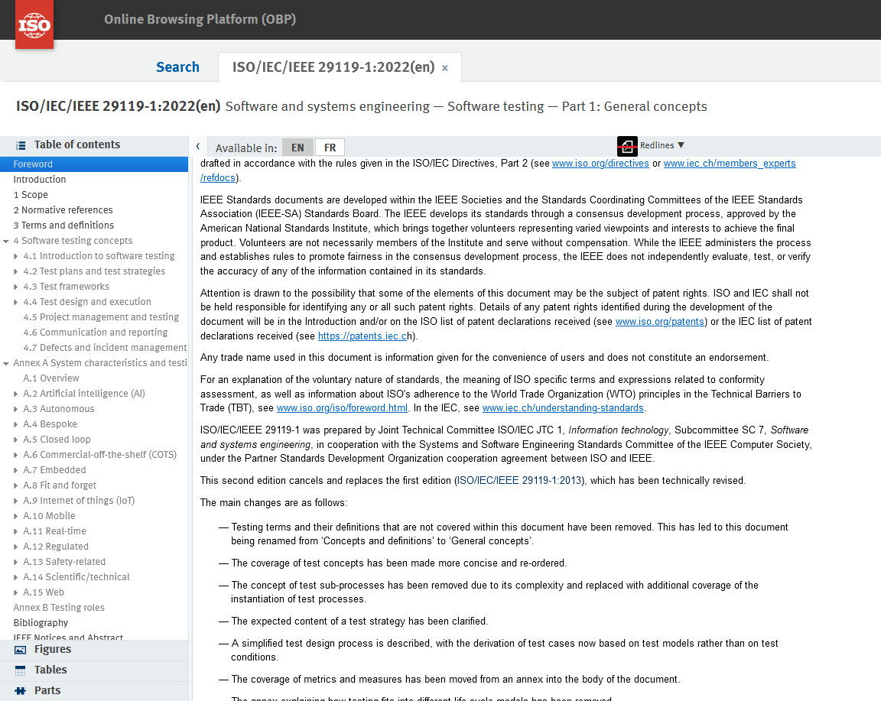
Who is talking about software testing?
Notes:
Wilhelmina
There is even an ISO standard for software testing. That’s at https://www.iso.org/obp/ui/#iso:std:iso-iec-ieee:29119:-1:ed-2:v1:en . It is hundreds of pages long. You can get it as a PDF, and the PDF is more than 1000 pages long!
Who has time to read this standard?

Slide 12
DevOps
Development
“The development phase includes all aspects of developing software code. In this phase, DevOps teams do the following tasks:
Select a development environment.
Write, test, review, and integrate the code.
Build the code into artifacts to deploy into various environments.
Use version control, usually Git, to collaborate on code and work in parallel.”
Operations
“The operations phase involves maintaining, monitoring, and troubleshooting applications in production environments.”
Definitions from: Microsoft, What is DevOps? (Jan. 24, 2023), https://learn.microsoft.com/en-us/devops/what-is-devops .
Notes:
Wilhelmina
Who has heard of the term “DevOps”?
DevOps is a contraction for “development” and “operations”.
This slide has definitions for development and for operations in the context of software.
The things to notice are that development is part of a more in depth process of “developing all aspects of software code”. Operations is about maintaining, monitoring, and troubleshooting applications in production environments.
Fundamentally, instructions about software testing, literature about software testing, and certifications in software testing, are coming from the development field. Meanwhile, all the software we run at Georgia Southern is more like operations. For ILLiad, we get the code from Atlas and OCL and we run it on a server in house. For the discovery tool, Primo VE, it’s fully hosted by Ex Libris, and sometimes their updates can make it to where our configuration settings get wiped.
In the library, we have a need to do software testing. Meanwhile, software testing is so so closely associated with this different area of software, that there isn’t training for where we are at over in operations.

Slide 13
Who is talking about software testing?
If a test procedure covers every workflow…
… it’s going to be long and complicated.
If a test procedure covers someone else’s workflow…
… it probably doesn’t cover your workflow.
Notes:
Wilhelmina
Think about that complexity in development. Software development is about everything that a piece of software could do. Trying to test every single thing that ILLiad could do would not be realistic at Georgia Southern. We are all wearing many hats. And, we aren’t even necessarily using all the features in a piece of software. An example is ILLiad has various Add Ons. We are using just a few of those. The need at the libraries is to test what’s most important to us.

Slide 14
A Simple Approach to Testing
Notes:
Wilhelmina

Slide 15
A Simple Approach to Testing
Take your own library's training material.
Click through each task that you train employees or patrons on.
Notes:
Wilhelmina
For planning out how to do testing, these steps have tended to work with most software:
Get your library’s training materials together.
Look for each single task that you train on for that software.
Make a list of those tasks, and that is your testing plan.

Slide 16
A Simple Approach
You control the time commitment.
  You can predict how long it will take, and you can prioritize what to test.
You will test out your library’s most important tasks. If you train someone on it, then it’s important to you.
Your instructions probably already have screenshots.
  If anything goes wrong, you have a screenshot of what was supposed to happen. You can send that to tech support. You can send that to someone who doesn’t work at your library. Tech support can see exactly what was supposed to happen.
Anything custom at your library is already in your instructions.
  Your locations are there. Quirks about how patron identifiers are assigned are there. What options are in a customized drop down are there.
Notes:
Wilhelmina

Slide 17
ILLiad upgrades - the easy way
Notes:
Melissa

Slide 18
Georgia Southern University intro
GSU is classified as an R2 Carnegie institution, offering doctoral degrees with high levels of research activity.
The main campus is in Statesboro, with a second location in Savannah and a third at the Liberty Center at Fort Stewart.
GSU has 708 Tenured and Tenure track faculty members.
As of Fall 2023, enrollment was 26,488 over three campus locations.
Notes:
Melissa
Mention consolidation in 2018, and I became the official ILL Librarian for all campuses in 2021.

Slide 19
Georgia Southern University Libraries
GSU uses ILLiad as its primary ILL software, and is self-hosted. It has two libraries in OCLC:
Henderson Library (GPM) on the main campus in Statesboro, and Lane Library (GAC) on the Armstrong campus in Savannah.
The ILL Librarian is located on the Armstrong campus, but has full access to ILLiad for both campuses.
Notes:
Melissa
GPM ILL has four people, GAC ILL has two. Both locations use RAPID and Reprints Desk in addition to ILLiad.

Slide 20
Old upgrade workflow ?
Due to regular staff turnover, we kept having to re-teach ourselves how to upgrade.
We would pull from 50 different onboarding and staff training files to figure out what to do. Plus beg for help on the listserv and from OCLC.
Additionally, we were at the mercy of the University’s ITS department.
Notes:
Melissa

Slide 21
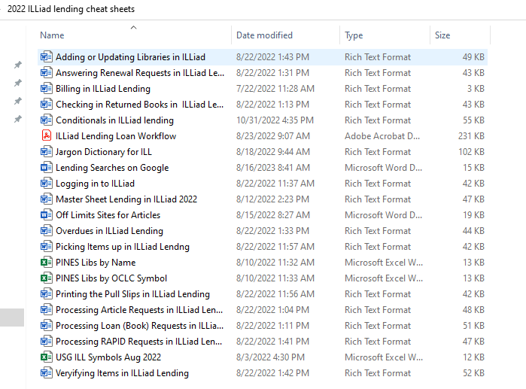
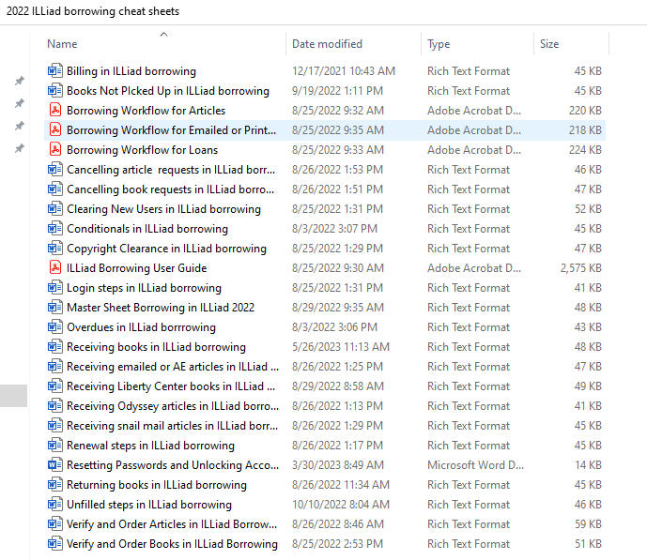
Onboarding documentation examples
Notes:
Melissa

Slide 22
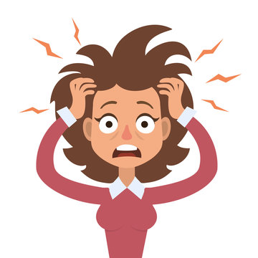

How we felt about upgrading
Notes:
Melissa

Slide 23
Enter Mina!
When Wilhelmina came to GSU as the new head of Libraries Technology and Systems she knew this was unsustainable. She worked with ILL staff, Systems staff and University ITS to create a better process, and make sure every step was recorded for future reuse. The basic steps are:
Prep
Upgrade
Test
Launch
Notes:
Melissa

Slide 24
New workflow - much more straightforward!
PREP, part one
Schedule with main campus ITS: Provide basic information about workflow and expectations, confirm with ITS and answer any questions, choose a date.
Two weeks beforehand, the ILL Librarian sends a targeted email to the“power users” about the coming upgrade. 3-4 days before the upgrade, she sends the message to the power users again.
Notes:
Melissa
The ILL Librarian uses ILLiad reports to create two lists of regular, if not daily users: students and fac/staff. The latter is kept for future re-use.

Slide 25
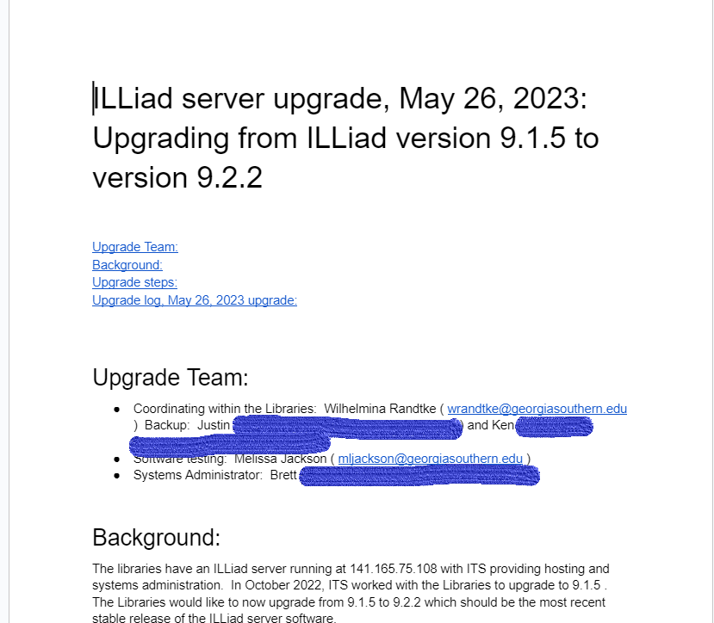
Prep:
Communication with the team
Notes:
Wilhelmina
Part of the prep is communication with main campus ITS. We have a different programmer assigned each time we do an upgrade. They have the tech skills. Whether they have the time to walk it through and coordinate the upgrade is a toss up. It’s not a given that main campus ITS will walk it through, and the University Libraries assume we will coordinate the big picture.
Part of prep was to write all this down. This is our Spring 2023 upgrade document. Basically, the first time we scheduled an upgrade, we wrote up the steps ahead of time. Part of this is the upgrade notes from the actual upgrade. Each time we do a new one, I can make a copy of this and make any changes based on what happened last time.
To start the upgrade process, I start a ticket with main campus ITS, and I include the this planning document with the ticket. I also copy paste the Background section into the ticket.

Slide 26
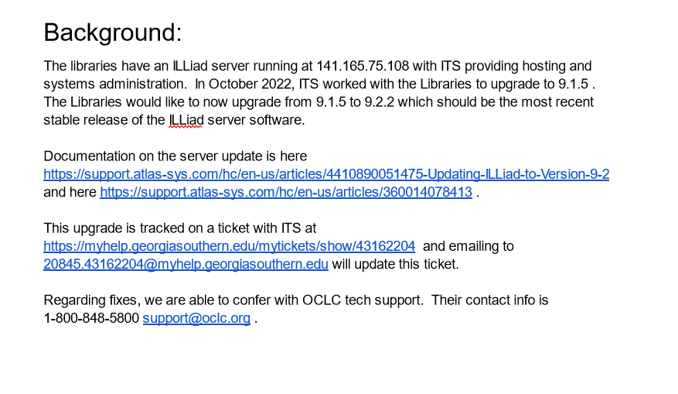
Notes:
Wilhelmina
That’s the Background section of the upgrade planning document. It has information about the previous upgrade - to help main campus ITS find any notes in their system. I will put information about the ILLiad server, and about what version of ILLiad we are going from and to. This lets ITS research the actual code part of the upgrade.
When I open the ticket, the programmer with ITS can use those links to research and plan for the code part of the upgrade.

Slide 27
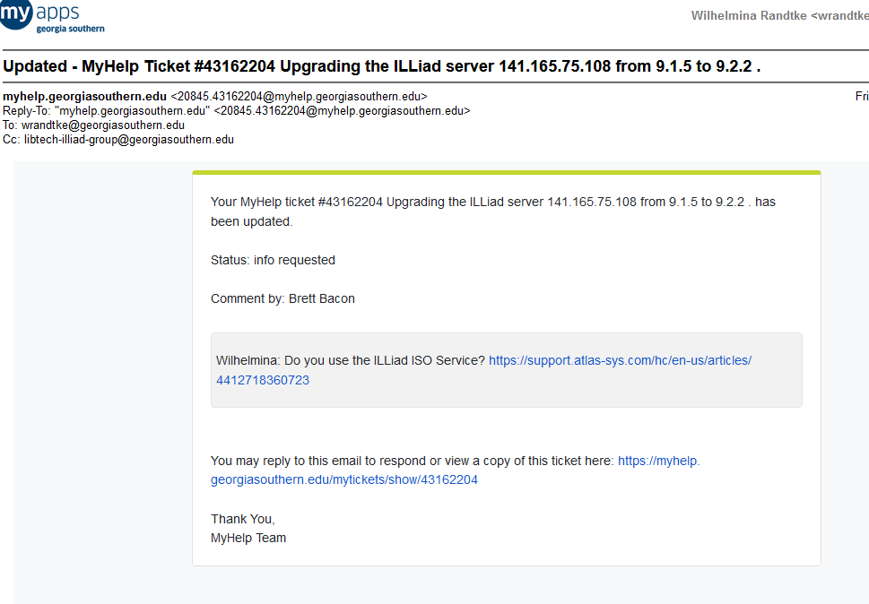
Prep - communication with main campus ITS
Notes:
Wilhelmina
We will schedule the upgrade with ITS. Ahead of time, ITS will work through instructions from the vendor or the open source community, and may ask questions based on research. Here’s where the programmer asked a question about something in Illiad to where the upgrade instructions are different based on whether or not we are using this. When these questions come in, I will tend to research these, look at settings in Illiad, and then email to Melissa to confirm the results of my research.
I also will update the upgrade steps to include the information - that we are not using this feature - so that on the day of the upgrade, that info is easy to find if it comes up again.

Slide 28
New workflow - much more straightforward!
PREP, part two
The day before: the ILL Librarian sets both campuses to non-supplier in ILLiad, so no lending requests are lost if a rollback is needed. Systems staff puts a message on ILLiad login page saying "ILLiad is undergoing maintenance on xx/yy/zz . Please do not submit requests on that date."
Notes:
Melissa

Slide 29
New workflow - much more straightforward!
PREP, part three
The day before, continued:
The ILL Librarian sends a brief email to the faculty/staff listserv letting them know about the imminent upgrade. Wording can be pulled from the targeted email sent to power users. She also sends the email to power users one final time.
Notes:
Melissa

Slide 30
Example of the email to power users
Hi everyone!
We will be doing an upgrade of the ILLiad servers on XX/YY/ZZ first thing in the morning. I'm sending this email to ask all of you to NOT place any requests in ILLiad on that date until you get the all-clear from me.
We will take a snapshot of the database at 8 AM, and then get to work. If things go wrong we'll roll back to the snapshot and try again. Any requests added during the attempt will be lost forever. This is why I'm asking you to stay out of ILLiad - I don't want you to lose your research.
Wish us luck!
Melissa Jackson, ILL Librarian
Notes:
Melissa

Slide 31
New workflow - much more straightforward!
UPGRADE
At 8 AM the University ITS department makes a snapshot of the database and does the upgrade.
All library employees and patrons stay the heck out of ILLiad during this process.
Notes:
Melissa

Slide 32

How I feel at this stage
Notes:
Melissa

Slide 33
New workflow - much more straightforward!
TEST, part one
Once complete, the ILL departments on both campuses test the upgrade. If there are new patrons to be cleared, they test that as well.
If there are any problems, they call for Systems staff. Systems and ITS will grab the log files, roll back to the snapshot and try again.
If no problems, we’re done!
Notes:
Melissa
ILL staff act as borrowers and place requests from the patron login page. (I usually do 1 article and 1 book.) Then sign into ILLiad to make sure they came through, and process them.

Slide 34
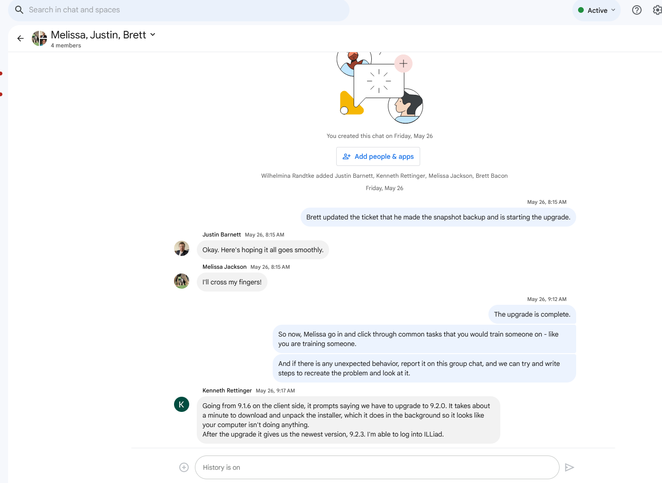
Upgrade:
The chat chain
Notes:
Wilhelmina
Communication on the day of the upgrade: We do a group chat. That has everyone in Libraries Systems on it, the programmer from main campus ITS on it, and Melissa our ILL librarian on it. When we’ve done the upgrade, we have a different programmer from ITS each time. Sometimes they will go on group chat, sometimes they don’t post, and they do updates to the ticket only. We also have an internal listserv, such that when the programmer from main campus ITS updates the ticket, it emails everyone working with ILLiad at the libraries.

Slide 35
New workflow - much more straightforward!
LAUNCH
Systems staff replaces the message on the ILLiad login page with an ‘all clear’ message.
The ILL Librarian sends the all-clear by email to the faculty/staff listserv and to the power users.
The ILL Librarian turns lending back on in OCLC.
Notes:
Melissa
When over, the ILL Librarian collapses in relief. After a few minutes, she gets back to work. :)

Slide 36
Example of the all-clear email to power users
Hi everyone!
We’ve finished the ILLiad upgrade, and everything went well. Please feel free to log back into the software and ask for anything you need. The message on the login page is being updated and word is being spread online that we’re back in business.
Happy researching!
Melissa Jackson, ILL Librarian
Notes:
Melissa

Slide 37


How we feel afterwards
Notes:
Melissa

Slide 38
Benefits to this method:
We can do this on our schedule, based on Atlas releases.
We can structure the process to suit our needs, versus what a big corporation or R1 international institution would require.
Steps and documentation are saved in a shared folder for quick access.
Requires minimal time commitment from the University’s ITS department.
Easy to teach new employees how it’s done.
Notes:
Melissa
This process also uses minimal involvement of campus ITS. Since we need so little of their time and know exactly what path to follow, they’re more willing to work with us.

Slide 39
Handout and slides
Additional copies of the handout for the ILLiad portion of this presentation (as well as the slides) will be available shortly in our institutional repository:
https://digitalcommons.georgiasouthern.edu/lib-facpresent/
Search by Wilhelmina Randtke or Melissa Jackson in the box to the left to find them. Or contact Melissa at mljackson@georgiasouthern.edu to get them emailed to you.
Notes:
Melissa

Slide 40
Questions or Comments?
Please feel free to contact Wilhelmina Randtke (wrandtke@georgiasouthern.edu) and/or Melissa Jackson (mljackson@georgiasouthern.edu).
Notes:
Melissa

Slide 41
Software Maintenance:
Planning a server upgrade - a library perspective.
Wilhelmina Randtke, Head of Libraries Technologies and Systems, Georgia Southern University Libraries
Melissa Jackson, ILL Librarian, Georgia Southern University Libraries
Georgia Library Association Conference, October 4-6, 2023, Athens, GA
Notes:
Contact Information:
wrandtke@georgiasouthern.edu, mljackson@georgiasouthern.edu

