Slide 1
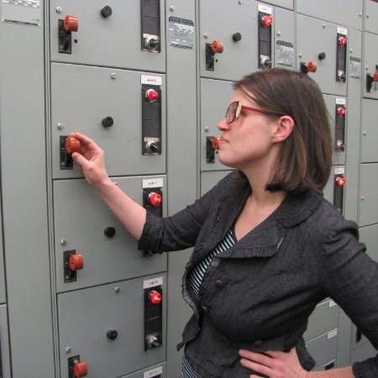
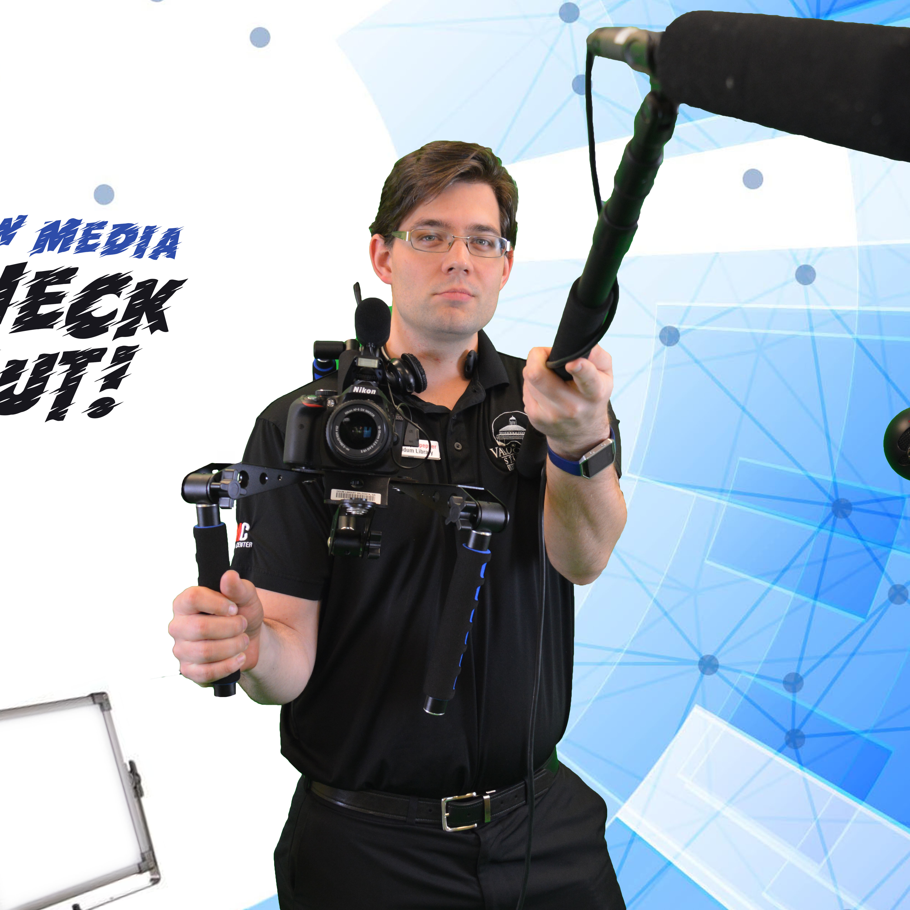
Growing & Maintaining Your Tech Collection: A Guide for Libraries Large & Small
Kyle W. Culpepper Director of NMC Valdosta State University Odum Library | New Media Center
Wilhelmina Randtke Head of Libraries Technologies & Systems Georgia Southern University

Slide 2
Agenda
Single Library​ Perspective
About Our Support Area(s)
Type of Inventory
Cost to Maintain
Circulation Policies
Future Initiative
Q&A
Valdosta State University New Media Center
Multi-Library Perspective
Georgia Southern University Libraries

Slide 3
About Our Support Area(s)
Odum Library New Media Center

Slide 4
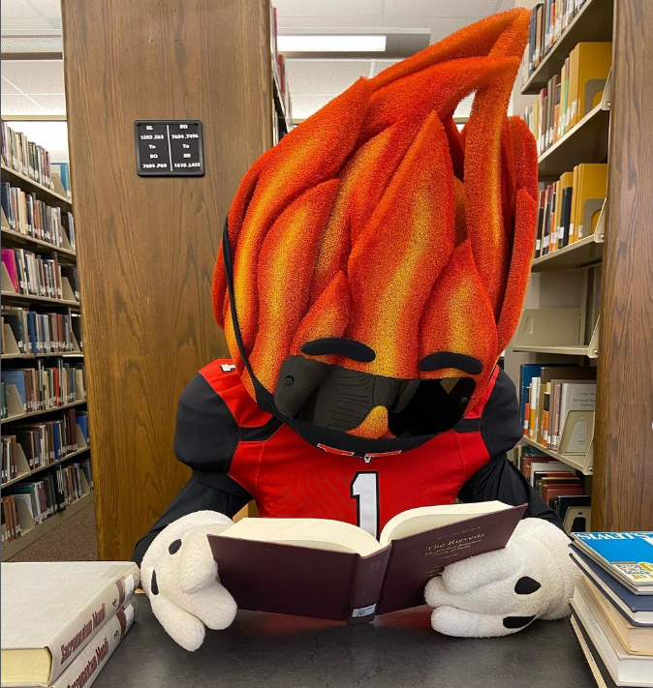
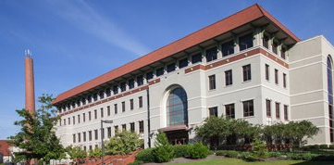
Valdosta State University Odum Library

Slide 5
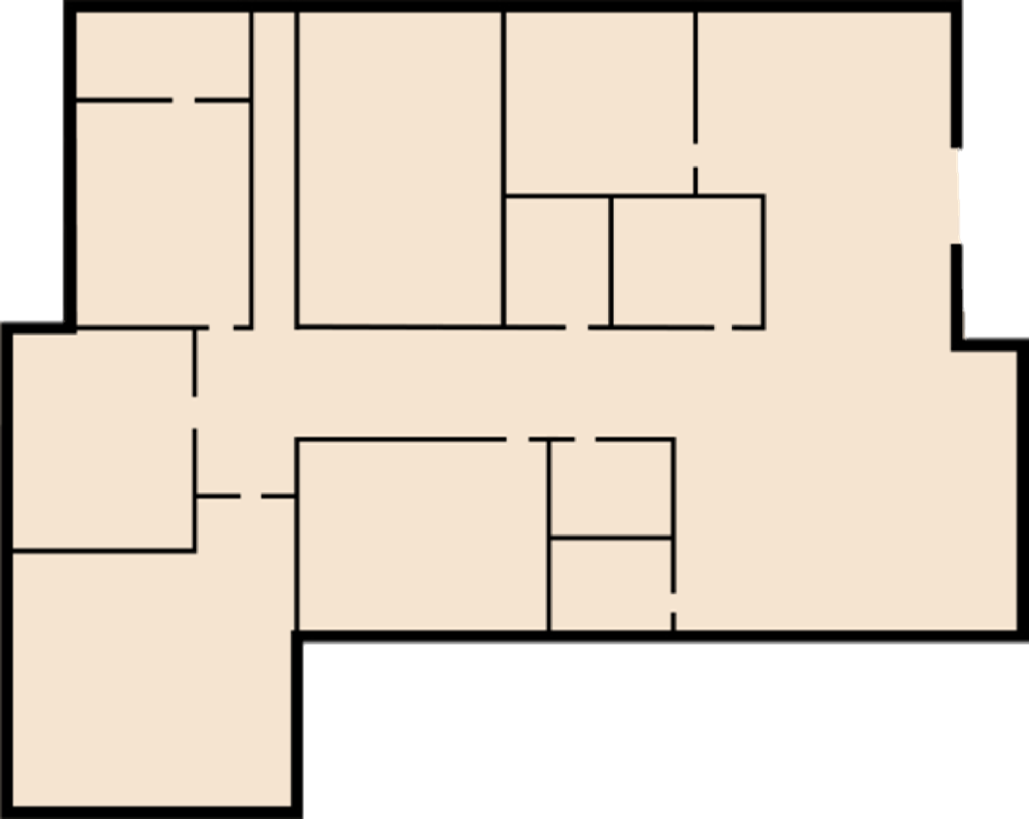
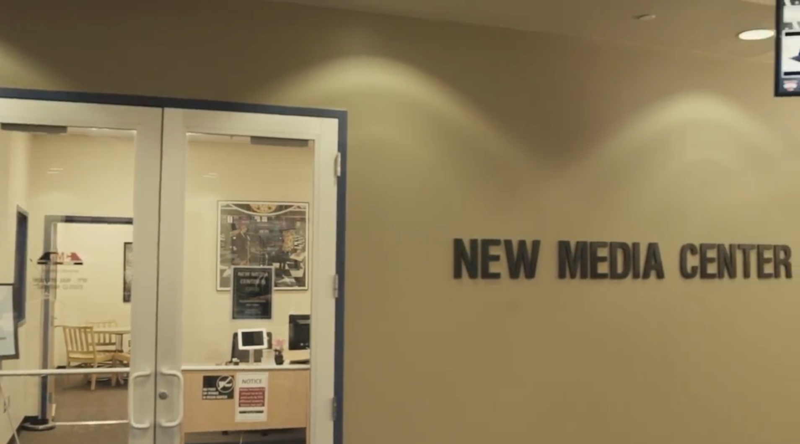
Emergency Exit
Help Staff
PCS
Mac Lab
Equipment Circulation
Entrance from 1st floor of Odum Library South Side
Edit Suite
Director
Help Staff
3D Printers
Lightboard Studio
Edit Suite
Open Lab
Multimedia Lab
Edit Suite
NMC Classroom

Slide 6
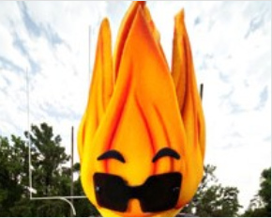
Current NMC Team
Kyle Culpepper
Joel Dion
Student Workers
NMC Director
Instructional Technology Specialist
6-8 Student Assistants
1 Graduate Assistant (If funding is available)
1 Intern (Student Course Outreach)

Slide 7
Be the heart of multimedia support at VSU, dedicated to serving our students, staff, & faculty academic needs. We empower our patrons by granting them access to A/V technology, software tools, and expert guidance, unlocking the boundless possibilities of digital media for their academic journeys.
Mission Statement

Slide 8
NMC Rooms
3 Editing Suites
1 Green Screen Room
1 Lightboard Studio
1 Lab
3 Classrooms
Utilization
2,648 HOURS TOTAL
322 VIDEOS CAPTURED
27 WORKSHOPS

Slide 9
NMC PRINT SERVICES
1,467 Posters
5,325 (g) 3D Prints
14,322 Copies
560 Faxes

Slide 10
25,163 VISITORS ANNUALLY
3,533 LOANS
1,535 RENEWALS

Slide 11
About Our Support Area(s)

Slide 12
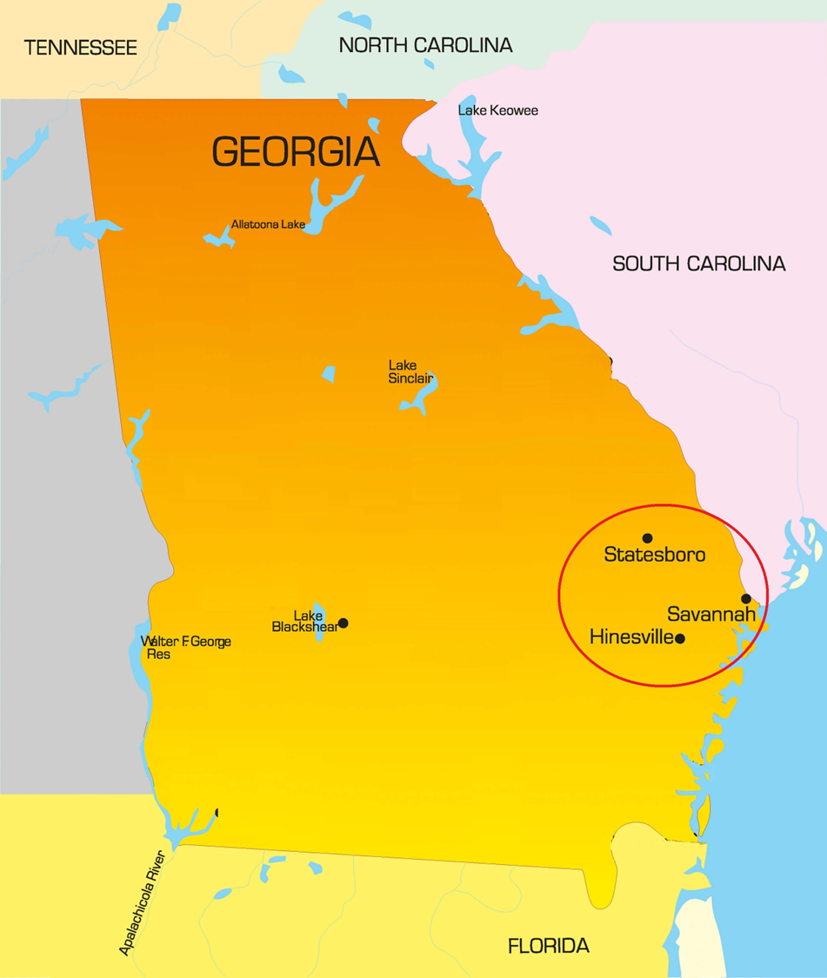
Georgia Southern University Libraries
3 campuses served
The University Libraries operate 3 buildings on 2 campuses
Learning Commons in Savannah
Lane Library in Savannah
Henderson Library in Statesboro

Slide 13
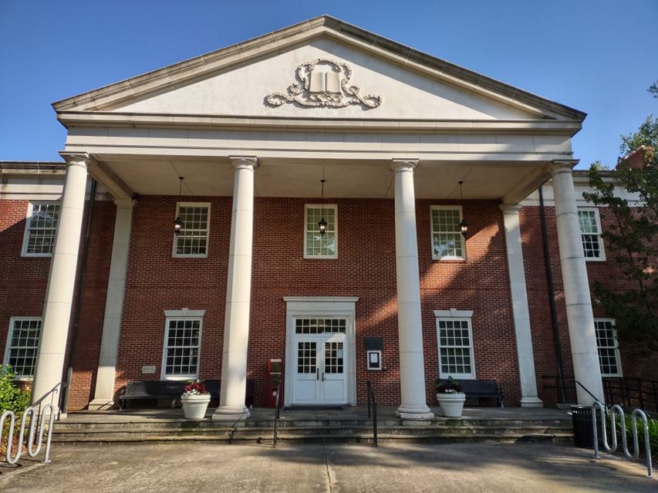
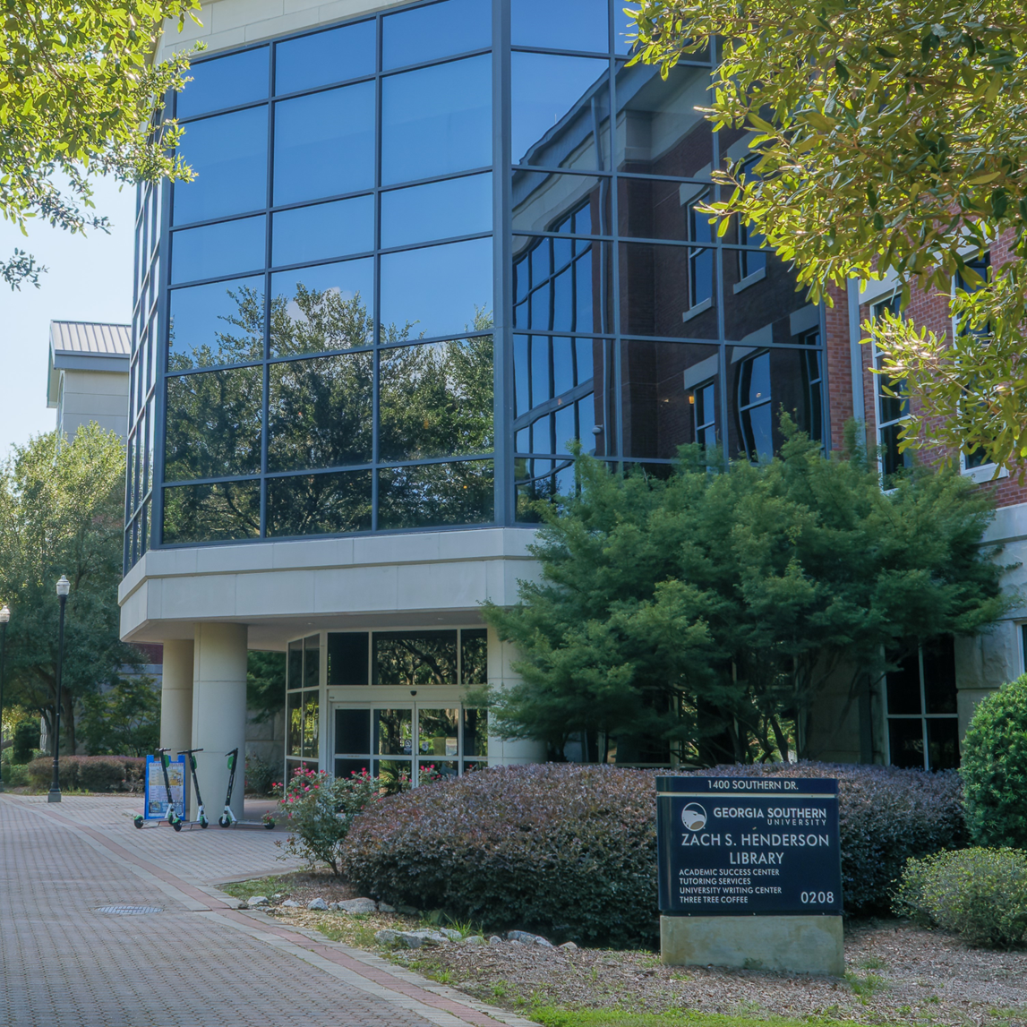
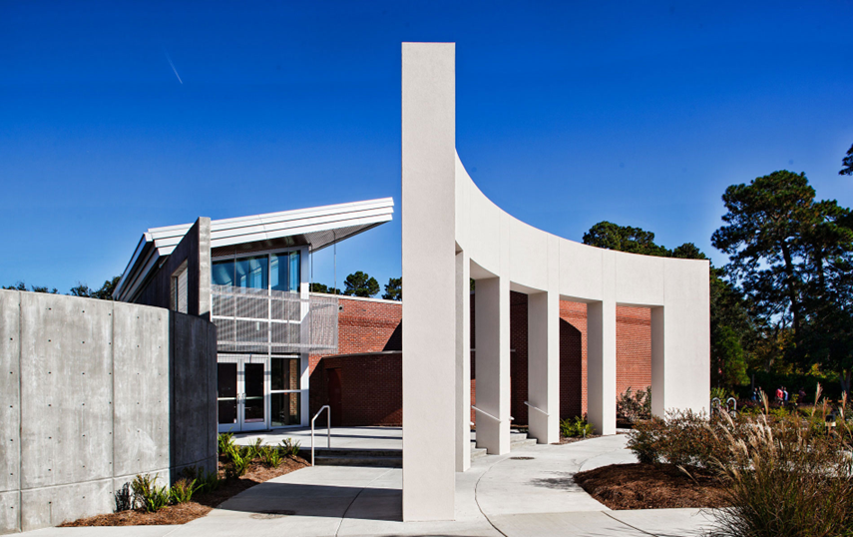

Slide 14
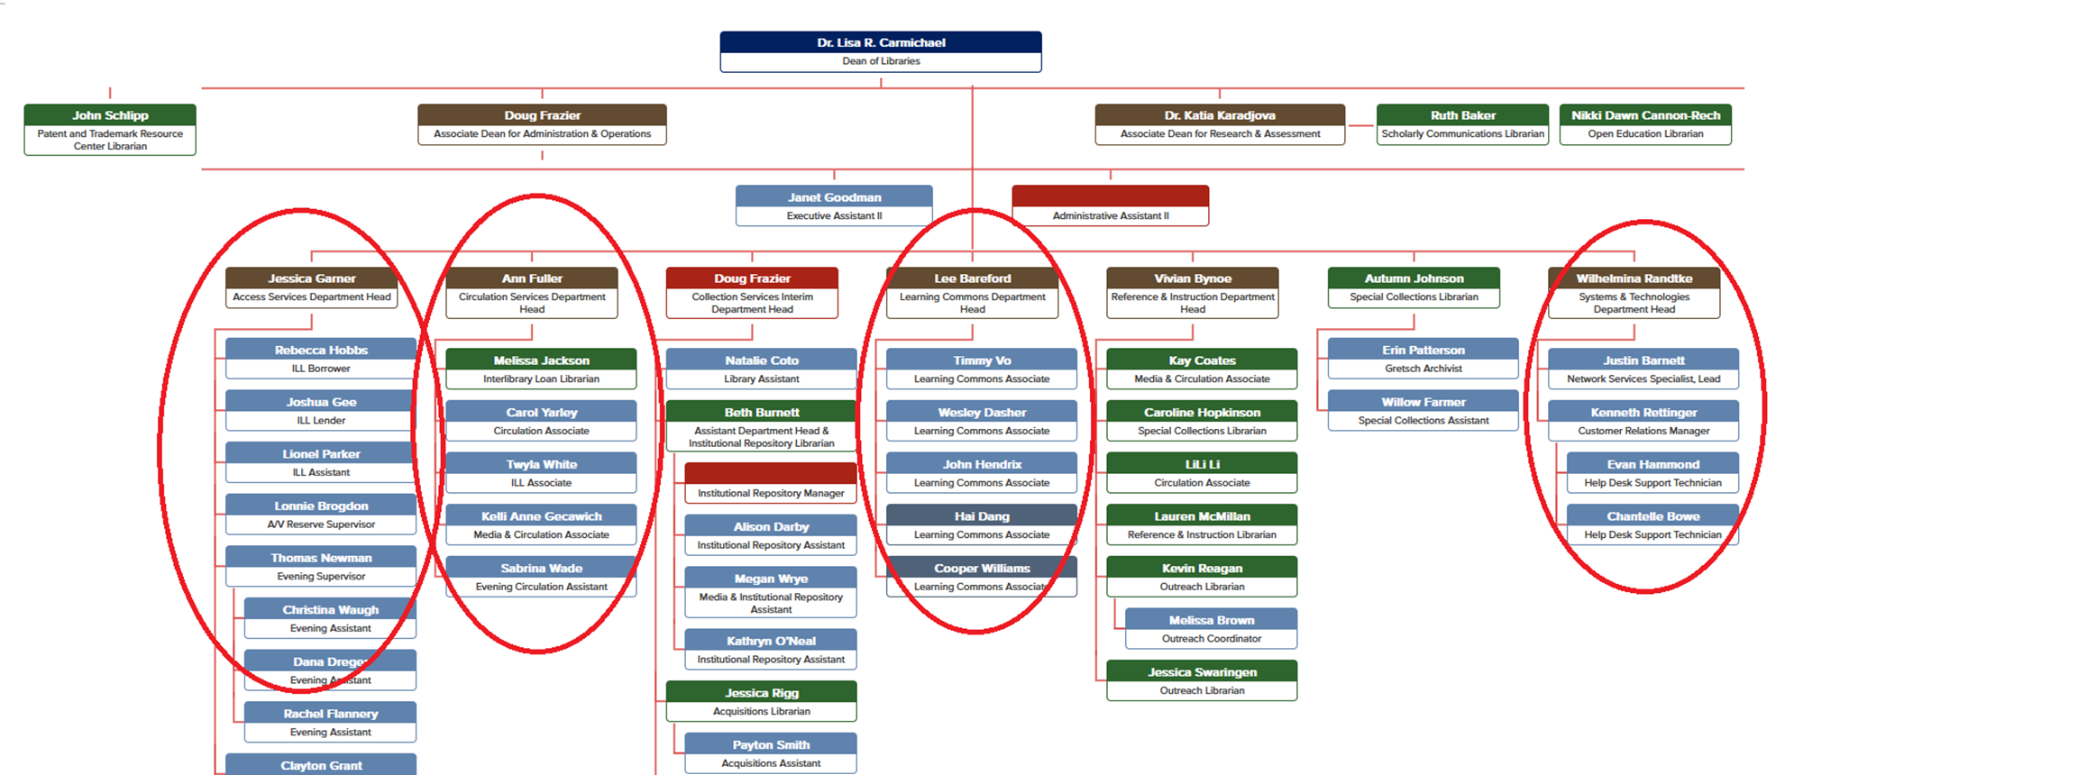
Georgia Southern University Libraries: Technology checkout:
Managed through 4 separate departments – 3 service desks and Technologies and Systems

Slide 15
Type of Inventory
Odum Library New Media Center

Slide 16
Equipment Available
886 items available
Laptops: (HP ProBook 440/450 or HP 255) w./ Absolute Tracking
107 Student Laptops
57 Faculty Laptops
30 Cart Laptops
Cameras: (Photography and Videography)
31 DSLR (Single Lens, Dual Lens) (Canon EOS Rebel T7, Nikon D32xx, Lumix FZ80)
10 Camcorders and 16 Video Kits
8 Smart Phone Lapel Kits
7 GoPros

Slide 17
Equipment Available Cont.
8 Webcams
Presentation Equipment
8 Block Rockers & quarter-inch microphones
6 Drawing tablets
Video/Audio Material
Laptop Peripherals
4 Tascams
3 Shotgun mics
2 ring lights, 9 Light Kits
4 Gimbles
5 Snowball Microphones
15 Card Readers
5 PA Systems, 5 extra mics/xlr cables
9 Projectors
5 Aux, 9 USB Headphones
20 PPT Presenters
39 Easles
13 Power Strips, 15 Power Extension Cords
3 Wireless Microphones
16 tripods
Backdrop Screen (Black, Green, White)

Slide 18
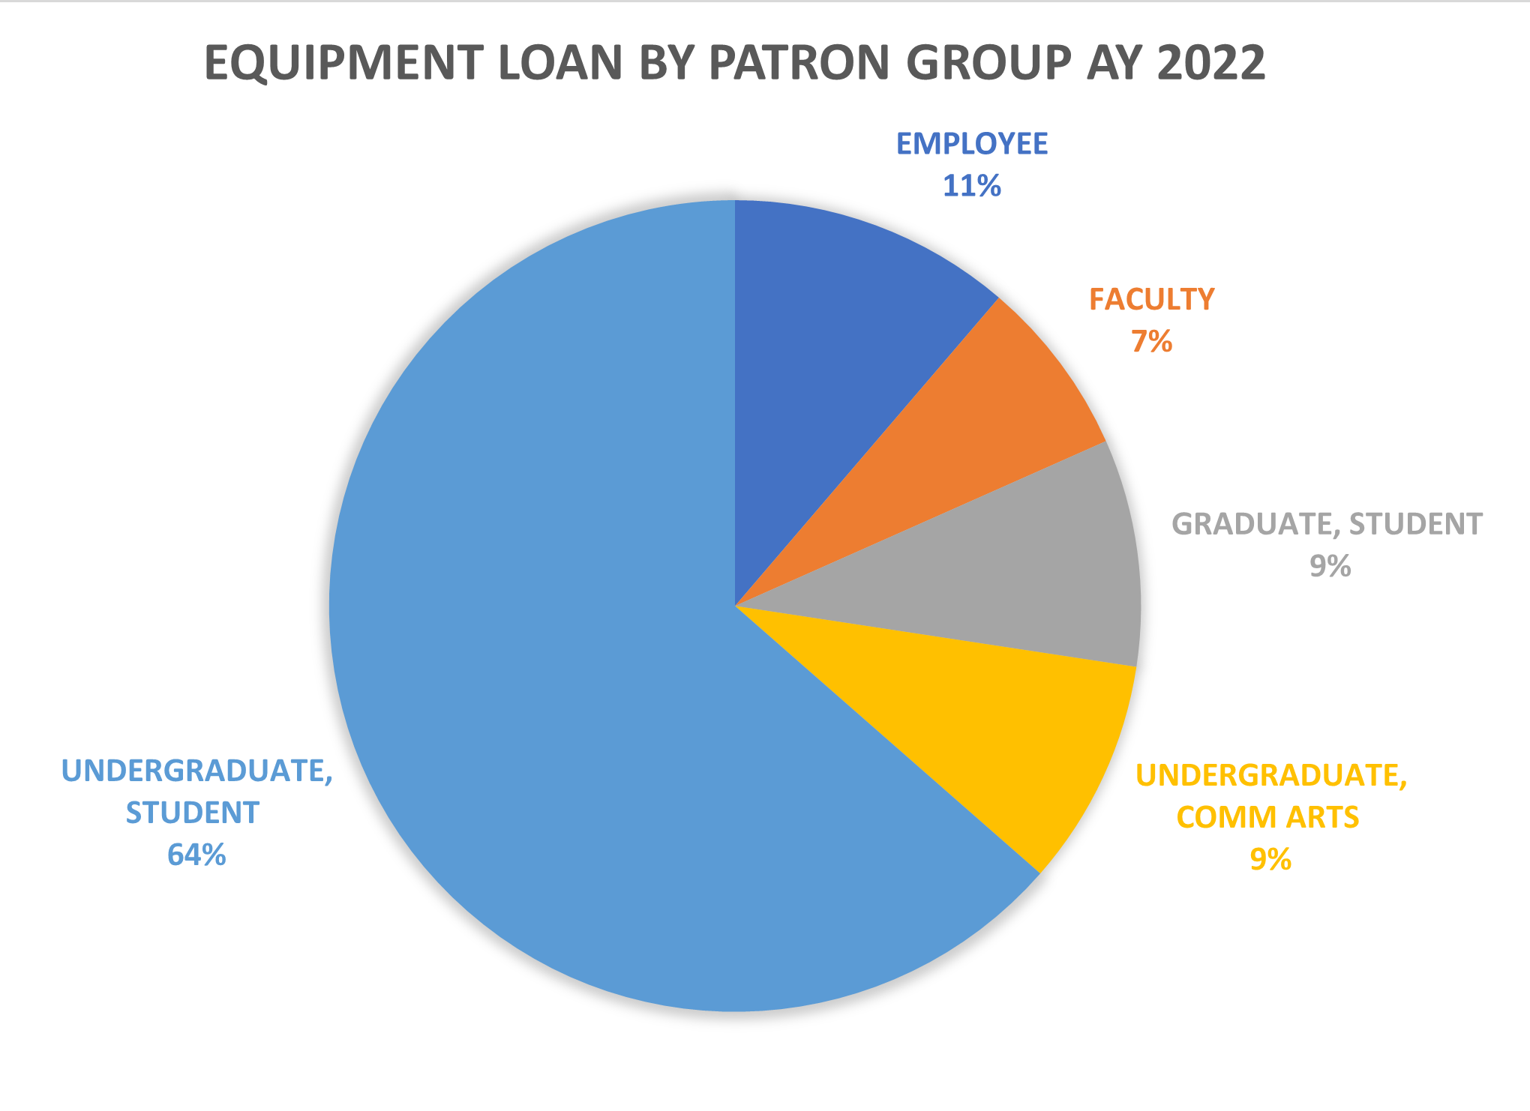
NMC User Base & Needs AY 22
3,533 Loans | 1,535 Renewals 32,168 Days Loaned
47.85% laptop loans
8.51% Laptop peripherals
16.85% Presentation Equipment
18.99% Cameras and A/V
6.24% Cables & Chargers
1.56% Other

Slide 19
Types of Inventory

Slide 20
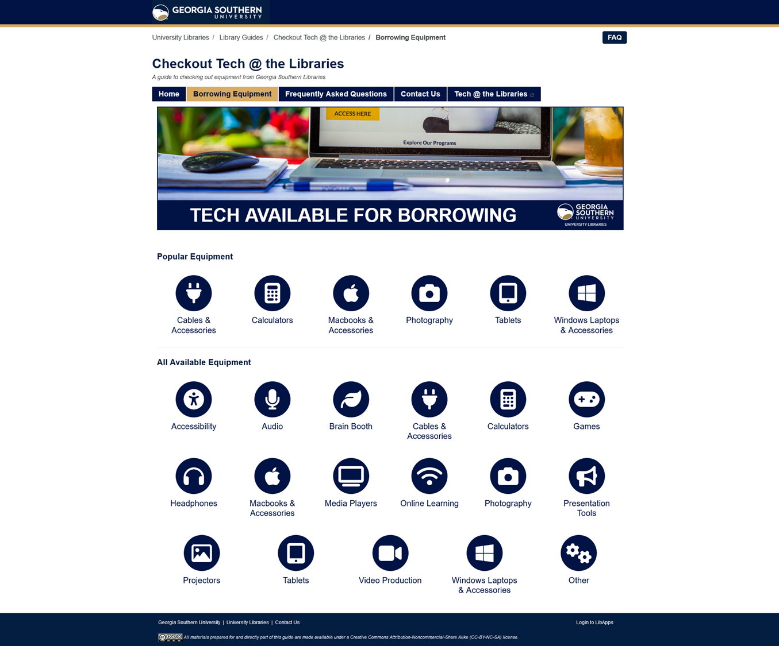
Types of Inventory:
Laptops
Cameras
Camera accessories (lighting kits, tripods, greenscreen kits)
Graphing calculators
Chargers and Cables

Slide 21
Laptops
Henderson Library (Statesboro)
Approximately 120 Windows laptops (some are very overdue, but not yet written off). 111 circulating.
Lane Library (Savannah)
47 Windows laptops
12 Macbooks
Learning Commons (Savannah)
9 Macbooks
Approximately 190 total checkout laptops
All are primarily for student use.

Slide 22
Equipment Offerings
Approximately 190 checkout laptops
40+ graphing calculators
DSLR cameras (Canon EOS)
Headphones
Microphones (high end Blue Yeti mics)
Projectors
Tablets and iPads
Dongles and phone chargers

Slide 23
Cost to Maintain
Odum Library New Media Center

Slide 24
NMC Inventory Cost Breakdown
Equipment in Inventory: $253K+
Support Budget: $3K - $5K
Growth Budget: $15K+
Equipment Circulation Software: $93K+
Cost to NMC: $0
Staffing: ~ $170K
Students
Full Time Staff Combined + Benefits

Slide 25
End-of-Year Projects (FY 2019)
Goals:
Upgrade Faculty Laptop Pool to at least 50 more (~$52k)
Increase Student Laptop Pool by at least 26 laptops and Surplus Netbooks (~$23K)
Success:
Went from 9 Faculty Laptops -> 57 Fac. Laptops
Went from 52 Student Laptops -> 87 Student Laptops
Mitigate Loss of Equipment
Purchased Absolute Tracking Software

Slide 26
End-of-Year Projects (FY 2020) COVID Happened!
Goals:
Craft Shipping Program
Provide Semester Loans to All
Success:
Added 200 MiFi Units to Circ. (3/23/2020) +42 more (6/24/2020)
Shipped 157 MiFi/Laptops to Students (End of May 2020)
Supply MiFi Units
Boost Laptop Inventory 300+ (~70+ Temp + 72 HP 255 + 20 ProBook 450 G7s)
Cost Funded from (EoY & Government Support) ~$102K

Slide 27
End-of-Year Project (FY 2021) COVID STILL!
Goals:
Phase out
Semester Loans to All
Success:
6 Shipments total (Ended May 2021)
Supply MiFi Units
Returned Dept. Laptop Inventory (70+) (End June 2020)
137 Student Laptops & 57 Faculty Laptops
Shipping Program
Re-Organize Inventory
Add 5-Yr License of Absolute
12 DSLRs added (Lumix FZ300 & Canon EOS 2000D)
1-Week Loan Policy (Fall 2020)

Slide 28
End-of-Year Project (FY 2022)
Goals:
Success:
Bought 4 Block Rockers, 9 Light Kit Cases, 5 Epson Projectors, Several Cables and Chargers... $6K
107 Student Laptops, 57 Faculty Laptops, 30 Cart Laptops
Improve Equipment Circ.
Add 5-Yr License of Absolute
Surplus Old Inventory
Create Cart Laptop Solution
11 more DSLRs (Canon EOS Rebel T7)… $6K
HERF Funding (Lost/Stolen ~$6K

Slide 29
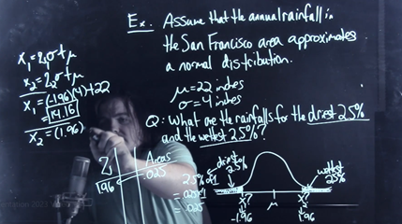
End-of-Year Project (FY 2023)
Goals:
Success:
4 YeaLink Room Panels
Joel Dion DIY Created
Room Reservation Upgrades
Lightboard Studio Creation
42 hrs. Of Use
January 2023
~$3K

Slide 30
Costs to Maintain

Slide 31
Funding Sources
The Georgia Southern University Libraries self-funds most checkout technology out of the library operational budget.
We tend to get end of year money from the Provost’s Office.
Each year, about $20-$30K for laptops.
FY22: Purchased SSDs for all in building computers and checkout laptops (better performance in older computers)
FY23: Purchased 20 new Windows laptop.
Donation of used equipment:
FY 23: Received circa 2016 Windows laptops from the College of Nursing, and self funded an upgrade to 16 GB RAM and 500 GB SSDs.

Slide 32
Costs of the Laptop Checkout Program: Losses
Fleet size = approximately 190 total
Replacement parts for repairs = $3,000 annually
Approximately 4 laptops never returned per year = $4,400
Approximately 3 laptops irreparably broken per year = $3,300
Replacing laptops on a 5 year cycle = $41,800 annually
(but, we currently don't replace on a 5 year cycle; laptops are up to 12 years old)
Total of $52,000 per year (excluding labor)
At any given time, about 10 laptops are egregiously overdue.

Slide 33
Reducing laptop losses (ie. late returns)
The Georgia Southern University Libraries are fine free.
Laptops have a 7 day checkout period.
To reduce losses:
If equipment is overdue, suspend equipment checkout.
Notes in the checkout system and 3 late returns or any missing equipment items means no more equipment checkout.
For overdue laptops, systems locks them and displays a message saying to return them.

Slide 34
Laptops are most of the Budget
Laptops (FY23)
= Approx. $26K
$24,557.40 for 20 new laptops
Approx $1,500 to upgrade and refurbish 29 laptops circa 2016
All other Checkout Tech (FY23)
= Approx $7K
4 Wacom Intuous tablets to Henderson Library
2 magnetic mini-lighting kits to Henderson Library
4 headsets with headphones only to Henderson Library
20 laptop bags
3 View Sonic Projectors
10 Large fancy lighting kits for photography
6 DSLR camera kits with accessories
4 Pop up greenscreen backdrop kits to expand photography offerings

Slide 35
Circulation Policies & Procedures
Odum Library New Media Center

Slide 36
Policies NMC
Late Fees Accrue Daily
$5/day for items like mice, keyboard, headphones, etc.
$10/day for items like laptops, projectors, PA system, DSLRs
1-Week Loan Period for all items
Some items like laptops or laptop peripherals are eligible for renewal request up to no more than 2-times
Repeat check-out can occur the very next business day after return of equipment
Lost or stolen equipment is the responsibility of the person loaned the equipment
Late Fees cause loss of checkout/renewal privileges

Slide 37
Paperless Requests
Fill out "Borrower Agreement Request Form" online
NMC Staff Approve/Deny Request
Email communications about approval/denial
Equipment is Loaned
The patron arrives with their VSU ID card and is provided the equipment after
The patron's account is checked
The equipment is demonstrated to the patron as working
The patron receives a short description of how to operate the equipment being loaned and our loan policy is also shared

Slide 38
Circulation Terms

Slide 39
Circulation Terms
The Georgia Southern University Libraries are fine free.
Goal = all take-home equipment gets 1 week checkout
Laptops are on 1 week checkout.
Because of high demand, camera equipment in Statesboro is on 4 day checkout.
8 hour loan for in-building equipment
Ex: Headsets and webcams to support virtual meetings in the libraries.

Slide 40
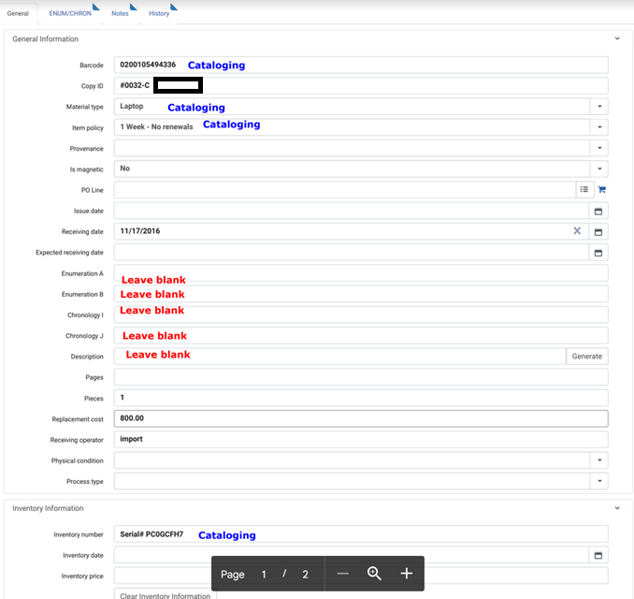
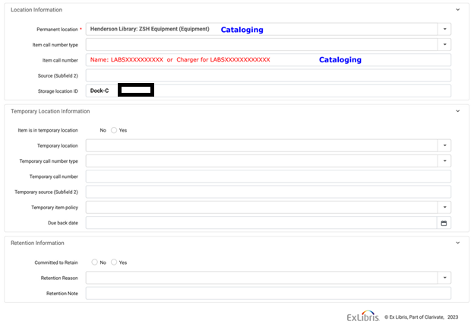
Standardized item records in Alma
Internal Consistency is the goal. The exact fields are less important. Internal consistency helps us know how to get accurate usage and inventory info.

Slide 41
Future Initiatives
Odum Library New Media Center

Slide 42
Equipment Oriented Initiatives NMC
Survey Academic Departments and Student patrons for technology needs that can be added or improved upon in our circulating inventory. (FY 2024)
End-of-Year Fund Request for 50 laptops. (1-2 years)
Re-obtain the full-time staff position removed in June 2022 to allow for more hours of operation. (1-2 years)
Start transitioning to Windows 11 (Now – Fall 2024)

Slide 43
Future Initiatives

Slide 44
Biggest upcoming challenge
Windows 10 end of life, Oct. 2025
Approximately 1/3 of the checkout fleet is impacted.
Approximately 60% of in-building student use computers impacted.
Biggest ongoing challenge
Understanding student use of checkout technology and unmet needs.
“Despite some calls [. . .] for research into user workflows to support technology integration and technological services, libraries facing resource constraints may adopt solutions based on budget requirements, a need to demonstrate innovation [. . .], or quantitative survey results that, while reasonable catalysts, are not constructed from a sympathetic understanding of the student experience.” - Warren, R., & Hartner, J. (2020), Reducing Hardship: Student Motivations, Educational Workflows, and Technology Choices in Academic Settings, 15(1), 1-18.

Slide 45
Future Initiatives
Address Oct. 2025 Windows 10 end of life!
This fiscal year, get qualitative data about how students use checkout technologies.
This fiscal year, ask for funding to amortize older equipment. Meanwhile, gather data from students to know if a change in offerings is appropriate.

Slide 46
Q&A

Slide 47
Thank You
Kyle Culpepper kwculpepper@valdosta.edu https://www.valdosta.edu/media
Wilhelmina Randtke wrandtke@georgiasouthern.edu https://georgiasouthern.libguides.com/technology/TechCheckout

