Slide 1
The
The
Google Analytics
Google Analytics
Change
Change
Universal Analytics to Google Analytics 4: Overview and checklist for Libraries
Wilhelmina Randtke & Justin Barnett / April 7, 2023
Looking Back to Look Forward: Reflection in Assessment
Notes:
Contact Information: wrandtke@georgiasouthern.edu jbarnett@georgiasouthern.edu

Slide 2
Why Care About Analytics?

Slide 3
Statistics: Showing the Value
Subdomain | Pageviews (home) | Pageviews (total) | Avg. Monthly Views | Avg. Views/Page | Approx # Pages
library.georgiasouthern.edu | 215,892 | 301,741 | 25,145 | 4,250 | 71
parker.georgiasouthern.edu | 34,279 | 351,554 | 29,296 | 469 | 750
coe.georgiasouthern.edu | 34,215 | 481,773 | 40,148 | 681 | 707
cec.georgiasouthern.edu | 22,764 | 322,688 | 27,049 | 675 | 478
chp.georgiasouthern.edu | 21,209 | 726,863 | 60,572 | 1,349 | 539
jphcoph.georgiasouthern.edu | 15,396 | 121,533 | 10,128 | 881 | 138
cah.georgiasouthern.edu | 14,295 | 412,328 | 34,361 | 399 | 1,034
cosm.georgiasouthern.edu | 13,743 | 339,670 | 28,401 | 346 | 981
cbss.georgiasouthern.edu | 13,258 | 320,996 | 26,750 | 742 | 433
Notes:
Mina: Why do we care? Statistics helps to show the value.
Here are the Google Analytics statistics for the entire Georgia Southern University campus. Our main campus Marketing and Communications Department pulls them regularly. The Libraries is a college on campus, and the Libraries gets waaaaayyyy more traffic to the homepage than any other college on campus.
In short, statistics helps to show the value.

Slide 4
Why Are We Talking?

Slide 5
What’s Happening with Google Analytics?
Google is changing from Universal Analytics (aka, v3) to Google Analytics 4
Last time this happened was 2012, when v3 came out
Analytics 4 was released in 2020, and is slowly phasing out v3.
As of 1 July, v3 is fully sunsetting, and will no longer collect data
Make sure you’ve switched your tracking to v4 by then!
Traffic data from v3 is - eventually - going to be removed
Notes:
Justin: We’re talking about this because there’s a big shake up coming - and it’s soon. It’s been over a decade since the last analytics shift like this, and many people aren’t prepared or sure what to do about it.
So, what’s changing? Well - Google has released a new version of Analytics. They actually released it back in 2020, but the final cutover is this coming July, at which point Analytics 3 (also known as “Universal Analytics”) is going to stop collecting data. That means if you want to keep getting traffic data, you’ll need to have v4 up and running on your sites by the last day of June - earlier is better, though, because it means you’ll have more data in the Analytics 4 system.
Why is this happening? Well, that’s really a question about what’s different with GAv4, so…

Slide 6
What’s Different About v4?
Universal Analytics was about specific, pre-defined usage data; Analytics 4 lets users define “events” that they are interested in tracking.
Analytics 4 is more capable, but requires more involvement from users on what they want to track.
Analytics 4 consolidates “computer” and “mobile” data together, treating it all as website traffic.
Analytics 4 stores data it has collected in an entirely separate location than Analytics 3 - you can’t look up combined statistics from both systems.
Notes:
Justin: We’re not going to spend a lot of time talking about the nitty-gritty code details of the two systems - we only get ten minutes, after all! - but there are a few things worth quickly touching on.
From a broad overview perspective, Analytics 4 collects data on “events” which can be just about anything that happens on a site, and defined by person managing your analytics. Universal Analytics had some support for events, but mostly was a bunch of pre-defined things - page views, time spent on page, and the like. For most of us? This isn’t a huge difference, because we were mostly interested in those simple events and data points, but it does give it a lot more flexibility to do things like count clicks on a LibChat in-page window or interactions with some sort of widget on the webpage. It’s potentially good data, but… it’s also way outside the scope of today. Just keep in mind that data like that will now be available if you choose to set it up, and this is why they’re making the change.

Slide 7
What Do I Have to Do?
Notes:
Justin: And on the note of setting it up, Mina is going to talk some more about the specific things you need to do before the cutoff to make sure you’re still gathering statistics.

Slide 8
Do I have to do anything? Yes
Update your website
The code snippet on your website to collect info is different. You have to update your website.
Notes:
Mina
If you work with Google Analytics on your campus, you may have gotten emails from Google with subject lines like, “We’ll soon configure Google Analytics 4 for you”. It sounds oh-so-automatic. But actually, that is not true.
Most of the online coverage about the change is way deep into the settings for people who work full time in web development and are really digging into Google Analytics.
We went through that, and pulled out the basic checklist for people who are using Google Analytics because it’s easy to set up, and maybe pulling a couple of basic statistics for an annual report.
Here are the things you need to do about this change:
1)
2)
3)

Slide 9
Do I have to do anything? Yes
Update your website
Pull and save any older reports
Universal Analytics (ie. Google Analytics data from 2012 to June 2023) is only guaranteed until December 2023. The tone of Google’s mentions of it sounds as if the data will become unavailable after that. So, if you have any statistics that you want to refer back to later, then right now, you should pull and archive reports.
Notes:
Mina
If you work with Google Analytics on your campus, you may have gotten emails from Google with subject lines like, “We’ll soon configure Google Analytics 4 for you”. It sounds oh-so-automatic. But actually, that is not true.
Most of the online coverage about the change is way deep into the settings for people who work full time in web development and are really digging into Google Analytics.
We went through that, and pulled out the basic checklist for people who are using Google Analytics because it’s easy to set up, and maybe pulling a couple of basic statistics for an annual report.
Here are the things you need to do about this change:
1)
2)
3)

Slide 10
Do I have to do anything? Yes
Update your website
Pull and save any older reports
Update your reporting metrics for future reports
Universal Analytics and Google Analytics 4 collect different data and support different reports. You might not be able to get a report that shows the exact same data as before. Up until June 30, 2023, you can set up both Google Analytics 4 and Universal Analytics side-by-side on a website, and try pulling reports and comparing data for the same time period. If you do heavy reporting, it’s probably a good idea to do so.
Notes:
Mina
If you work with Google Analytics on your campus, you may have gotten emails from Google with subject lines like, “We’ll soon configure Google Analytics 4 for you”. It sounds oh-so-automatic. But actually, that is not true.
Most of the online coverage about the change is way deep into the settings for people who work full time in web development and are really digging into Google Analytics.
We went through that, and pulled out the basic checklist for people who are using Google Analytics because it’s easy to set up, and maybe pulling a couple of basic statistics for an annual report.
Here are the things you need to do about this change:
1)
2)
3)

Slide 11
Detailed Steps
Notes:
Justin: The following slides aren’t likely to come up during the presentation due to time constraints, but we wanted to include them and some notes for people to potentially refer back to.

Slide 12
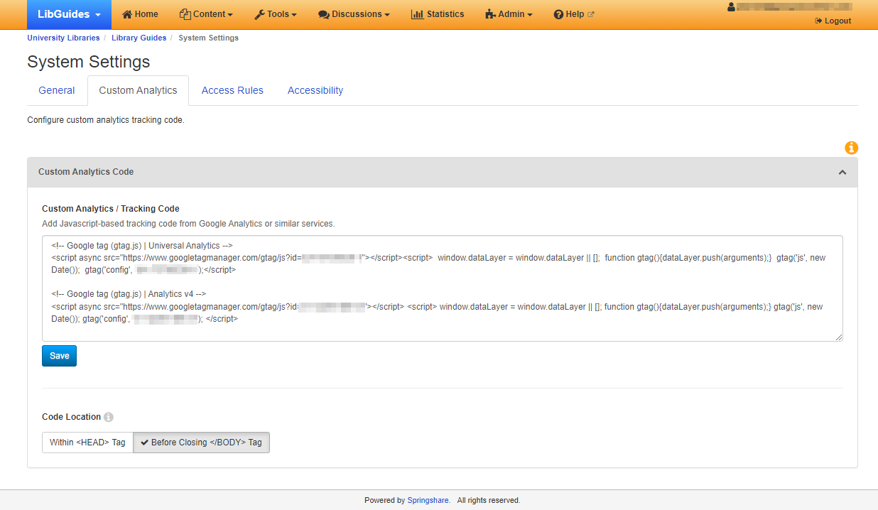
#1: Update your website
Notes:
Justin: The big thing you need to do to keep getting data after June 30, 2023 is update the code snippet on your site. Most - if not all - of us use Libguides, which has a settings page specifically for adding those snippets. For now, you can happily just add the new one alongside the existing snippet - they work together just fine, each sending data to their respective version of Analytics. After the turnover (1 July), you can come back and remove the v3 (Universal Analytics) tracking code.
To find this in Libguides, you’ll need to be an admin, then go to “System Settings” and the “Custom Analytics” tab. If you’re going to be keeping the old Analytics code in there for now, make sure the code location is set to “Before Closing <BODY> Tag” - but if you’re just replacing it full-out with the v4 code, or when you drop the v3 code later in the year, you can switch it to “Within <HEAD> Tag” and things will run a little faster (and collect a little more data).

Slide 13
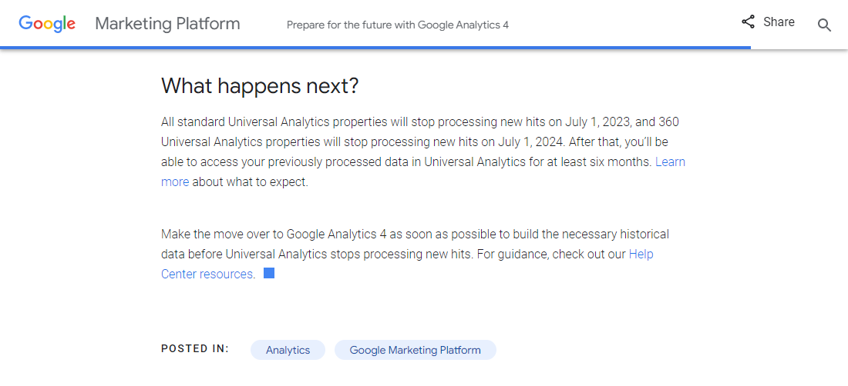
#2: Pull and save older reports
https://blog.google/products/marketingplatform/analytics/prepare-for-future-with-google-analytics-4/
Notes:
You’ll definitely want to download as much of your information from Universal Analytics as possible, since there’s no guarantee it will still be available after December of this year. Depending on your report setup and structure, there are lots of different ways you may need to go about it - but a good starting point is this Google help article: https://support.google.com/analytics/answer/1038573?hl=en .
This guide, by Zakhar Yung, provides a more in-depth set of steps for getting different types and groupings of data out of Universal Analytics with an eye towards the v4 migration: https://blog.coupler.io/how-to-export-google-analytics-data-guide/

Slide 14
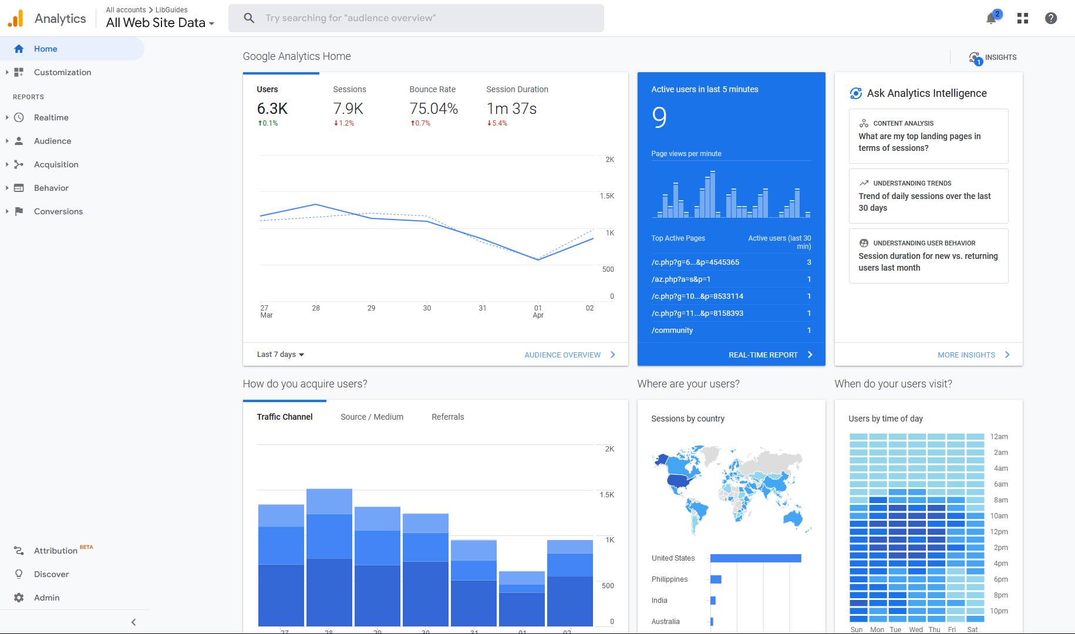
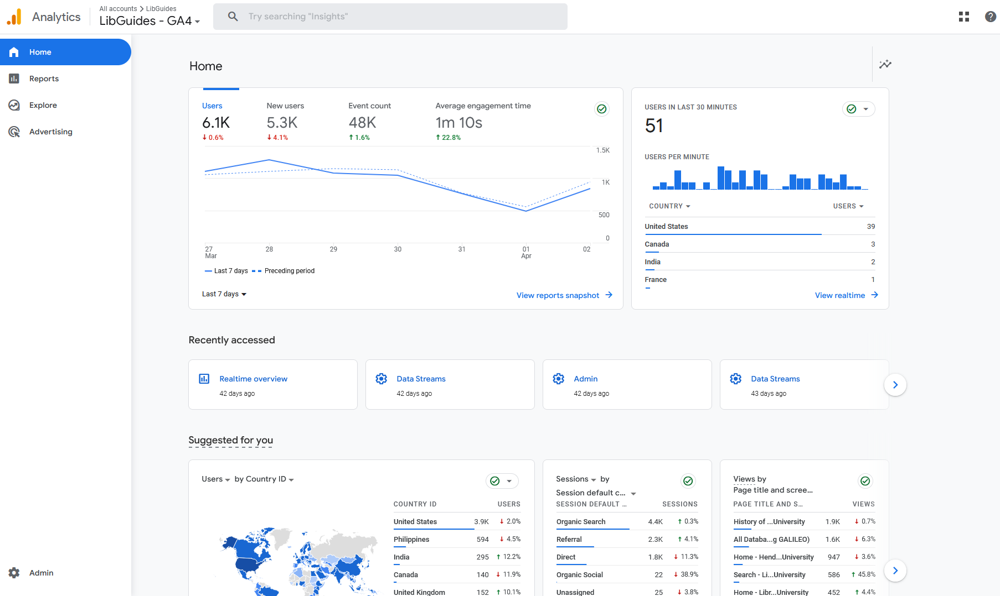
#3: Update how you pull reports
New platform: Google Analytics 4
Old platform: Universal Analytics
Notes:
The following are a number of useful resources regarding how Analytics 4 works and putting your data to use. Most aren’t academic in focus, but obviously that doesn’t prevent them from being useful - after all, businesses who thrive on their SEO and page traffic are probably the most invested in gathering this information, anyway!
Introducing the Next Generation of Analytics: https://support.google.com/analytics/answer/10089681?hl=en This is the official Google “getting started” help page. It’s not as detailed as some of the other links, but it’s the starting point many people will want to work with, and it does contain everything you need… it just might be a little scattered or lacking in context, because their documentation doesn’t take the time to explain the why of much.
Introduction to Google Analytics 4: https://developers.google.com/analytics/devguides/collection/ga4 Also by Google, this is a more technical set of information on setting it up, but it also contains links to a few useful resources for more “power user” settings.
Comparing metrics: Google Analytics 4 vs. Universal Analytics: https://support.google.com/analytics/answer/11986666?hl=en#zippy=%2Cin-this-article
Another Google link, this is their in-house guide on the differences between reporting methods from UA to v4, and where you can find similar reports to what you might have used in the past.
Google Analytics 4 Events Tracking & Creation: https://bradgerick.com/google-tag-manager/google-analytics-4-events-tracking-creation/
This guide details the different event types in Analytics 4, how many of them compare to UA data, and how to go ahead and set up specific events for things you want to track.
Google Analytics Tagging Guide & Checklist: https://www.datadrivenu.com/google-analytics-tagging-guide/
This guide requires you to sign up for a mailing list - ugh, I know - to get the full details (though even the short version on the webpage is helpful) but it’s a remarkably thorough checklist that covers where to find your new tracking code, related services you might want to set up, and where to get additional help.

Slide 15
The
The
Google Analytics
Google Analytics
Change
Change
Universal Analytics to Google Analytics 4: Overview and checklist for Libraries
Wilhelmina Randtke & Justin Barnett / April 7, 2023
Looking Back to Look Forward: Reflection in Assessment
Notes:
Contact Information: wrandtke@georgiasouthern.edu jbarnett@georgiasouthern.edu

