Slide 1
Georgia Southern University Libraries’ Ongoing Technology Checkout Program
Wilhelmina Randtke, Head of Libraries Systems and Technologies
Georgia Southern University
Georgia Association for Instructional Technology (GAIT) IT Forum
March 11, 2023, Virtual

Slide 2
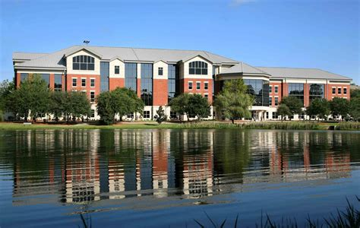
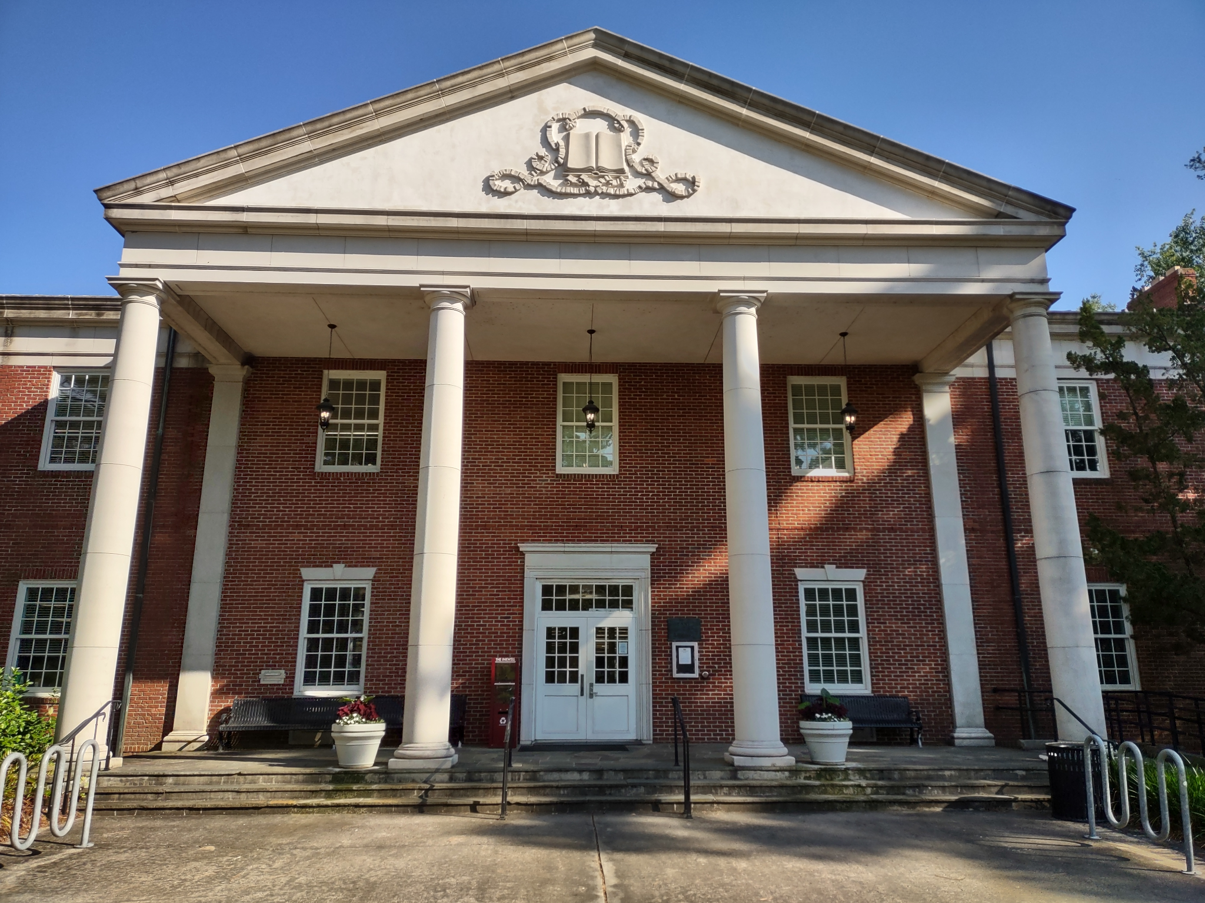
Georgia Southern University campuses and libraries
Georgia Southern University has 3 campuses:
Armstrong Campus (Savannah)
Statesboro
Hinesville
Notes:
The GS Libraries have 3 checkout desks on 2 campuses:
Statesboro:
Henderson Library checkout
Savannah (Armstrong Campus)
Learning Commons checkout
Lane Library checkout

Slide 3
Equipment Offerings
Approximately 190 checkout laptops
40+ graphing calculators
DSLR cameras (Canon EOS)
Headphones
Microphones (high end Blue Yeti mics)
Projectors
Tablets and iPads
Dongles and phone chargers
Notes:
The GS Libraries have 3 checkout desks on 2 campuses:
Statesboro:
Henderson Library checkout
Savannah (Armstrong Campus)
Learning Commons checkout
Lane Library checkout

Slide 4
Equipment Offerings: Laptop fleet
Approximately 190 checkout laptops total
36 Chromebooks
32 MacBooks
122 Windows laptops
Going forward, will not purchase Chromebooks.
Average age is just over 5 years.
Checkout is for 1 week for most laptops (some laptops are same day in-building)

Slide 5
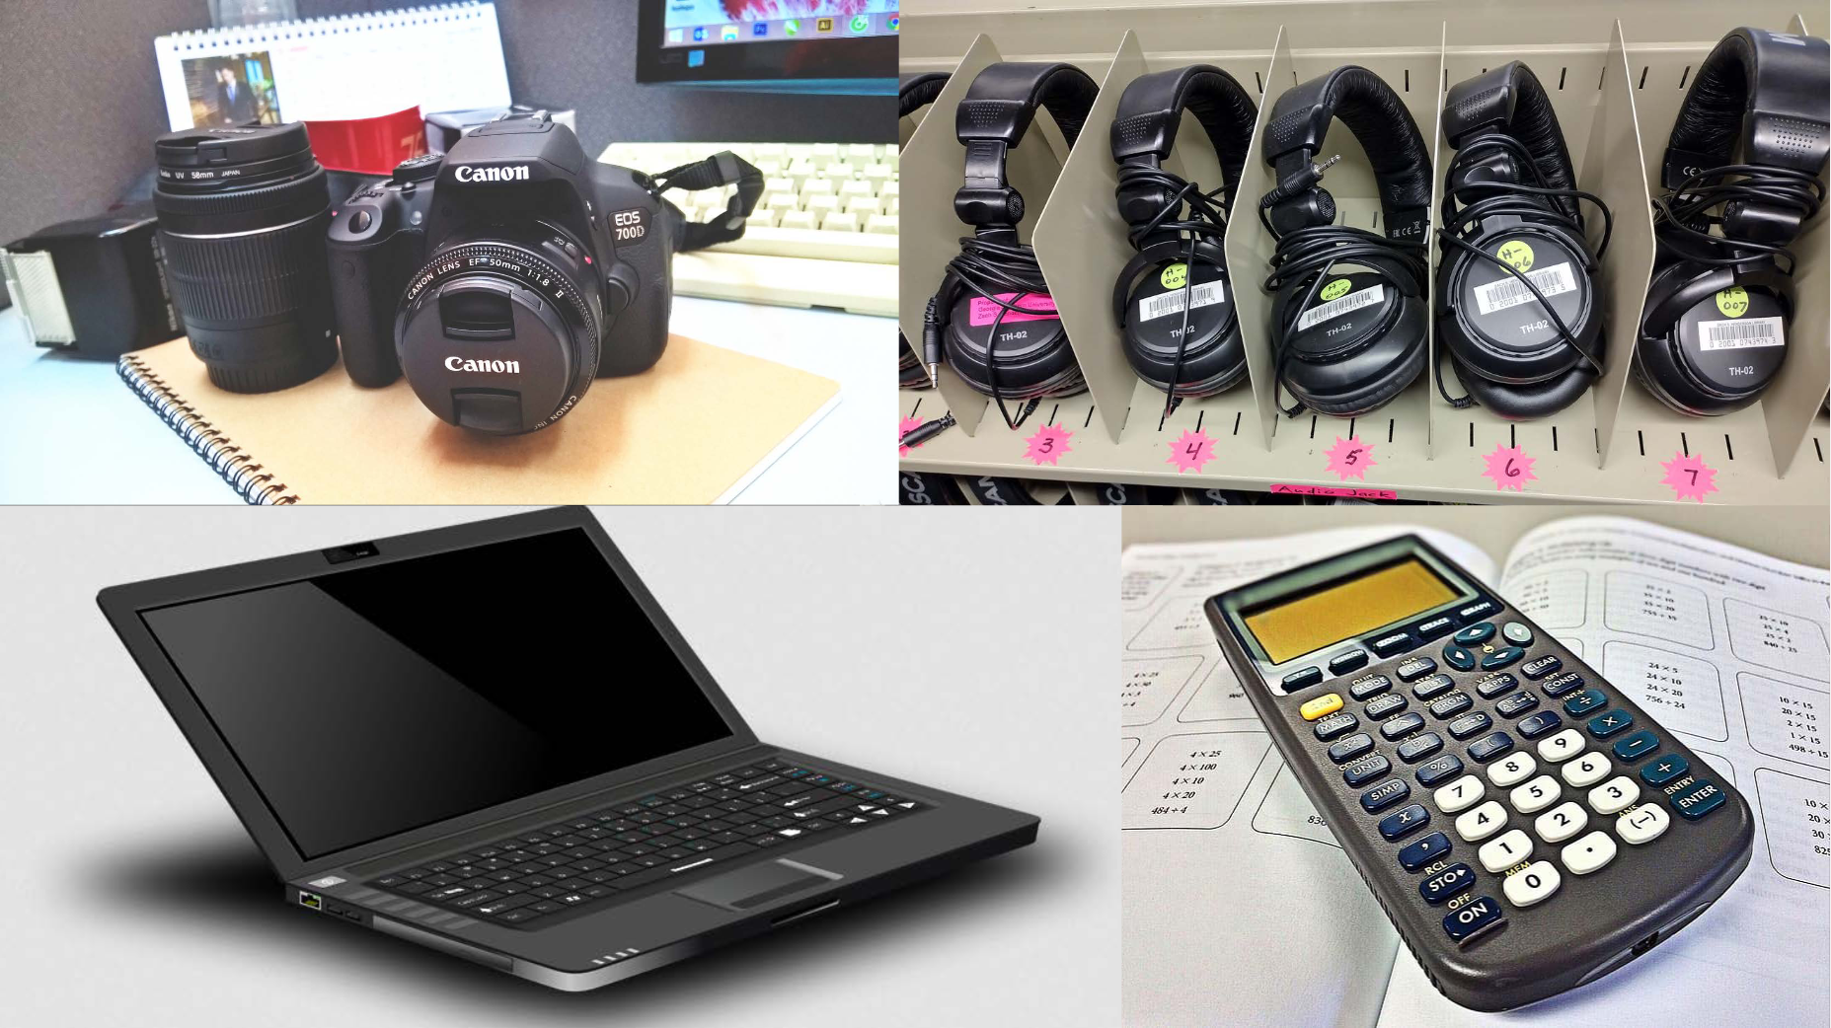
Notes:
This slide shows the kinds of equipment offered.
Canon EOS pic from https://www.pexels.com/photo/canon-eos-7000-dslr-camera-190220/
Laptop pic from http://www.freestockphotos.biz/stockphoto/17118
Graphing calculator pic from https://www.pikrepo.com/fvezx/black-texas-instruments-graphing-calculator
Headphones for checkout - pic taken by Wilhelmina Randtke

Slide 6
Notes:
This slide shows the kinds of equipment offered.
Microphone pic is from https://www.pexels.com/photo/gray-blue-yeti-1080746/
Projector pic is from https://pxhere.com/fr/photo/1041957
Wacom tablet pic is from https://pixabay.com/es/photos/tableta-gr%C3%A1fica-wacom-photoshop-1964816/
Pic of cables and chargers is from https://pxhere.com/en/photo/1595203

Slide 7
Equipment checkout is popular
In 2022, cameras were completely checked out so frequently that we had to change from a 7 day to a 4 day loan
The average laptop is checked out approximately 40% of the time
Each type of equipment maxes out (ie. all items checked out at the same time) occasionally

Slide 8
Managing Equipment
Students do most of the checkouts and check ins
Lots of equipment has many pieces
labeling and packaging helps make it obvious when a part is missing
Biggest cost / loss
Egregiously late returns
Obsolescence and replacing older equipment
Not the biggest loss: breaking, never returned

Slide 9
Managing equipment: Student Workers
In hiring, screen out applicants who have turned equipment in egregiously late
Students have to enforce the rules - get a liability form for expensive equipment checkout, not waive a block on checkouts
Upper level students train new hires

Slide 10
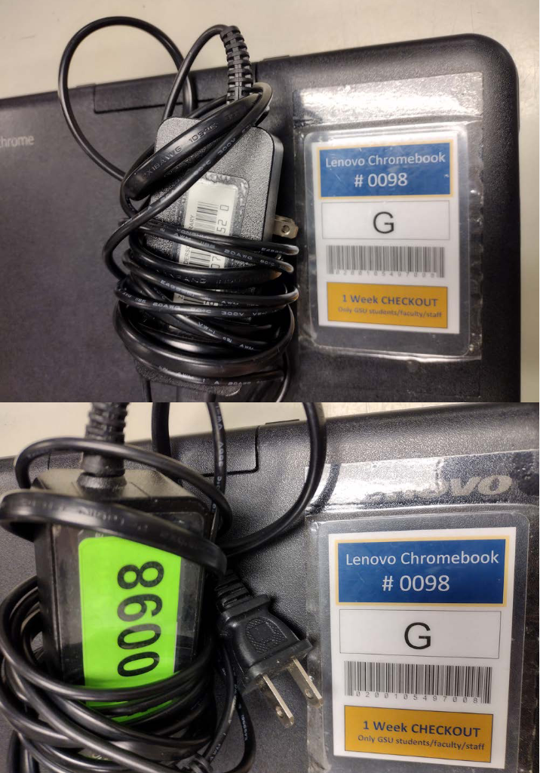
Managing equipment:
Labeling for multipart
equipment

Slide 11
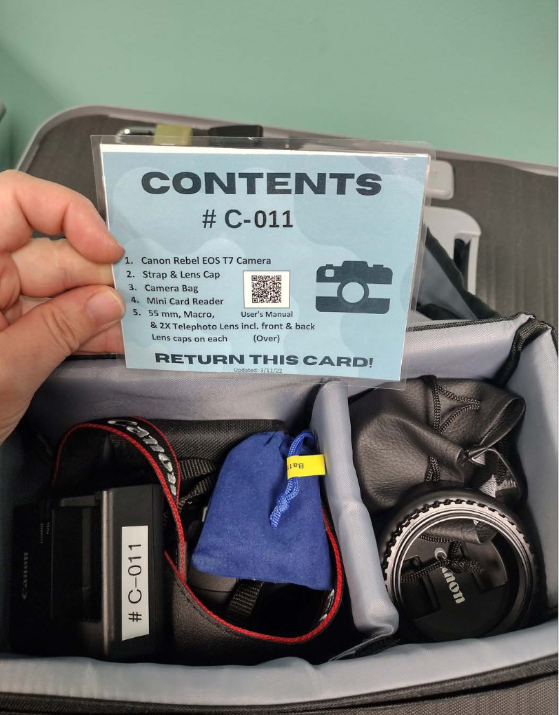
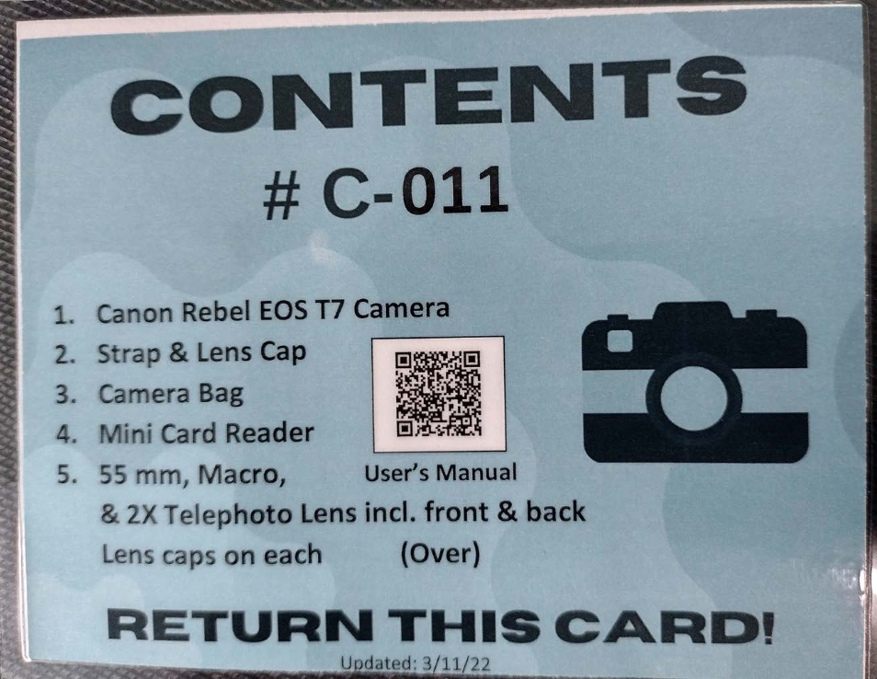
Managing equipment:
Labeling for multipart
equipment

Slide 12
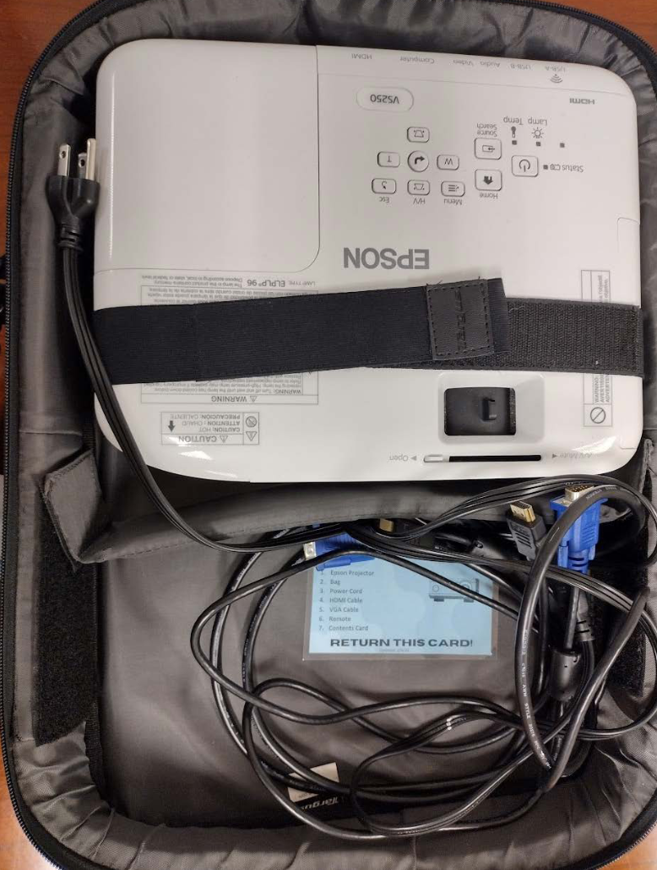
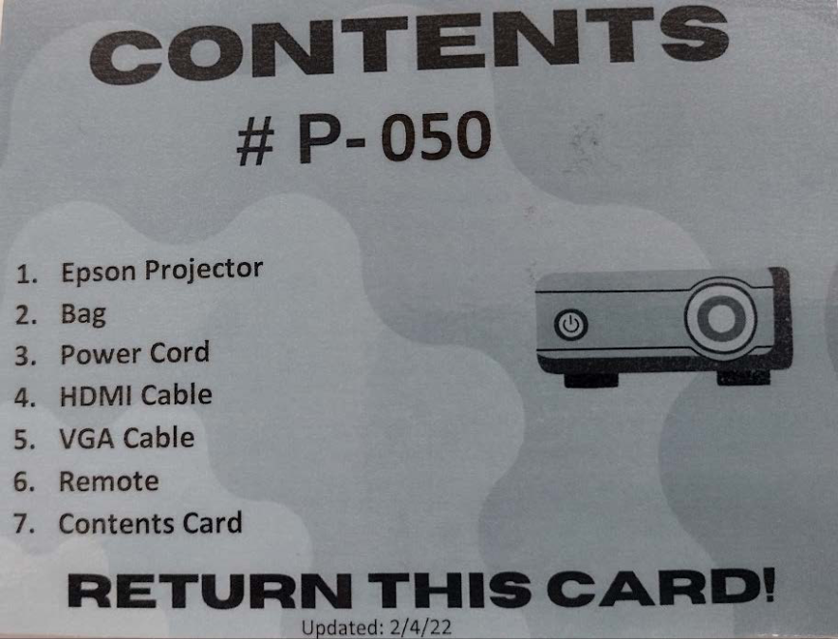
Managing equipment:
Labeling for multipart
equipment

Slide 13
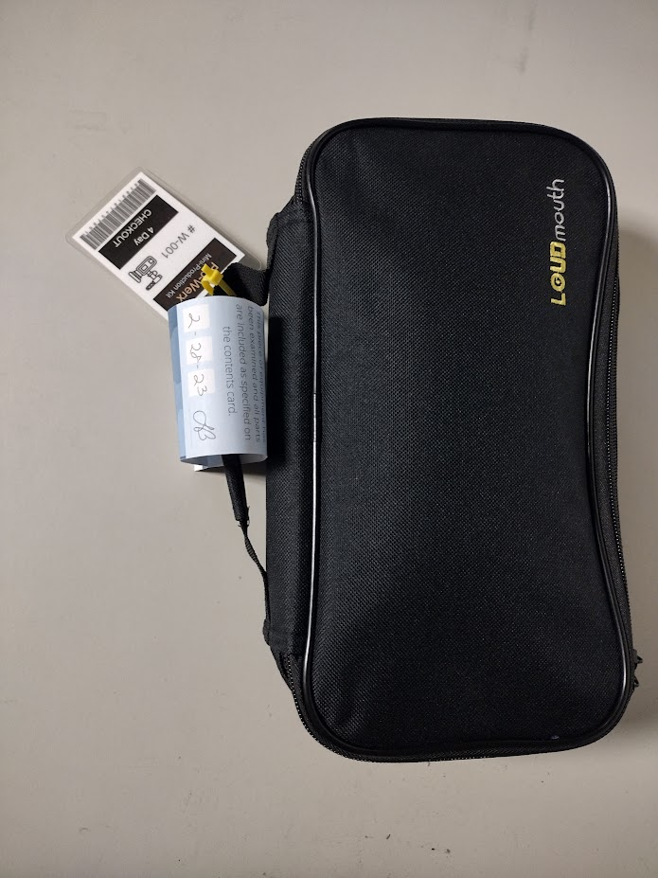
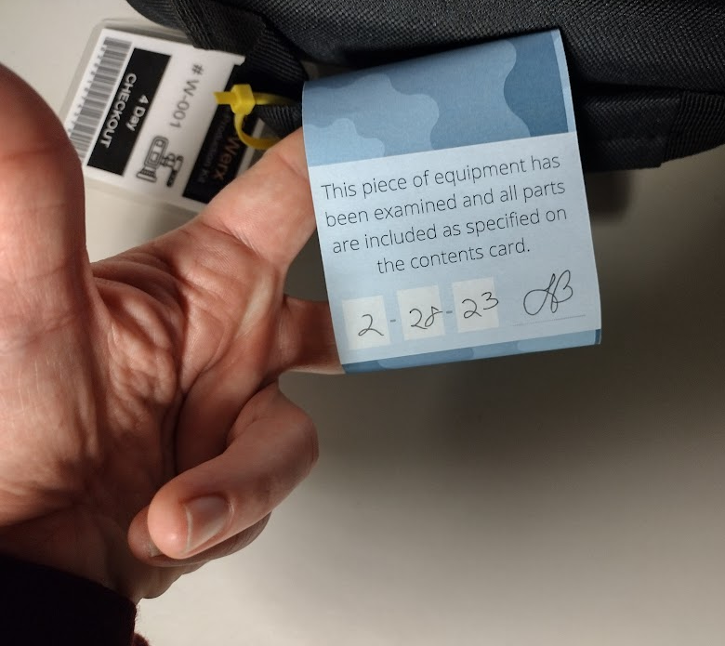
Managing equipment:
Labeling for multipart
equipment
Notes:
With multipart equipment, we have slips, where an employee signs off that all parts are included with the kit. Students issuing equipment at the checkout desk know to check for that.

Slide 14
Managing equipment: Packaging
Cases and protectors to prevent breakage
Cases to keep multipart equipment together
Packaging to handle odd shapes and sizes

Slide 15
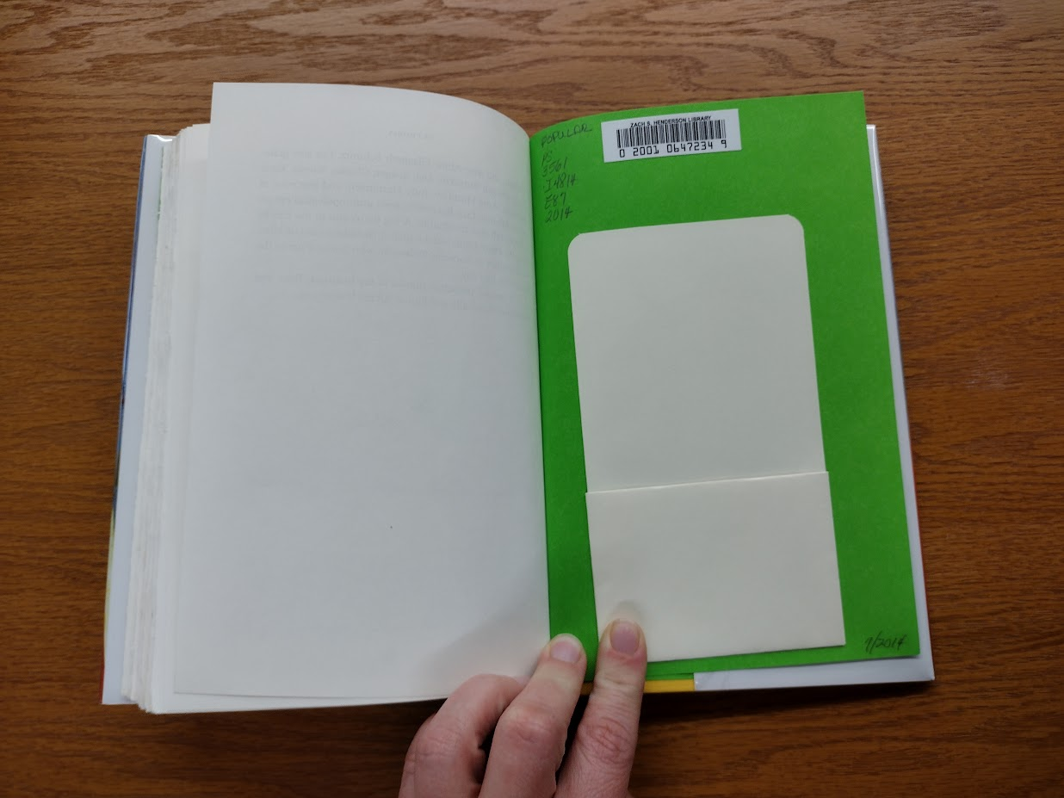
Managing equipment: Packaging
Notes:
We do all our equipment checkout at the same desks where you would check out books. All the books have barcodes. The checkout process uses barcodes. So, we are looking to get barcodes onto the equipment.

Slide 16
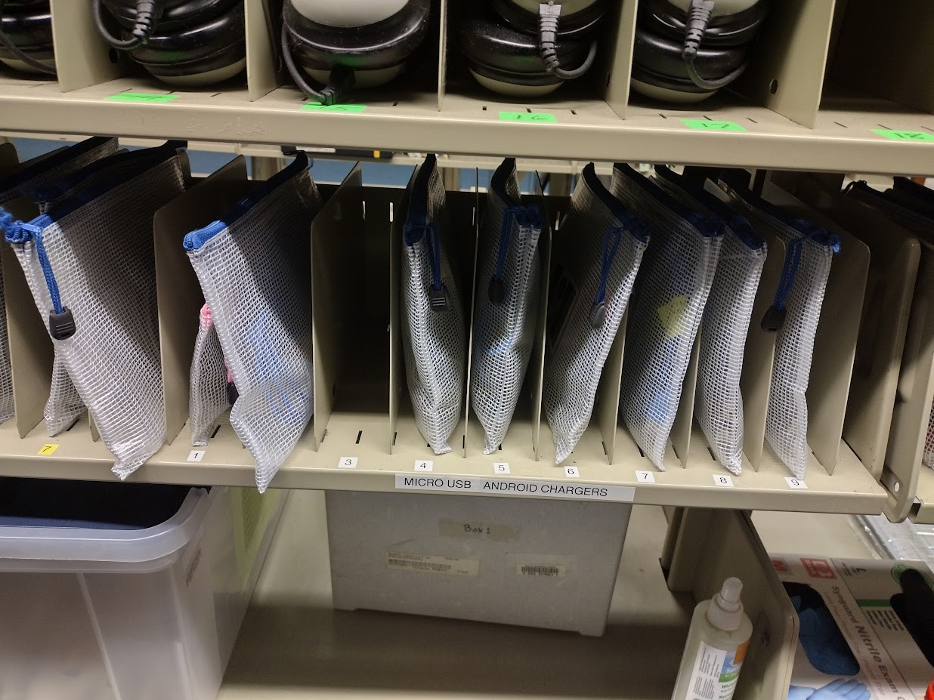
Managing equipment: Packaging
Notes:
Bags of awkward shaped and small technology can stack on a shelf with the right packaging.

Slide 17
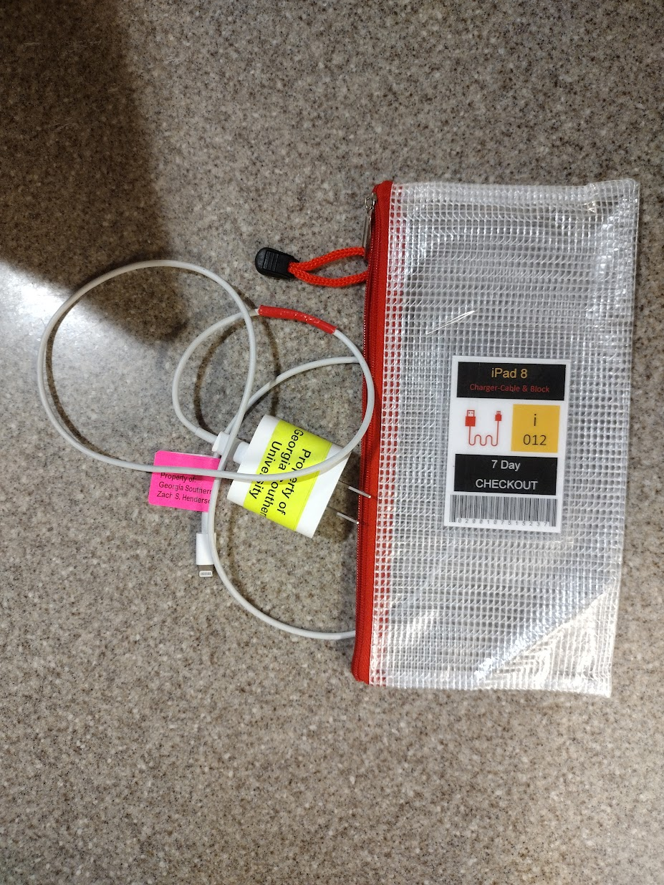
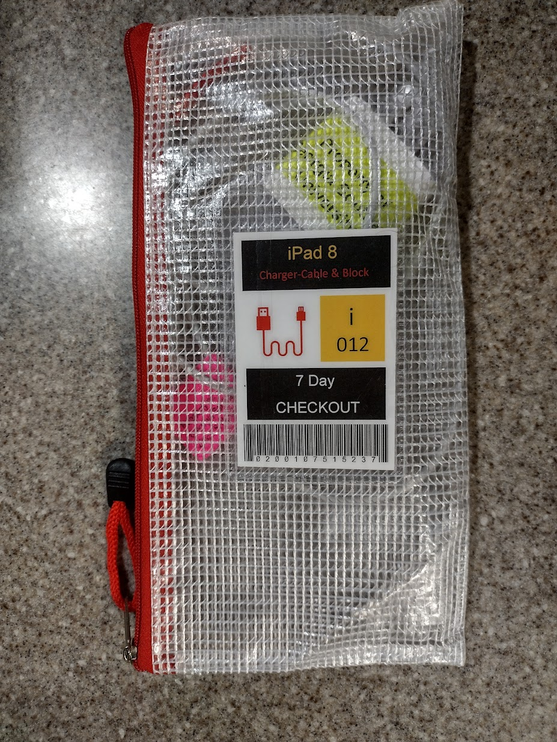
Managing equipment: Packaging
Notes:
Cables and dongles get bagged, and the bag gets the barcode on it.

Slide 18
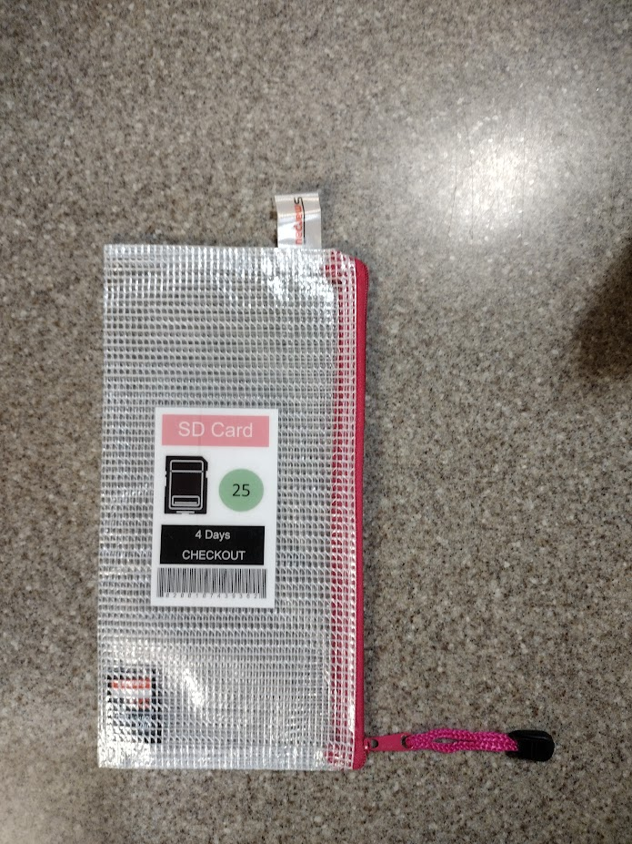
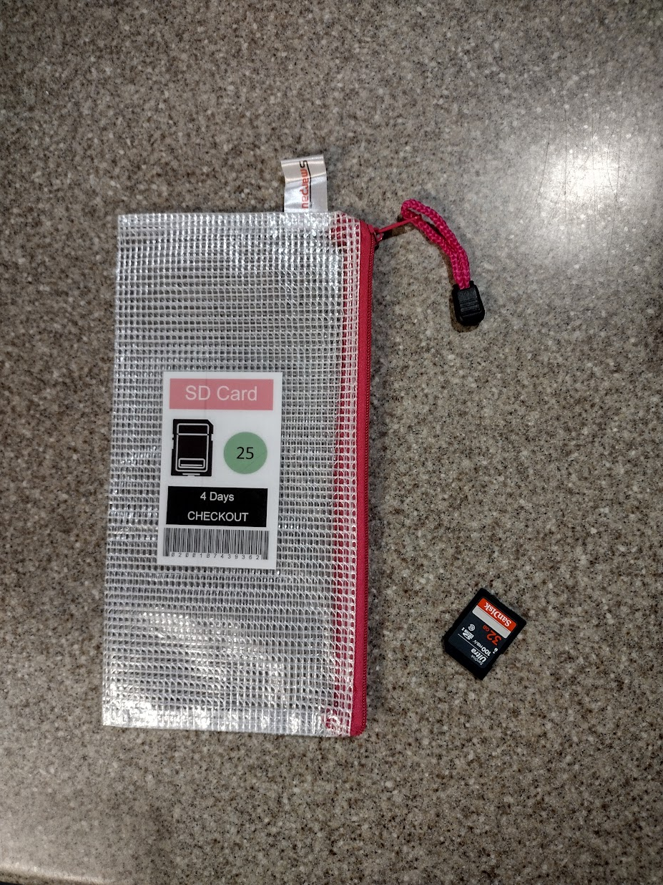
Managing equipment: Packaging
Notes:
SD cards which are too small to put a barcode on.

Slide 19
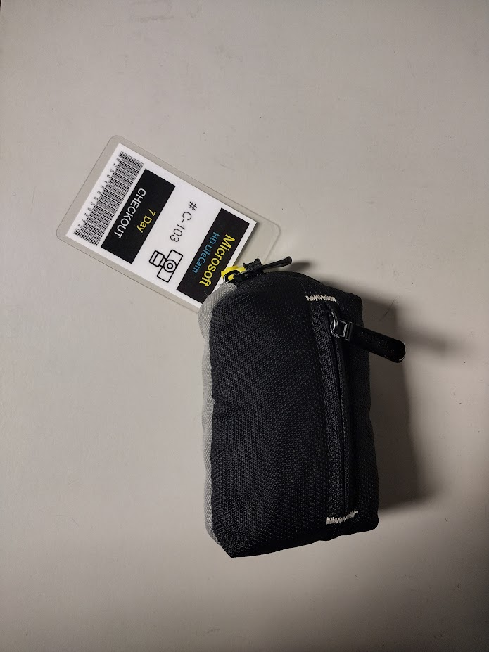
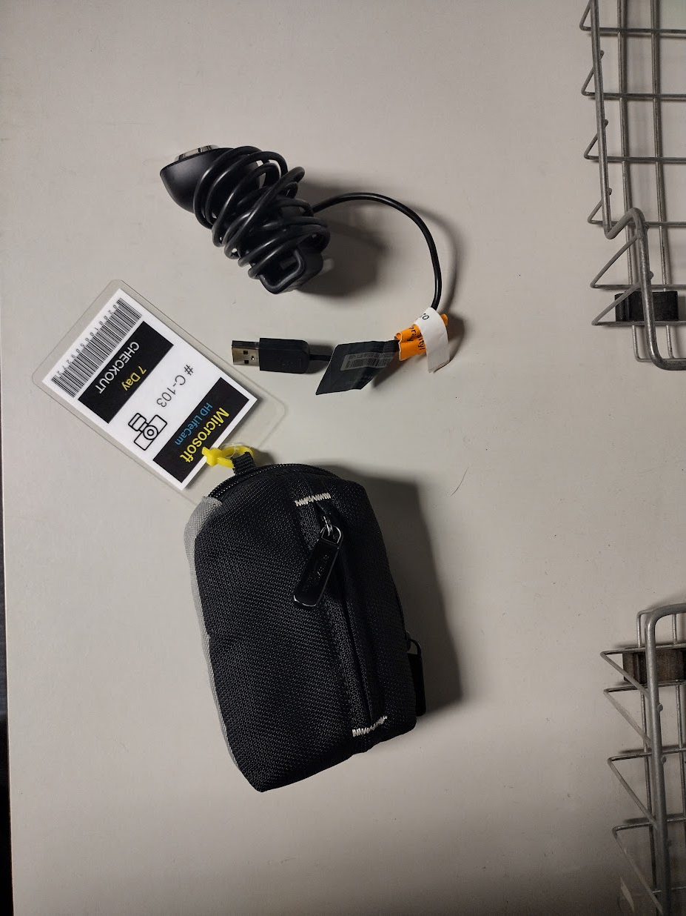
Managing equipment: Packaging

Slide 20
Costs of the Laptop Checkout Program:
Laptop Repairs
Most laptop repairs are done in house
Replacing screens and keyboards is common
Two full time employees spend a good chunk of time on repairs
Cost of parts = $3,000 per yr

Slide 21
Costs of the Laptop Checkout Program:
Losses
Fleet size = 190 total
Replacement parts for repairs = $3,000 annually
Approximately 4 laptops never returned per year = $4,400
Approximately 3 laptops irreparably broken per year = $3,300
Replacing laptops on a 5 year cycle = $41,800 annually
(but, we currently don't replace on a 5 year cycle; laptops are up to 12 years old)
Total of $52,000 per year (excluding labor)
At any given time, about 20 laptops are egregiously overdue.

Slide 22
Reducing laptop losses (ie. late returns)
The Georgia Southern University Libraries are fine free.
Laptops have a 7 day checkout period.
To reduce losses:
If equipment is overdue, suspend equipment checkout.
Notes in the checkout system and 3 late returns or any missing equipment items means no more equipment checkout.
For overdue laptops, systems locks them and displays a message saying to return them.

Slide 23
Georgia Southern University Libraries’ Ongoing Technology Checkout Program
Wilhelmina Randtke, Head of Libraries Systems and Technologies
Georgia Southern University
Georgia Association for Instructional Technology (GAIT) IT Forum
March 11, 2023, Virtual

