Slide 1
Orange Grove Postmortem: Discontinuation of Florida's Open Educational Resources Repository for K20
Wilhelmina Randtke, Head of Libraries Systems and Technologies, Georgia Southern University
Open Texas 2022, Show and Fail, Sept. 21, 2022

Slide 2
What was the Orange Grove?
Formally launched in 2007 with about 500 learning objects.
Planning process from circa 2004 to 2007.
Key principles guiding repository development:
SCORM standards (ie. “talk” to an LMS)
Quality assurance process for included materials
Metadata standards
A focus on building user community
Content requires management
Content must be reusable in new teaching environments
Training provided in how to use the system
Notes:
Decorative side image from https://web.archive.org/web/20070928231149/http://www.theorangegrove.org/ (decoration from when the Orange Grove launched in 2007).

Slide 3
Orange Grove Demise: August 31, 2020

Slide 4
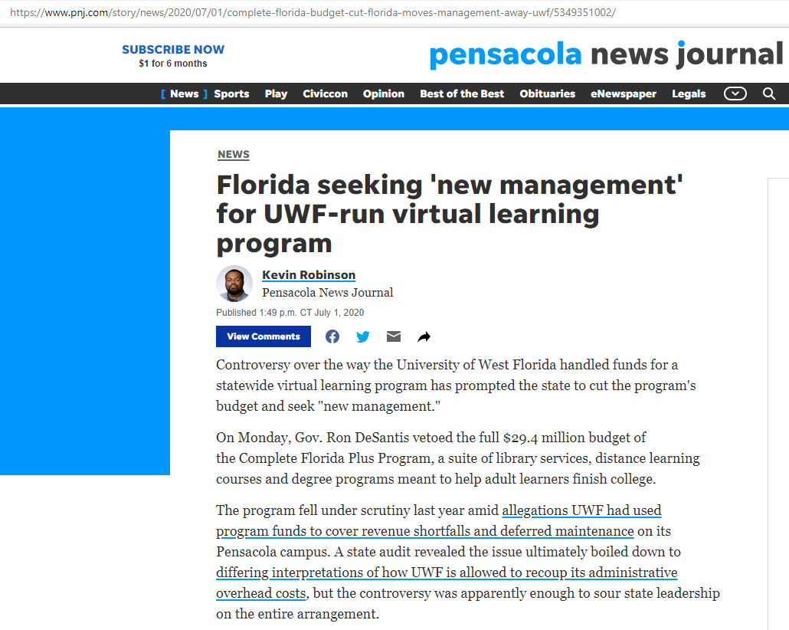
Orange Grove Demise: August 31, 2020
Notes:
The immediate crisis reason for this specific decommissioning date was that on July 1, 2020, the governor of Florida defunded the Florida Virtual Campus consortium. The FLVC did central library technology and distance learning for Florida’s state college and state university systems, and hosted the Orange Grove.
But, this defunding is not the whole story. I’d worked with digital publishing at FLVC, and the vast majority of publishing programs got funded through voluntary chargebacks to colleges and universities. Basically, after defunding, FLVC provided basic information about each service it provided and cost information, and the member institutions voted on what to fund or not fund, and for a year FLVC was on a chargeback model. Other digital publishing programs almost universally were funded on a chargeback model. Institutions scrambled, and people went to their provosts and got money allocated. Orange Grove got nixed. Library directors and deans voted and pretty much it didn’t get funding.
There’s a whole community aspect and a journey to go from vibrant and building a buzz to having a buzz to being seen as irrelevant. This presentation is about the journey from vibrant to forgotten.

Slide 5
A Striking Statistic
At take down in August 2020, approximately 20% of original content in the Orange Grove was in Flash.
Notes:
I want to start with a striking statistic: In August 2020, when the Orange Grove was decommissioned, approximately 20% of content hosted in the Orange Grove was in the .swf Flash format.
My actual statistic was 20.8% of items in Flash format. This percentage is a little bit like reading tea leaves. In August 2020, when Orange Grove was decommissioned, there were 707 items in the Orange Grove to where there was a record and a file or files. But the vast majority of those 707 were multipart. About the only learning objects with one file were PDF textbooks. There were also many items that were things like websites with several .html files, several images, and all kinds of content. Or .zip files with a whole course worth or workshop worth of content in the .zip file. To get to that approximately 20% percent, I looked at each item and noted what I thought was the dominant format for the object.
5 different people looking at the learning objects would probably calculate percent in each file 5 different ways.
Nevertheless, Orange Grove had a lot of Flash format files for Fall 2020.
For context, Flash was the way to do things around 2004 to 2007 when the Orange Grove launched. Flash was very interactive compared to HTML way back in 2004. Then, in 2008, HTML 5 came out. New features in HTML 5 were directly modeled after Flash. In 2010, Apple said Flash wouldn’t be supported for iPads and iPhones. Right before that 2008 / 2010 timeframe, Flash was THE WAY to make an interactive online resource, and after that 2008 / 2010 timeframe Flash lost dominance. And in 2017, Adobe, Apple, Facebook, Google, Microsoft and Mozilla jointly announced end of life for Adobe Flash with an end of life date of December 2020. See https://blog.adobe.com/en/publish/2017/07/25/adobe-flash-update . It wasn’t just end of life and a fizzle. All big tech said “we are stopping you running it and we are uninstalling it off your computer on that date”.
August 2020, when around 20% of items in the Orange Grove were in Flash was also a few months before Flash was set to stop working completely on all U.S. computers.
And even beyond that, the Flash items in the Orange Grove were not just Flash but really old Flash. A lot of them said to download the Flash player from Macromedia. Macromedia was acquired by Adobe in 2005. Fifteen years before the Orange Grove was decommissioned.
This Flash statistic - of 20% of content being in Flash - is almost is the whole story. Captured right there, there’s something unique and more ephemeral about good OER. Teachers want OER to be interactive. Beyond a handout or a diagram or a textbook, teachers and professors want something interactive that will grade, and get a grade, and then that grade can get plugged into a class and into the learning management system. Teachers want something that students click on and interact with.
Captured right there is start up effort that fizzles. We all know the story of a grant funded project that gets a big up front infusion of cash, but then once that’s gone, has a lower level of funding for maintenance or just doesn’t get maintenance at all.
Captured right here is pressure to prioritize statistics and numerical growth over community. An easy statistic to get about any digital library is: How many things are in it? That’s much easier to measure than is something like “How easy is it to find things? What percent of things in the library are useful?” Sometimes with pressure for “growth” and growth measured by numbers, there can be pressure to keep the numbers going up and not to delete older content. Even though deleting older content could remove clutter and improve the search experience for people using the site.

Slide 6
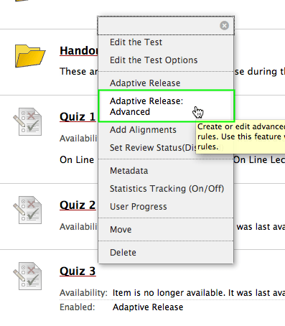
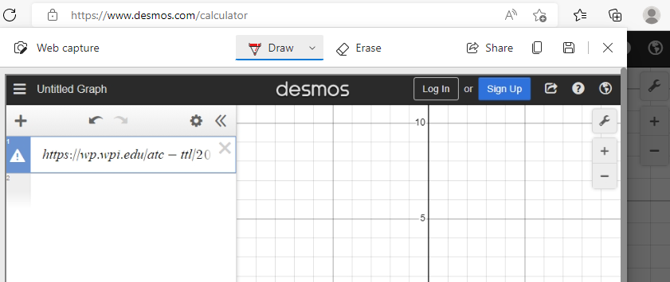
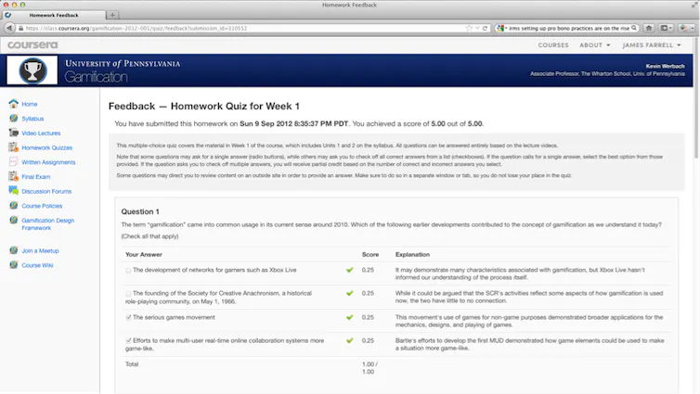
Unique to OER: Focus on interactivity
Notes:
I’ve worked extensively in digital publishing, and something unique to OER is that there is a tremendous demand for and value to interactivity.
When I was working more closely with OER, professors wanted quizzes, modules, and interactivity. They wanted more than a pdf or text file. A common conversation would be me saying, we have this platform, and you can upload OER. And professors would want to host quizzes and share quizzes and have a streamlined way to get the grade automatically into their class. And, I would be like, “You can upload a PDF.” Which was not very impressive.
When the Orange Grove launched, it was ambitious. It focused on high quality interactive content. Back in 2004, Flash was the way to be interactive on the internet. Orange Grove was doing what professors and teachers wanted.
And, the catch to this is that interactive software objects are more ephemeral. Updates or changes in technology are far more likely to break interactive files than to break a text file, or a photograph. A text file or a static picture are a lot easier to manage over time. Something interactive is part of a whole software ecosystem and when that ecosystem ages out, pieces get lost and eventually that file won’t run.
Editing the test pic is from https://wp.wpi.edu/atc-ttl/2012/09/13/the-online-quiz-feedback-conundrum/
“Feedback - Homework Quiz for Week 1” is from https://theconversation.com/an-insiders-guide-what-its-really-like-to-study-a-mooc-10718

Slide 7
Statistical pressure
Notes:
Statistical pressure is also an issue. It’s usually easier to pull quantitative than qualitative data.
Zig zaggy line from https://www.scirp.org/Journal/PaperInformation.aspx?PaperID=69143
Pruning pic from https://commons.wikimedia.org/wiki/File:The_Gardener_Pruning_a_Shrub_Met_DP890717.jpg

Slide 8
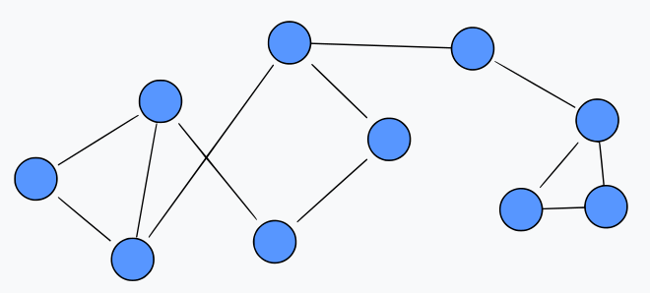
Maintenance: Software, Content, and Community
Key principles guiding repository development:
SCORM standards (ie. “talk” to an LMS)
Quality assurance process for included materials
Metadata standards
A focus on building user community
Content requires management
Content must be reusable in new teaching environments
Training provided in how to use the system
Notes:
Maintenance is a huge issue for all digital libraries. There’s the story that is always happening, where a project starts with grant funding and energy, and then it’s supposed to convert to sustaining funding, but that never happens.
Orange Grove is a little different, in that it started as a seed project then went and got funding. So, the pre-launch 2004 to 2007 time period was not grant funded. Then it got a grant in 2007 through Fund for the Improvement of Postsecondary Education (FIPSE). There’s still the concept there of seeking funding. And the concept of infusions of cash especially cash for something new rather than cash for long term maintenance or something permanent. The grant actually went to buying a perpetual license for Pearson Equella, which had high annual costs. And at the end of the grant, there was the start up content, the start up community, and a repository platform. But not an endowment.
Going back to the guiding principles which launched the Orange Grove, basically these principles didn’t get sustaining funding. Coming out of 2007, there had been this community and content push in 2004 - 2007, then the repository platform got set up right around 2007, then those principles weren’t resourced. The repository platform got maintained, but these principles didn’t. Over the years, new things happened with the Orange Grove brand. But the workflows and content and community at launch languished without resources for maintenance.
Pic of circuit board from https://commons.wikimedia.org/wiki/File:Computer_Circuit_Board_MOD_45153621.jpg .
Pic of files from https://opensource.com/article/21/3/batch-files-freedos .
Pic to symbolize community is from https://commons.wikimedia.org/wiki/File:Social_network-gu.svg .
The blue and white logo in the top right corner is the Equella logo.

Slide 9
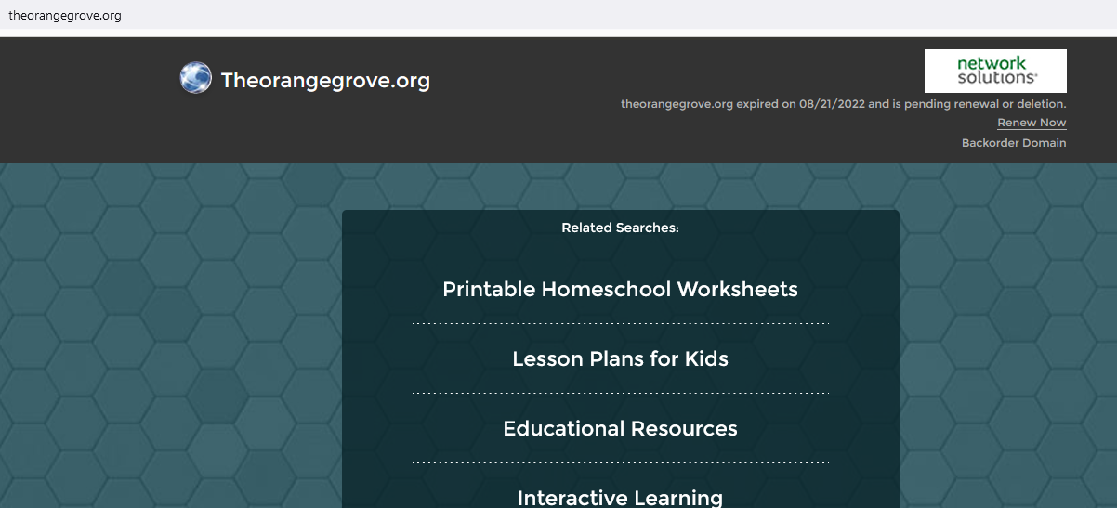
Relaunch? As a brand?
Notes:
A common theme in digital libraries, is that ultimately beyond collections and platforms, what is being built is a brand. In open education, we’ve seen that with Harvard’s H2O relaunching multiple times with the same theme, but different content and software. Florida is still doing work with OER and it’s still a focus at the state level. I had thought that there was a possibility to roll over Orange Grove into a brand. But, now I’m not so sure. FLVC let the URL for the original Orange Grove repository expire this year. Orange Grove was not hosted there at the end, and instead showed up on the flvc.org domain, but this URL had a lot of incoming links from way back and in a sense was part of the brand. To me, letting it expire means it’s likely that the brand will be decommissioned along with the repository. There is extremely likely to be a similar project in the future, but the name and branding are likely to be new and different.

Slide 10
Orange Grove Postmortem: Discontinuation of Florida's Open Educational Resources Repository for K20
Wilhelmina Randtke, Head of Libraries Systems and Technologies, Georgia Southern University
Open Texas 2022, Show and Fail, Sept. 21, 2022

