Slide 1
Locking in the status quo for business,
recent changes to U.S. data privacy law and long-term impacts on data collection
Wilhelmina Randtke
Head of Libraries Systems and Technologies
Georgia Southern University
Research and Assessment Interest Group (RAIG) Mini-Conference, March 25, 2022

Slide 2
Introduction
Emerging social issues from technology
Libraries value privacy but because library technology is vendor hosted, privacy isn’t controlled by libraries or implemented.
Surveillance technology is in conflict with most people’s desires. Large technology companies make money in ways that are invasive to individual people’s privacy.
There’s a lot of tension over privacy
The US doesn’t have a comprehensive privacy law
Little pieces are regulated - student records, medical records, financial records, but not privacy in general.
Pressure for a general right to privacy
Two paths are state law and federal law.
This presentation is about how the state law side of that is playing out.

Slide 3
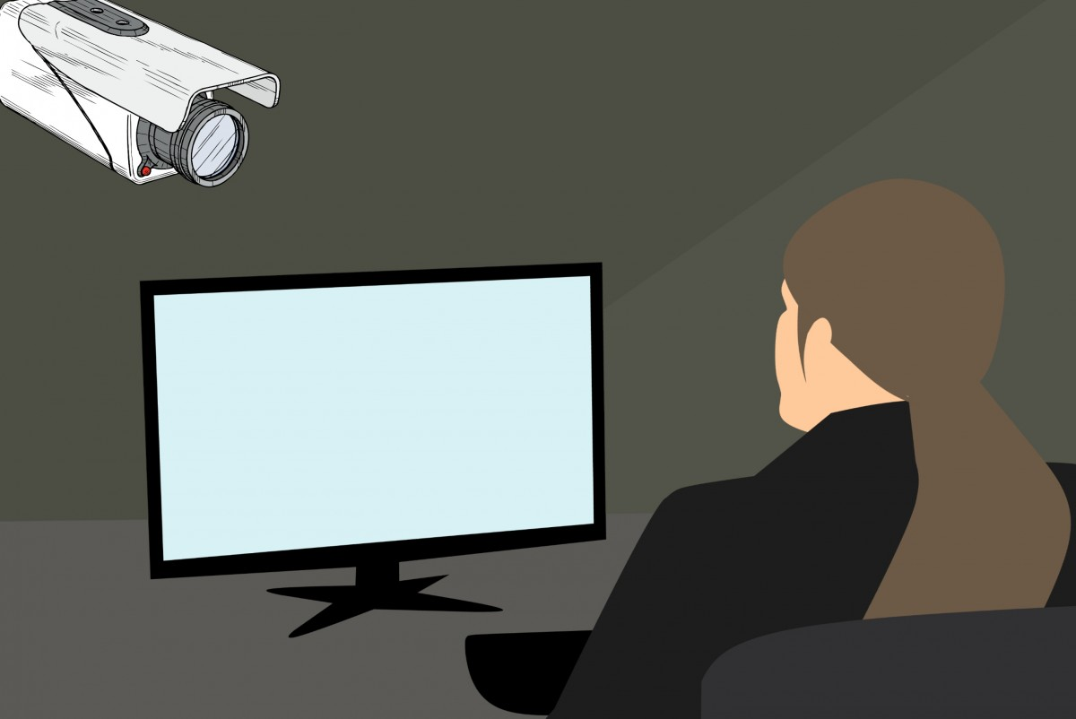
Current social problems: surveillance technology
Big tech companies make money through targeted advertising (based on tracking).
In 2019, 83% of Google’s revenue came from advertising.
In 2019, 98% of Facebook’s revenue came from advertising.
And in 2019, 70% of websites had a Google tracker, and more than 20% of websites had a Facebook tracker.
Targeted advertising pays a lot more. Trackers and targeted advertising is the business model for at least some big tech companies.
Source = Australian Competition and Consumer Commission, Digital platforms inquiry - final report (2019), available at https://www.accc.gov.au/publications/digital-platforms-inquiry-final-report.
Notes:
Pic is CC0 from https://pxhere.com/en/photo/1448067

Slide 4
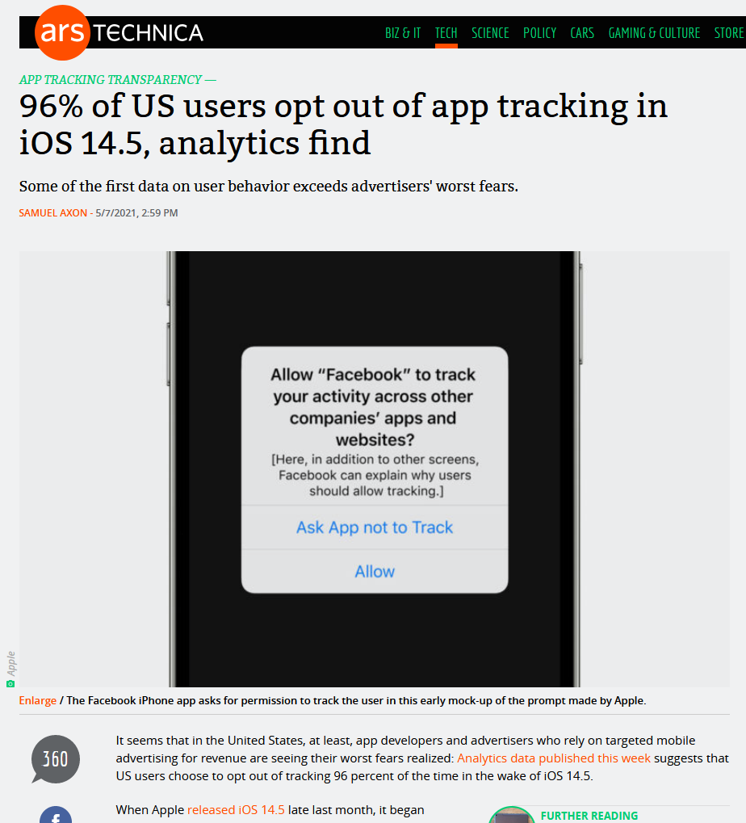
Current social problems:
surveillance technology
Regular people don’t want to be tracked.
Notes:
Last year, Apple gave a simple pop up for apps, and for each app, the person could opt out of tracking. So, not let that app track their browser use on the cell phone. 96% of U.S. iPhone users chose to opt out of tracking. (The iPhone is more than 30% of the U.S. market for smart phones.)
Essentially, what regular people want is in tension with how technology companies make money, and that’s centered around privacy issues.

Slide 5
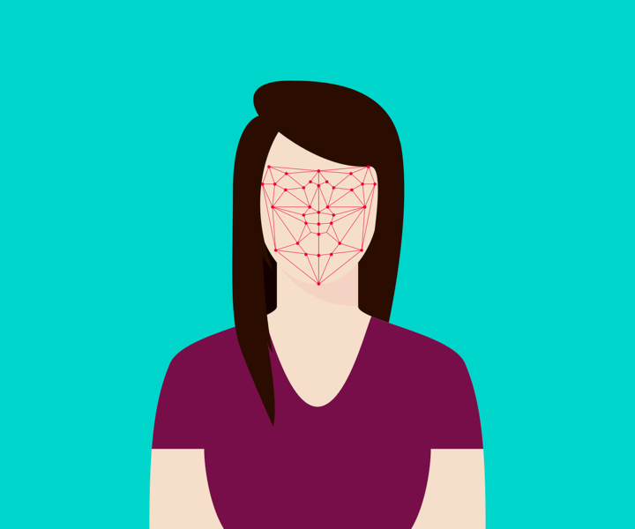
Current social problems: surveillance technology
Widespread use of cameras in public places and of facial recognition has led to backlash from the public.
Notes:
Face recognition pic from https://commons.wikimedia.org/wiki/File:Face_Recognition_3252983.png CC0

Slide 6
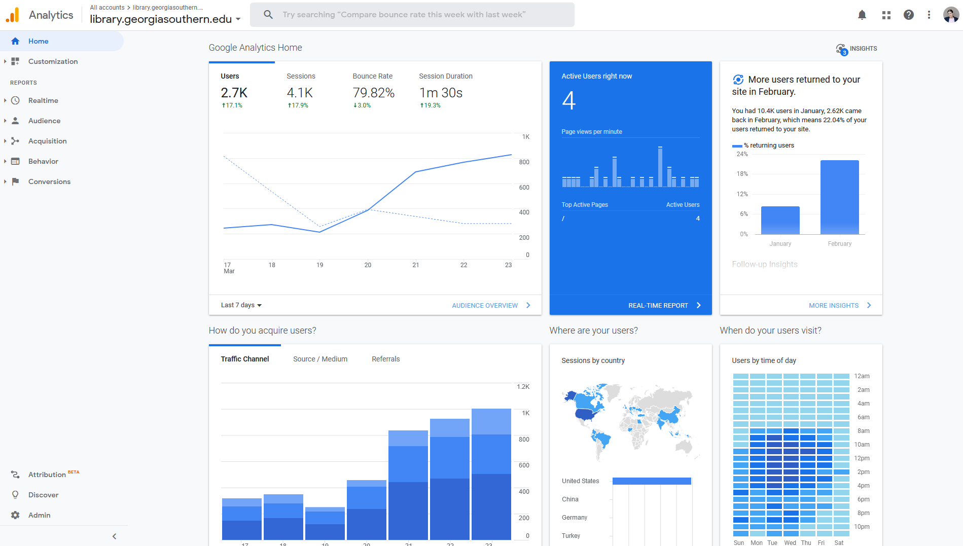
Current library problems: tension between principles and reality
Libraries value privacy
vs
The vast majority of library technology is vendor hosted
Libraries want statistics and often pressure vendors against privacy
Notes:
(!! add pic from ALA’s state library privacy laws !!)

Slide 7
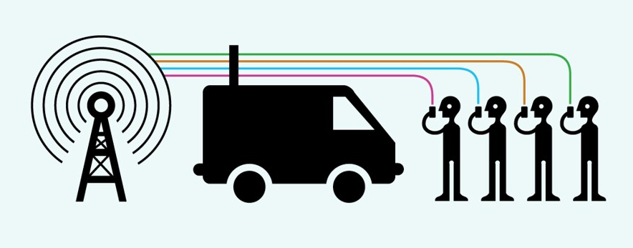
The current state of privacy law
Notes:
Image from https://www.flickr.com/photos/electronicfrontierfoundation/39412520654/ CC-By (made by the Electronic Frontier Foundation)

Slide 8
The current state of privacy law
The U.S. doesn’t recognize a general right to privacy.
Specific laws cover specific kinds of information
FERPA - educational records
HIPAA - health records
financial records
As of 2021, three states passed a general privacy / personal data law:
California in 2018; Colorado in 2021; Virginia in 2021
Possible ways to have a U.S. privacy law:
Federal law is one path
Many states adopting a similar law is one path

Slide 9
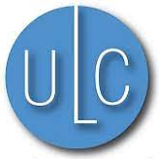
Uniform Law Commission (ULC)
Nonprofit formed by state governments
States appoint people to it, and the process is usually written into state law
ULC drafts and publishes model laws
Don’t apply to anyone.
Tend to get adopted by states and written into state law.
ULC is highly influential and represents the consensus of what state law will be.

Slide 10
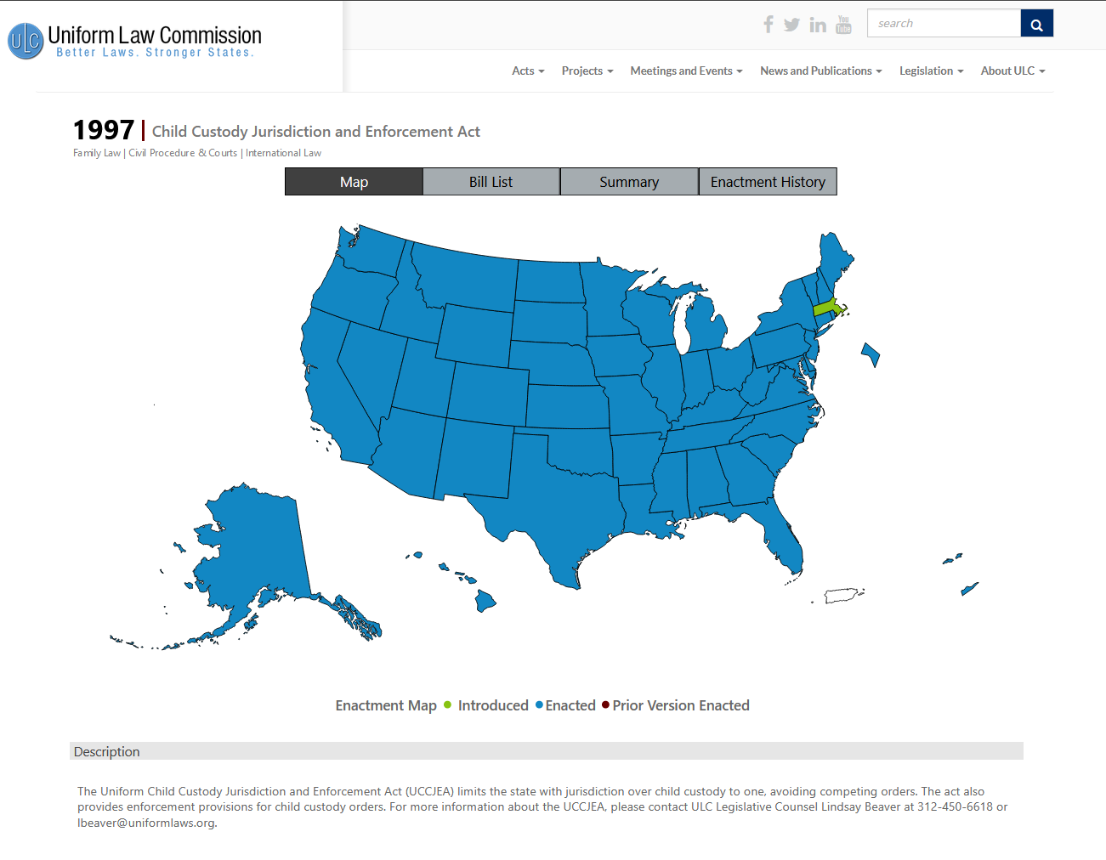
Uniform Law Commission (ULC) is highly influential
Notes:
Uniform Child Custody Jurisdiction and Enforcement Act - adopted in 49 states; only Massachusetts didn’t adopt it
UCCJEA was passed 1968. Even though that says 1997 in the top, that’s a revision that went through in 1997.
Very influential and adopted practically everywhere.

Slide 11
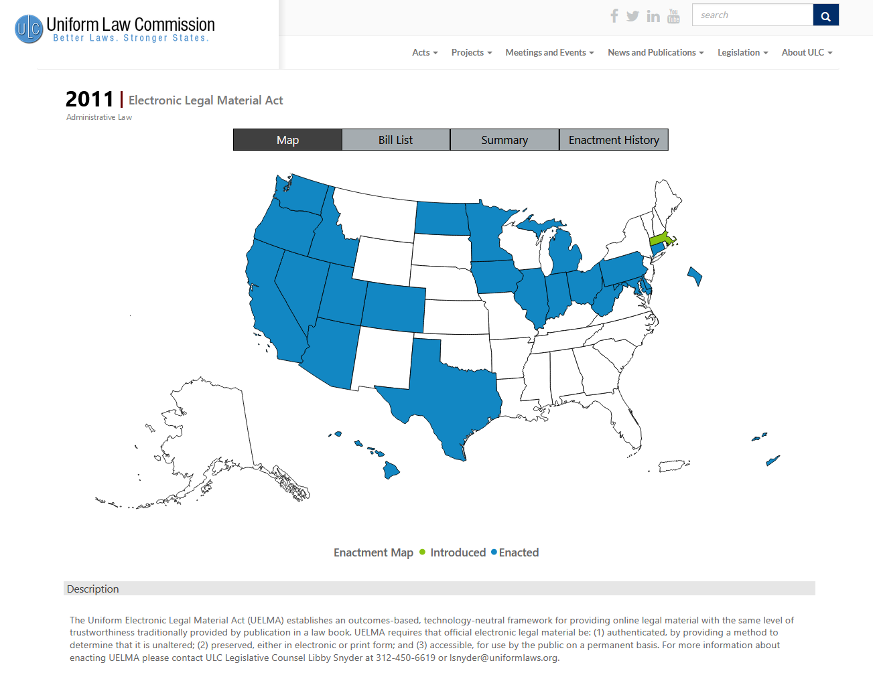
Uniform Law Commission (ULC) is highly influential
Notes:
Uniform Electronic Legal Material Act - 2011 model law, now adopted in 24 states.
Once again, the Uniform Law Commission is highly influential. If it does a model law, then that is likely to be widely adopted.

Slide 12
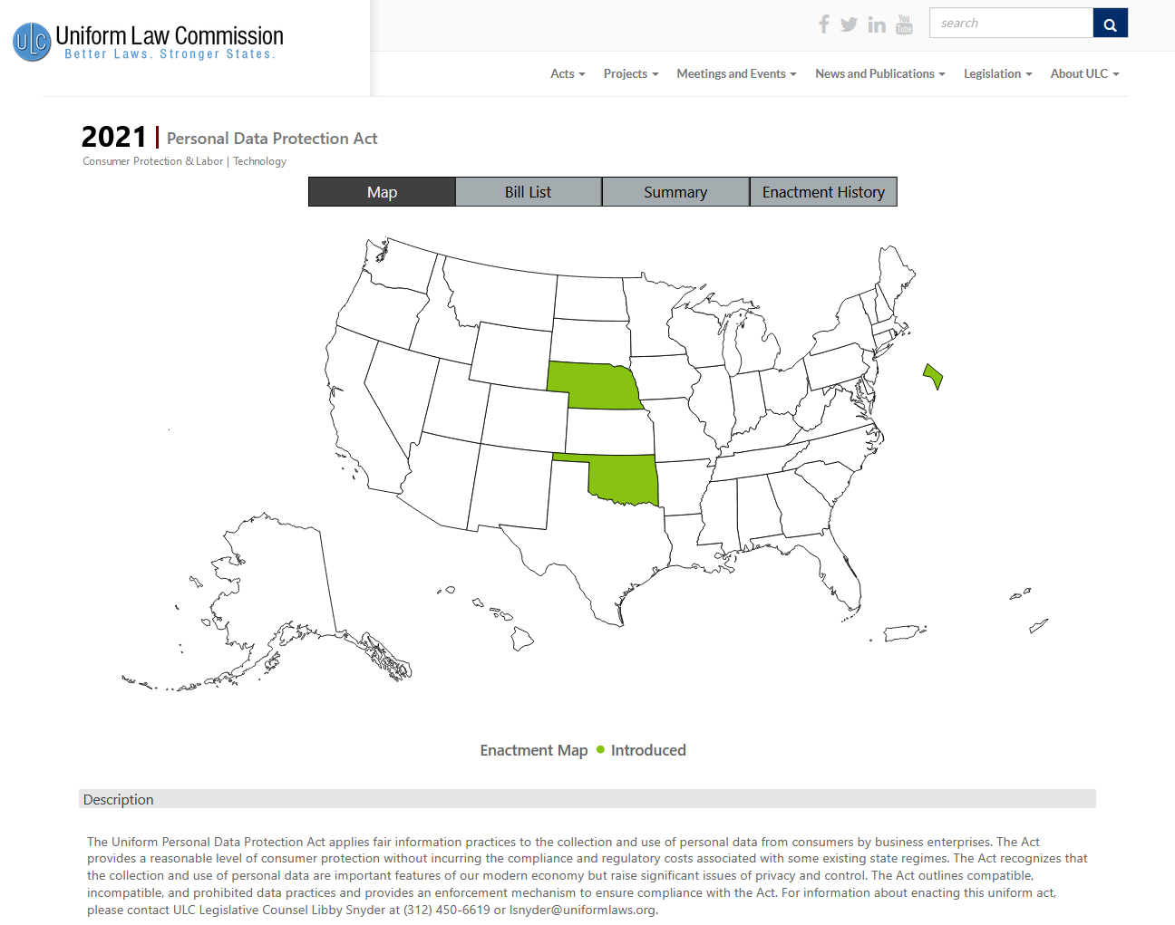
Uniform Personal Data Protection Act
Notes:
And, now, as of last year, the Uniform Law Commission finalized the Uniform Personal Data Protection Act.

Slide 13
The current state of privacy law
The U.S. doesn’t recognize a general right to privacy.
Specific laws cover specific kinds of information
FERPA - educational records
HIPAA - health records
financial records
As of 2021, three states passed a general privacy / personal data law:
California in 2018; Colorado in 2021; Virginia in 2021
Possible ways to have a U.S. privacy law:
Federal law is one path
Many states adopting a similar law is one path
Notes:
The significance of the Uniform Personal Data Protection Act is that many states adopting a similar law in each state is one way that the US might start to have a privacy law.
It’s likely that the Uniform Personal Data Protection Act will be widely adopted, and definitely any state looking to regulate this area is more likely to go with the Uniform Law Commission than to go it’s own way.
Up to now states would look at those 3 other states, at other countries, and at abstract concepts of how they want it to be. Going forward, states will look at the Uniform Personal Data Protection Act and start from there.
In a sense, this is the beginning of finality.
Definitely, going forward, the federal government could do a general privacy law. But, the states are very likely to either follow Uniform Law Commission or not to do anything unified and consistent.

Slide 14
What the Uniform Personal Data Protection Act is and does
Data access - people can request to see and correct data with the company that collected it directly from the person (people can’t request this from companies that bought it or got it downstream from the collecting entity; can’t request to delete the data)
3 classes of personal data:
compatible data practice
compatible with consumer expectations and best interests
(long list of these)
No consent needed
incompatible data practice
incompatible with expectations and direct interests of consumers
(anything else not in a list)
Must get consent; can have a fee scale to opt out
prohibited data practice
prohibited by this act (ie. harmful)
(list of these)
Can’t do these, even with consent.
All these have to be in the privacy policy - company has to say what it’s collecting.

Slide 15
Current social problems:
Lack of consent: Click through ads don’t allow real consent or choice. There isn’t even time to read all of them, so there’s definitely no choice.
Surveillance technology: Targeted advertising: This depends on tracking, this how tech companies make money, but people don’t want to be tracked.
Surveillance technology: Widespread use of cameras in public places and of facial recognition has led to backlash from the public.

Slide 16
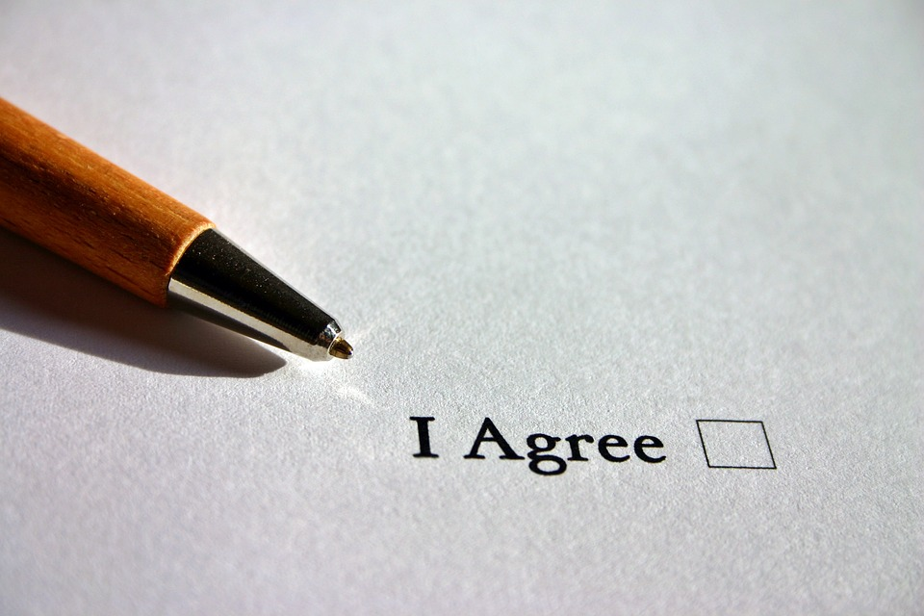
Current social problems:
Lack of consent: Click through ads don’t allow real consent or choice. There isn’t even time to read all of them, so there’s definitely no choice.
Uniform Personal Data Protection Act:
The law should make most choices for people, and then only give people the most important choice.
Idea of the law giving consent on each person’s behalf. There’s a long list of compatible data practices, and those can be done without consent.
Notes:
Image from https://pixabay.com/photos/agree-english-consent-contract-1728448/ (no attribution required)

Slide 17
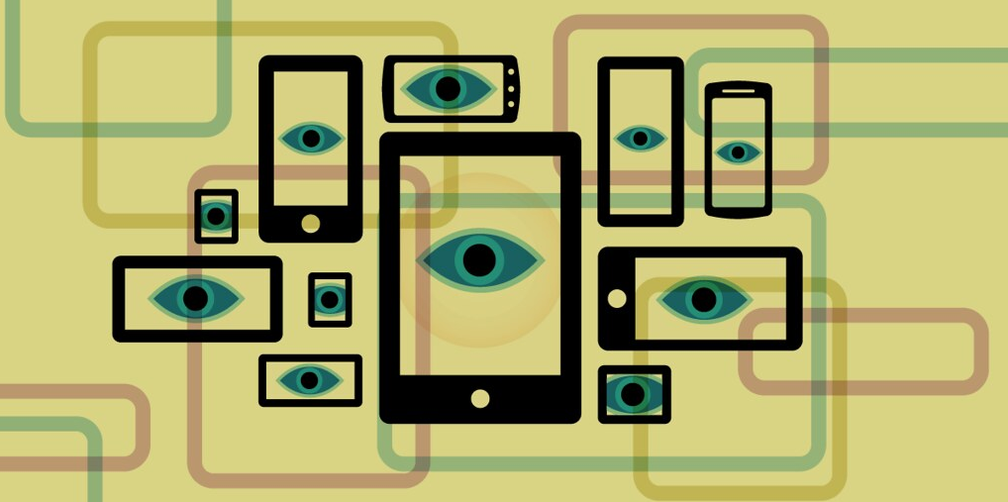
Current social problems:
Surveillance technology: Targeted advertising: This depends on tracking, this how tech companies make money, but people don’t want to be tracked.
Uniform Personal Data Protection Act:
Targeted advertising is a compatible data practice. No consent is needed to share and use personal data for targeted advertising.
Notes:
Picture from https://www.flickr.com/photos/electronicfrontierfoundation/39225195145/in/photostream/ CC-By (photo by Electronic Frontier Foundation)

Slide 18
Current social problems:
Surveillance technology: Widespread use of cameras in public places and of facial recognition has led to backlash from the public.
Uniform Personal Data Protection Act:
Section (3)(c)(1): "This [act] does not apply to personal data that is: (1) publicly available information;"
Section (2)(15):
“Publicly available information” means information:
(A) lawfully made available from a federal, state, or local government
record;
(B) available to the general public in widely distributed media, including:
(i) a publicly accessible website;
(ii) a website or other forum with restricted access if the information is available to a broad audience;
(iii) a telephone book or online directory;
(iv) a television, Internet, or radio program; and
(v) news media;
(C) observable from a publicly accessible location; or
(D) that a person reasonably believes is made available lawfully to the general public if:
(i) the information is of a type generally available to the public;
and
(ii) the person has no reason to believe that a data subject with authority to remove the information from public availability has directed the information to be removed

Slide 19
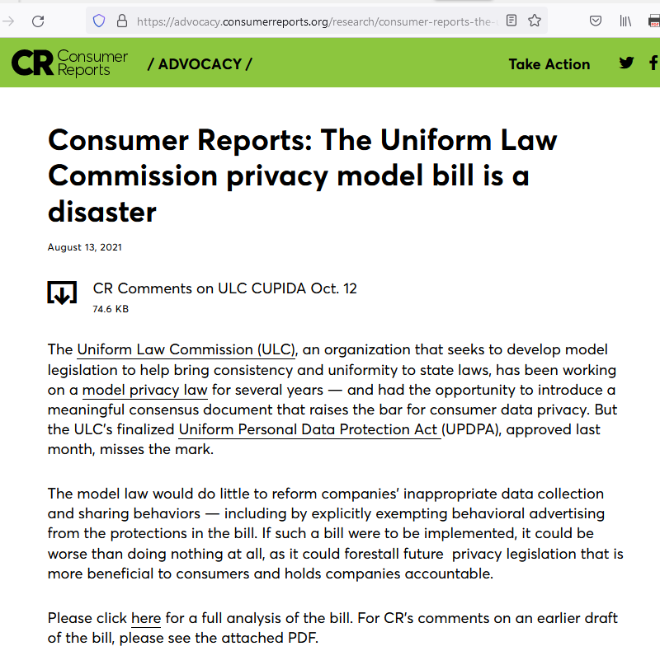
Notes:
(!! add Consumer Reports screenshot !!)
It’s pretty bad for regular people. Even Consumer Reports takes a grim view.
Nevertheless, this is what we have.

Slide 20
Impact
State law is likely to lock in the status quo
No right to view downstream personal data bought from the original company that collected it.
No privacy in info collected from public places
Cameras in public - not restricted
Downloading and reselling web content (jail records, social media posts, etc.) - not restricted
Current industry norms are protected
Targeted advertising
Data that permits analysis for research or development of a product or service
Notes:
Basically, many of those ethical conflicts get tossed away.

Slide 21
Implications for Libraries
Any change will be labor intensive and take tremendous coordinated effort
NISO Privacy Principles haven’t been picked up by vendor terms of service.
Libraries should reckon with pressure for usage statistics being in conflict with the long term library value for privacy.
Ethics is written out of reality, and anyone studying data privacy should be aware of this idea of law giving consent on behalf of people.

Slide 22
Locking in the status quo for business,
recent changes to U.S. data privacy law and long-term impacts on data collection
Wilhelmina Randtke
Head of Libraries Systems and Technologies
Georgia Southern University
Research and Assessment Interest Group (RAIG) Mini-Conference, March 25, 2022

