Slide 1
Tensions Between Privacy versus Fundamental Needs of OER
2022 Open Education Conference
Virtual, October 17-20, 2022
Wilhelmina Randtke, Head of Libraries Systems and Technologies, Georgia Southern University
Notes:
Hello, I’m Wilhelmina Randtke. I’m the Head of Libraries Systems and Technologies at Georgia Southern University. Today I’m talking about Tensions Between Privacy versus Fundamental Needs of Open Educational Resources.

Slide 2
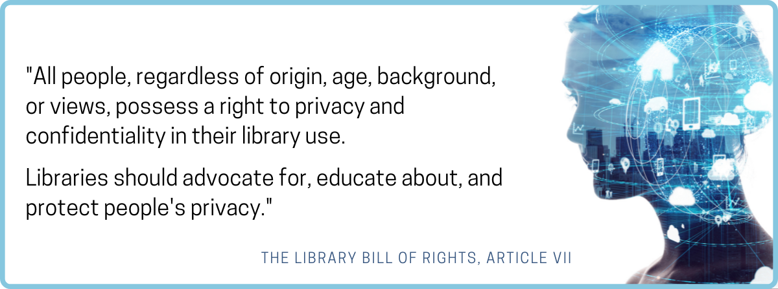
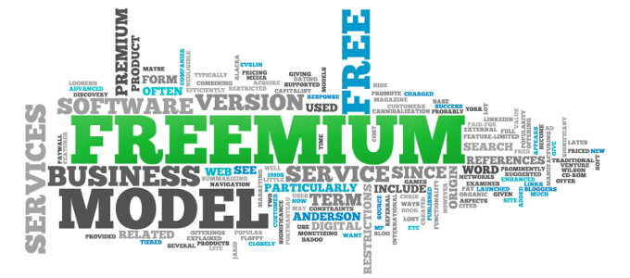
Privacy as a value
For Libraries
Privacy is a longstanding value
For OER
Privacy and social justice
Notes:
First off… why should we care?
Both libraries and the open educational community have reasons to value privacy.
For the library community privacy is a long standing value. And libraries are often deeply involved in OER. The library tends to be somewhere where all academic disciplines are using resources. Libraries tend to spend on material, to where when open resources get adopted libraries get a cost savings. And libraries tend to run publishing programs to where they are able to assist with publishing and sharing out open educational resources.
Privacy is a long standing value for Libraries. It’s written into the Library Bill of Rights promoted by the American Library Association. “All people, regardless of origin, age, background, or views, possess a right to privacy and confidentiality in their library use. Libraries should advocate for, educate about, and protect people’s privacy.”
Then, for the OER community, privacy is not as clearly stated a value. But open educational resources has a social justice aspect to it. Open educational resources are fundamentally about social justice issues like better access to information, having someone be able to study without the cost of materials being a barrier, and about promoting equality. And, OER is kinda sorta based in technology. Definitely the potential for technology to get rid of printing costs and to decouple the content from physical media is part of the potential. Remixing, sharing, making copies - that’s all easier with digital. Some of the issues with privacy are also much easier or newly possible in digital
Which brings me to the “freemium” business model. A common business model in technology is to provide a set of services for free or for a discount in exchange for personal data. That’s now starting to be written into law, that charging more for privacy is protected and not a consumer protection issue.
That’s bad for equality and equity. Demographics with more money can buy privacy, and people with money can buy privilege, so privacy will be less important to protect for the people with the most power because they will be able to buy their way out of regular people problems. Promoting a baseline level of privacy promotes freedom for everyone.
ULC comment on section 5: “A variety of firms follow a business model that provides services for free or at a reduced rate in exchange for their customers providing personal data. This provision does not affect such a business model.” https://www.uniformlaws.org/HigherLogic/System/DownloadDocumentFile.ashx?DocumentFileKey=aa01aeda-7133-723a-de2b-5c63c33fbad8&forceDialog=0
Freemium word image from https://bangwin.net/2018/03/29/model-bisnis-hiper-disruptif-freemium-model/ (I can’t actually find a license on that page.)

Slide 3
Tension: Showing the value of free… Statistics
Notes:
The first fundamental tension between privacy and OER comes from the need to show the value of OER.
Making open educational resources, sharing them out, maintaining them over time, and hosting a publishing platform for them all cost money. There’s always going to be pressure to justify that expenditure. And… probably that is going to be done by showing usage statistics.
We want to know and be able to show who is using the OER, how much usage specific OER are getting, and generally to be able to show the value through use.
Anyone comparing different publishing platforms is probably going to look at usage statistics as something to use as part of that comparison. Anyone putting out an RFP for a publishing platform is probably going to have a section on statistics. Basically, the advocates publishing OER will demand statistics to be built into tools for sharing out OER.

Slide 4
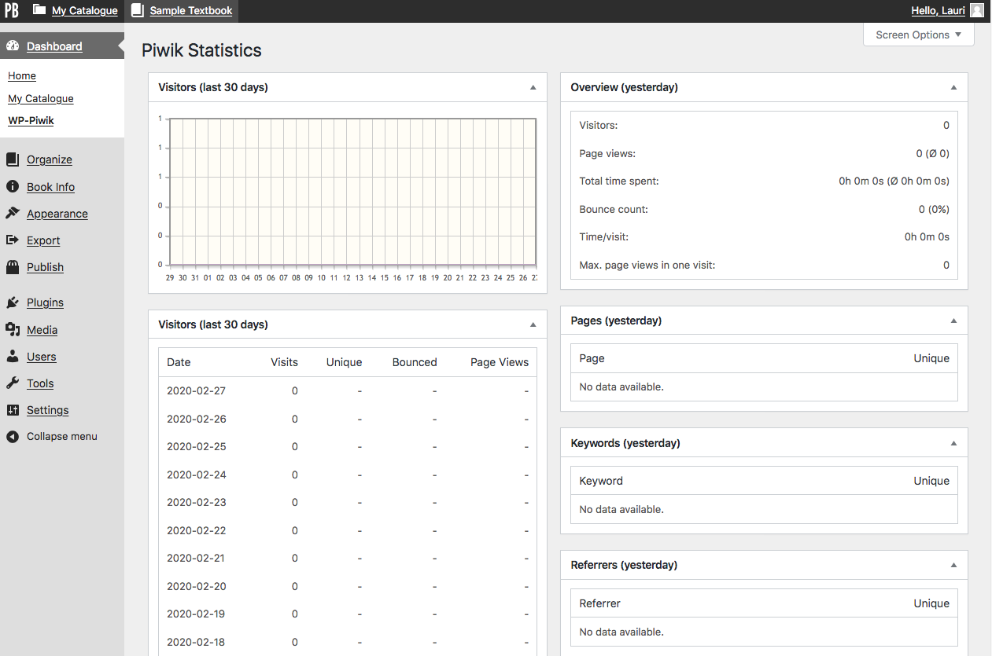
Tension: Showing the value of free… Statistics
On left: Pressbooks statistics
Notes:
There’s statistics for Pressbooks.
Pressbooks statistics screenshot is from https://opentextbc.ca/pressbooks/chapter/pressbooks-account-stats/

Slide 5
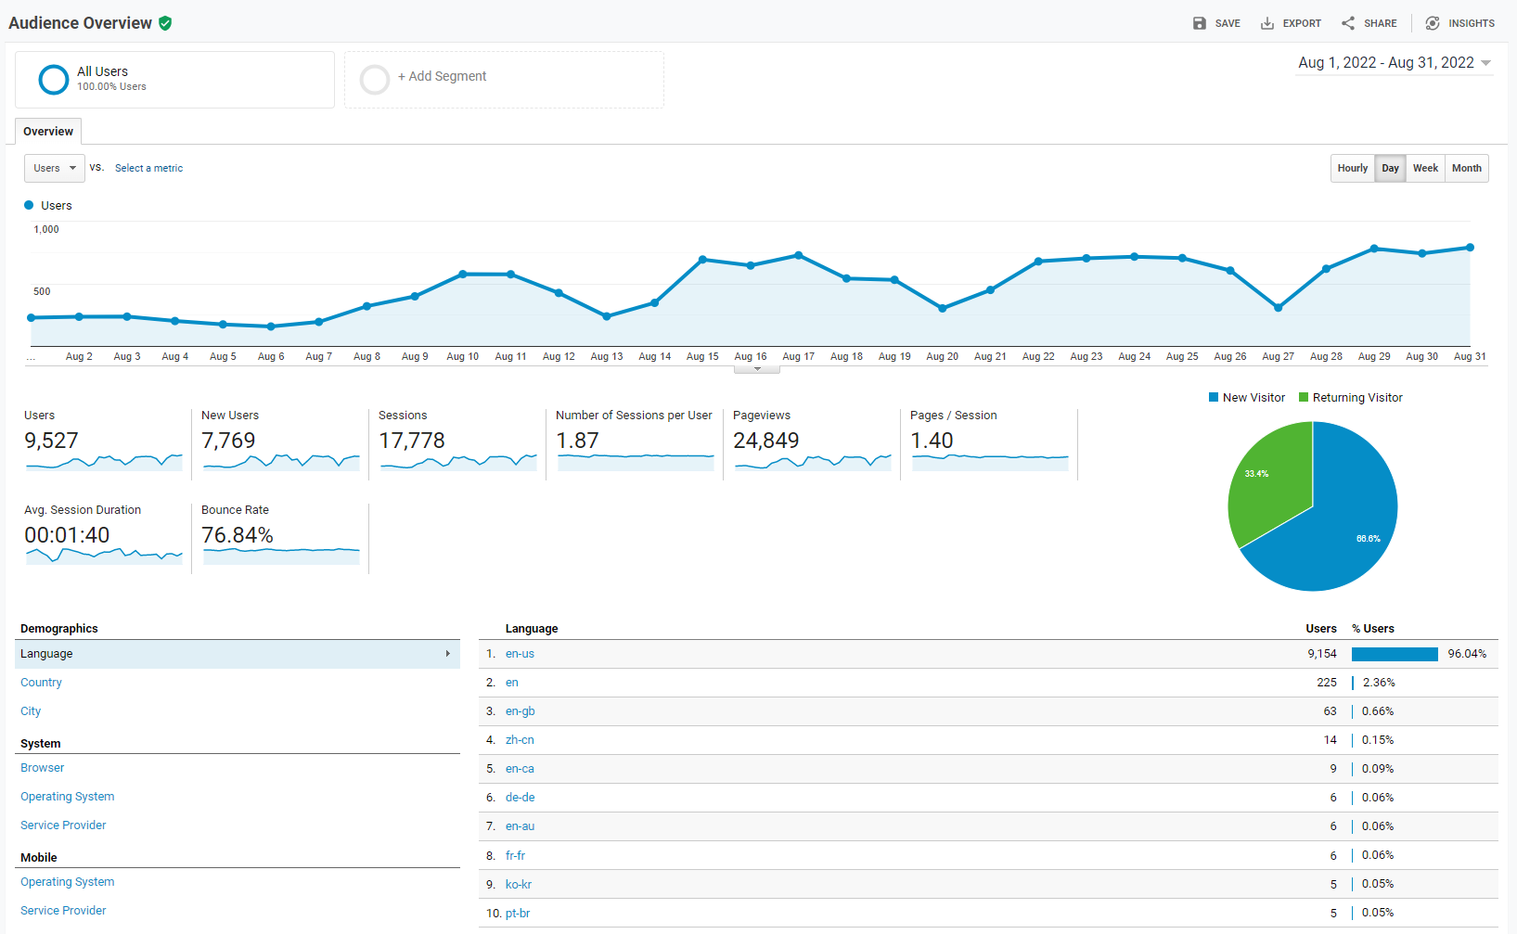
Tension: Showing the value of free… Statistics
On left: Google Analytics statistics
Notes:
There’s Google Anaytics. We put it on everything.
Pic is a screenshot of the Georgia Southern University Libraries’ usage statistics.

Slide 6
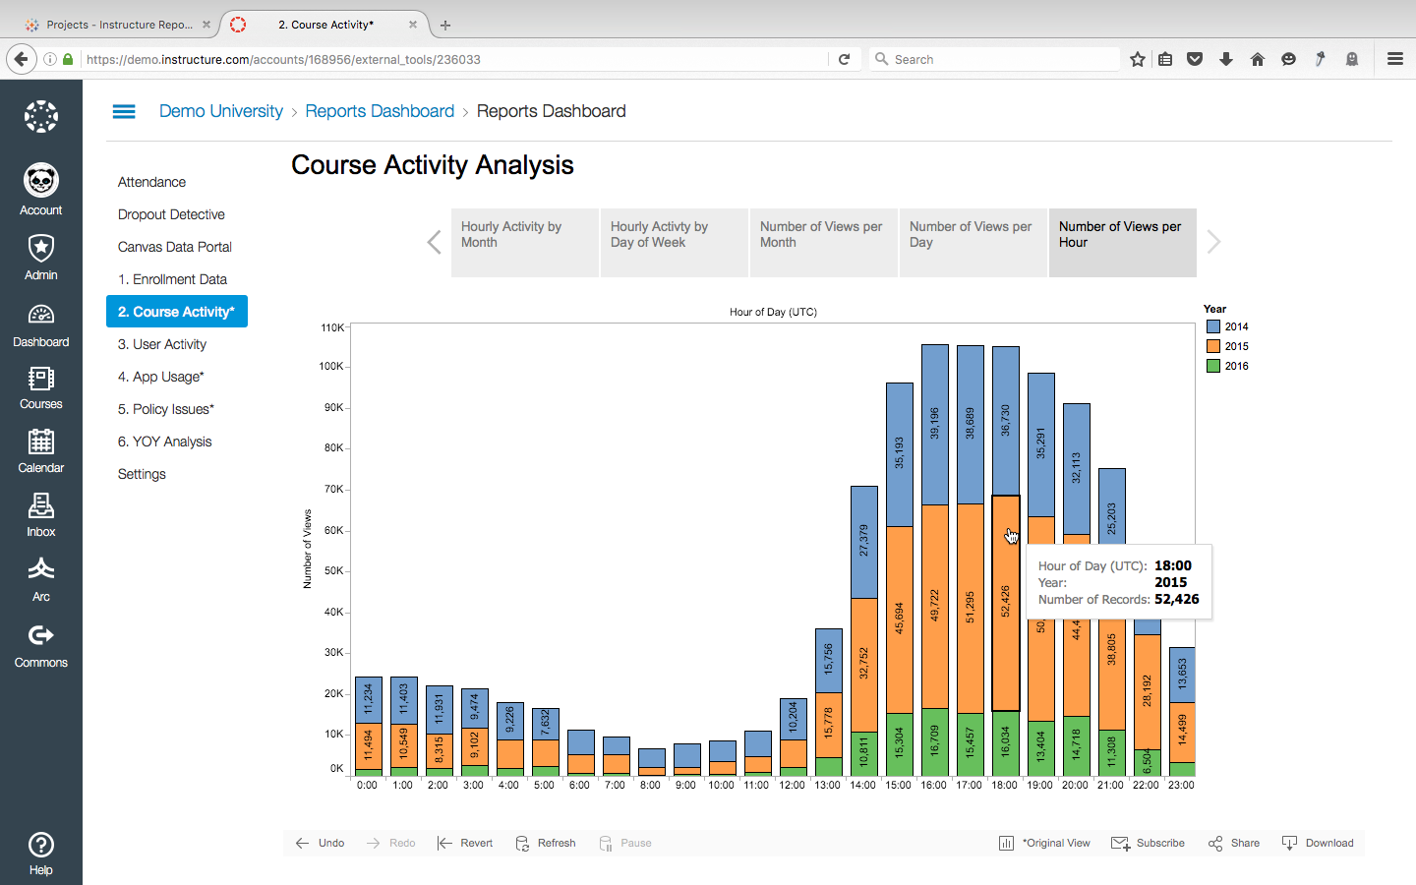
Tension: Showing the value of free… Statistics
Notes:
There’s statistics in Canvas.
Pic is from https://www.pinterest.com/pin/211174969265260/ . It is not openly licensed, but it is a factual screenshot of the analytics available in Canvas.

Slide 7
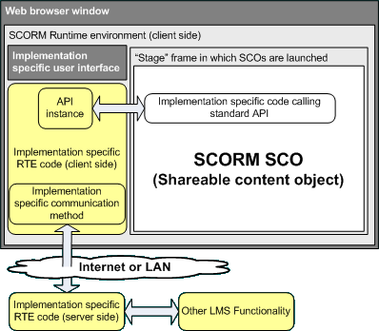
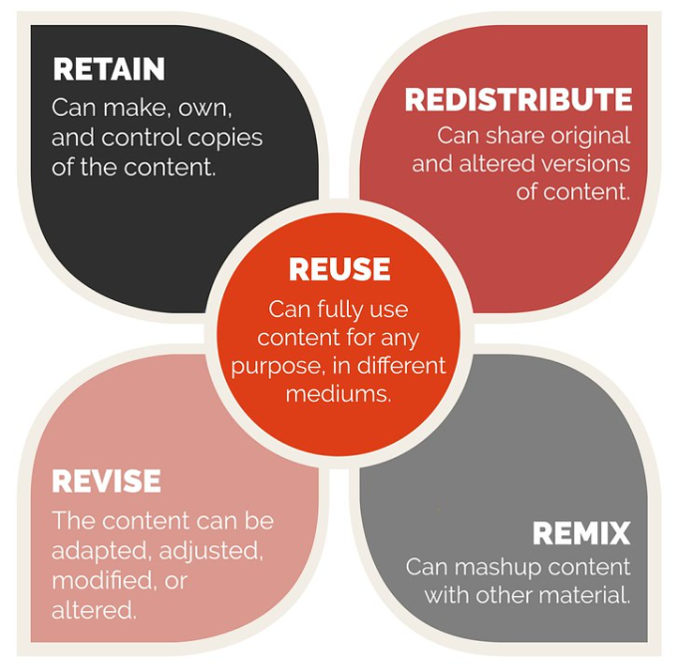
Tension: There is demand to share grades, progress, etc. with Learning Management Systems
Interoperability, and dropping grades into an LMS is something teachers want.
Notes:
When I was working more directly with OER, and with digital publishing in Florida, a common conversation with faculty would go something like this: I would say, you can upload OER. Faculty would want quizzes that put the grades in the learning management system, and would want all kinds of interactive content and interoperability. And, I would be like, “You can upload a PDF.” And that really would not go over well.
Good OER, done right, will also be easy to implement. Dropping grades in the LMS makes it easy for teachers and faculty to grab something and be able to integrate it right in, and really helps adoption. And, as it turns out, we have the SCORM framework for being able to pass off to an LMS information about progress through a learning resource, grade information from a learning resource, and completion information.
In OER, we have our 5Rs. But stepping back, looking at what makes a good learning resource period whether that’s open or licensed or proprietary - making it easy for teachers to grab it, use it, and get the progress and completion information automatically into their course - that’s what’s driving adoption. That makes it easy for people. It’s not unique to open. This about sharing information to the LMS applies to all the learning resources, and to compete, OER should be doing that. For any learning resource, the easier it is for teachers, and the more value it brings, the more likely teachers are going to be to use it. Interoperability and sharing grades is killer app feature that teachers want. There is a standard for that - SCORM - Sharable Content Object Reference Model - it’s been around since 2000, and it’s built into all the major learning management system platforms. And, at the core of that it’s passing information about an individual student or learner’s progress through a resource. Tracking and getting that information and then sharing that information is a killer app feature driving OER adoption for busy teachers.
5Rs pic is from https://www.flickr.com/photos/ellenmetter/37631415622/in/photostream/lightbox/
SCORM diagram is from https://web.archive.org/web/20160203003142/http://www.ostyn.com/standards/docs/GeneralArchitectureForLMSImplementation-1.htm

Slide 8
Tensions Between Privacy versus Fundamental Needs of OER
2022 Open Education Conference
Virtual, October 17-20, 2022
Wilhelmina Randtke, Head of Libraries Systems and Technologies, Georgia Southern University
Notes:
I hope this got people thinking more about the issues.
These fundamental needs of OER - statistics to show the value, and ability to share out completion information - are pretty fundamental to the survival and adoption of an OER program.
My hope is that being more aware of the tension with privacy and with social justice issues will get people thinking about how to act more ethically along the way. To think about what’s the minimum amount of personal information needed, where that information is going (especially off to huge data brokers like with Google Analytics), and how to proceed more ethically. And especially, thinking about what’s a baseline level of privacy that we want to ensure for everyone using OER. Often thinking about something and going in with an awareness can bring up questions that lead to small changes with a big impact.

