Slide 1
Welcome to Kraemer Copyright Conference 2021!
Implementing RightsStatements.org in the digital library, and in search engines
Presenters: Kaleena Rivera & Wilhelmina Randtke

Slide 2
Reminders
•Please keep your microphone and camera off.
•There will be 15 minutes of Q&A at the end of the session.
•Post your questions in chat, and I will read as many as possible during the Q&A session.
•If clarification is necessary for your question, you may unmute to expand or explain.
•Recordings will be posted here: https://copyright.uccs.edu/ at the end of the month.
•Please see KCC Code of Conduct at: https://copyright.uccs.edu/code-conduct.

Slide 3
Implementing RightsStatements.org in the digital library, and in search engines
Kaleena Rivera, Florida Gulf Coast University (FGCU)
Wilhelmina Randtke
Kraemer Copyright Conference, June 8, 2021
Notes:
Molly introduces.
Kaleena Rivera
Kaleena Rivera has a background in archives and special collections, with a focus on digital initiatives to make historic objects publicly accessible to the public via the internet. She has recently taken a role as Scholarly Communications Librarian at Florida Gulf Coast University in Fort Myers, Florida. Although her focus has been diverted to institutional scholarship, her knowledge of copyright and digital preservation continues to serve her well.
Wilhelmina Randtke
Wilhelmina Randtke has a background in law and in digital publishing technologies. Most recently she was the Digital Library Services and Open Educational Resources Coordinator at the Florida Virtual Campus, Florida's central office for technology in public higher education, where she was product manager for the Florida Online Journals publishing platform and the state digital library platform implemented in Islandora.

Slide 4
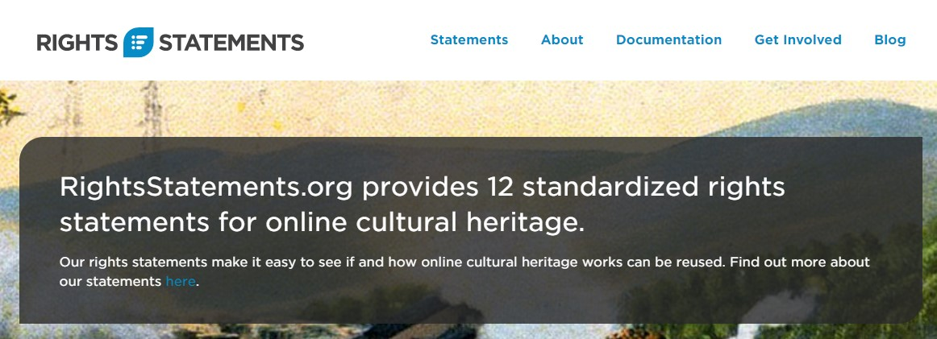
What is RightsStatements.org ?
Standardized notices that briefly describe copyright status
RightsStatements.org was developed to address cultural heritage institutions
URLs are human-readable and machine-readable
NOT to be confused with licenses (such as CC)
Notes:
WVR
-RightsStatements.org , the rights statements, are standardized notices that briefly describe the copyright status of an asset to interested parties, as opposed to notices that vary in wording from institution to institution (which can cause confusion for users)
-RightsStatements.org came about as a means of addressing the emerging need for cultural heritage institutions to simplify copyright notifications while being broad enough for wide use. They are notable in that they use URLs to differentiate between statements
- URLs offer both a human-readable version (via HTML) and a machine-readable (RDF) formats. This renders the URLs inter-operable in addition to standardizing for ease of use.
- It’s important to note that rights statements should not be confused with the process of licensing work, such as with Creative Commons.

Slide 5
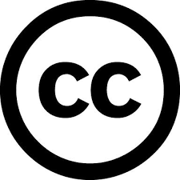
“So what’s the difference?”
Backing it up...
Let's revisit Creative Commons licenses.
Who here is familiar with Creative Commons licenses?
Creative Commons licenses are for copyright owners to specify use (can share, transform, etc.)
Does NOT grant copyright and can’t be licensed by anyone else
CC is great for sharing/expanding copyright work without asking permission
Rights statements divulge rights status where CC can’t be used
Notes:
WVR
Backing it up. Before RightsStatements.org , let’s revisit Creative Commons licenses. Who here is familiar with Creative Commons licenses? (you can just type a yes or no in the chat)
-Just a quick refresher: Creative Commons licenses were developed as a means for copyright owners to grant usage permissions to other people.
-It at no point grants copyright to any other individual and no one aside from the copyright owner can apply a CC license to their work
-While a Creative Commons license is ideal to allow usage without having to ask permission, it does provide does not stipulate copyright status
-Rights statements provide clear information about the rights status of works in situations where Creative Commons licenses and other legal tools cannot be used.

Slide 6
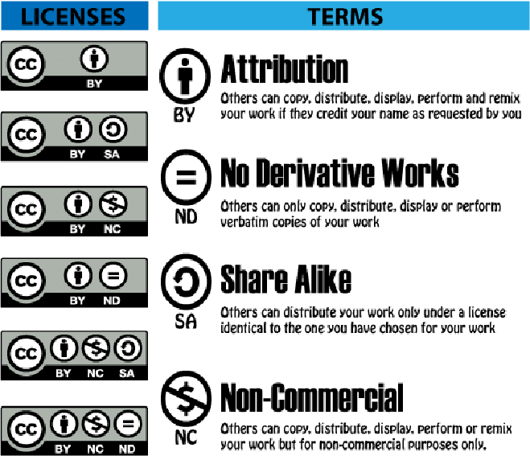
Creative Commons
licenses
Notes:
WVR
So, basically Creative Commons licenses let authors and creators grant reuse permissions to their works. The problem they solve is that copyright attaches to creative works automatically. If someone makes something, they may want it copyrighted and to have the full force of ownership. But they may also want other people to be able to reuse or remix their material. And they may want others to be able to put it out there - let people print it out and pass it out in a classroom or at an event, let people upload it to a website and share it out - they may just want it out there being used. Traditional copyright doesn't make it easy to allow for that. Creative Commons licenses are a standardized way for creators to mark up their creative work so that it's really clear what reuse permissions anyone would have.
============================
The image shows a chart of the creative commons licenses and of the terms used to build the licenses.
Here are the licenses:
BY
BY-SA
BY-NC
BY-ND
BY-NC-SA
BY-NC-ND
Here are the terms:
BY = Attribution: Others can copy, distribute, display, perform and remix your work if they credit your name as requested by you
ND = No Derivative Works: Others can only copy, distribute, display of perform verbatim copies of your work
SA = Share Alike: Others can distribute your work only under a license identical to the one you have chosen for your work
NC = Non-Commercial: Others can copy, distribute, display, perform or remix your work but for non-commercial purposes only.

Slide 7
Creative Commons
licenses
Key point:
The licenses break out use permissions in a standardized way that people can learn and apply, and that computers can understand.
Notes:
WVR
The key point about them is they break out user permissions in a way that people can learn and apply, and that computers can understand.
This chart shows the Creative Commons licenses. (The Creative Commons standard also includes a public domain mark and a public domain dedication, but this chart is all the licenses for limited reuse.) You can see there’s a one sentence definition for each. So, regular people can quickly understand this. And there’s codey type way of representing it “CC-BY” “CC-BY-SA” “CC-BY-NC” and those are something computers can quickly recognize and process and sort on.
So, instead of people having to think through permissions and write a paragraph about you can do x, y, and z, they have a simple license to grab and use. And instead of computers having to do some kind of free text analysis, they can look at a little standardized snippet and quickly sort all the items with the same permissions together.
Easy for people to understand and apply. Easy for computers to understand and use in search.
===============================
The image shows a chart of the creative commons licenses and of the terms used to build the licenses.
Here are the licenses:
BY
BY-SA
BY-NC
BY-ND
BY-NC-SA
BY-NC-ND
Here are the terms:
BY = Attribution: Others can copy, distribute, display, perform and remix your work if they credit your name as requested by you
ND = No Derivative Works: Others can only copy, distribute, display of perform verbatim copies of your work
SA = Share Alike: Others can distribute your work only under a license identical to the one you have chosen for your work
NC = Non-Commercial: Others can copy, distribute, display, perform or remix your work but for non-commercial purposes only.

Slide 8
Creative Commons licenses launched in 2002.
They are now incorporated into major search engines:
Bing Image Search
Google Advanced Image Search
Creative Commons Search (CC Search)
Flickr
Notes:
WVR
Creative Commons launched in 2002. They have been around long enough and are popular enough that they are on lots of content. And because they are on so much content, search engines use them. Some example search engines that use them are Bing, Google Advanced Image Search, Creative Commons Search, and image sites like Flickr.

Slide 9
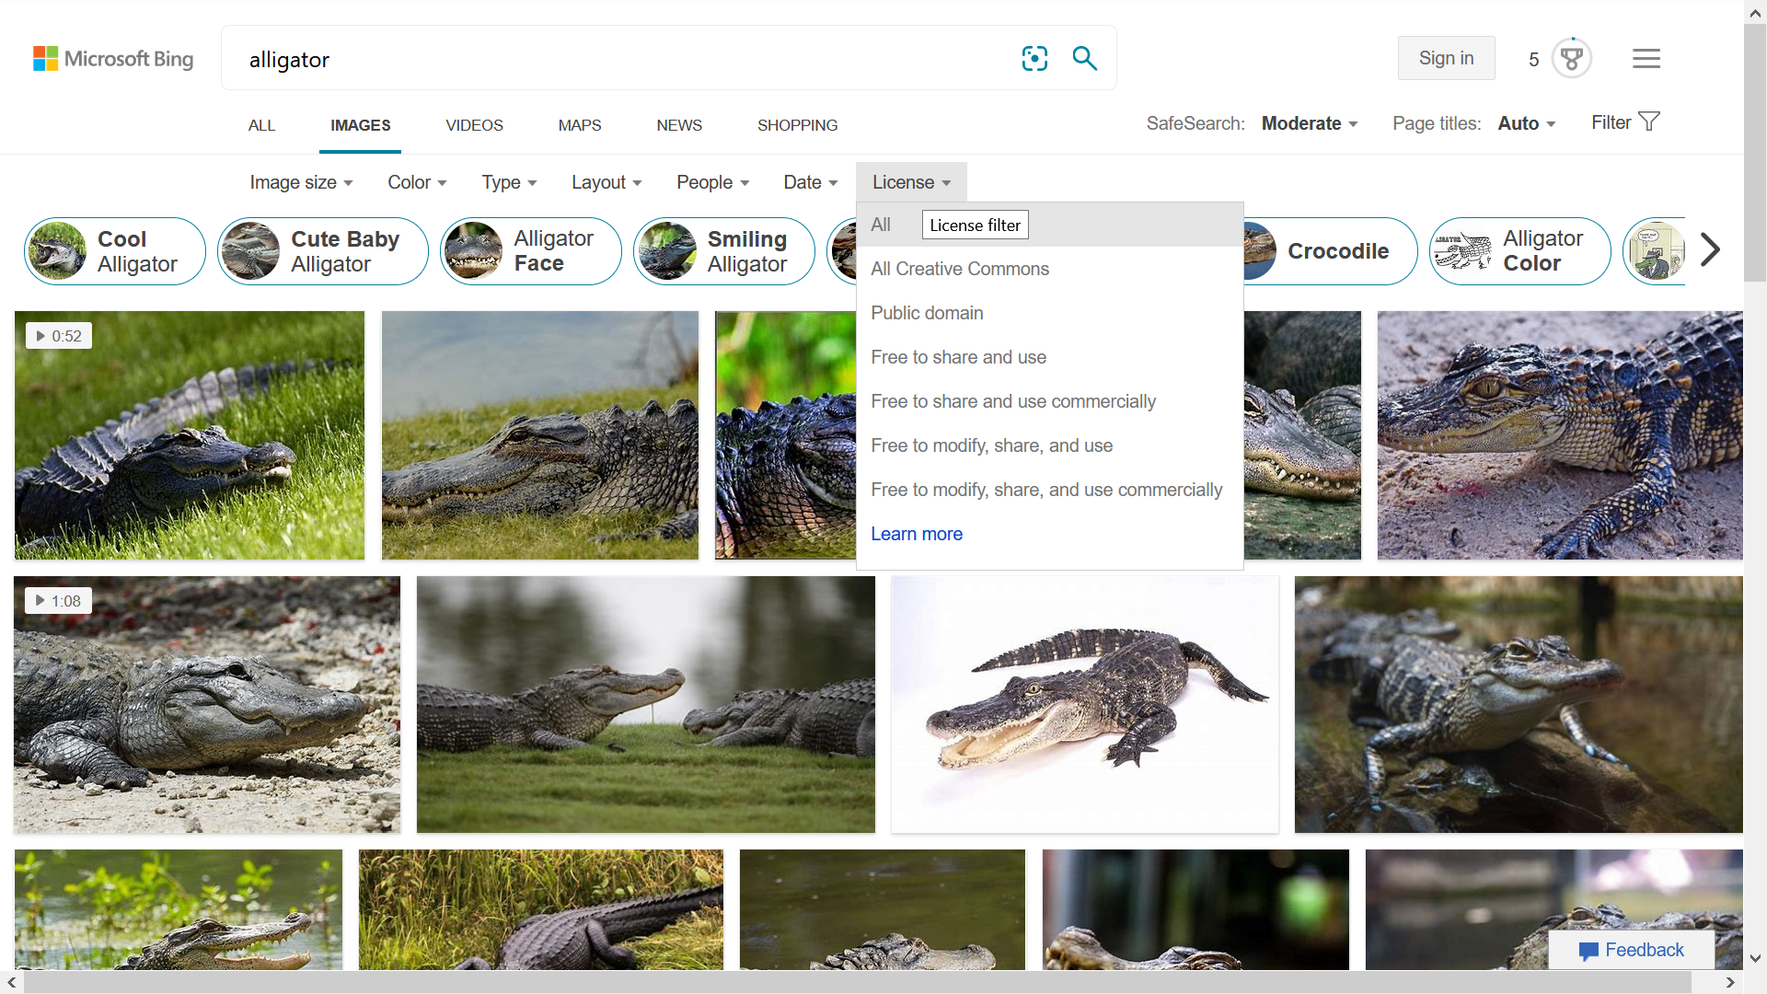
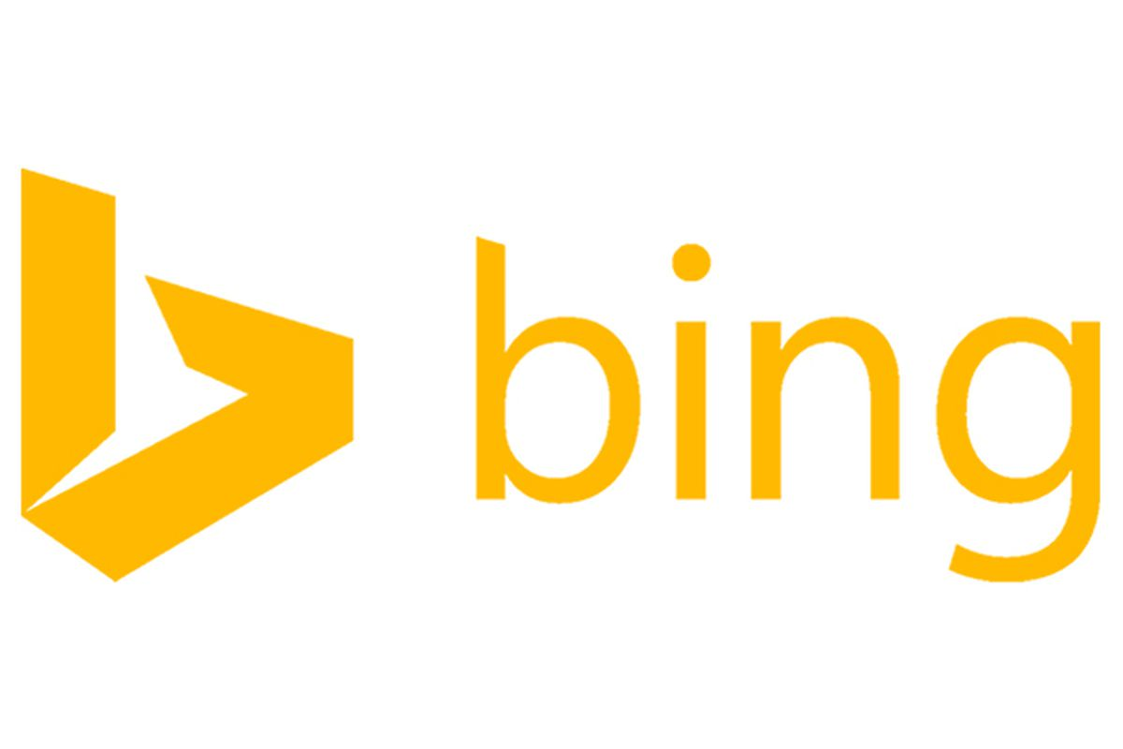
Notes:
WVR
Bing Advanced Image Search uses Creative Commons. There’s a drop down facet for Creative Commons.

Slide 10
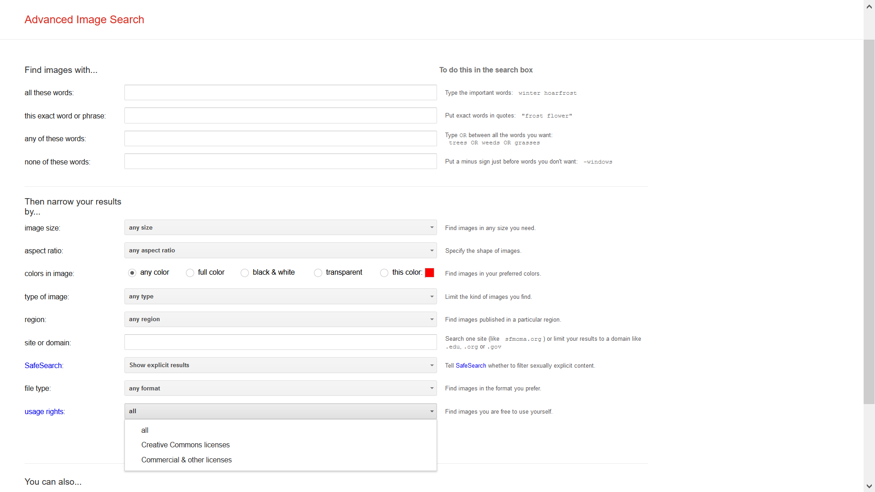
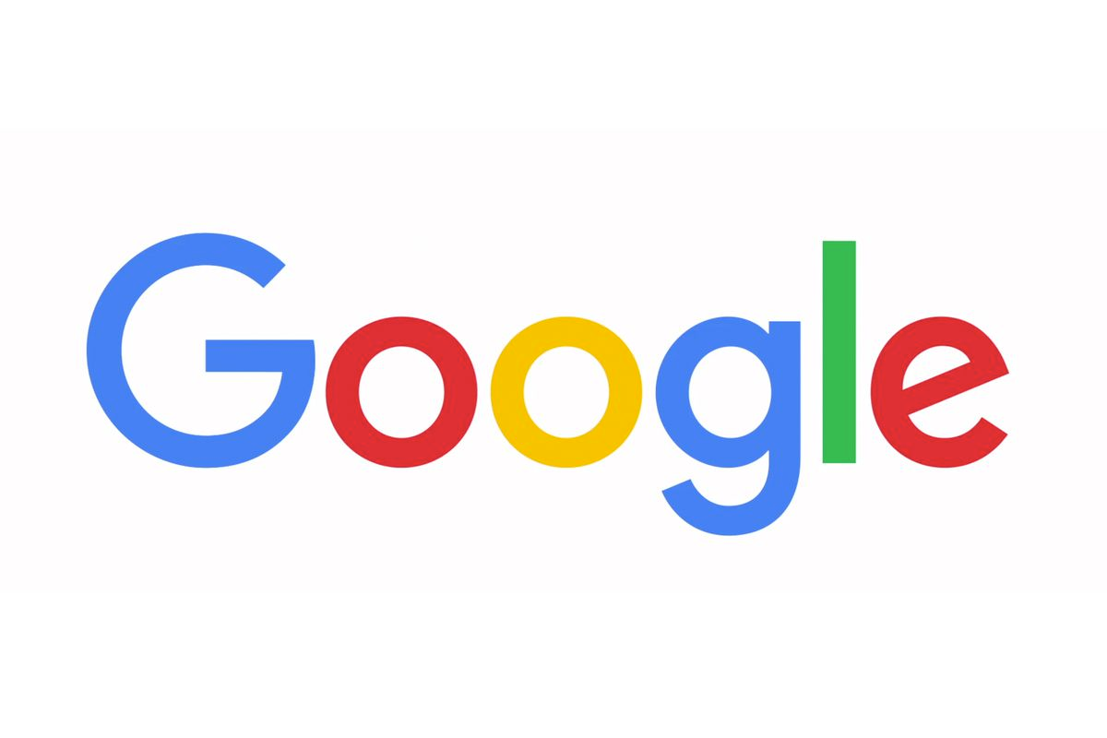
Notes:
WVR
Google Advanced Image Search uses Creative Commons. It used to be more fine grained by what kind of reuse, but there’s still a drop down box for these licenses.

Slide 11
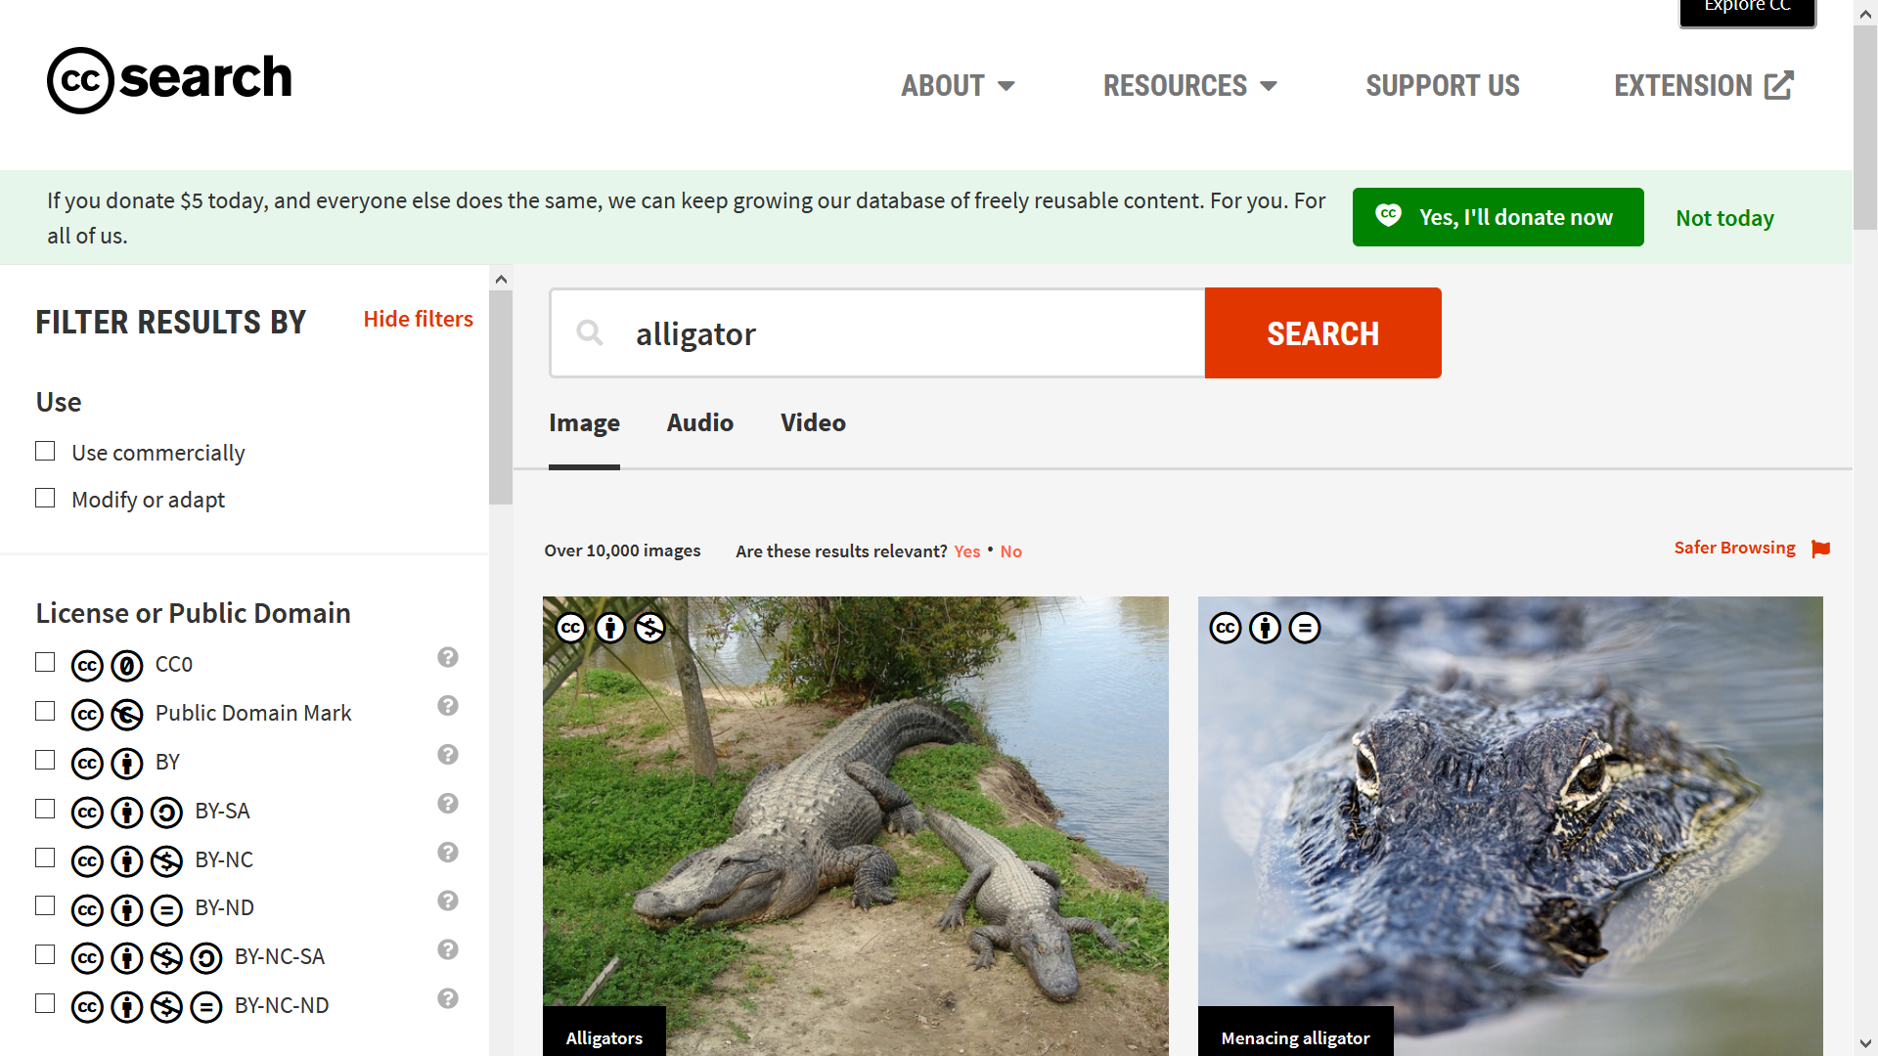
Notes:
WVR
Creative Commons has its own search engine, which searches only Creative Commons licensed material, and lets you facet on the side based on what kind of licenses you need for your project.

Slide 12
Creative Commons LICENSES
Limitations of a license:
The author/creator/copyright holder has to assign it.
There’s legal liability if you put one on and didn’t have the authority to do so.
The bottom line: Awesome that’s it’s useful in search; bummer that archives can’t add these.
Notes:
WVR
Creative Commons is licenses.
Welp, I work in archives. The bug huge limitation of Creative Commons is that it's a license, so it has to be applied by the author or creator. In an archive, you have old stuff. Often the author is dead long enough that the material is out of copyright. But, since the author is dead, they can't issue a Creative Commons license. Also, a digital library or archive shouldn't issue a license. The licenses make a promise "I own copyright to this, and I'm giving this exact permission for reuse." A digital library probably doesn't want to make a promise. Instead a digital library wants to give information about copyright status. So, give the information, but not make a promise. Those are different in terms of liability. It's saying "I own it, and here's my permission I’m giving to you" versus "This exists, and this is what I believe permission to be." Less liability gives way more flexibility for libraries and archives to give useful information without the implications that a license would have.
This with the Creative Commons - both the potential for being able to search and find content on copyright status, and the fact that licenses aren't a good fit for digital libraries which have older cultural heritage material - was what led to RightsStatements.org.

Slide 13
Search by copyright status is useful
Notes:
WVR
Search by copyright status is useful. But, digital libraries can’t add Creative Commons to most of their material. And legal liability for putting a license on something that can’t legally be licensed is kind of a chiller.

Slide 14
The Solution: RightsStatements.org
Similar to Creative Commons:
Shows copyright status.
Easy for people to understand and assign to items.
Computers can understand it, so it can be used in search.
Different from Creative Commons:
Not a license.
So… Don’t need the author/copyright owner in order to add these. And no liability for inaccurate information.
Notes:
WVR
This need - to quickly add and show a copyright status was the driving force behind RightsStatements.org .
RightsStatements.org was developed by large library search sites - Digital Public Library of America and Europeana - in order to meet that need: The need to show copyright status without issuing a license, and to show it in a way that people can easily mark up the status and so that computers can easily incorporate copyright status into search. This led to the rights statements.

Slide 15
Notes:
WVR
There are 3 categories of rights statements: In Copyright, No Copyright, and Other.
There are 12 statements, so when you see the RightsStatements.org value for something, you get more fine grained information about copyright and allowed uses.

Slide 16
Notes:
WVR
This is slide 1 of 3 with the rights statements. There are 12 of them total. This slide has the statements for In Copyright objects. Similar to Creative Commons, there is a human readable short statement. And similar to Creative Commons, there is a short way of tagging the rights statements so that computers can grab a rights statement and get a copyright status and use it in search.
So, easy for a person to read, understand, and apply. Then easy for a computer to read and use in search.

Slide 17
Notes:
WVR
These are the rights statements for objects that are not in copyright. Once again, they are easy for a person to read, understand, and apply. Then easy for a computer to read and use in search.

Slide 18
Notes:
WVR
And these are the statements for copyright undetermined.

Slide 19
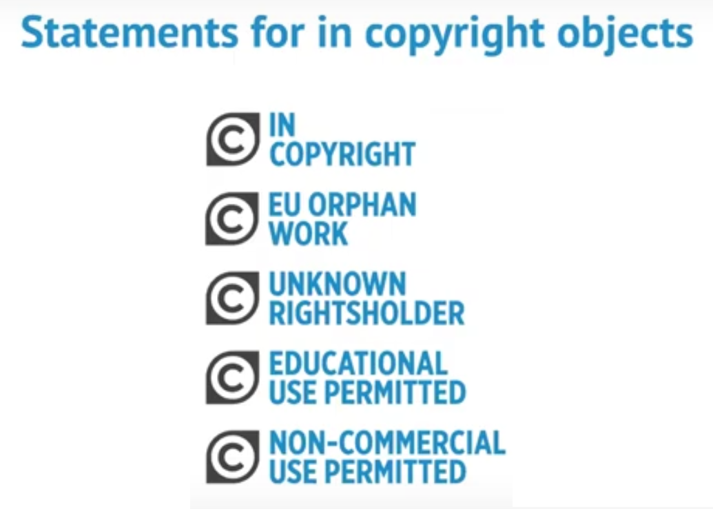
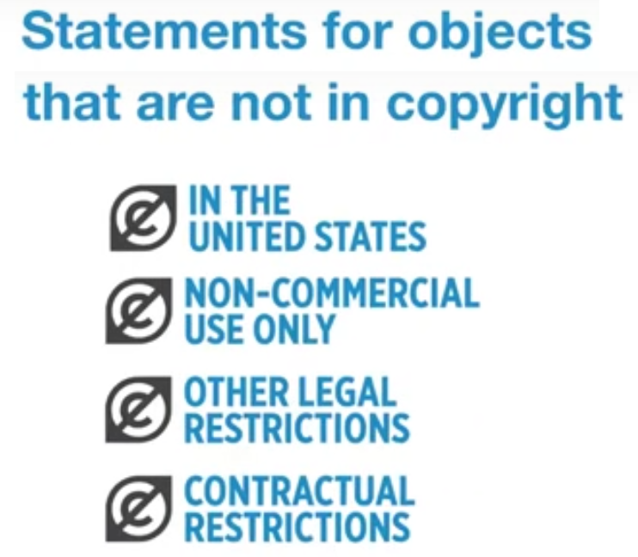
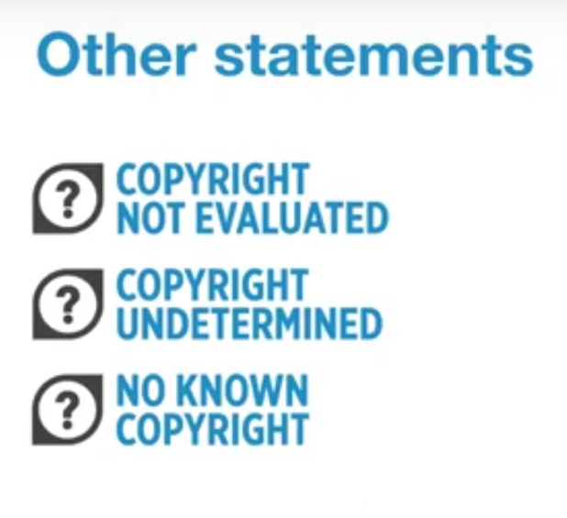
Notes:
WVR
Basically, it's 12 statements that express broad categories of copyright status. These are intended to let someone mark up the current copyright status for anything in a digital library. And these aren't licenses. If you click into Creative Commons into the full license, you will find a promise. If you click into RightsStatements.org into the full text of the statements, you will find wishy washy language about believing this to be the status and saying that someone should verify status before reusing. RightsStatements.org was specifically written to avoid putting digital libraries into a situation where there would be legal liability. RightsStatements.org does not make a promise.
Also, because there are 12 of them, and there is a specific way to mark each up for computers to understand, it's possible to use these in search interfaces. Similar to how Creative Commons licenses are used in search interfaces, it may be the case that in the near future RightsStatements.org is used in search results broadly across the internet.

Slide 20
How rights statements help archives/special collections
Digital collections often predate staff with copyright knowledge or good record keeping
Remember, if the institution doesn’t own copyright, no CC allowed!
General knowledge of copyright law allows staff to assign rights statements to collection assets...
HOWEVER
Lots of digital collections = “Where do I start?!”
As John and Paul wrote, “I get by with a little help from my friends”
Notes:
-Many collection items predate having staff that considered copyright or maintained copyright records. For older/more established institutions, this can mean that thousands of digital assets (if not more) could have absolutely no copyright information listed. This is a problem, as users may be interested in reusing these materials for all sorts of reasons and without copyright information, can’t do anything even as simple as make an inquiry to the copyright owner
-Creative Commons is often proposed by those with little experience with it, but as we’ve noted, if copyright hasn’t been expressly signed over by the copyright holder (and only them), CC licenses can’t be applied
- Rights statements are great because with general knowledge of copyright laws in their respective country, someone in collections can now inform users of copyright right status (with reasonable degree of accuracy) even if copyright records don’t exist
-HOWEVER...A large number of digital collections with many individual assets can mean that applying rights statements retrospectively can be intimidating, especially for smaller cultural heritage institutions who can only devote a small amount of staff to a project like that can make it so one is unsure of where to start.
-This is where asking for some help comes into play or, as the Beatles sang, “I get by with a little help from my friends”

Slide 21
The Florida rights statements implementation
Notes:
WVR
Now we’ll go into the Florida rights statements implementation.

Slide 22
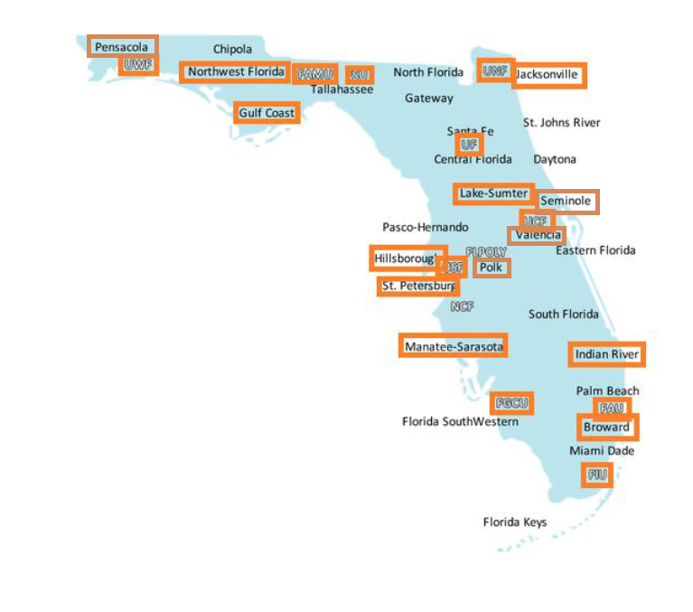
Florida Academic Library Services Cooperative (FALSC)
Department within the Florida Virtual Campus (FLVC).
FLVC is a state established non-profit for providing central library technology and distance learning services for the public higher education system (universities and colleges).
FALSC provides digital library hosting to public institutions in Florida.
Orange in the pic = using the FALSC digital library
Notes:
WVR
This is a diagram of digital library hosting in Florida provided through the consortium.
Here’s a little about FALSC, the Florida Academic Library Services Cooperative.
The predecessor organization, Florida Center for Library Automation had provided digital library hosting since 1992.
The consortium provides digital library hosting to Florida’s public higher education system. It’s free of charge, and libraries can choose to source digital library hosting elsewhere. Many do source through the consortium. This map of Florida shows the name or acronym of each institution served by FALSC. Orange boxes show institutions using FALSC’s digital library publishing software in some capacity. For many of the institutions, it’s their primary digital library platform For some institutions, there are multiple platforms and they are using FALSC hosting, but also using other platforms to put cultural heritage materials online.
Since FALSC has provided hosting since 1992, most of these collections have been around since before RightsStatements.org came out in 2016. When the rights statements launched, there was already A LOT of content in the digital libraries around the state.

Slide 23
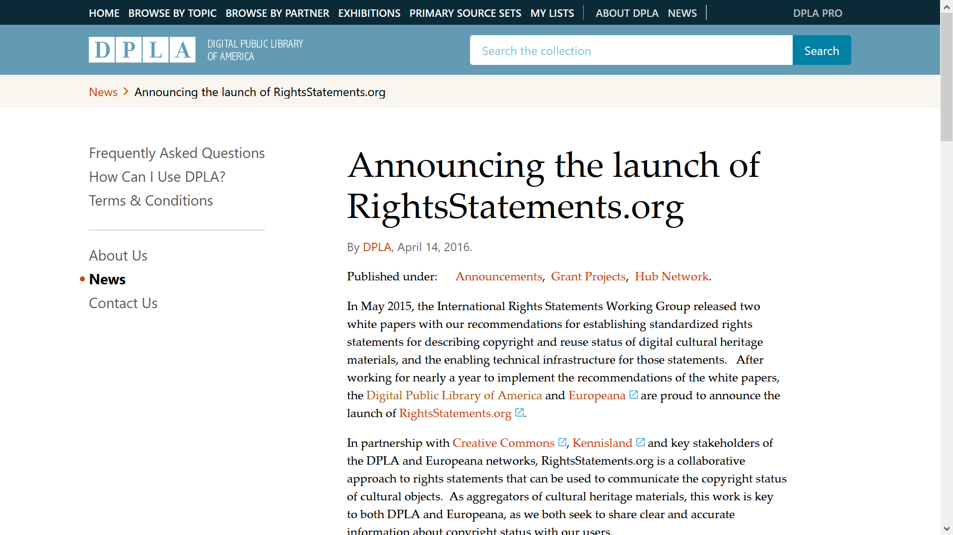
The problem:
New rights statement plus many existing records
Notes:
WVR
RightsStatements.org launched in 2016 with an announcement from the Digital Public Library of America (DPLA). The announcement described the statements and said that in the near future the statements would become mandatory to participate in the DPLA.
This was a new standard. Meanwhile, digital libraries already existed and they have lots of material already online.

Slide 24
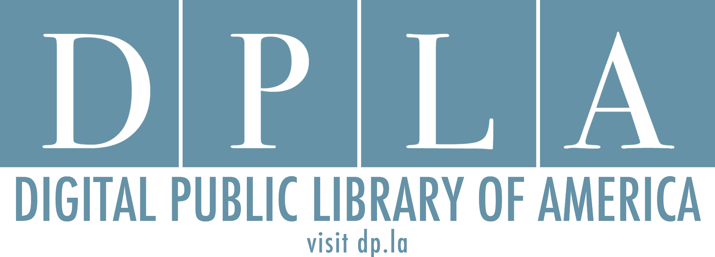
Motivation to use the rights statements
Notes:
WVR
Meanwhile, Florida had begun activity to join the DPLA. The DPLA is a search engine that searches across library and archives collections in the US. The goal is to have as much cultural heritage material available and searchable as possible, so that people who want to find digital library materials can go to a central place and run the search. The way the DPLA works is to have regional hubs, which get records from libraries in a large geographical area, and then send those records to DPLA.

Slide 25
The DPLA in Florida
Notes:
WVR
In Florida, the regional hub is the Sunshine State Digital Network. It formed in 2016. Then began working on logistics of getting Florida materials into the DPLA search.
Kaleena and I are both involved in the Sunshine State Digital Network's Metadata Working Group. Part of what that group does is write out the requirements for libraries to participate regarding what kind of information a library has to have in it's records. So - items should have a title, items should have a date, things like that. Then suggestions on how to format each. The goal is better search and better allowing the hub to be able to do the technology of getting the records from libraries and sending them on to DPLA. The Sunshine State Digital Network's metadata guidelines (metadata is information about each item in the digital library) were released in Fall 2018. Those guidelines restated the DPLA requirement to have a copyright status in each record using RightsStatements.org . At this same time in Fall 2018, Sunshine State Digital Network released instructions to libraries about how to participate - so how to submit their digital libraries to the regional hub and have their items show up in DPLA.
Now, it's never been enforced by DPLA or by Sunshine State Digital Network, but consistently from 2015 to 2018, DPLA was telling participating libraries that the RightsStatements.org requirement was going to kick in in the near future.
And the RightsStatements.org requirement is in the Sunshine State Digital Network’s Metadata Guidelines. It’s never been enforced, but as of Fall 2018, it was “coming soon”.

Slide 26
Immediate assistance:
Reports to assist in finding copyright status
One-at-a-time rights statements entry form
Add copyright status to search
After a strong ask from libraries:
Batch insert the rights statements
Notes:
WVR
The really key thing to know is that there was big demand for implementing RightsStatements.org , and the demand drove the tech tools being created pretty quickly in the software.
I was working the FALSC consortium continuously from 2016 when the rights statements were released to 2018 when the Sunshine State Digital Network put out the call for participation. It would be difficult for me to clearly express how much buzz and enthusiasm there was about the Digital Public Library of America. There was and is so much excitement in the library community. Meanwhile, because I worked with tech at the consortium, I knew that it would be important to be able to make sure that any libraries hosting materials on the consortium's publishing platforms would be able to smoothly contribute to DPLA through the Sunshine State Digital Network, and be able to participate as soon as that call went out. I got involved with the Sunshine State Digital Network's Metadata Working Group, specifically to plan ahead.
When the Metadata Guidelines, so the technical requirements for being able to send records to DPLA, came out, I had already analyzed the Florida records and been in touch with computer programmers and leadership at FALSC about the level of effort to be able to put out tools to let libraries get where they need to be. RightsStatements.org was the only required field missing from a majority of digital library records in Florida. The other technical requirements were met, since those were based on longer running standards.
Some assistance could be done through existing software. When the first strong ask came in, almost immediately - FALSC released spreadsheet reports to help determine copyright status and a form to add status one-at-a-time to items. But, with thousands of items already in the digital collections, a data entry form to add a rights statement one-at-a-time is slow going.
Basically, what we had on day 1 was a spreadsheet of all items in each collection with information like publication date and author to help determine copyright status, and then a one-at-a-time form. So, big huge spreadsheet to help workflows, and then a bottleneck for data entry.
The consortium has monthly group meetings with libraries using each software tool. For the digital library platform, there is a monthly meeting, the Islandora SubGroup meeting (Islandora is the name of the digital library software). At this meeting, libraries can make requests for software development from FALSC, and other libraries can join in to make a group ask. At a meeting shortly following the metadata guidelines, libraries asked for assistance adding the rights statements en masse. It was a pretty strong ask.
I took that strong ask to management, along with information from the computer programmers about the level of effort to code a batch insert, and I was able to get commitment to resource a bulk insert if a critical mass of libraries had rights statements ready to add. By December 2018 just a couple of months after the metadata guidelines came out, more than half of libraries using FALSC digital library software had formally requested a batch insert and had turned in completed or partially completed spreadsheets with the desired rights statements filled out. Based on that, FALSC approved computer programmers to code the batch insert.
The details of this are published in this Code4Lib Journal article https://journal.code4lib.org/articles/14745 .
The really key thing to know is that there was big demand for implementing RightsStatements.org , and the demand drove the tech tools being created pretty quickly in the software.

Slide 27
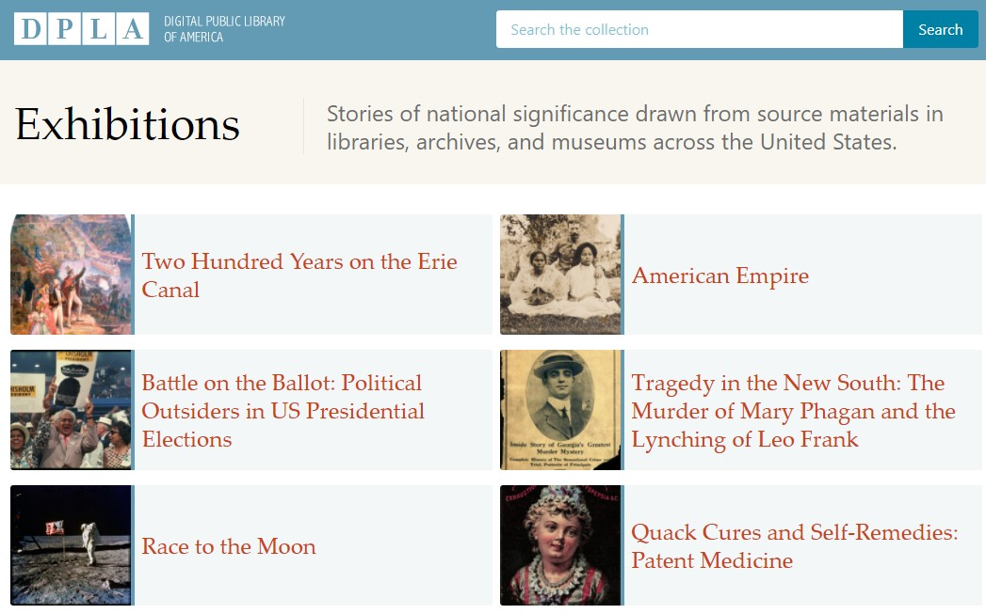
“Hey, we want to be in DPLA, too!”
Contributing to DPLA is good for shining spotlight on your institution
Alas, so many assets, so little time
Notes:
-Having your institution’s collection items can be made available in DPLA is a great way to get eyes on your digital collections, thanks to DPLA’s high profile. In addition, any digital community collections that you might host on behalf of a smaller cultural heritage institution (i.e. a local historical society who lacks technical infrastructure to display their collections) also benefits that smaller institution as well (just be sure to get their permission to display on DPLA)
-But, like I said before, it can be overwhelming trying to figure out how to get started with assigning rights statements. I know firsthand how impossible it can feel, especially when the institution wants to begin contributing to DPLA.

Slide 28
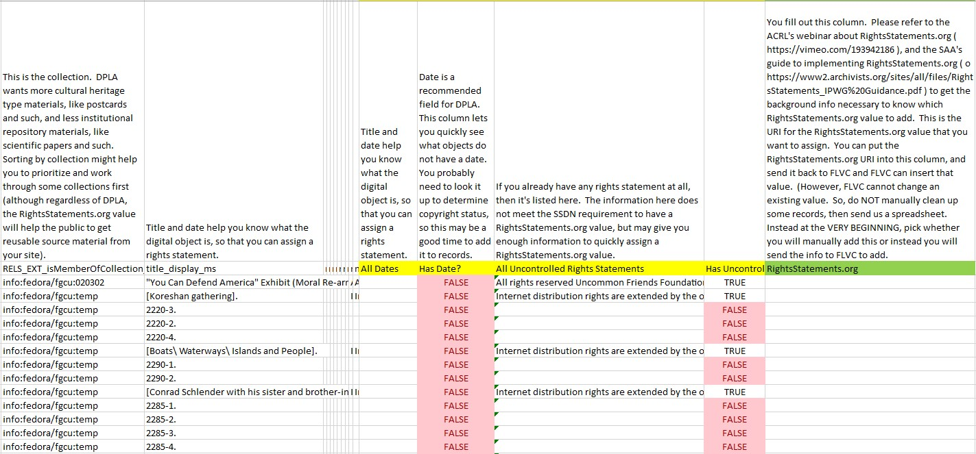
A Helping Hand
Using reports provided by FALSC enabled us to view collection-by-collection to see if there was rights statements applied
Notes:
-So here’s where the assistance comes into play: FALSC (typically via my co-presenter, Wilhelmina here) provided detailed reports of individual assets, complete with identifying information (in order to locate them easier). These reports allowed us to see at a glance not only whether or not there is a rights statement present (either an uncontrolled statement written by me or a RightsStatement.org URL), but if there was a date included in the metadata to use as a guide for determining copyright. This helped to work systematically through assets (rather than trying to pick a random start)

Slide 29
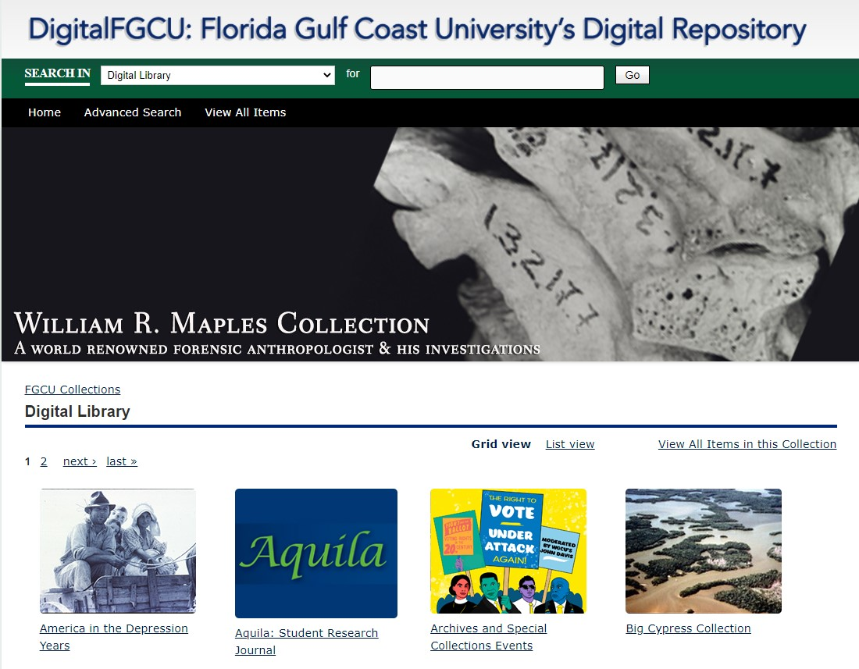
Background on the Florida Gulf Coast University Library
Young institution; about to celebrate its 25th anniversary of classes beginning
FGCU Archives & Special Collections is less than 10 years old
Currently 25 digital collections consisting of 13,372 individual assets
Notes:
-So a bit of background on the FGCU Library: As a public university, FGCU was founded in 1991, with classes beginning in 1997, with the library opening shortly thereafter
-FGCU Archives & Special Collections is younger still, having only been established within the last decade, with digital collections made publicly available via Islandora, the open access software framework, with the technical aspects overseen by FLVC
-There’s 25 online collections consisting of 13,372 assets; note that this does not reflect the number of PHYSICAL assets held by Archives & Special Collections

Slide 30
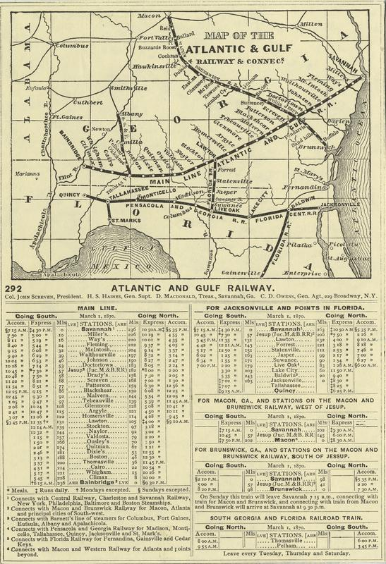
Example of Collection Item
Some older digital collections exist with assets created in the 1800s and onward
One example is the Turner Railroad Collection
Good collection to start retrospective rights statements
For example, date here “March 1, 1870”; pretty safe bet that this falls under public domain within U.S. copyright laws
Identifying “clues” can help make an educated evaluation of copyright
Notes:
-Some of our older digital collections (scope-wise) have assets created between the late 1800s through the mid-20th century
-One such collection is the Turner Railroad Collection, which is an assortment of railroad-related paraphernalia (think advertisements, train schedules, etc) assembled over years by railroad scholar Gregg Turner
-After a lot of thought, this seemed like a good collection to begin attempting a rights statements retrospective. It’s finite, many of the assets have identifiable creation dates, and, better yet, the older nature of materials means many of them would likely be assessed as public domain
-For example, the image on the right is a combination map and time table (apologies that you folks can’t see it very well). A future date can be found here listed as “March 1, 1870.” I say “future” because we know this was printed PRIOR to March 1st because otherwise, what good would it be? So using that bit of logic, combined with some basic copyright knowledge, such as the fact that corporate copyright expires in 95 years, there’s no copyright notice on the item, and works created before 1925 fall within public domain, we can confidently state this asset falls into public domain and is available for reuse
-Not all assets are going to be this simple. Items such as photographs or correspondences written within the 20th century gets a little more complicated, especially when certain key information isn’t readily available, like the date of the creator’s death (or even the possibility they may still be alive depending on how recent the work is)

Slide 31
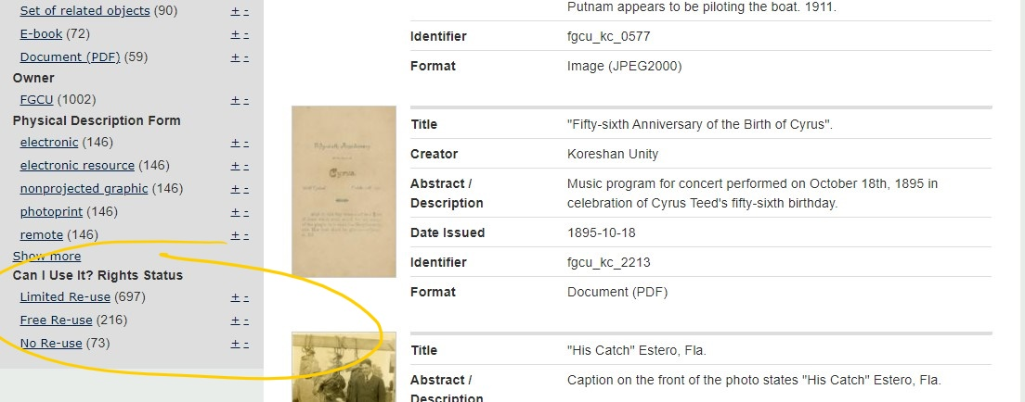
“Can I Use It? Rights Status”
Over time, FALSC was able to develop a reuse notice within collection facets
Remember: this is not an exact science!
Notes:
-Over time, FALSC developed an additional facet that would allow users to limit their searches by rights status in a very generalized way. Users can then view the general rights statement and the accompanying RightsStatements.org URL to obtain more context regarding who, if anyone, owns the copyright.
-Remember, this isn’t an exact science. As long as you make an effort to determine who owns it, document your attempt, and apply rights statements judiciously, the odds of you running afoul of anyone is fairly low.

Slide 32
RightsStatements.org in search engines
The rights statements are integrated into:
Europeana
Florida digital libraries
Ex.: PALMM
Ex.: FGCU
Digital Public Library of America (DPLA)
Notes:
WVR
Here are search engines that use the rights statements in the interface.

Slide 33
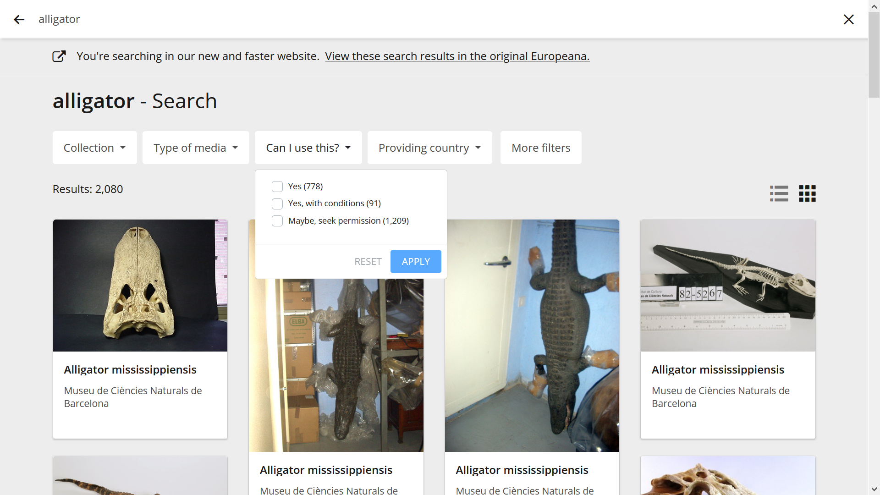
Europeana
Notes:
WVR
Europeana:
Europeana is a search engine of cultural heritage materials in Europe. It was the model for the DPLA. Europeana had an earlier standard for showing copyright status. It had had a RightsStatements.org predecessor way of showing copyright status for several years before RightsStatements.org rolled out. Almost as soon as RightsStatements.org came out, Europeana incorporated it into search.
(!! show facets on Europeana !!)

Slide 34
Florida digital libraries: PALMM
Notes:
WVR
These are incorporated into search for FALSC hosted digital library sites. Any library using FALSC for hosting can request to have these facets turned on. So, the library can add rights statements, check rights statements, and then turn on the facets so that researchers can use them.
This is the Publication of Archival Library and Museum Materials site. The rights statements show up as a facet there - the “Can I Use It? Rights Status” facet.

Slide 35
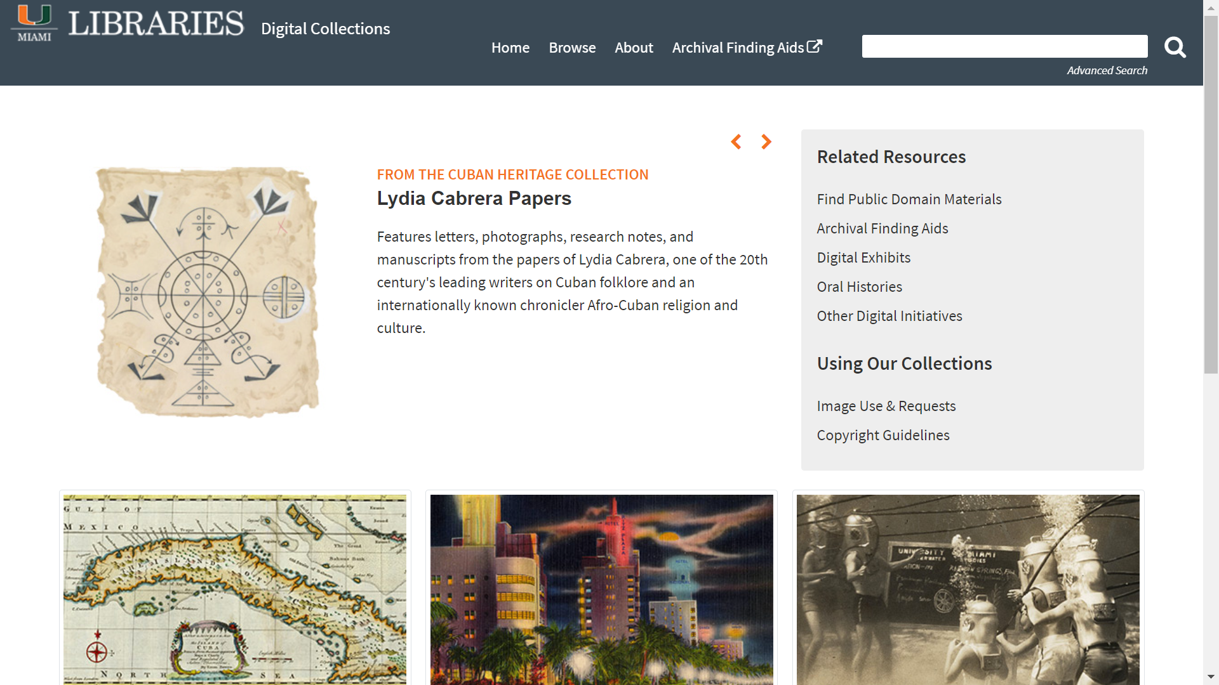
Notes:
WVR
University of Miami - not a search engine. Instead, they ran the search for public domain materials on the homepage at https://digitalcollections.library.miami.edu/ , and if you click that, it runs the search and finds all the public domain materials in the digital collections.
So, you don’t need to wait for the vendor to be able to make the rights statements useful. After you have them in, you can be creative and find a way to give them to researchers.

Slide 36
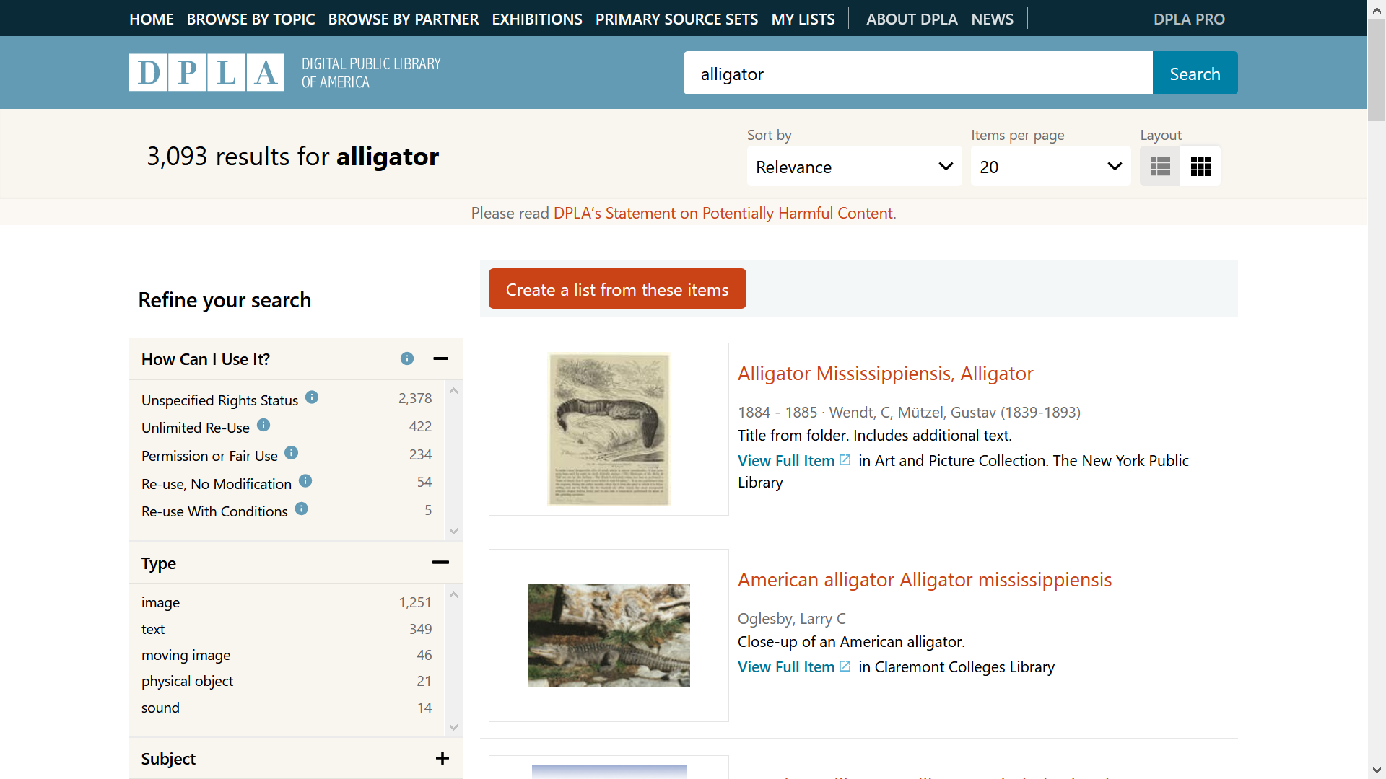
Notes:
DPLA:
DPLA meanwhile made two changes. In 2019, they pulled back on the requirement for contributors to have a RightsStatements.org value on every item. They had been saying "the requirement is coming soon", and instead said it wouldn't be a hard and fast requirement but is instead encouraged.
Meanwhile, DPLA began their implementation. They began the process of adding rights statement into search.
As of last month, DPLA rolled out the rights statements in their search interface.
(!! show facets in DPLA !!)
Future adoption?:
I suspect that now that these rights statements are part of DPLA's search engine, that various vendors will try and integrate them into search.

Slide 37
Questions?
Notes:
Are there any questions. (!! participants have to type questions into chat, so need to give a long pause to allow time for typing questions !!)

Slide 38
Implementing RightsStatements.org in the digital library, and in search engines
Kaleena Rivera, Florida Gulf Coast University (FGCU)
Wilhelmina Randtke
Kraemer Copyright Conference, June 8, 2021

