Slide 1
Cost-Effective Legal Research:
Resources and Strategies
March 20, 2015
Mike Martinez, Jr.
Wilhelmina Randtke
Sarita Kenedy East Law Library
St. Mary’s University School of Law
Notes:
Hello, I’m Wilhelmina Randtke and I’m Electronic Resources Librarian at St. Mary’s. Slides from this should be posted to the CLE website after the CLE ends today.

Slide 2
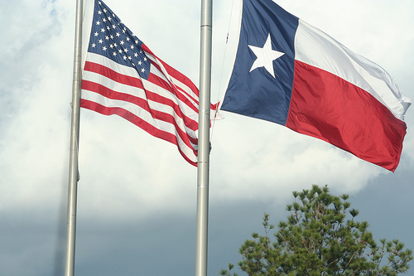
What we will be covering this morning:
Legal Information Institute
Free Federal Resources
Statutes
Regulations
Free Texas Resources
Statutes
Regulations
Free Local Resources
Municipal Codes
Free Caselaw Resources
Fastcase
Casemaker
Google Scholar
Recommended Publications
Law Libraries
LexisNexis Academic

Slide 3
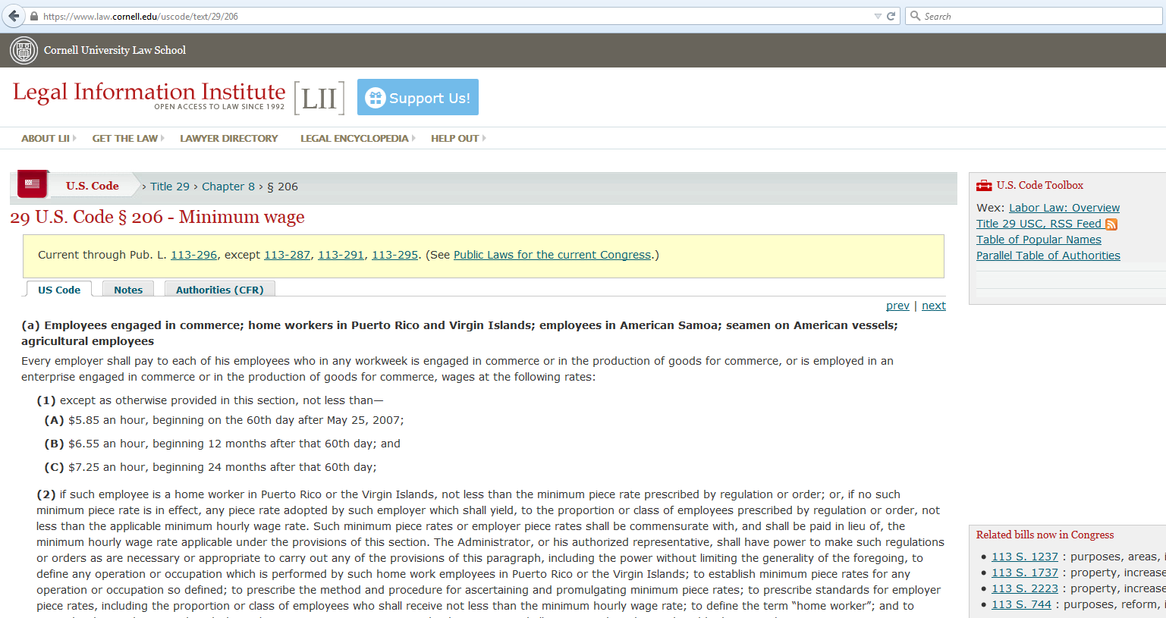
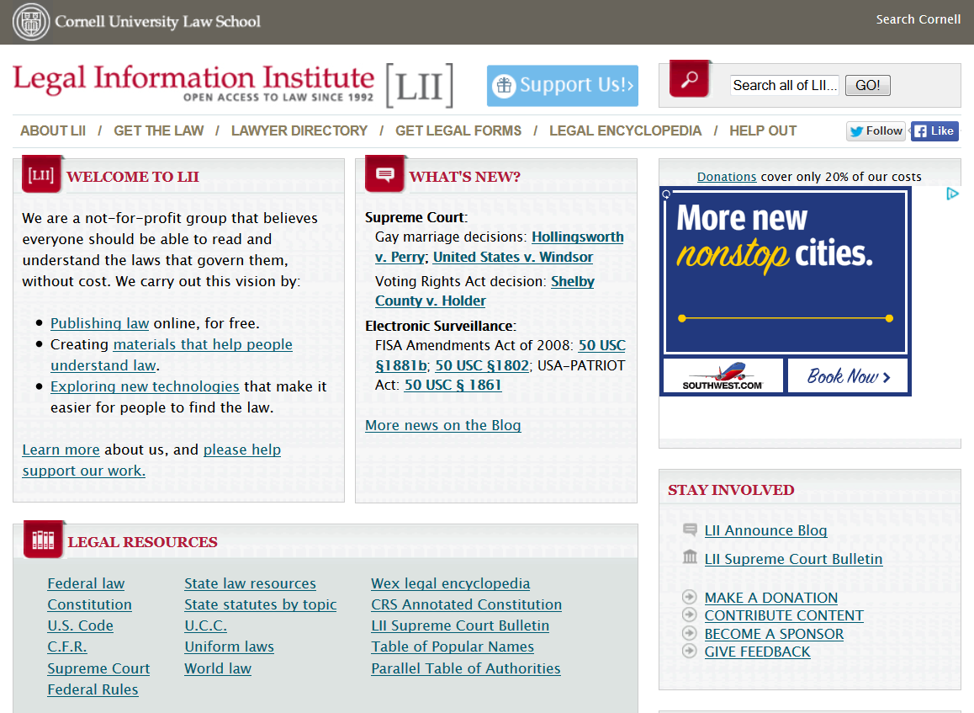
Legal Information Institute [LII]
http://www.law.cornell.edu/

Slide 4
Legal Information Institute [LII]
http://www.law.cornell.edu/
Notes:
First thing to notice on LII is what is there. Years ago, it was just the US Code. Newly added sections are the Code of Federal Regulations, and the Wex legal encyclopedia.

Slide 5
Legal Information Institute [LII]
http://www.law.cornell.edu/
Notes:
The statutes in LII might be out of date. At the top of each statute, there is a note saying “current through Pub. L. 113-296”. That is the last law passed in 2014. So, the whole database got updated once after all last year’s laws had gone through, and now it’s up-to-date.

Slide 6
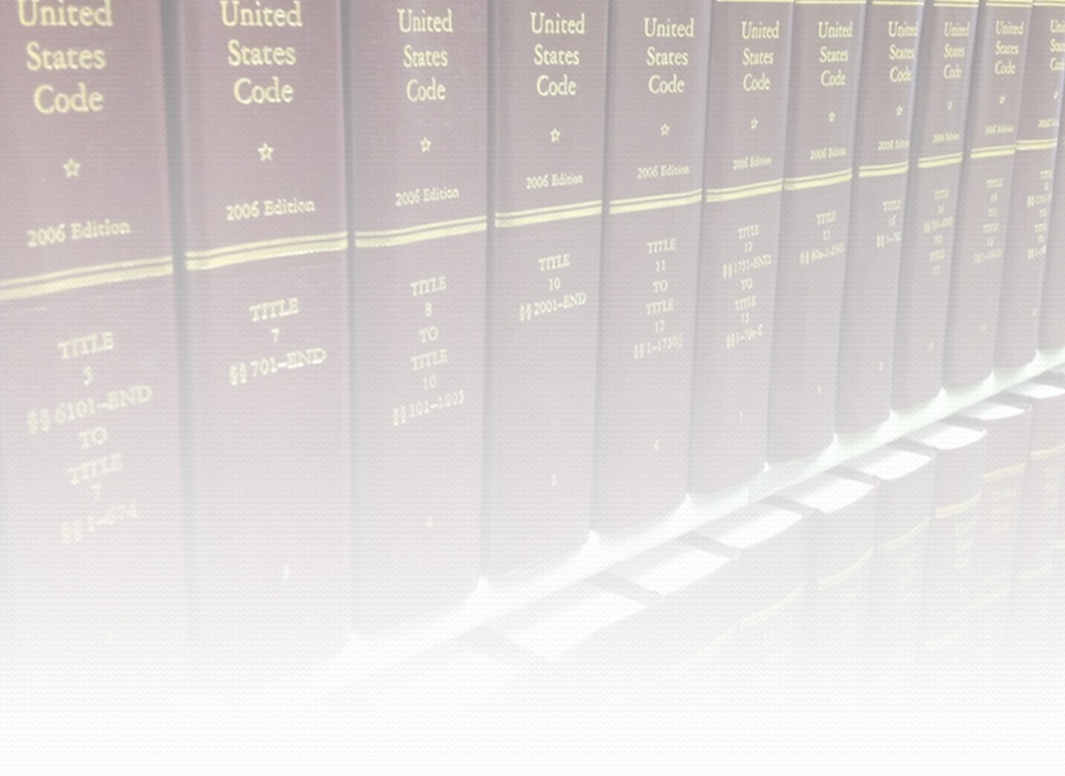
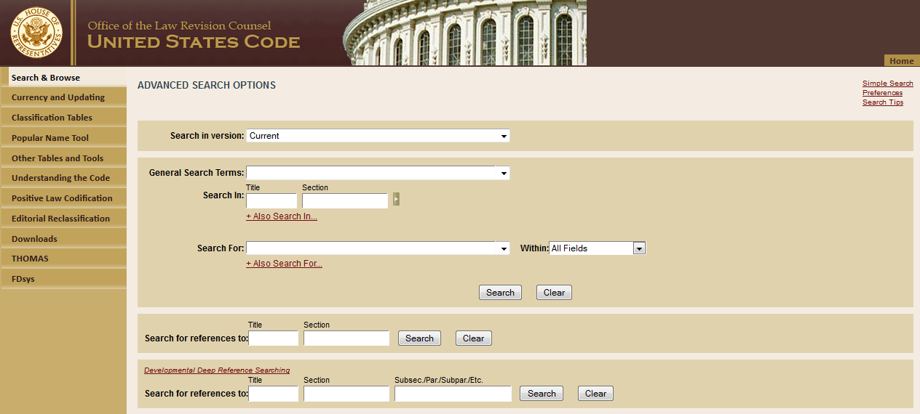
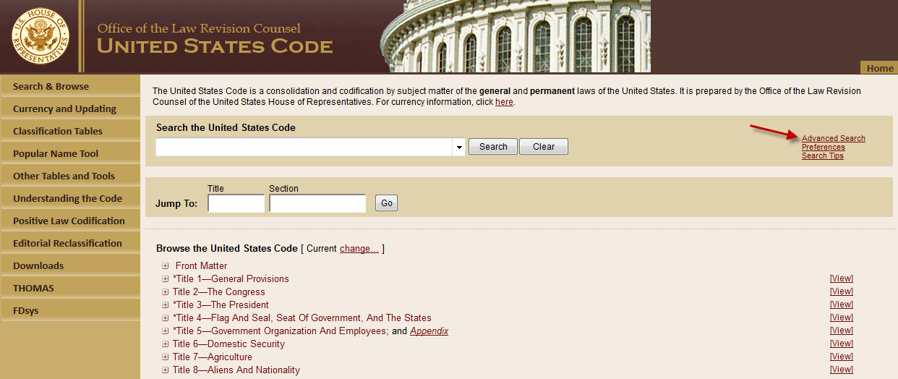
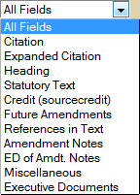
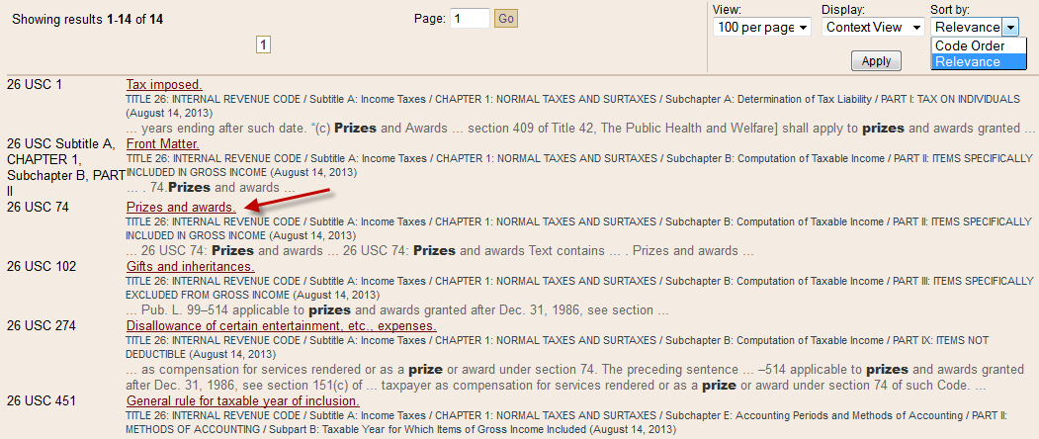
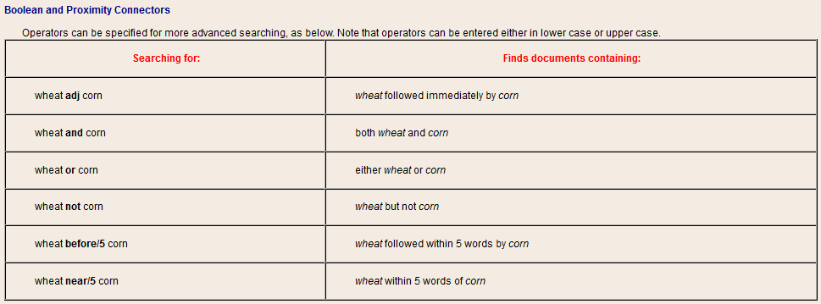
Office of the Law Revision Counsel (OLRC)
U.S. Code website
Advanced Search:
Search w/in Titles
Field Searching
Boolean Searching
26
prize
Sort by Relevance (?)

Slide 7
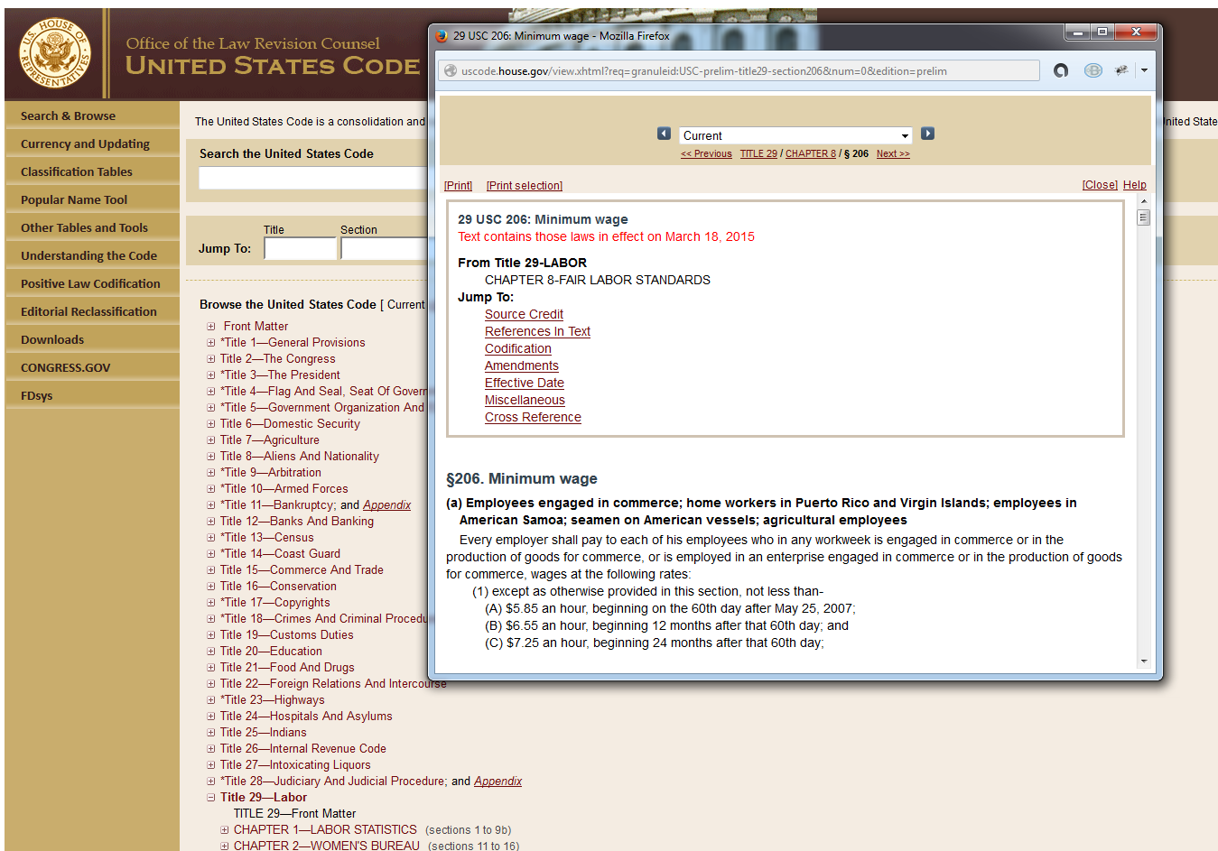
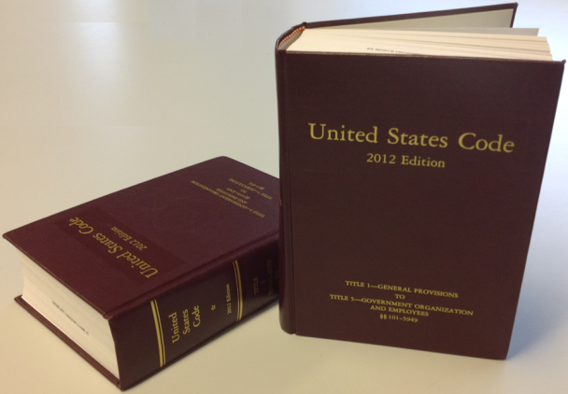
OLRC’s U.S. Code
Notes:
The version shown on the Office of Law Revision Counsel’s website is current and up-to-date as of today, so when a bill becomes law, the change will show up immediately.

Slide 8
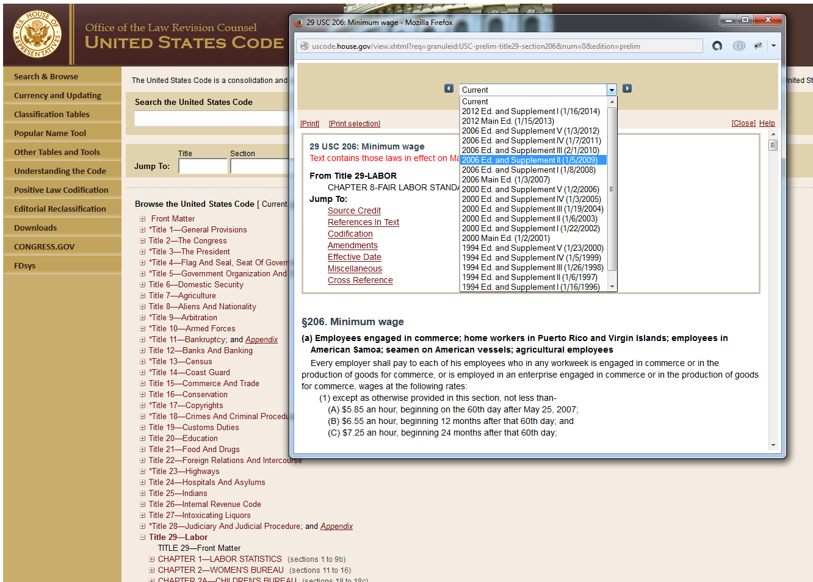
OLRC’s U.S. Code
Notes:
You can pull an older version of the US Code.

Slide 9
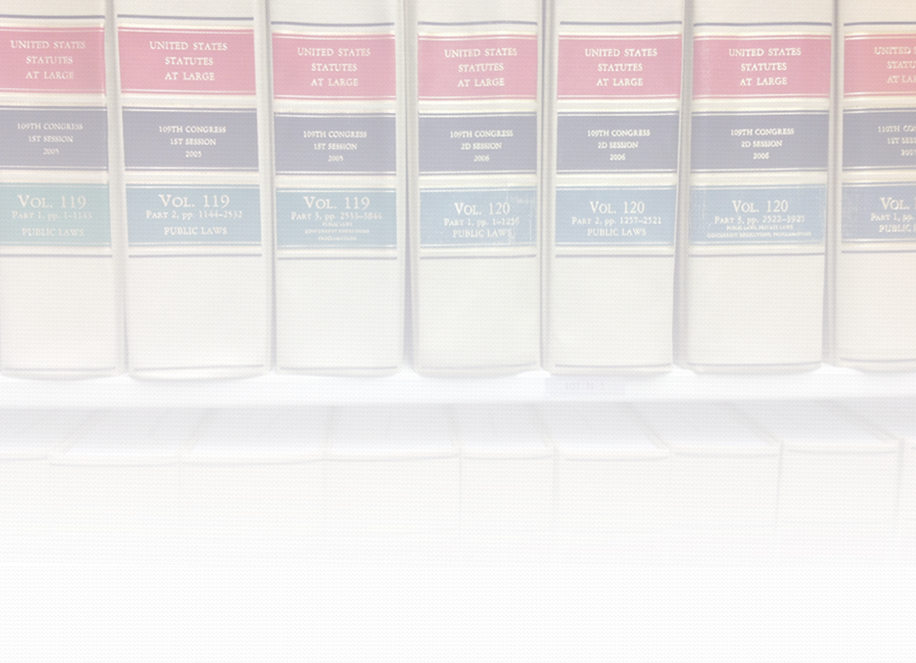
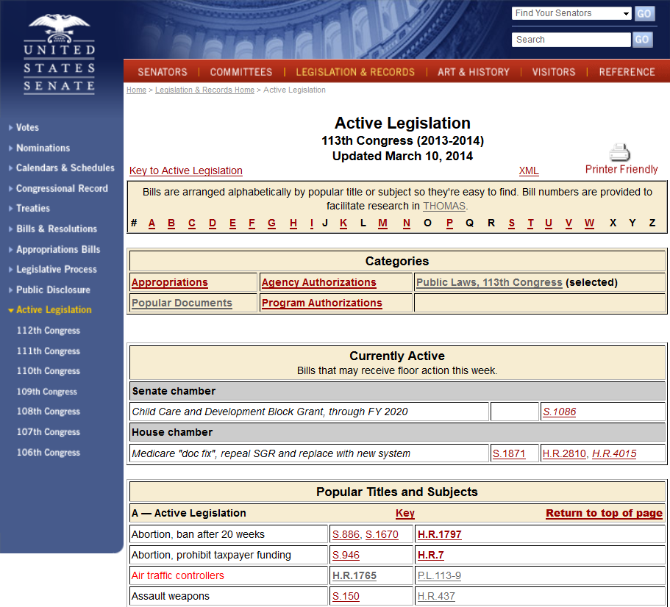
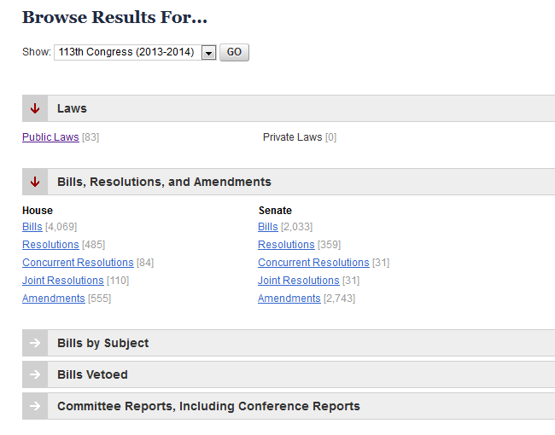
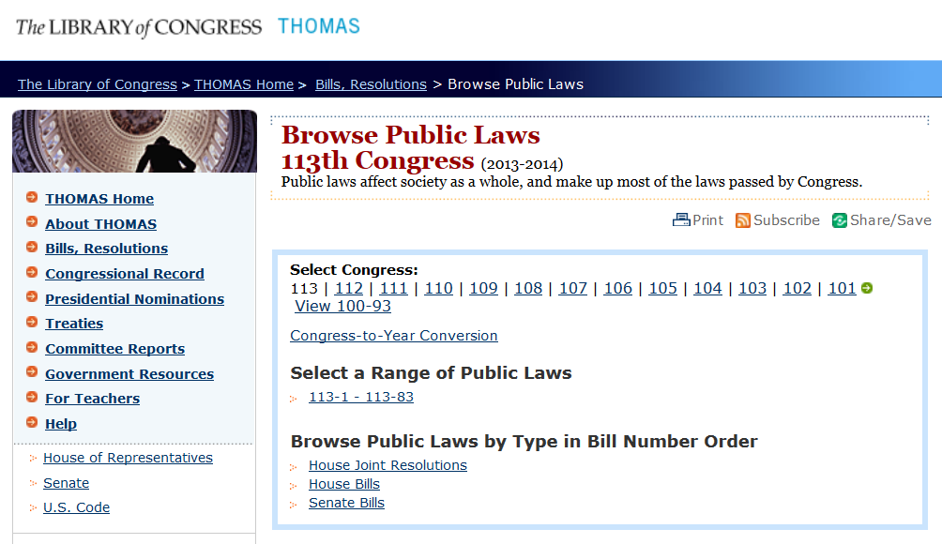
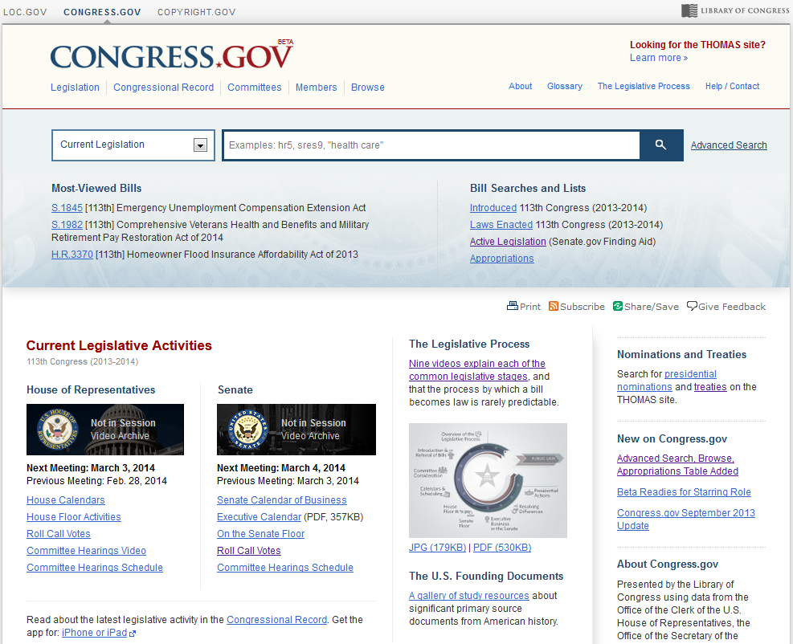
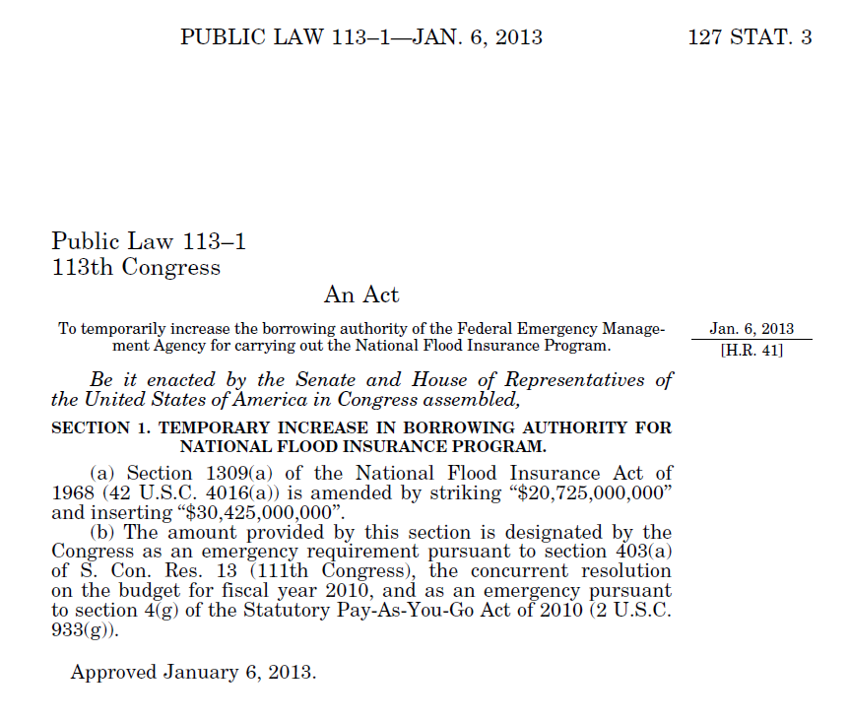
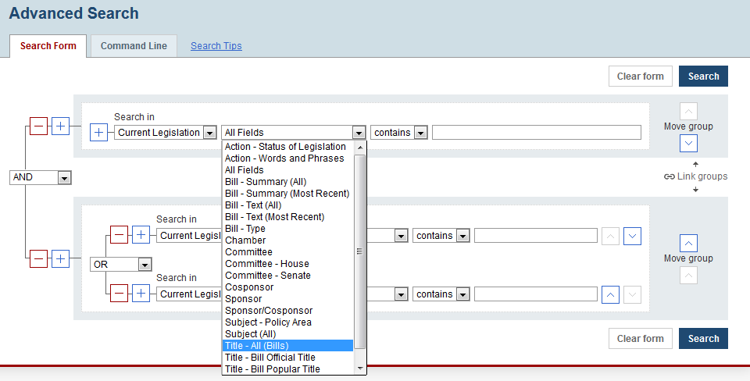
Federal Legislation
Pending Legislation
Public Laws
Slated for retirement by 2015
THOMAS’ Replacement:
Congress.gov

Slide 10
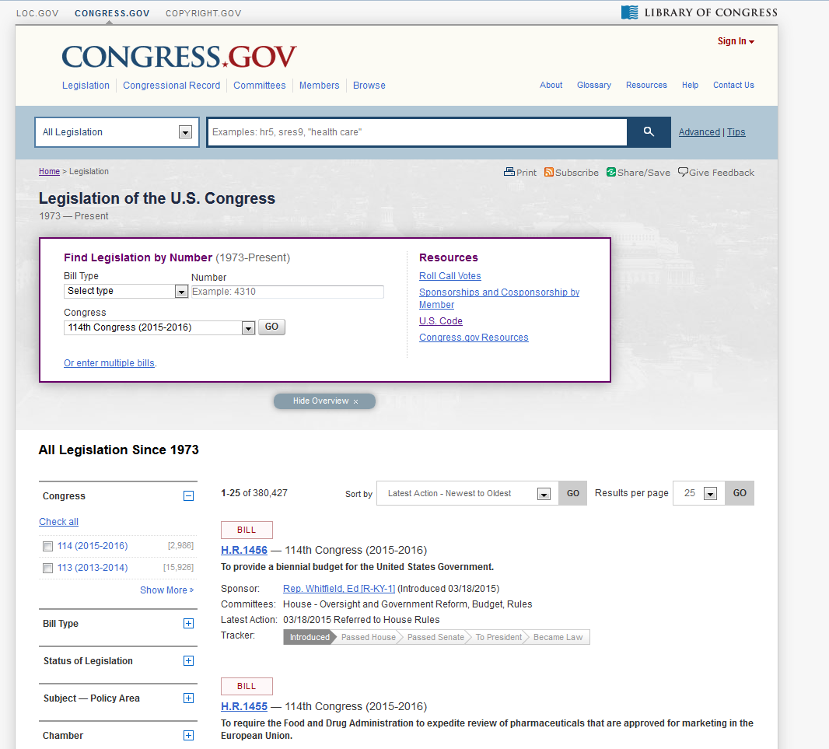
Federal Legislation
THOMAS will retire this year.
Congress.gov is the replacement

Slide 11
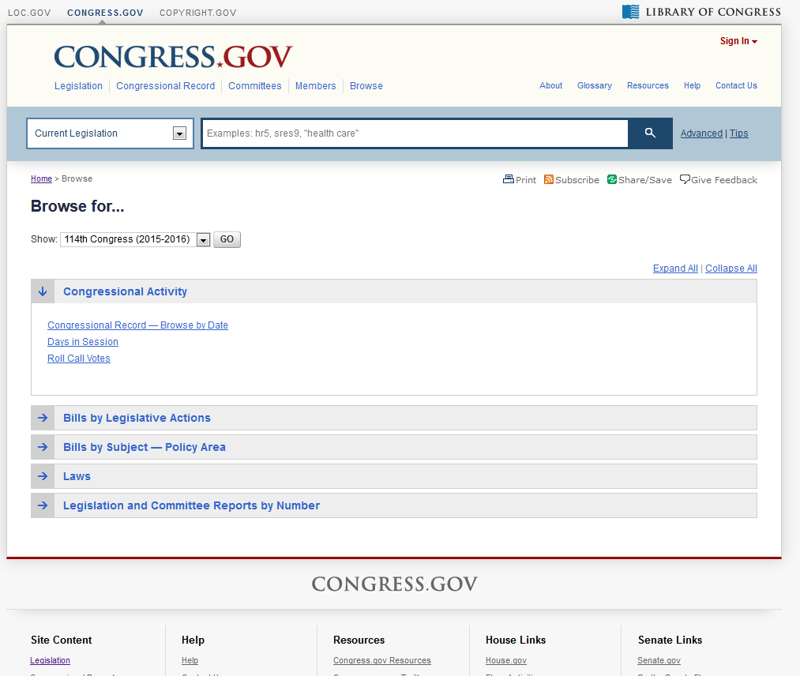
Public Laws

Slide 12
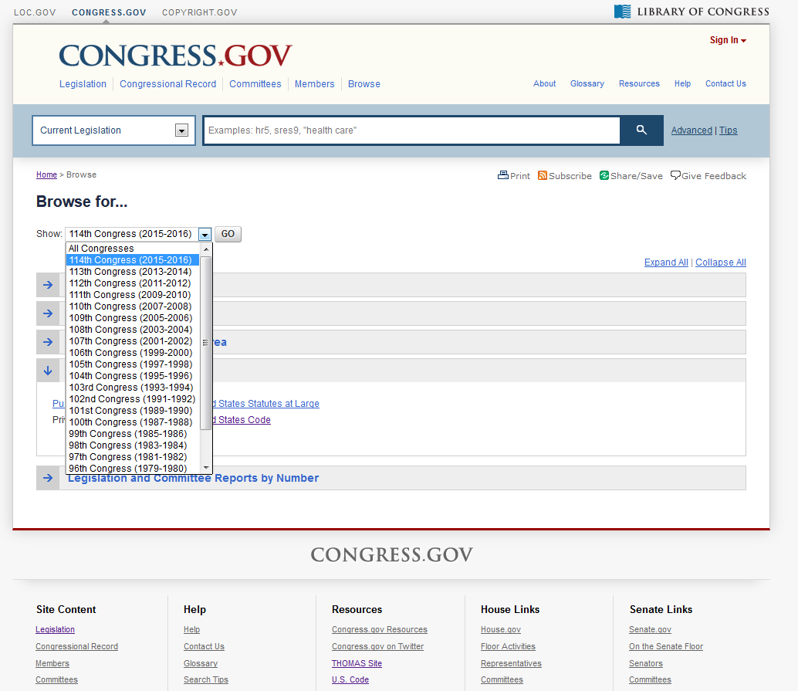
Public Laws

Slide 13
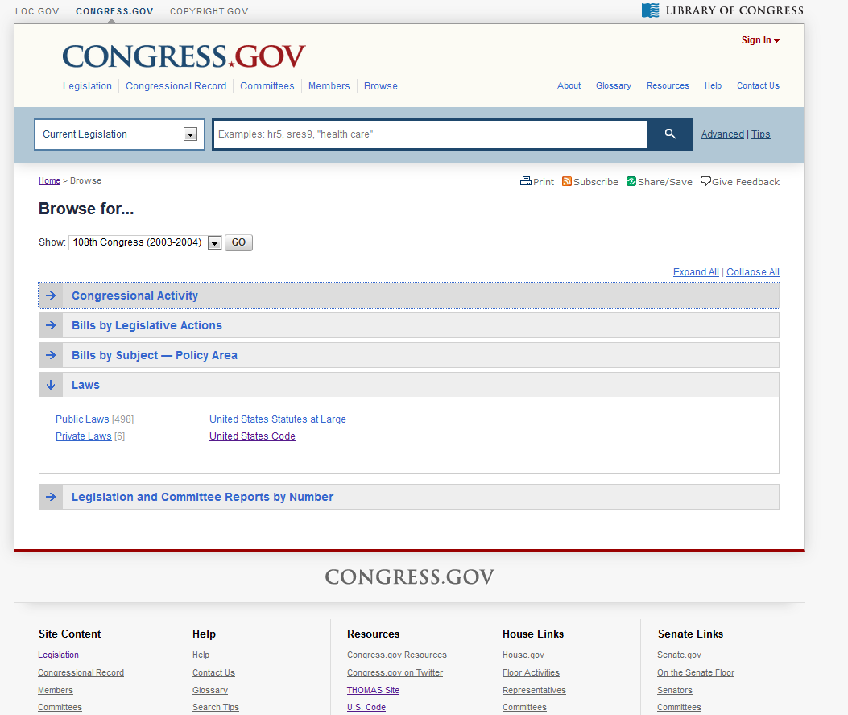
Public Laws

Slide 14
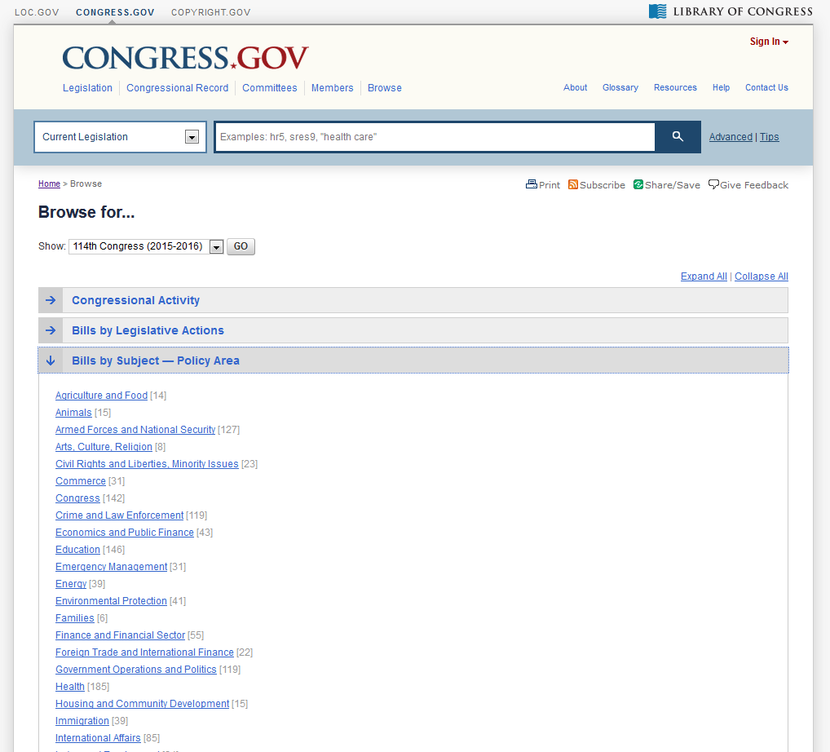
Pending Legislation

Slide 15
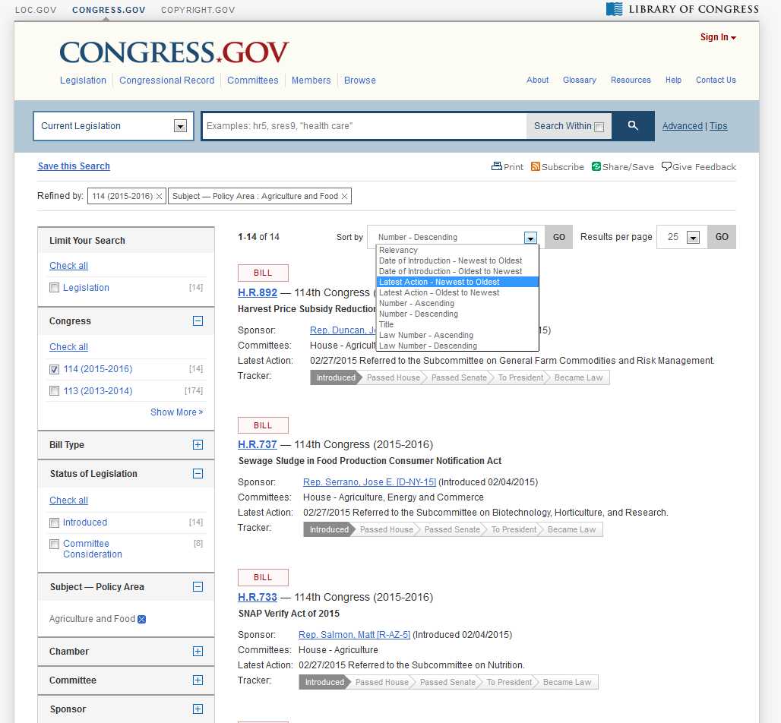
Pending Legislation

Slide 16
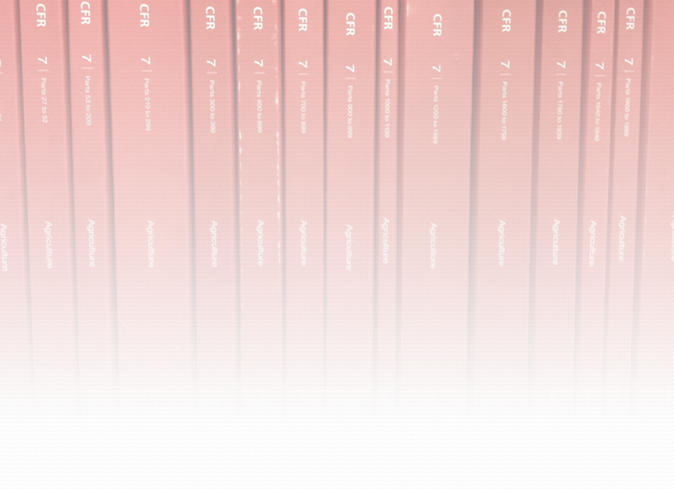
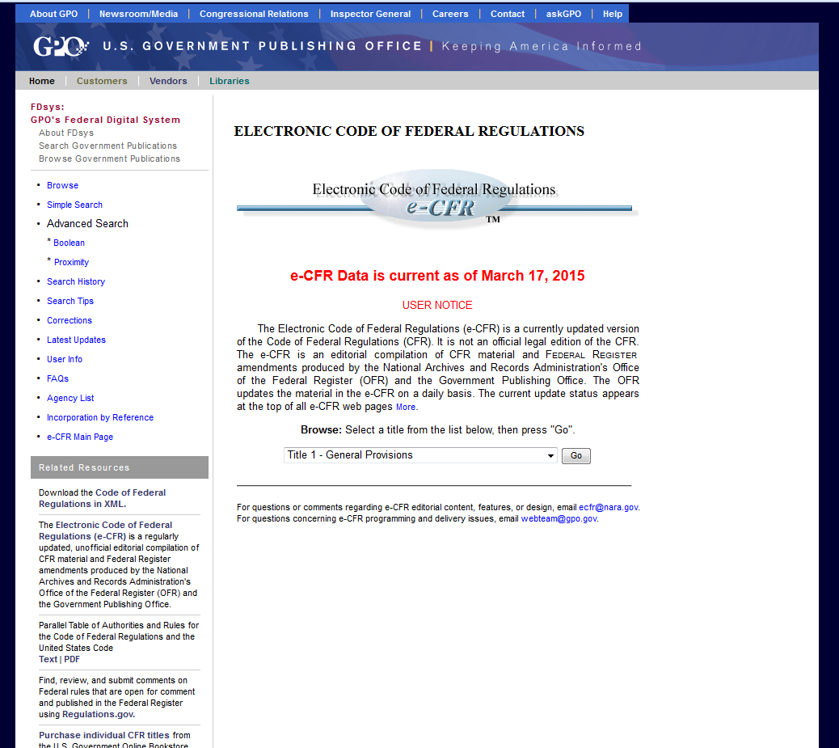
CFR in FD SYS

Slide 17
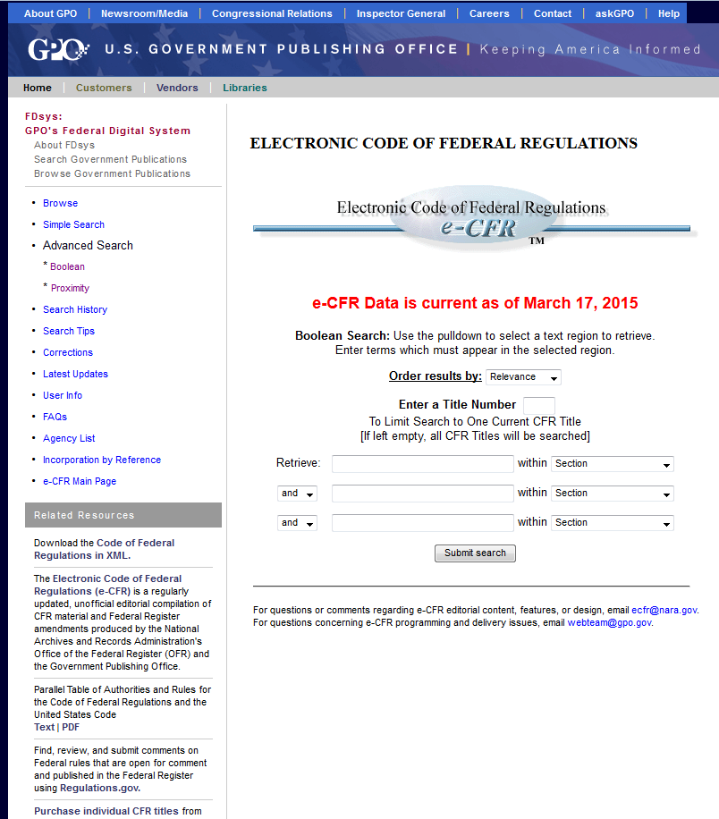
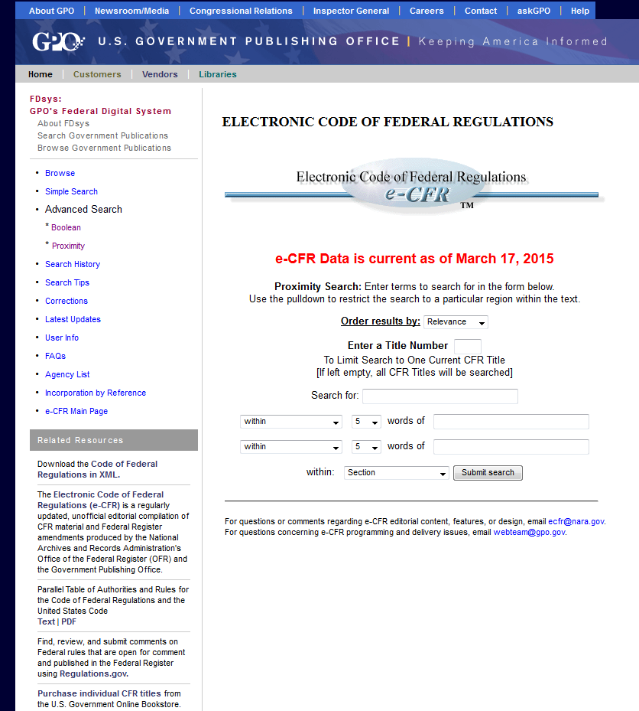
CFR in FD SYS
Boolean Search
Proximity Search

Slide 18
How up-to-date is the CFR?
CFR Publication schedule:
Titles 1 -- 16 as of January 1
Titles 17 -- 27 as of April 1
Titles 28 -- 41 as of July 1
Titles 42 -- 50 as of October 1
Notes:
This is really, really important. In Lexis and Westlaw, when you look up the CFR, you will get a version that is up-to-date as of today. Almost everyone else will give you the published version that is up to date as of the dates on this slide. The e-CFR website we are looking at actually has a developer section where you can download all the files, so almost every other CFR project does that – downloads the files and then just ahs a version that is current for those dates.
Side note: When you pull a historic CFR from Lexis or Westlaw, then that historic version is correct as of these dates.

Slide 19
How do I update the CFR?
CFR Parts Affected from FDsys!
Notes:
This is really, really important. In Lexis and Westlaw, when you look up the CFR, you will get a version that is up-to-date as of today. Almost everyone else will give you the published version that is up to date as of the dates on this slide. The e-CFR website we are looking at actually has a developer section where you can download all the files, so almost every other CFR project does that – downloads the files and then just ahs a version that is current for those dates.

Slide 20
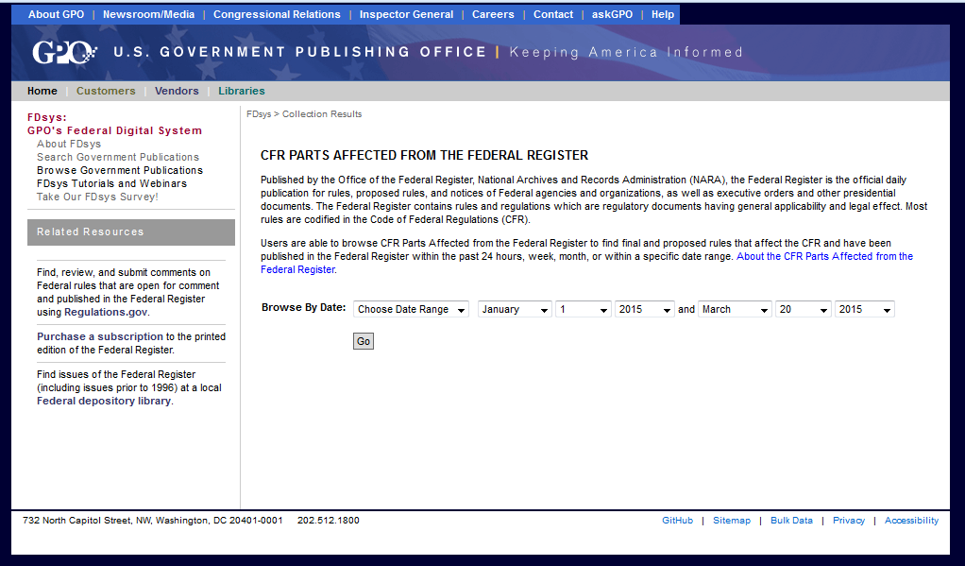
CFR Parts Affected: Checking for changes to the CFR
Get changes CFR sections
Current Awareness

Slide 21
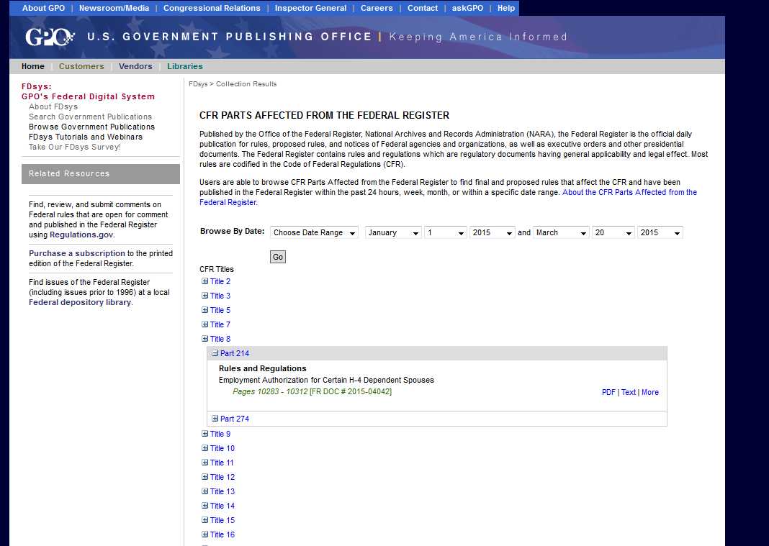
CFR Parts Affected: Checking for changes to the CFR
Get changes CFR sections
Current Awareness
Notes:
Here, I’ve run that search, and expanded Title 8 to check whether there are any changes there. Two sections of Title 8 changed since the CFR was published.

Slide 22
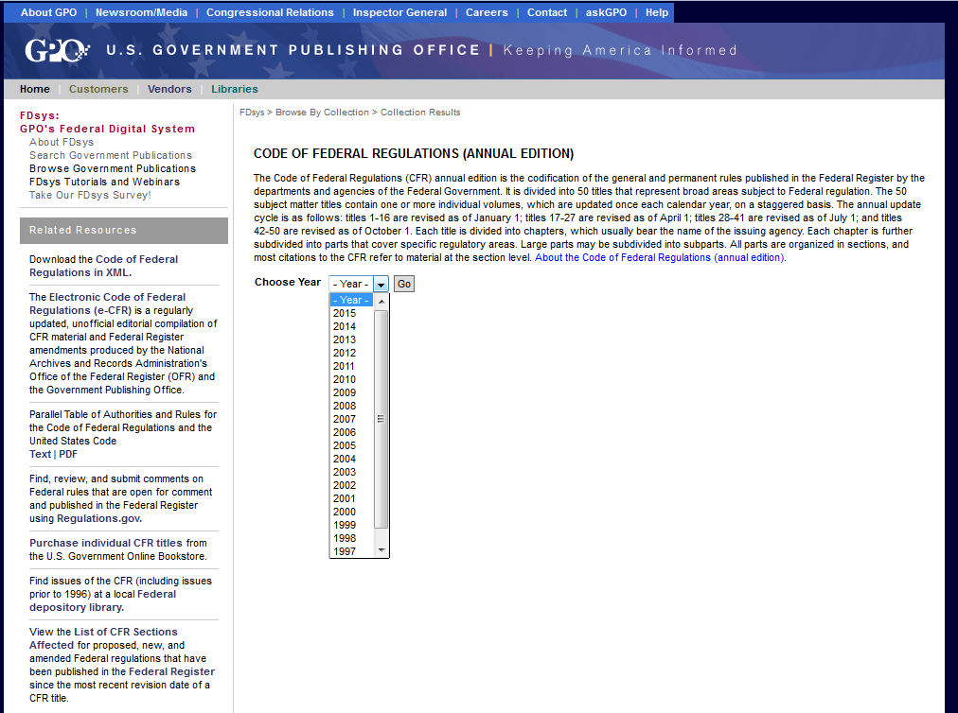
Old CFRs: CFR Annual Edition

Slide 23
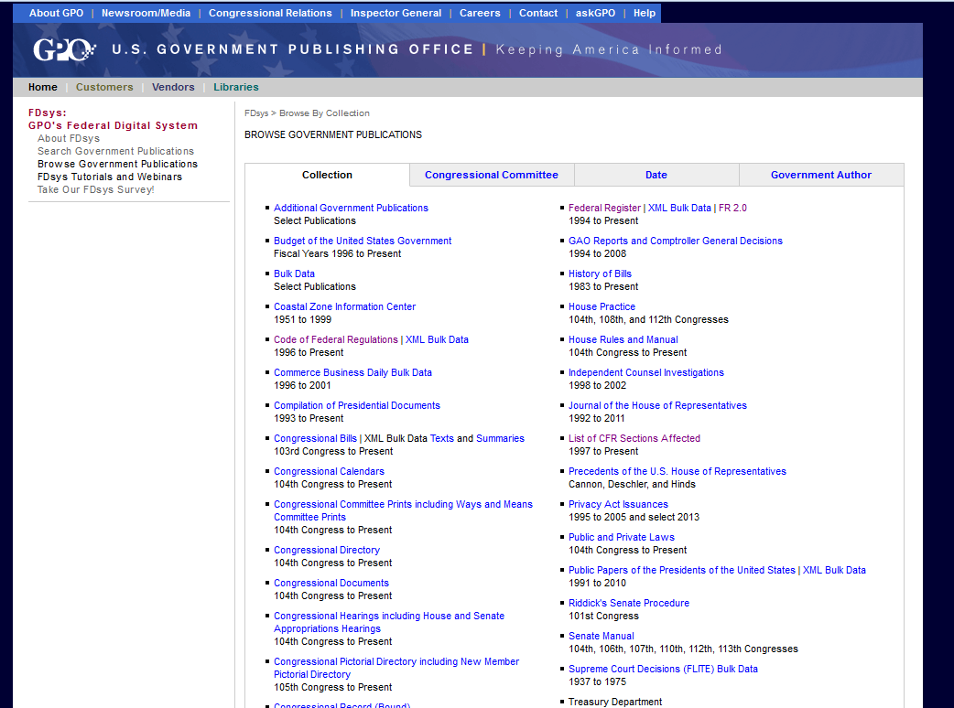
Where are all these goodies?
Notes:
That link, in the top left of most of these pages, that says “Browse Government Publications” takes you to a list of all the goodies in FDsys.
All these slides are going to be posted on the CLE website, and on the law school’s repository, and all can

Slide 24
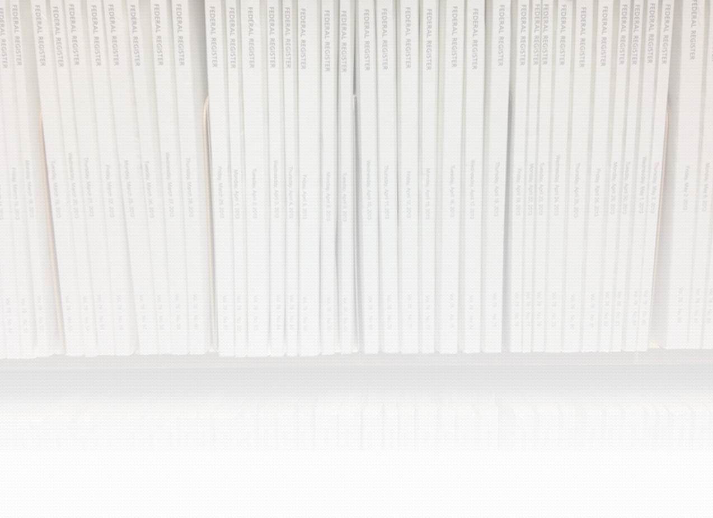
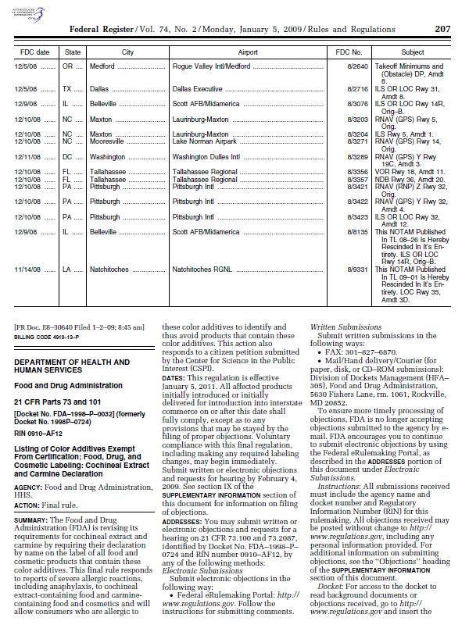
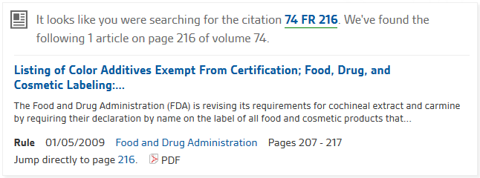
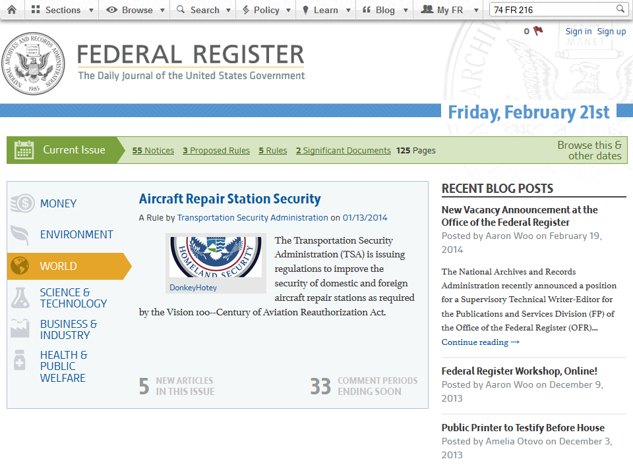
Federal Register
21 C.F.R. § 73.100 (201)
https://www.federalregister.gov
Notes:
All those CFR resources on FDsys linked to the PDF of the Federal Register. You can also go and pull it directly from federalregister.gov.

Slide 25
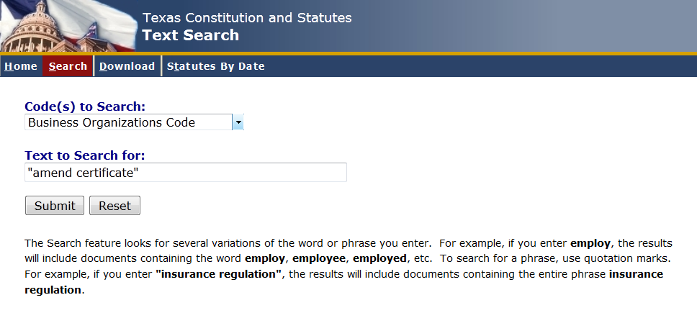
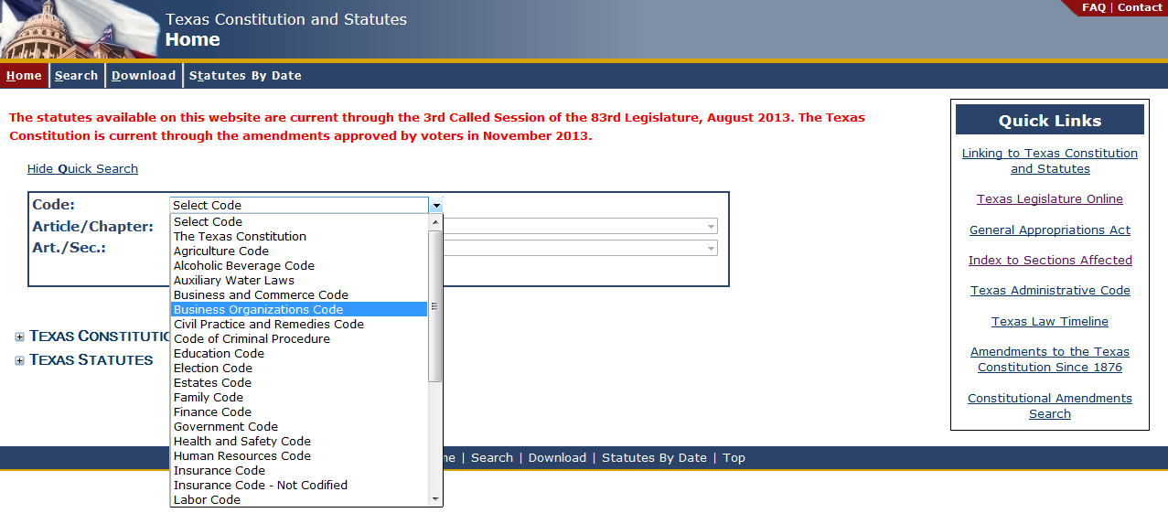
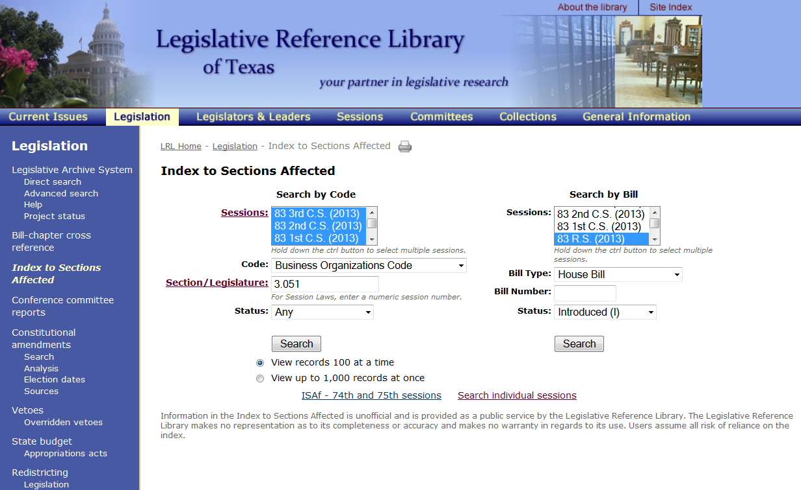
Texas Statutes
Texas Statutes and Codes Online
Searchable Codes Database
Index to Sections Affected

Slide 26
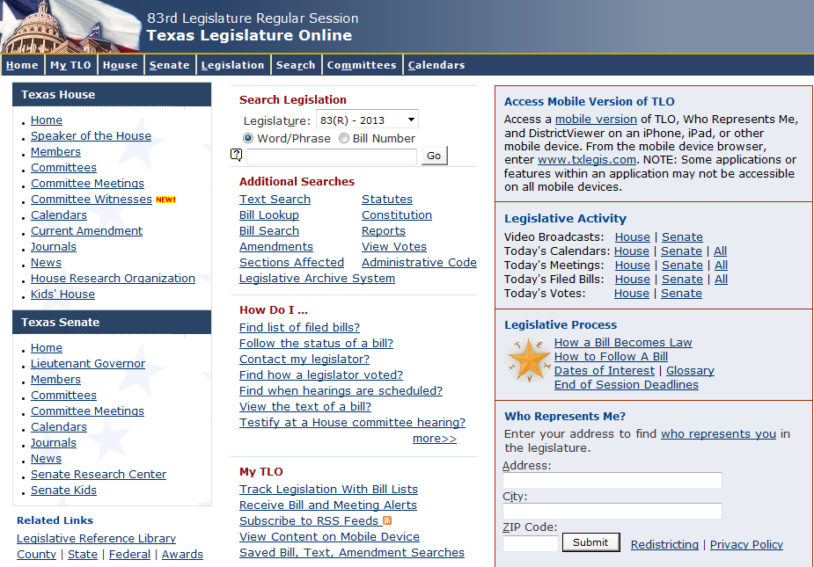
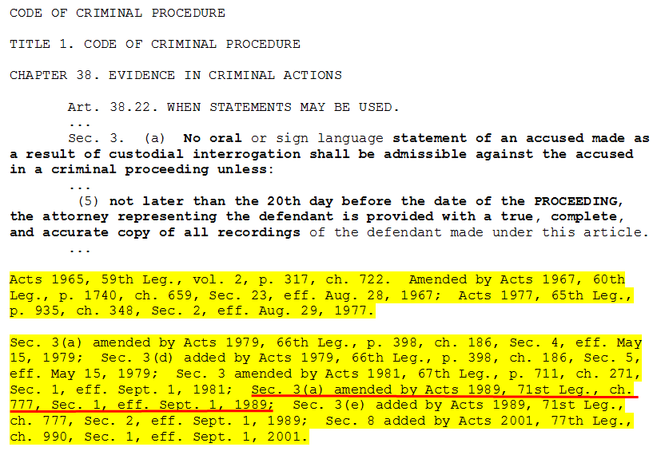
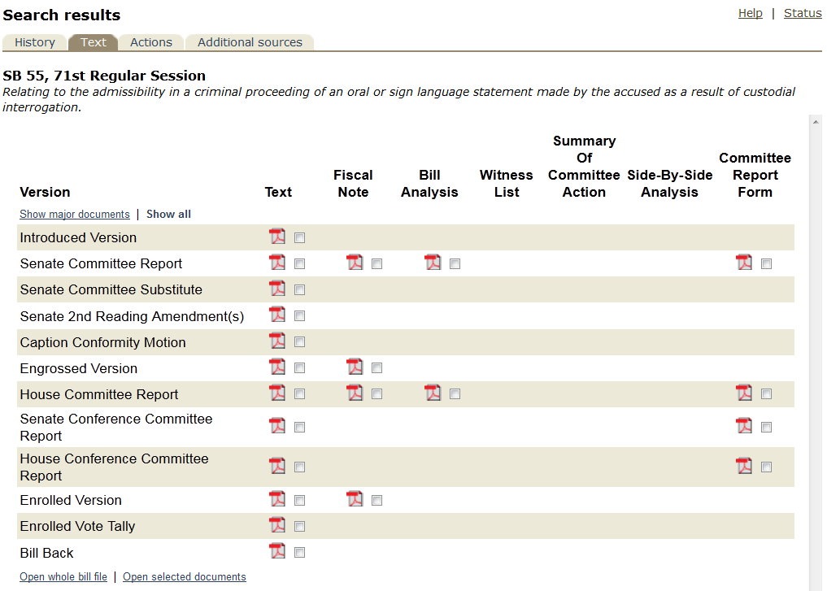
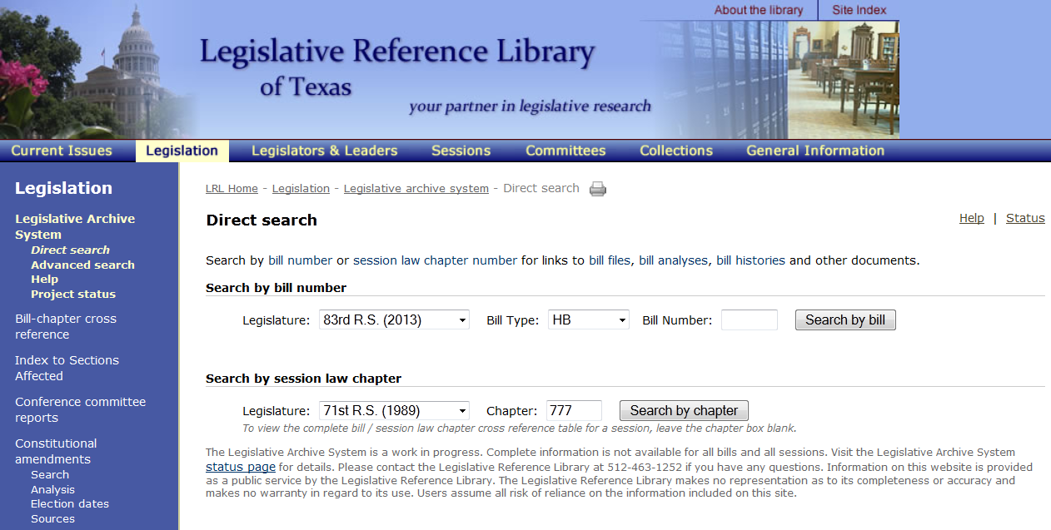
Texas Legislation
Texas Legislature Online
Legislative Reference Library

Slide 27
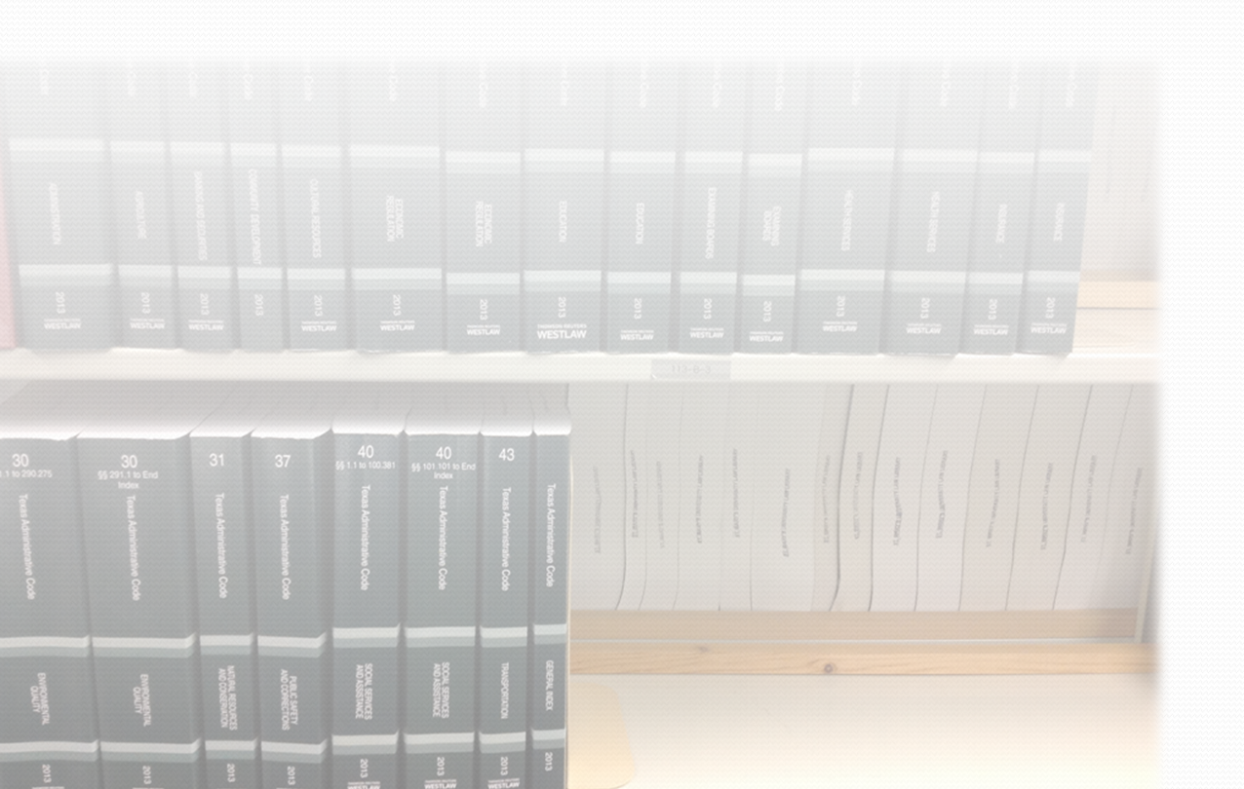
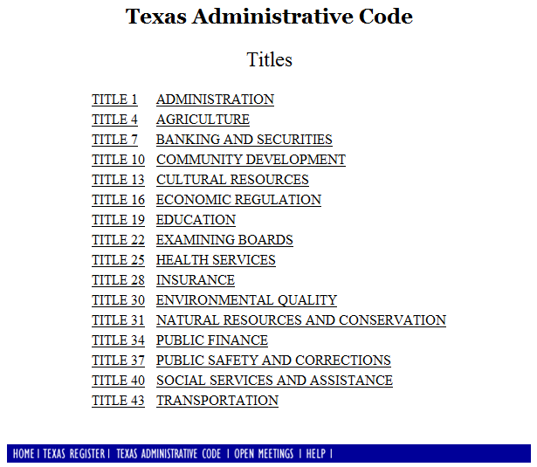
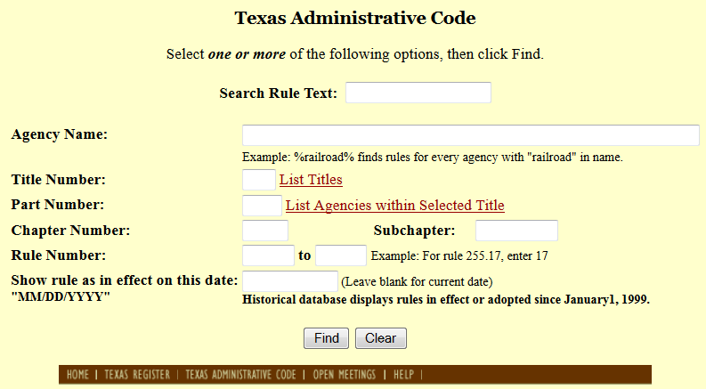
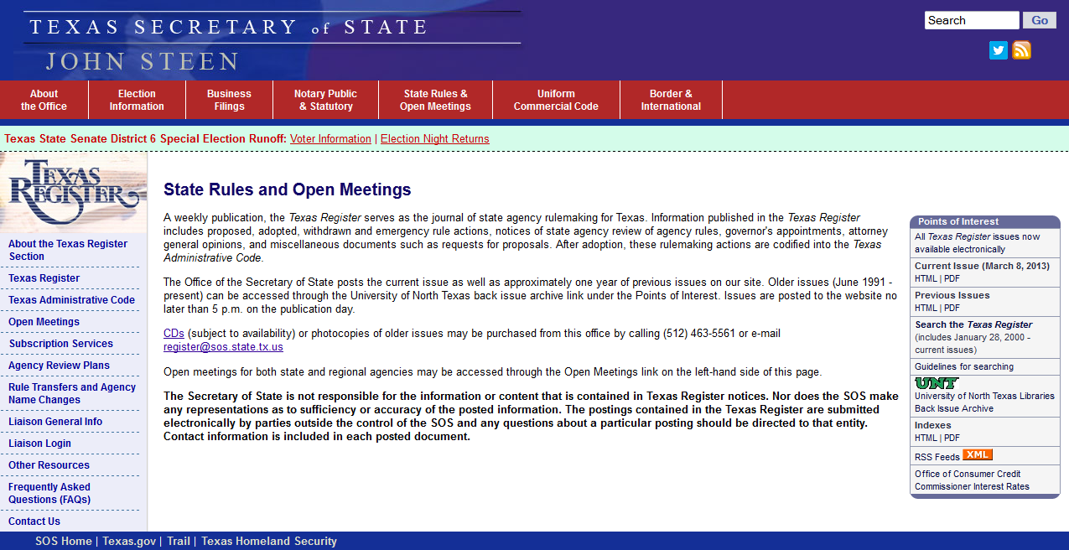
Texas Regulations
Texas Administrative Code
Searchable Database
Texas Register
Archive (1976 – 2013)
Searchable Database

Slide 28
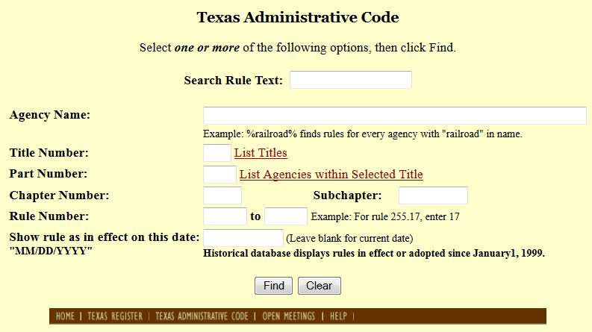
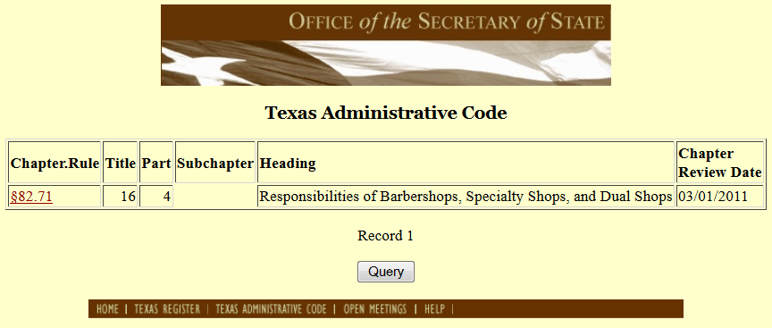
Texas Regulations
barber pole

Slide 29
Municipal Codes
http://www.municode.com/Library

Slide 30
Free Caselaw Research
Casemaker

Slide 31
Casemaker
Citator Accuracy Issues?

Slide 32
FastCase
New addition to the Texas Bar member benefits. All of you have it, if you are barred in Texas.
Your Texas Bar membership includes Texas and Federal Resources.
Notes:
And, just to add, FastCase has the same citator issues as CaseMaker. Pretty much, for a reliable citator, you need Lexis or Westlaw (or you can visit the law library to use Lexis Academic).

Slide 33
FastCase
Visualization tools

Slide 34
Google Scholar
...is Galloway still “good law”?

Slide 35
Google Scholar’s Citator
Comparing “How cited” to KeyCite on WestlawNext
?
!!!
“Negative Treatment” References:
Ranked by type of treatment
Red/yellow flags & Treatment
Headnote references indicate areas discussed
Supreme Court granted Cert.
“Cited by” References:
Ranked by relevance
No indication of positive/negative treatment
Both negative cases listed…

Slide 36
Recommended Books
Texas Legal Research (2012)
List Price: $26.00
Amazon: $24.70
The Greenbook
List Price: $11.00
The Bluebook
List Price: $34.00
Legal Research in a Nutshell
List Price: $41.00

Slide 37
Recommended Books

Slide 38
Law Libraries
Sarita Kenedy East Law Library
Bexar County Law Library
Come back and see us!
Homepage
Online Catalog
Homepage
Print Catalog

Slide 39
Westlaw for the price of parking: Bexar County Courthouse has a Westlaw Terminal!

Slide 40
Sheppardize for free:
LexisNexis Academic
St. Mary’s Libraries (on campus only)
Notes:
You can also Sheppardize at UTSA libraries.

Slide 41
Cost-Effective Legal Research:
Resources and Strategies
March 20, 2015
Mike Martinez, Jr.
Wilhelmina Randtke
Sarita Kenedy East Law Library
St. Mary’s University School of Law
Notes:
Hello, I’m Wilhelmina Randtke and I’m Electronic Resources Librarian at St. Mary’s. Slides from this should be posted to the CLE website after the CLE ends today.

