Slide 1
Webscraping on a Shoestring with No I.T. Support: Libraries Preserving Access to Born-digital Government Information
Wilhelmina Randtke
June 23, 2012
ALA Annual Meeting
Anaheim, California
Materials online at www.randtke.com/presentations/ALA2012.html
Notes:
Hello, I’m Wilhelmina Randtke. I’m currently Electronic Services Librarian at St. Mary’s University in San Antonio Texas.
Today, I’ll present on Webscraping on a Shoestring with No I.T. Support.
The focus of the this presentation is government documents, and simple web scraping tools, which someone could use without needing to have much technological skill. If you are a government documents enthusiast, or are in a library which has no I.T. support, then I hope to give you some simple tools you can take home to do webscraping projects.

Slide 2
Overview
Why libraries, including smaller libraries, should archive digital government documents.
Barriers to web archiving, and tips for finding manageable projects.
Steps in a web archiving project:
Assess available resources: tools and IT skills.
The technology side of collection development: How to spot “low hanging fruit”.
Best practices and goals in a digital library.
Tools for web archiving, and walk throughs.
Long term planning.

Slide 3
Why archive electronic government documents?
Fits libraries’ traditional repository function
Low administrative costs
ie. fewer copyright concerns than privately produced documents
Lower costs to digitize
online documents have already been digitized
Lower costs to index
can often repurpose some metadata from the government site
Notes:
These are some brief reasons to archive government documents, especially for a small institution.
The traditional library function is something libraries have stepped back from. This dovetails with copyright. It’s very easy to make a copy of a digital item. That’s good, because it makes things like webscraping possible. That’s also led to some changes in how copyright affects library collections. In print, you own. In electronic, you rent.
Copyright isn’t a barrier to collecting government documents. Most state and federal materials are declared free of copyright. In the case of states that copyright primary law, that hasn’t been upheld. There is a right to access the primary law – so statutes and rules. With older material, printed through a private publisher, you may have some copyright concerns. In electronic, you tend to get the material directly from the government agency, so there’s even less of a chance to come into contact with copyright issues.

Slide 4
Government documents aren’t the only thing going online….

Slide 5
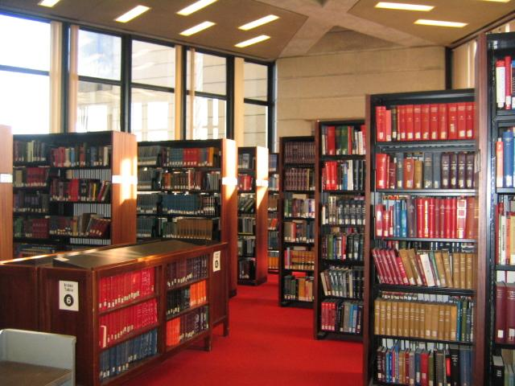
Research ecosystem of the past...
Notes:
The reference desk is up front. Similar books appear adjacent on the shelf. The material is structured by a neutral party.

Slide 6
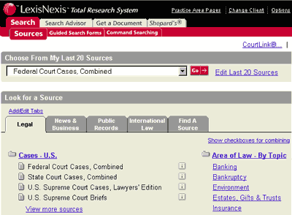
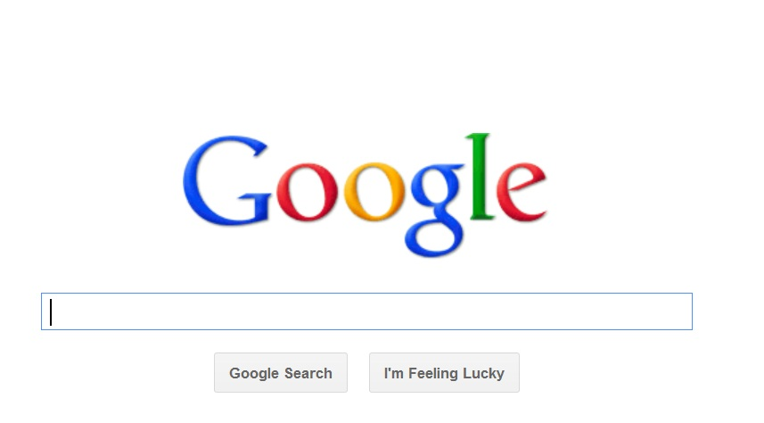
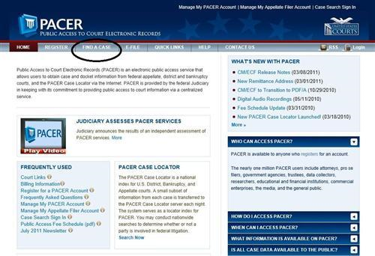
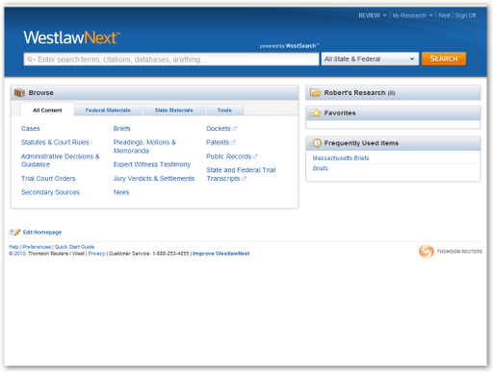
Research ecosystem of the present...
Notes:
Some links are more prominent, like the reference desk. Similar search results come up next to one another. The research environment is structured by private corporations.

Slide 7
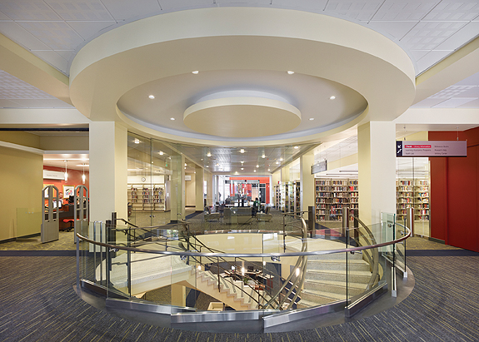
Library of the present...

Slide 8
Shift in everything from print to digital: Changing role of Libraries and Publishers
Libraries moving away from the repository function
Collection weeding by pure statistics, no look at books’ merits.
“Just in Case” to “Just in Time” acquisitions.
The “big deal” is falling apart.
The alternative of patron driven acquisitions may have long term drawbacks.
Notes:
Government documents are not the only thing which has moved from print to digital. All resources are going that direction, or are already gone.
So, the historical way things went was: The publisher made things available for a short window of time for sale, in print. The government made things available for a short period of time in print. Then, libraries took the long-term distribution role. They made things accessible into the future.
Why is this the case?
(seems to make financial sense – don’t store if it isn’t used)
(not enough IT in libraries to compete with rented databases)
(copyright issues)
What are some long term drawbacks of this shift? Material which aren’t profitable become unavailable forever. When a journal is canceled in print, they don’t come repossess the printed copies off your shelves. When a journal is canceled in electronic form, you totally loose it.
So far, publishers forced libraries to subsidize the low use items. Low use and high use items were bundled together into mass all-you-can-eat sales – the “big deal”. Now there is a strong backlash against that. There is a desire to only buy electronic items as they are used. But isn’t subsidizing low use items something that a healthy information ecosystem should do?
The harsh (and unintended) consequence of buying only high use items is that an electronic database and it’s contents may become completely unavailable.
Copyright is the current huge barrier to libraries acting as repositories in the context of electronic resources. The scholarly communications field focuses heavily on that barrier, and on licensing schemes and other ways to work around it. Copyright is much less a factor for government publications, so as government material goes digital, libraries can move seemlessly into an electronic repository role.

Slide 9
Library of the present... Traditional Repository Function?
15 years later, where can I find my highschool yearbook? *hint* not in the highschool
Notes:
Here’s a question… If you go back to your home city, and look for your highschool yearbook, where are you likely to find that?
In Jacksonville, the public library downtown, keeps these for all local high schools. The highschools don’t consistently keep them. It’s a really simple thing. It doesn’t get a lot of use. It’s not likely to be profitable for a publisher to digitize. But, it’s local history, and the use it gets is maybe higher value. If I check out a bestseller, I might have 5 bestsellers where meh I can go with any of them. I’ll just browse and find something else. If I want my brother’s senior yearbook, I can’t take a substitute. If I visit Georgia, and want to look at my grandmother’s senior photo, I want that specific yearbook – not any old yearbook.
Much as we are trying to make acquisitions and collection development into a parody of business, there is a strong argument against this. Libraries aren’t commercial publishers, and shouldn’t be. Preservation of local material, regardless of current use, has innate value.

Slide 10
Shift in government documents from print to digital
“Key Finding 1: States have begun to discontinue print official legal resources and substitute online official legal sources”
AALL’s 2007 State-by-State Report on Authentication of Online Legal Resources.

Slide 11
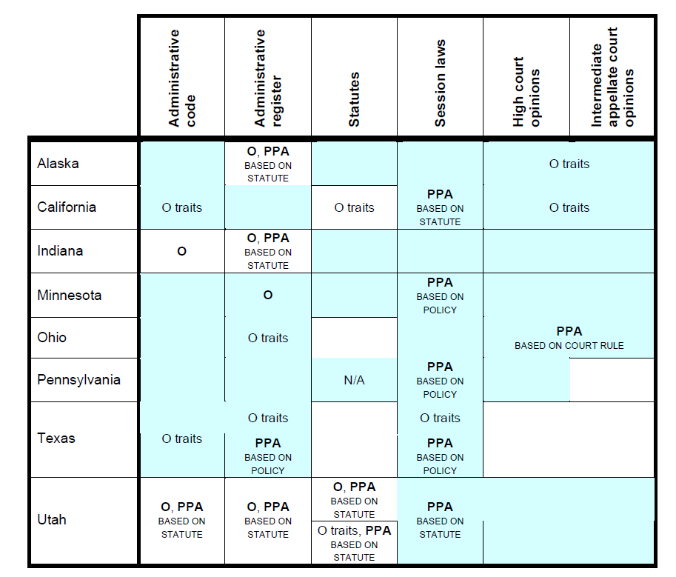
Notes:
From the AALL’s 2007 State-by-State Report on Authentication of Online Legal Resources.
“PPA” means permanent public access
According to 2009 update, four more states have permanent public access:
Connecticut, Georgia, Idaho, and Utah

Slide 12
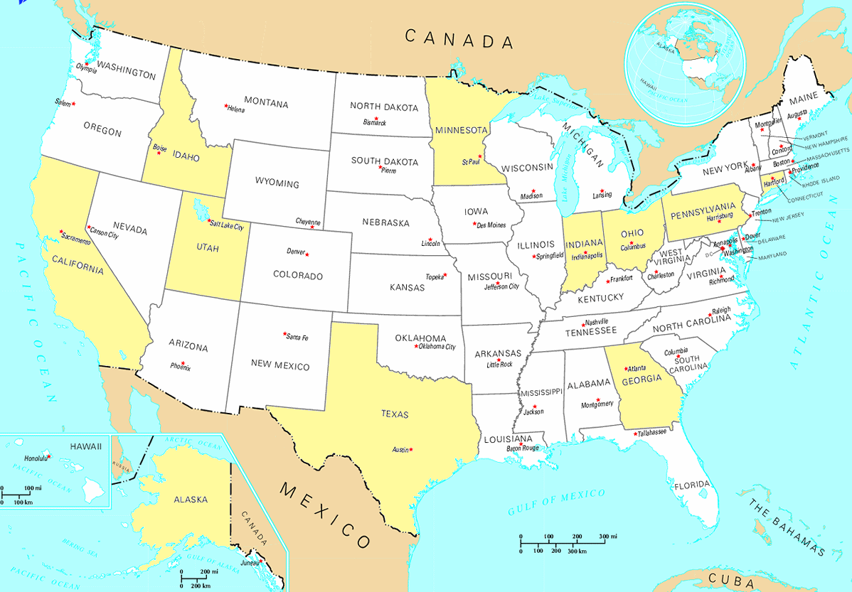
States which guarantee permanent access to online government information.
Notes:
In many cases, this is just one specific type of document. For example, from the previous slide, most are only guaranteeing access to session laws.
To my knowledge, none are guaranteeing at the lower levels – things like forms someone would fill out, state agency policies, frequently asked questions about government programs. So, really, the guaranteed permanent public access is NOT all documents in all these states. Instead, it is only a small subset of documents in these states.

Slide 13
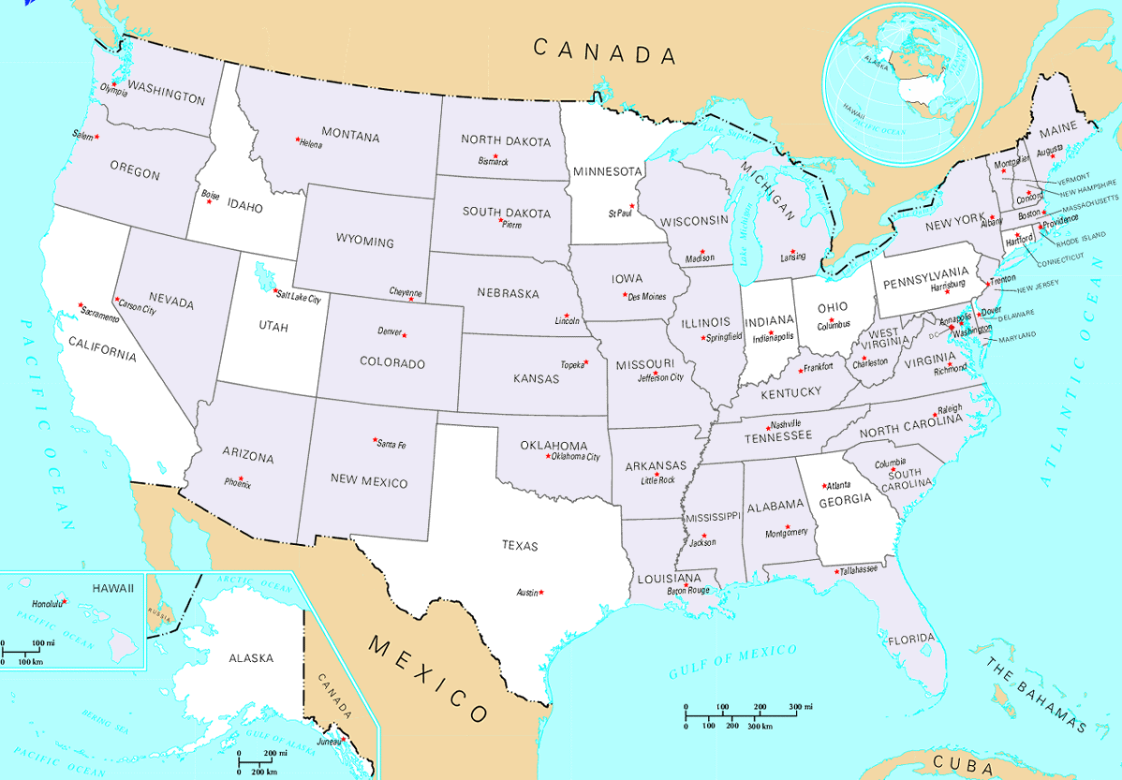
States which do NOT guarantee permanent public access to online legal documents.
Notes:
Another way to think of that is to consider the states which don’t provide any mechanism for permanent public access to online materials.
Once again, things are not so bad in these states. For example, in Florida, records are centrally regulated, and an agency must retain records on set schedules and then get permission from the State Archives to destroy public records with potential long term historical value.

Slide 14
Disappearing documents?
Good reasons
Outdated information
but… What if I have an argument about my interaction with a government agency back when that document was valid?
Bad reasons
Funding interruptions
Transition: New agency head; new elected official
Agency gets dissolved
Website redesign
Issues from Document removal, and changed URLs.
Notes:
We know this happens. At the federal level, after September 11, many many government documents available on federal websites became unavailable.
At the state level, disappearing documents is the norm.
A study which tracked federal, state, and local documents from January to December 2008 found that
3% of federal documents disappeared; 5% changed the URL
12% of state documents disappeared
4% of local documents disappeared; 12% changed the URL

Slide 15
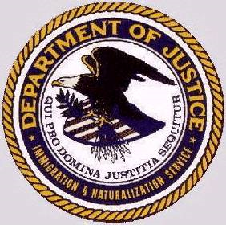
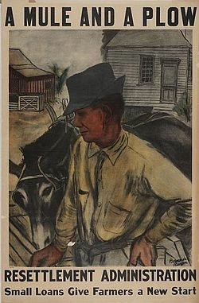
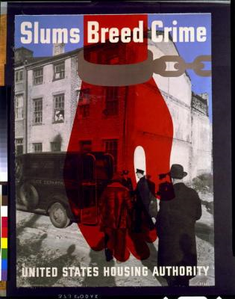
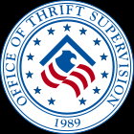
Immigration and Naturalization Service, dissolved 2003
Library of Congress Police, dissolved 2009
Resettlement Administration, dissolved 1937
United States Housing Authority, dissolved 1947
Information Agency, dissolved 1999
National Advisory Committee for Aeronautics, dissolved 1957
National Advisory Committee for Aeronautics, dissolved 1957
Office of Thrift Supervision, dissolved 2011
Interstate Commerce Commission, dissolved 1995
Notes:
Disappearing documents: When an agency is dissolved, the documents can disappear into limbo.
Here are several federal agencies which existed once upon a time, but no longer exist.

Slide 16
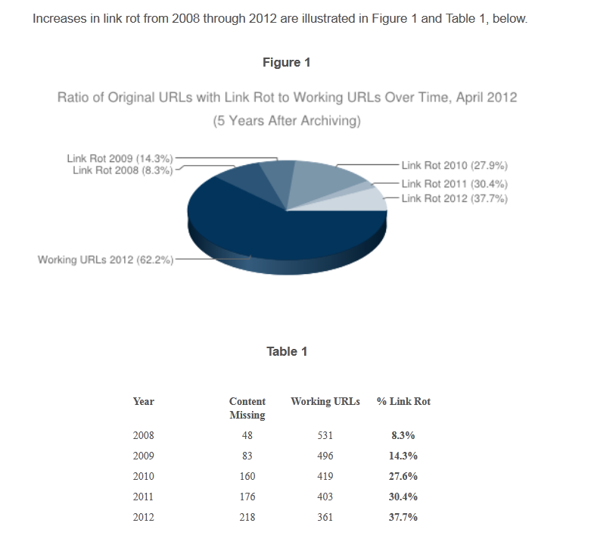
The Chesapeake Digital Preservation Group, "Link Rot" and Legal Resources on the Web: A 2012 Analysis by the Chesapeake Digital Preservation Group
Notes:
Even if the document is not removed, it is highly likely the URL will change. Monitoring in-house files is potentially less work than monitoring URLs, because you have more control over how the in-house files are arranged, and you can set a schedule for maintenance. With links, the fact of whether or not the URL works is out of your control.
Group collected URLs for online legal materials in 2008, and checks linkrot annually.
“More than 90 percent of the top-level domains in the sample are state-government (state.[state code].us), organization (.org), and government (.gov) URLs, representing approximately 41 percent, 32 percent, and 17 percent of the sample, respectively. Other top-level domains, comprising approximately 7 percent of the sample, combined, include .edu, .com, and .net, which respectively represent 2.9, 2.2, and 1.9 percent of the sample. Less than 3 percent of the sample consists of .mil, .us, .info, .uk, .au, .ca, and .int top-level domains. The sample also includes one IP address.
In 2012, the content at .org domains showed the highest increase in link rot. More than 43 percent of the materials posted to organization domains disappeared from the original documented web addresses. Link rot on government web pages also increased in 2012: up to 36 percent at .gov domains and nearly 34 percent at .state.[state code].us domains. Education domains also showed an increase to more than 41 percent in 2012 after decreasing slightly in 2011, and network domain link rot rose to more than 36 percent.”
For more info, the study is here: http://cdm16064.contentdm.oclc.org/cdm/linkrot2012

Slide 17
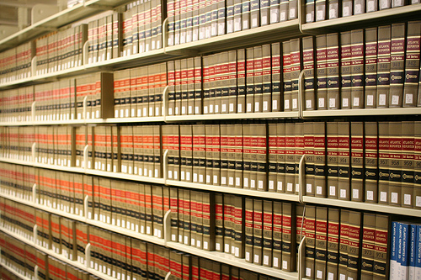
How has government handled long term official records in the past?
Notes:
Libraries traditionally took an active role in storing and preserving government documents. This may be welcome into the digital future.

Slide 18
Traditional Repository Function: Organizing links is not good enough; You must also control the content.
When you save a link only, the government can delete the document.
When you store a copy of the document, the government cannot delete it.
Even if the content remains posted, the URL can change.
Time consuming to tend to links
May be easier to tend to files
You choose a standard storage system for those files, not like URL formatting controlled by the agency.

Slide 19
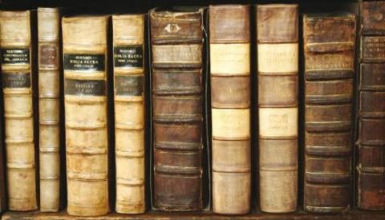
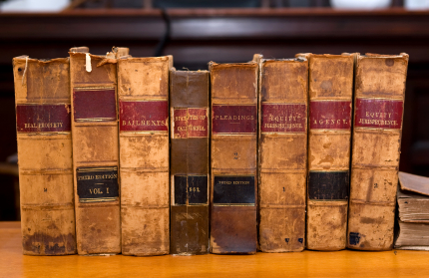
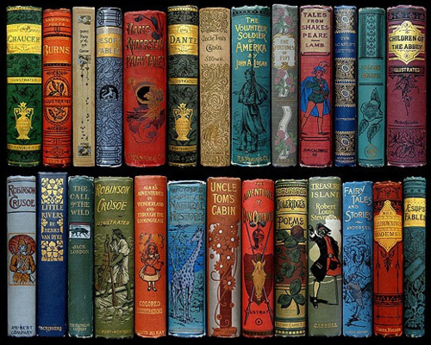
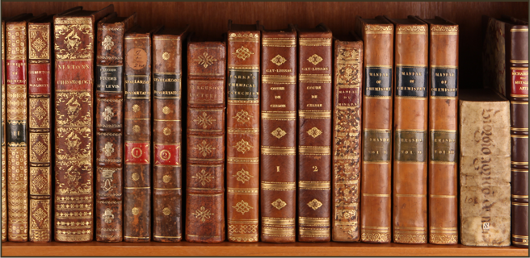
Traditional role of long term storage and availability

Slide 20
Authentication
How do I know this document is what it says it is?
“To satisfy the requirement of authenticating or identifying an item of evidence, the proponent must produce evidence sufficient to support a finding that the item is what the proponent claims it is.” Federal Rules of Evidence, Rule 901(a).
Notes:
For government documents, this is a big part of whether that document is useful or not.

Slide 21
Approaches so far...
Federal Rules of Evidence
AALL recommendations; Uniform Electronic Legal Materials Act
Government Printing Office
Too many copies to alter

Slide 22
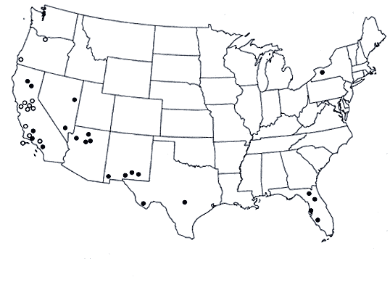
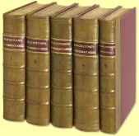
John Joergensen (Rutgers) and theory of multiple copies
Notes:
Hard to change something once it's distributed.
So, West printing may have errors, may be tampered with or altered before the print run is out.
But, once that print run is out and shipped, it's hard to alter the law. You can alter or forge one copy. That's doable. But, to alter and forge 3,000 copies, in 3,000 archive, is not possible.
So, there is the idea that collecting digital copies in-house will matter.

Slide 23
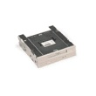
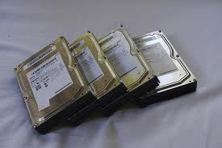
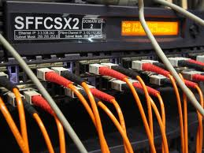
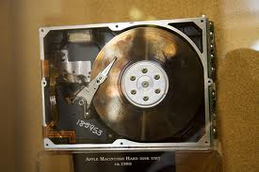
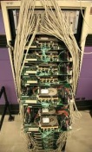
Harder to tamper with multiple copies
Notes:
Hard to change something once it's distributed.
So, West printing may have errors, may be tampered with or altered before the print run is out.
But, once that print run is out and shipped, it's hard to alter the law. You can alter or forge one copy. That's doable. But, to alter and forge 3,000 copies, in 3,000 archive, is not possible.
So, there is the idea that collecting digital copies in-house will matter.

Slide 24
Potential for Better Search
Good government search engines are siloed.
The publishing agency keeps to itself.
In print, the OPAC broke these silos down.
Most cataloging is copy cataloging, and this could happen with records for digital items.
(Can’t use the OPAC to catalog web links only. Links break quickly. So, the material has to be stored with a trusted source.)
Possible future directions for federated search could lead to better search and retrieval for government documents.
YOU NEED METADATA TO HAVE A “SEAT AT THE TABLE”

Slide 25
Why small / IT poor libraries?
(psst, keep it secret… everyone has bad IT)
More in tune with local patrons needs.
The least permanent documents are at the state and local level.
The more, the merrier for authenticating government documents.
Notes:
Not everyone, but most libraries.
If someone has good IT, they will tend to present it because it’s a strength. If someone has bad IT, they will frequently try to hide it, or at least not run around saying they are unable to move forward because of their bad infrastructure.
Even the title of my talk, “on a shoestring, with no IT support” may be shocking. I have worked at libraries where that title would not be allowed. At FSU’s law library, I was paraprofessional and it was a law library - they don’t mix much with the law library world – so that’s two reasons no body cares. However, some libraries discourage honest self criticism. Publishing on the “low end”, the mistakes, the projects which are done ad hoc and not perfectly – these may not be allowed.
The result is that when you look for walk throughs on any project, you tend not to see the low end, you tend not to see the internal barriers, and you tend not to see run-of-the mill projects.

Slide 26
Barriers to archiving electronic material
Daunting scope – the internet is large
Poor IT support in libraries
In libraries with better infrastructure, different staff have government documents expertise versus IT expertise
Solutions
Focused collection development
Manageable projects with the tools available
Tools selected for government documents librarians, not the technologically best tools
Accept reality and don’t be perfect

Slide 27
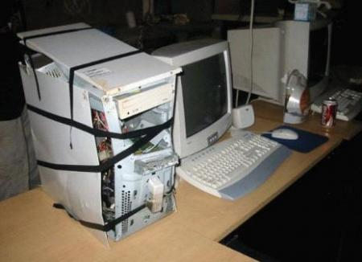
Poor IT support/infrastructure
Notes:
Everyone has a bad IT infrastructure.
At the FSU law library, getting something the library does not already have in terms of an IT resource is just not going to happen. There is some web space. In static HTML. That’s it. There is no database set up, and it isn’t going to come.
So, the status of IT hardware and resources there is stuck in time circa 1996.
The status of IT staffing is a bit worse. IT reports to the law school, not the law library. There is no accountability to the law library and the library is not a priority. The IT staff is unwilling to say “I don’t know”, so makes things up. Even if they had better communication skills, their primary purpose is to do audio and video set up for the classrooms, and it is unrealistic for the librarians to ask them to do web site work, server work, or anything more than audio and video recording and set up.
The best example of how little access to IT exists is that: When I started in 2008, my supervisor requested that I get access to edit the webserver. I resigned one year later, to work for the state. IT turned my access on two days before I resigned.
So, two days after I got access, my supervisor requested it be removed.
Then, in 2011, I started back at the law library. I verified that I still had access to edit the website.
Two weeks after I went back on payroll, my access was turned off based on the two year old request.
One year later, and after I had accepted a job in Texas, IT turned my access back one.
THE AVERAGE RESPONSE TIME TO A SIMPLE REQUEST WAS MORE THAN ONE YEAR.
This is unusually bad service, but not as far from the norm as libraries like to pretend.
The most realistic solution to this barrier is to educate librarians enough to know that most computer oriented tasks are outside the scope of the job for the IT staff. Someone hired to set up a projector cannot realistically be expected to work with a webserver.

Slide 28
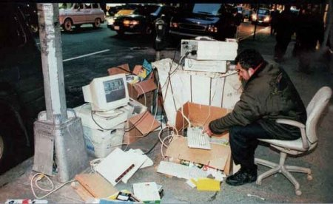
Poor IT support/infrastructure
Notes:
In small libraries, the problem is isolation. In big libraries, the problem becomes silos.
Even in libraries with good digital library programs, the digital library staff, and the government documents staff may be in separate boxes. The government documents librarian will have the background knowledge needed to do good collection development in terms of what documents matter. The IT staff will have the background knowledge to do good collection development in terms of what documents are easy to get.
In libraries with poor IT support, the government documents expertise may be the only piece of the puzzle present.
The goal of this talk is to give simple steps and tools to get started with webscraping.

Slide 29
Step 1: Assess what resources you have to host content.
Available hardware and software.
Website space? How much?
Database or any easy way to store and share metadata?
IT skills in other staff in the building.
What can your co-workers realistically edit or maintain?
Can any other departments assist in unusual tasks?
Long term financial resources (this lets you know what tools you can rent).
Hosting content means you can loose everything, if you don’t pay the bill.
Consultants can assist in non-routine tasks.

Slide 30
… content is not enough
Are these the same?

Slide 31
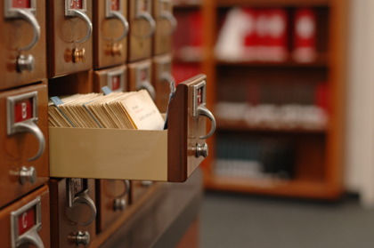
… content is not enough
Notes:
No one would plan to have a library without a card catalog.
In digital projects, suddenly, the focus shifts, and search is forgotten. If you don’t plan for search, then your digital collections will be useless. You don’t have a library if you only have a dump of documents with no indexing information.

Slide 32
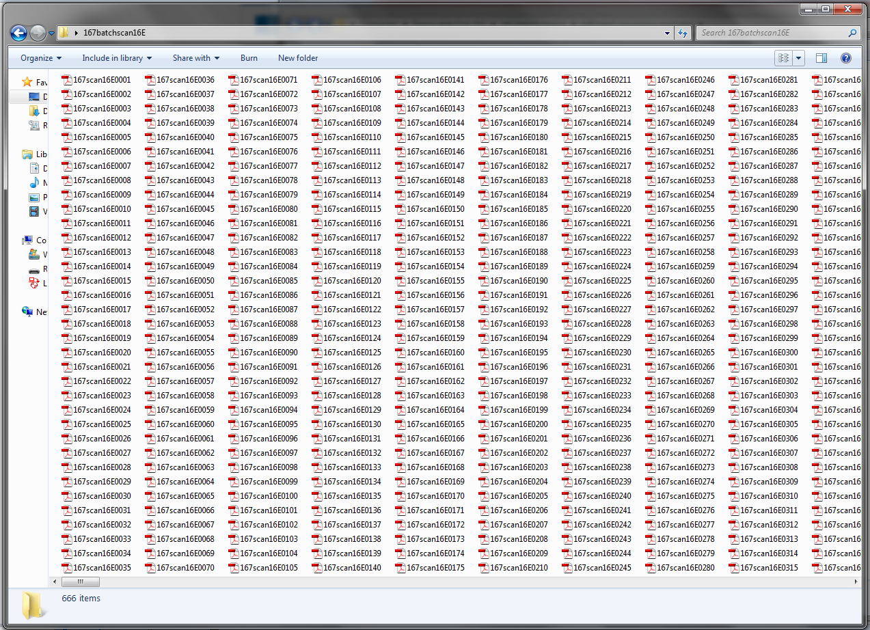
… content is not enough
Notes:
Content without indexing information is useless.
Librarians tend to be blissfully unaware of this when they move to the electronic environment.

Slide 33
Background: Metadata and Relational Databases
Metadata = any indexing information
Your Goal = Provide some indexing information in a format where computers can understand it and connect it to the document

Slide 34
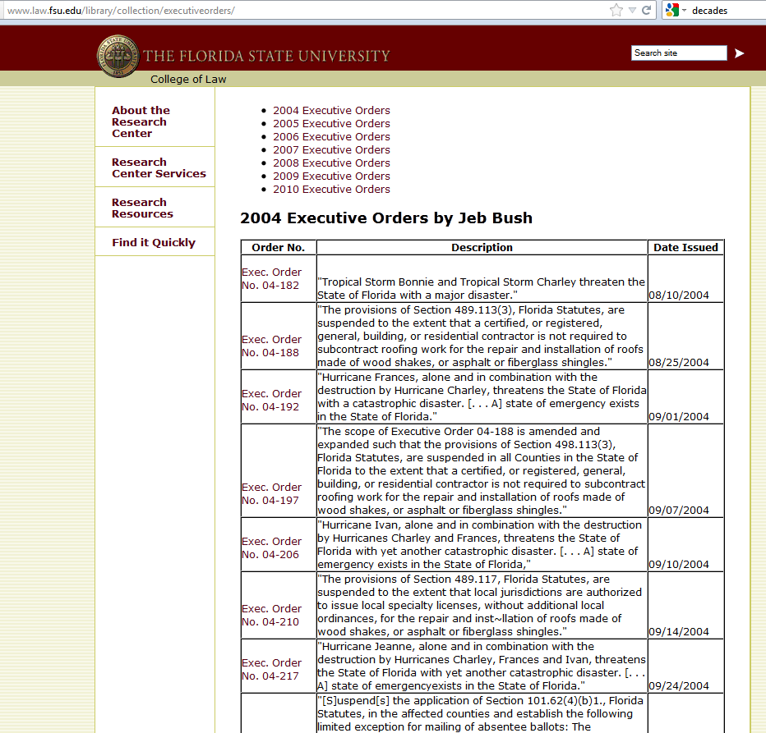
Useless metadata: only people can read it
Notes:
These are some labels to links on a project I did. They have citations according to the Florida court system’s citation scheme, they have titles, they have dates.
This is the equivalent of shelving books in order, and nothing else. So, assigning call numbers to books, writing those on the spine, and then shelving them. But not entering that information into a card catalog or anywhere else.
Two key things here:
This indexing information is basically useless. No one is going to browse to your site, then browse to the opinion. Instead, people are going to Google in to a document, and find a PDF with no context: no title page, no nothing on that PDF to label it. Your label will be here, with your link, but very very few people who see the document will ever see this label. To be useful, this labeling needs to go into a format where the computer can read it, understand it, and connect it to the document. That concept is metadata interoperability. You will NEVER be included in federated search projects, if this is all that you have.
Almost all websites have this labeling on links. So, if you can find it, you can try to convert it to a format the computer search can read, and that is much faster than writing it from scratch.
Does this concept make sense?
If you already have a static webpage that looks like this, you will need to get interoperable metadata in order to have a seat at the table.

Slide 35
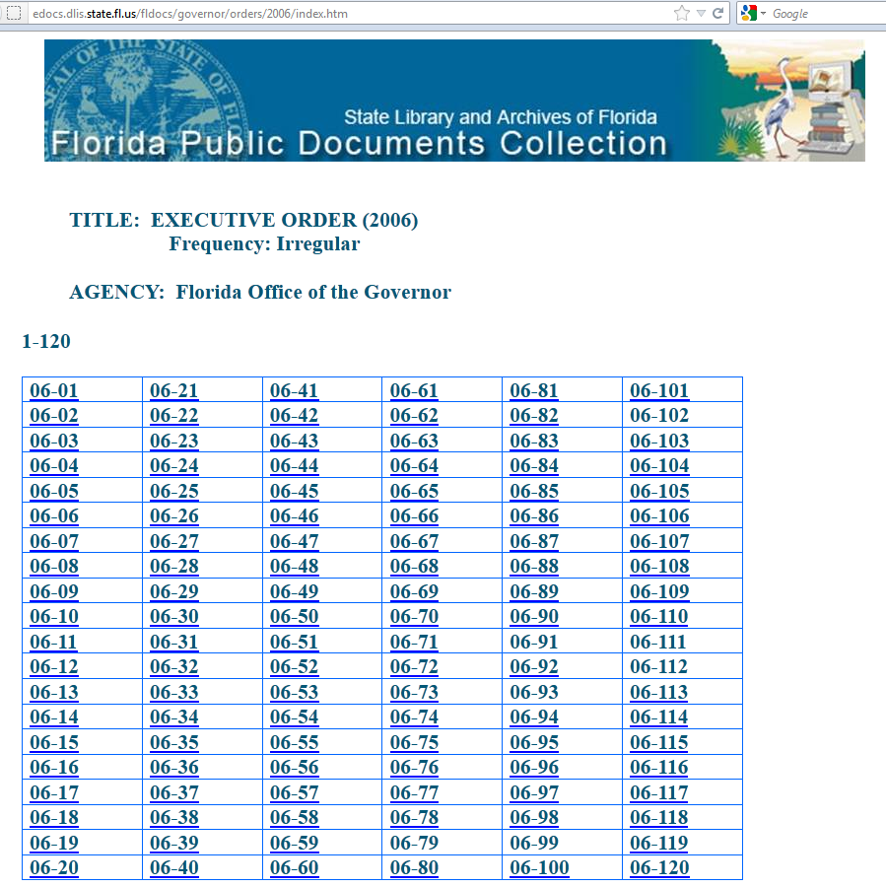
Useless metadata: only people can read it
Notes:
This is the Florida State Archives’ scrape of the same resource.
There is almost no indexing information, but not none. Incoming links could all have been labeled “document”. That would have been a little worse.
To be fair to the State Archives, they created a catalog record at the collection level. The FSU law library did not do this, because in the words of the Associate Director “Google will get to it”. That may be a self-defeating attitude for librarians, and is certainly not a best practice.

Slide 36
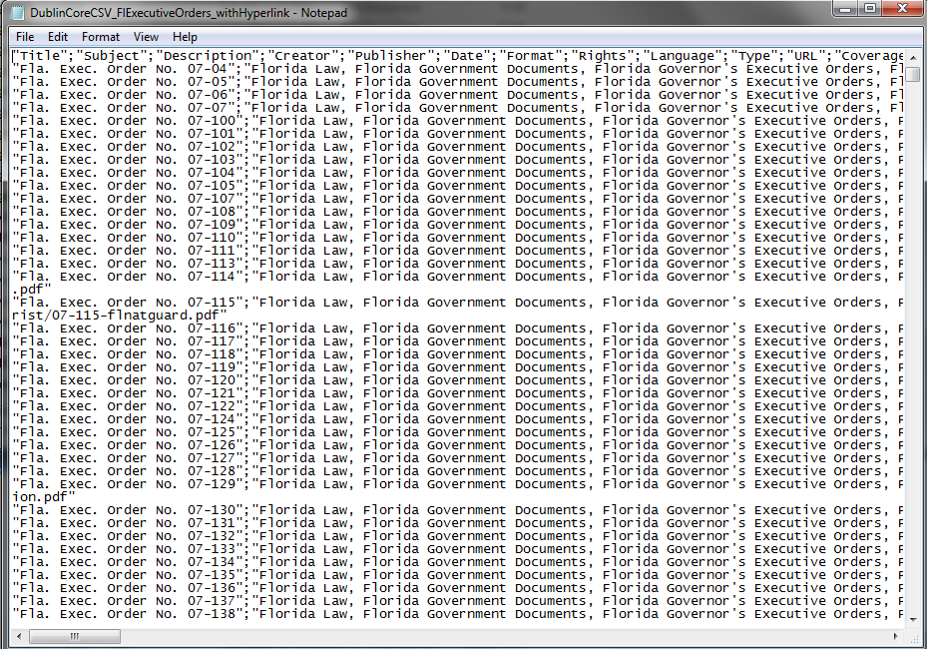
Better metadata: Indexing information is ready to load into a search system
Notes:
This is better. This is a comma separated value file with indexing information for all of the Florida Governor’s Executive Orders. It’s kind of useless if you double click and open it with Notepad. It’s kind of awesome if you upload it to a digital library platform, then the digital library platform uses it as a search for your documents.

Slide 37
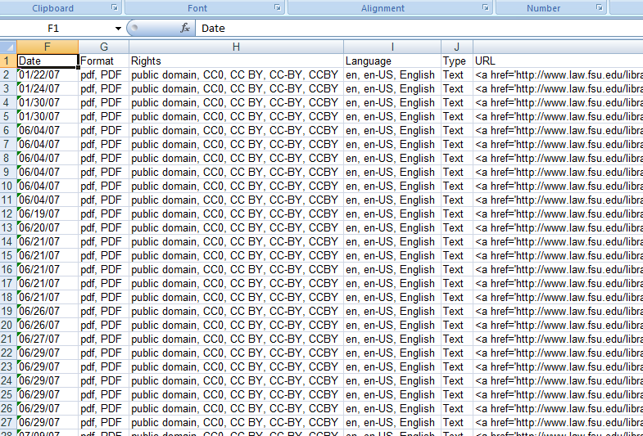
Better metadata: Indexing information is ready to load into a search system
Notes:
This is better. This is an Excel file with indexing information for all of the Florida Governor’s Executive Orders. It’s kind of useless if you double click and open it with Notepad. It’s kind of awesome if you upload it to a digital library platform, then the digital library platform uses it as a search for your documents.

Slide 38
If you can put information from links into Excel, then you can make Dublin Core records
Making them is not a technology skill; hosting and sharing them is.
(walk through Dublin Core records for Executive Orders)

Slide 39
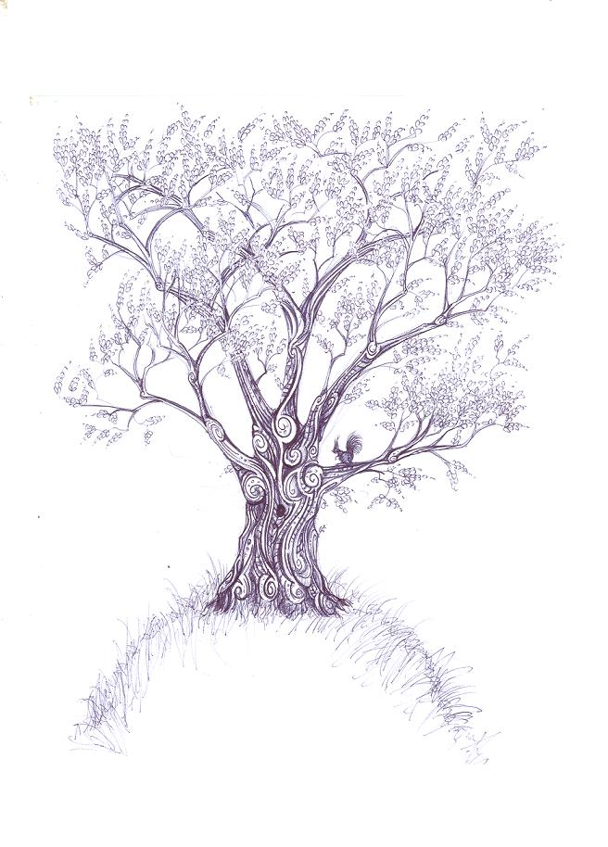
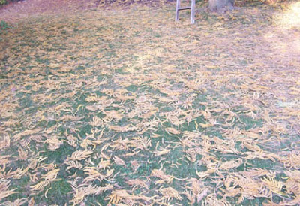
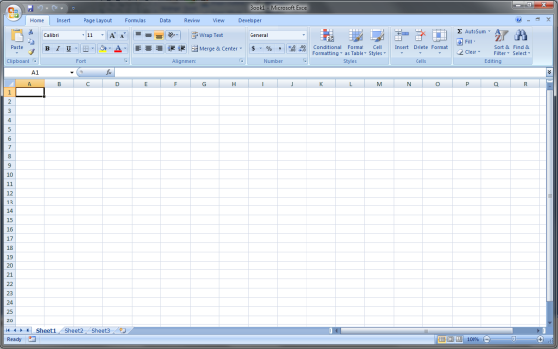
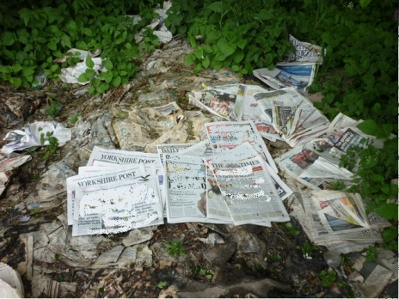
Static HTML versus Database
Notes:
The older layout for webpages from the 1990s was a static HTML structure.
You can picture this like a tree.
From the stem (the homepage), I click each branch, then I click to a smaller branch, then to a twig, and finally, my content is at the leaves.
This is a very old way to do a website. When it gets big, it is much harder to know which five branches, which 8 branches, which 15 branches, I must click down to know where I am going.
The current layout for websites is the Database and BLOB model. BLOB stands for Binary Large OBject – so files. All the files stay in the BLOB.
All the navigation stays in a database.
A database is maybe a tricky concept when you first see it. Who here has used Microsoft Access? How easy to understand was it, compared to Excel.
The tree structure is easier to understand because it’s similar to things that exist outside the computer. It’s like making a list, and checking it off. The same is true for Excel, it’s like making a list and you can actually write all the spreadsheet contents into a form and then enter them.
The database is something that only exists in the computer. You can picture the index as several Excel spreadsheets that reference one another. So they interlock in a specific way in order for the search to work. Different databases will interlock a little differently.
Some points:
The tree structure looks the same for all websites built this way.
So, a government website built as a tree is easy to copy. You click down to this branch copying as you go, then you go back up, click down to the next branch copying as you go, and so on until it’s done. You could even use a poster board and pen to draw a picture of the entire website.
It’s easy to copy, and because all tree websites use the same way to reach files – a plain old link – it’s easy to find a program to automatically copy these. We will cover such a program, HTTrack later today.
The database and BLOB is harder to copy. You must understand the database to do this, but from the public web you will not see the database. You will see a search box. Even when you understand the database, you must use the search to run searches until you have all the files. If you want to recreate the website, you will have to reverse engineer and recreate the database, so that someone using your copy will have the same experience as if they used the government website.
So, it’s easier to copy the tree structure.
There are also some implications, for your web archive on your website – so the framework that holds your collections:
The files are the leaves on the tree. Each fork in the branch is a webpage with some of your branding. Trying to make a global change to the tree structure is hard. The files are in many folders, so cannot be as easily migrated to a new format. When they are, if the file names change, then each incoming link must change.
It is very hard to maintain the tree structure long term.

Slide 40
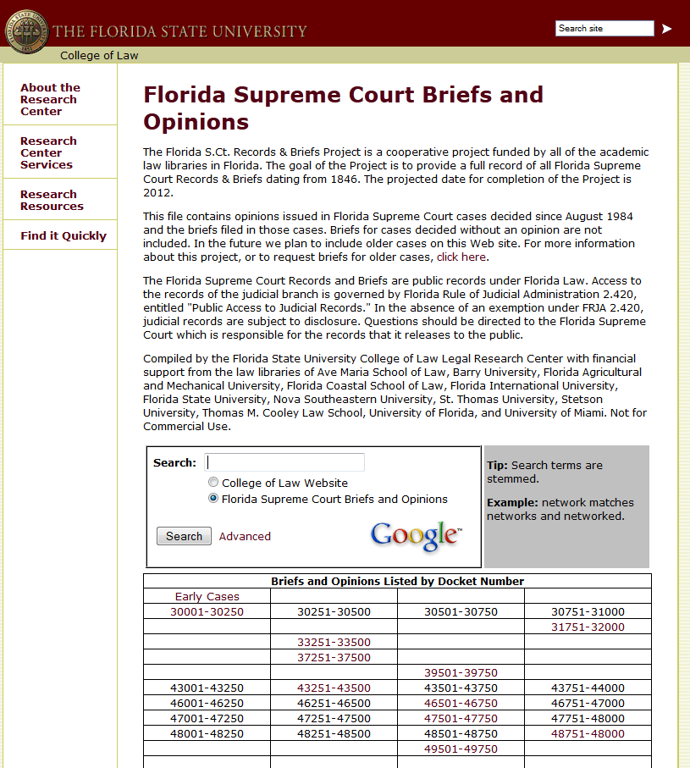
Notes:
Because of no IT support, the FSU law library must use the tree structure.
Here is the centerpiece collection: The Florida Supreme Court Briefs and Opinions project.
(To be fair, it was started in the 1990s, when the tree structure was how websites were done.)
Here, I click to a branch.

Slide 41
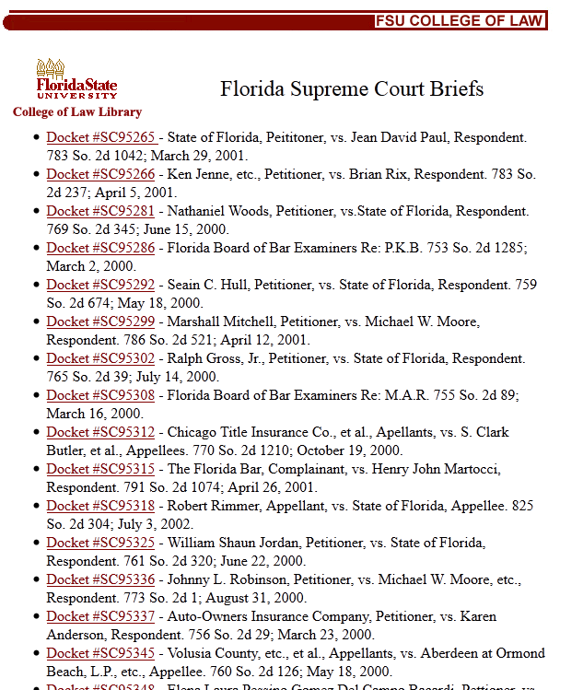
Notes:
Then I click to a branch.

Slide 42
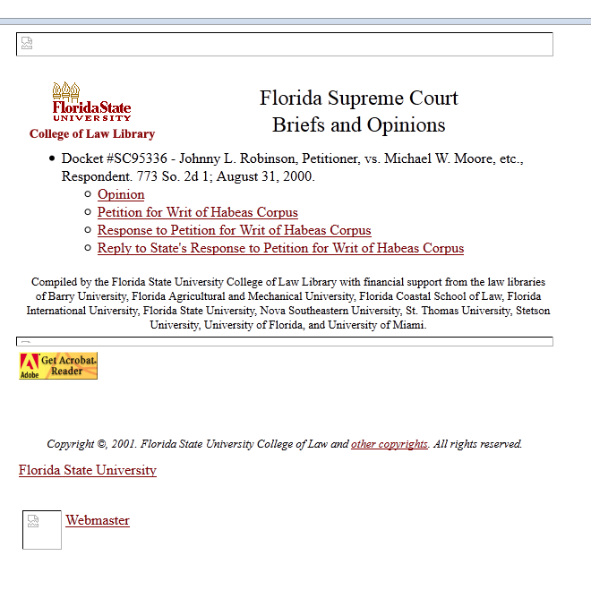
Notes:
Then I click to a twig. I see the leaves.
I also see broken links. The banner images that were up in the 1990s are gone now, leaving ugly blots. The only way to fix this is to edit each one of thousands of websites.

Slide 43
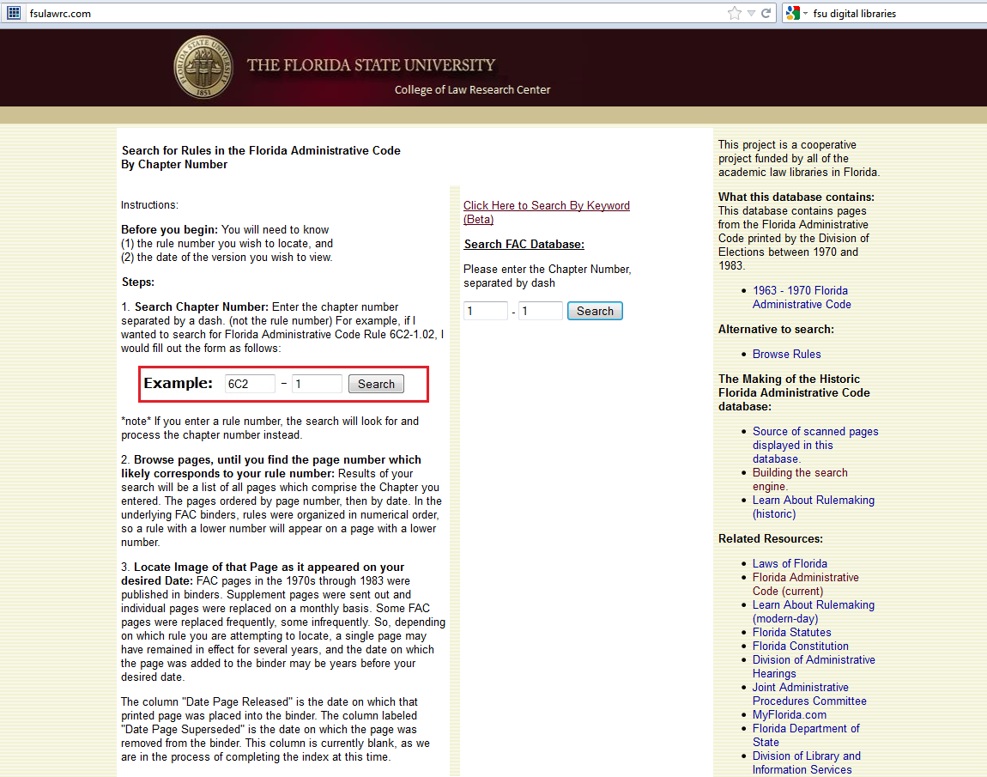
Database and BLOB
Notes:
Meanwhile, in a database and BLOB website, all the splash pages are rolled into one. If I need to change the look and feel of the page, I only have to edit one file: index.php

Slide 44
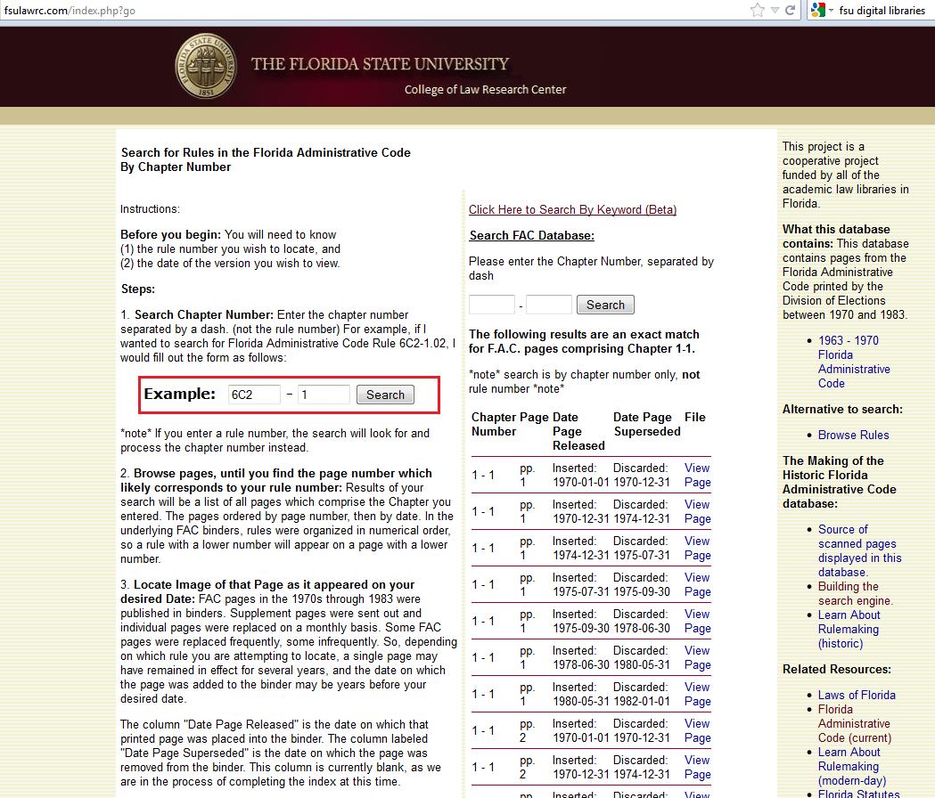
Database and BLOB
Notes:
Meanwhile, in a database and BLOB website, all the splash pages are rolled into one. If I need to change the look and feel of the page, I only have to edit one file: index.php

Slide 45
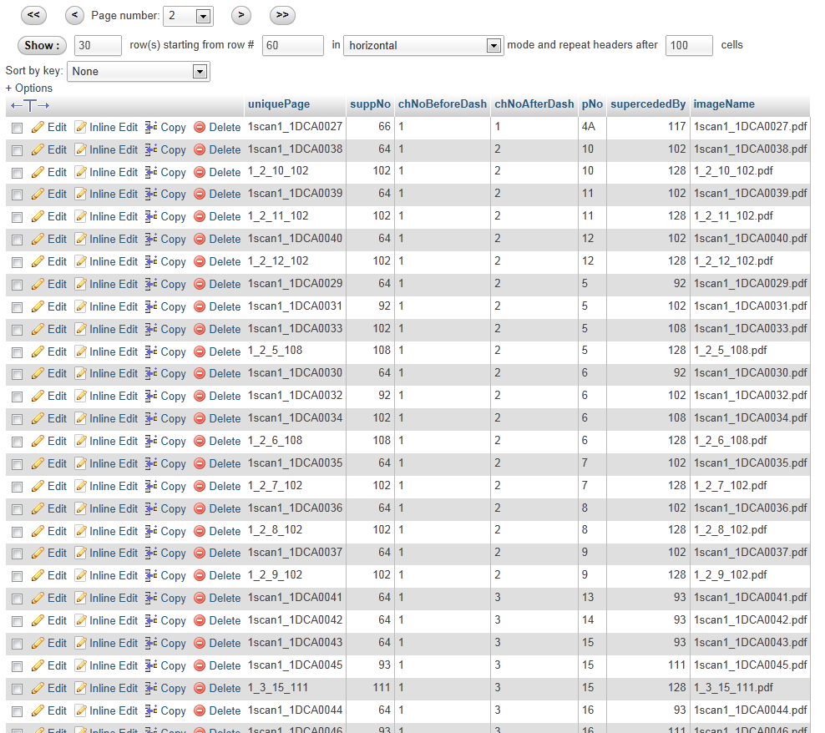
Database and BLOB
Notes:
If I did a format migration, so if I changed my file names from .pdf to .pdfx (doesn’t exist, but you never know about the future) or to .jpeg, then I just download this database to Excel, do “Find All” “Replace All” and upload this back to the database.

Slide 46
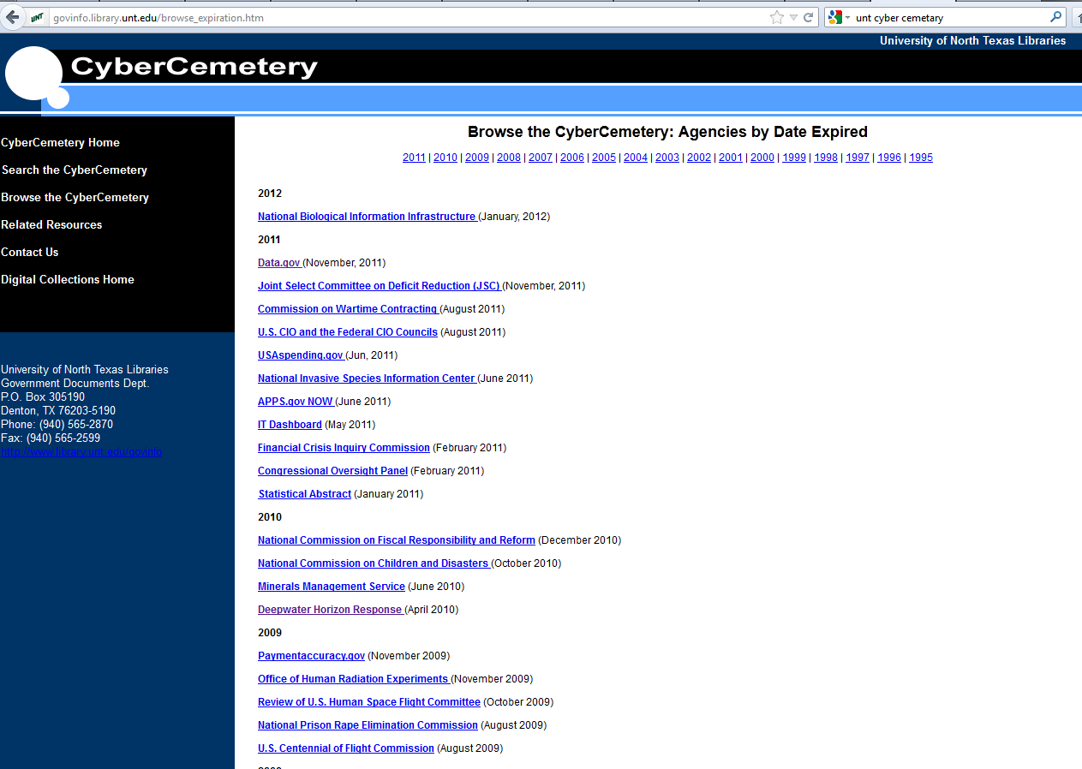
What is doable?
Notes:
This is the Cyber Cemetary by University of Northern Texas. They have really well funded, well staffed digital projects. They program their own digital library platform.
They indexed Data.gov
Let’s look at that more closely.

Slide 47
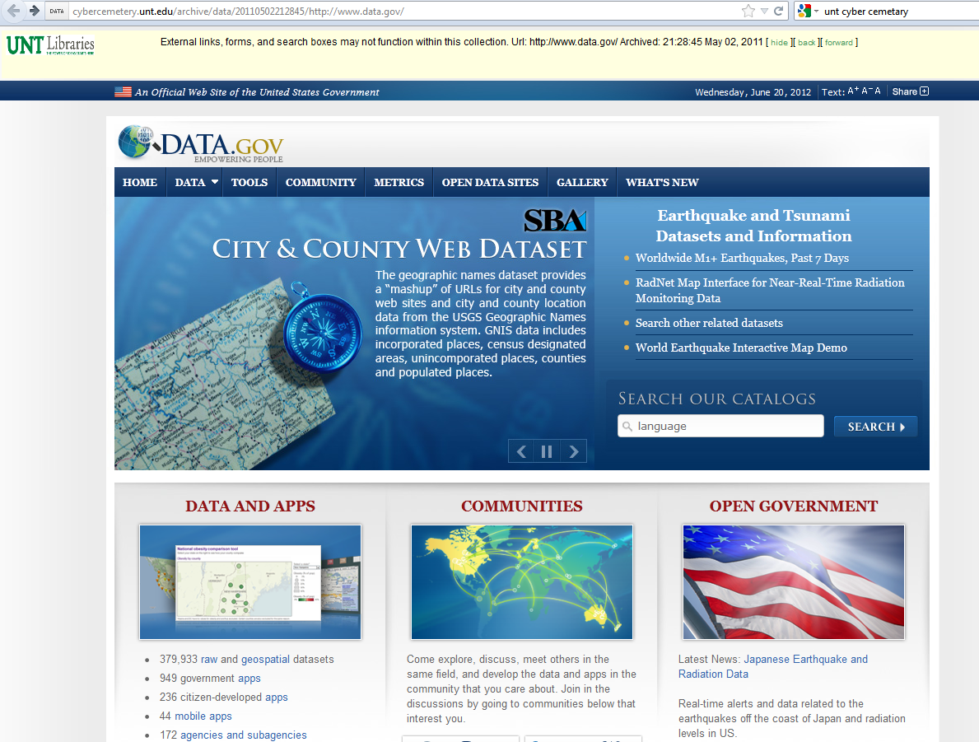
What is doable?
Notes:
I’ll search for something.

Slide 48
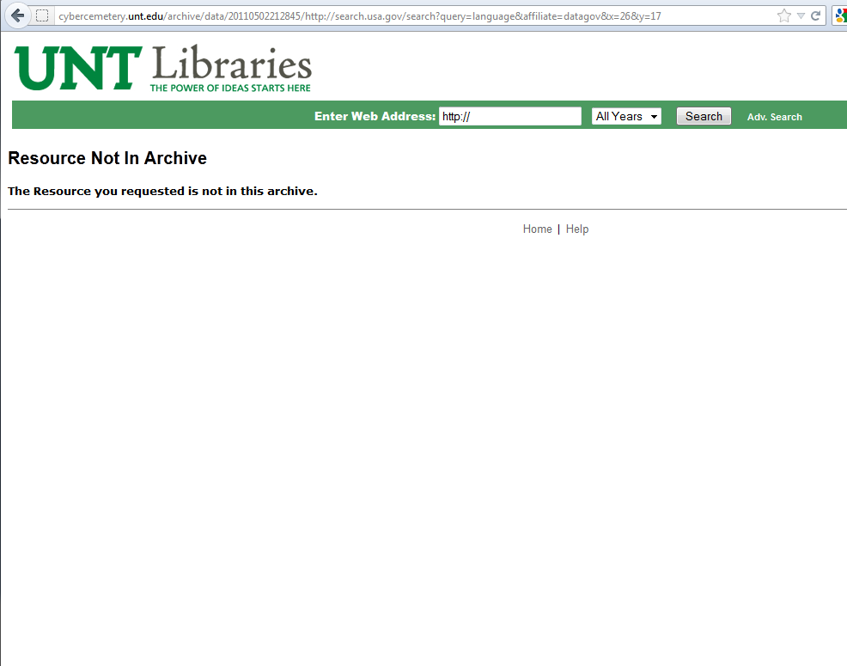
What is doable?
Notes:
Crash – I can’t run searches.
If you browse the site, you will find this in many places. Content is missing.
Remember about a tree structure versus database structure. The database structure is much harder to capture and recreate. University of Northern Texas is good at this, and they couldn’t do it. So, you should look somewhat at the technology behind the website and start with websites which are small and more “tree-like” before you move to more complicated websites.

Slide 49
Ultimate Goal: Metadata can be shared with an OAI harvester

Slide 50
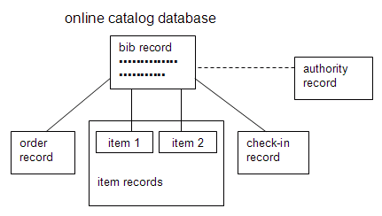
Another print resources analogy….
Notes:
Who recognizes this framework?
With catalog records, we don’t keep them separate. We have a common schema: MARC. We share records. We also put significant time and money into doing this.
OAI is similar. Each institution creates records for its digital items, then those records can be shared. There is a way to pull in records from other institutions (OAI harvesting), and a way to make records available to other institutions (act as an OAI repository).

Slide 51
Readily available, open source, free-of-charge tools for acting as an OAI repository

Slide 52
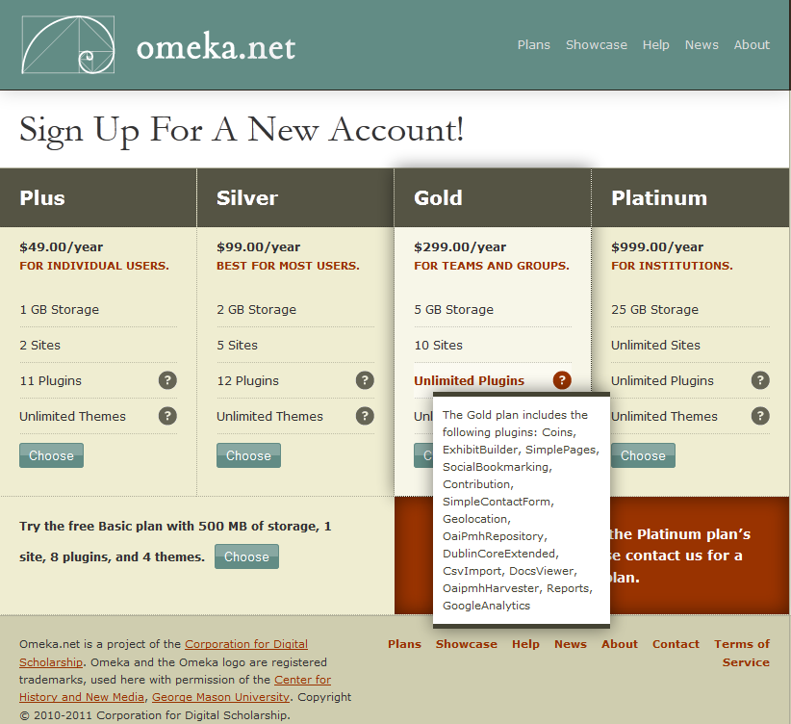
Also, lots of tools you can buy
Notes:
Almost no one programs the card catalog in-house. Instead, each library buys a tool, like Millennium, to assist in metadata handling and creation.
If you came to a talk called “with no I.T. support”, then you should not try to build this in-house. Instead, look for a low cost way to host and share metadata.
For example, this $299 per year plan from Omeka.net lets you host unlimited Dublin Core records, and then have a one-click method to host and share the metadata using this OaiPmhRepository plugin. (You are capped at 5GB of storage space, but get unlimited records.) So, this is a good option if you want to move from static HTML web pages on your library’s website, to being able to share those collections and make them visible to other libraries, and to federated search projects.

Slide 53
Step 2: Assess projects
Factors that make a project harder:
Really large website. When you browse, you have difficulty knowing what areas exist.
Website is created by a database, not static HTML.
Factors that make a project easier:
Smaller total size of the website. When you browse, you can feel “the end”.
You can see and understand labels for the documents you want. You can cut-and-paste several labels at the same time.
You understand how the website is structured.
Irrelevant factors:
Has someone else done this? (Remember, redundant digital projects is better for authentication.)
(You also don’t know how thoroughly they did it.)

Slide 54
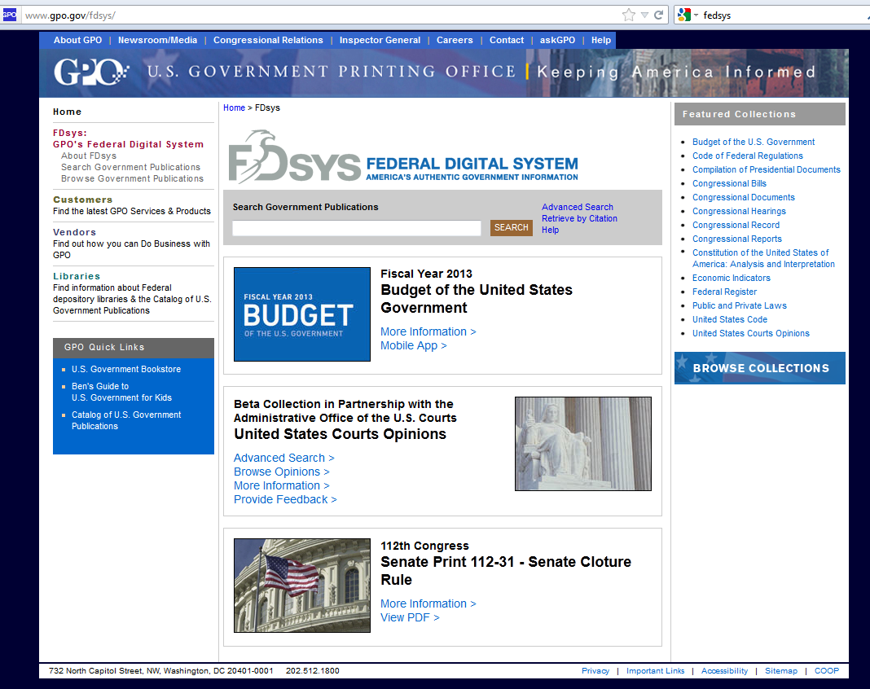
Daunting Scope
Notes:
Scraping the content from FedSys is a great project for attracting users, but a tough project in terms of requiring high technical skill and many internal resources to host the content.
FedSys is NOT a good project for almost any library.
Instead, to make it manageable, pick a manageable project. Try to think about what YOUR patrons might need, which no one else is doing. Millions of people use FedSys each year, but how many of your patrons use it?

Slide 55
Smaller may be better for your patrons
Notes:
Here is something that public libraries may deal with: unemployment compensation systems.
Notice, there is a benefits handbook, a brochure about the debit card. If the state updates these, then the patron may have a problem where he or she is flagged for fraud or has an issue a year later, and needs the older document. If the item is removed completely, then maybe you still want it. For example, in Florida, when we got the new governor in in 2011, the frequently asked questions document was essentially removed for Florida.
This is the type of resource which local patrons may have a need for, but which almost no one is doing.

Slide 56
Smaller may be better for your patrons
Notes:
I’ve just moved to San Antonio, so I scoped out some local government resources. And… I found the City of San Antonio Code of Ordinances.

Slide 57
Notes:
Here, I see a note that the previous Chapter was completely repealed in 2011. But, what if I wanted that previous Chapter?
MuniCode provides the previous version for 30 days after it is repealed. Otherwise, the city can pay to have historical information hosted going farther back.
San Antonio doesn’t pay for this, so a really useful web scraping project might be to pull the city ordinances monthly or yearly, and then make older versions available. A library outside of San Antonio is unlikely to take on this project, because they have a different patron base.
This is may be an ambitious project, and also could be upsetting to MuniCode. However, it’s easy to see how this information is both useful, local, and hard-to-get.

Slide 58
Local focus may be better for threatened materials
State and Local websites are less stable than federal.
The more local you go, the less likely someone else will do it.
Smaller more localized government bodies may have comparable IT access to libraries – a good fit.
Notes:
Studies on link rot show that state and local web documents are more in danger of disappearing than federal.
At the federal level, many groups are already doing this. A website with national interest has more eyes on it, and comes up more frequently as a candidate for archiving. A city government website is not going to come up in collection development meetings across the country.
Local governments are also more likely to have comparable IT to libraries. A city government may have only one web developer, and all the incentives to push a library towards a simpler backend for a website, will also push a city government or small state agency toward a simpler backend.

Slide 59
Step 3: Collecting Content: Use low end, easily available tools
Downloadthemall Firefox extension, to capture all documents linked from a single page
HTTrack website copier, to capture an entire website

Slide 60
Collecting Content: Avoid high tech tools
You are at a presentation title, in part, “with no I.T. support”
Here are some examples of the vastness you are unable to touch (so don’t try):
The Way Back Machine
Library of Congress web archiving

Slide 61
Collecting Content: Issues in getting documents directly from the agency
Higher entry barriers. Have to be in touch with the right person in the agency.
You may be “waiting by the phone” for extended periods of time.
Redaction may be an issue.
Documents and indexing may be in a non-standard format or arrangement.
But… This is probably the only possible way to archive a database based website.
(ie. Get the documents AND the database)

Slide 62
Notes:
Some materials on the FSU law library’s website were obtained through donation. Those are the legislative histories and the older Florida Attorney General Opinions.
Two issues came up there:
The index information was in very old Lotus Notes format, and was unreadable. So, no metadata came with the documents. The metadata, and link labels for these items are much more sparse than for other materials. In other projects which were done entirely in-house, digitization takes less than 20% of total staff time. So, if you cannot get the indexing information with the documents, then you aren’t getting so much.
There was some personal information mixed in, in the form of two extraneous tax documents. Even though the agency should not have released these, you still need to monitor for this type of information.
Redaction can come up in the following ways:
If you digitize print, then you may run into social security numbers and personal information in older material. For example, in Florida there was an about-face with social security numbers after ChoicePoint. At University of Florida, in 1999, social security numbers were written on assignments in the top right corner with name and date. In 2005, all internal use of social security numbers had been replaced with arbitrarily assigned numbers. In the 1990s, the social security number was required on the initial filings in a probate case. In 2005, it was required not to be there, and only the last four digits were used on the public portions of the court paperwork.
If you digitize old print material, then you may find social security numbers and other confidential information in odd places. It’s your problem, if you post it on the web.
If you get a collection of material from the state, they may charge you a redaction fee. This prices out materials.
If you get a digitized collection of material from the state, you may have to redact – so look at each document and review for confidential information. Not doing this has two negative consequences: you could be involved in identity theft, or you can loose the trust from the agency. There is a certain amount of trust in getting materials directly from the agency. The attorney general and legislative history materials were released directly to me, not to the law library, and not in connection with the law library. Getting them was reputational. I think the law library could have gotten them, but probably not easily, and maybe not at all.

Slide 63
Collecting Content: Use low end, easily available tools
Downloadthemall Firefox extension, to capture all documents linked from a single page
HTTrack website copier, to capture an entire website

Slide 64
Low End Tool: DownLoadThemAll Firefox Extension
https://addons.mozilla.org/en-US/firefox/addon/downthemall/

Slide 68
Low End Tool: HTTrack

Slide 70
Notes:
Pay attention to the options when you do run this. If you try to run it, and get a really unmanageable download, then tweak options to limit the scope of what you are doing.

Slide 71
Notes:
Maximum external depth = when a link goes off of that top URL, how many links down does the program follow it?
Each tab has many options. Look for message boards where someone encountered the same problem as you, and try to see what they did to solve it.

Slide 72
Step 4: Capture/Create metadata
Use a standard schema, for better support.
I will talk about Dublin Core.
Look for indexing information on the webpage.
You will translate this human-readable information into something a computer can understand.
Use Excel or Open Office Calc as a tool.
These are compatible with most digital library platforms and tools.
You already have and know how to use a spreadsheet.

Slide 73
Standard schema: Dublin Core
Dublin Core Metadata Element set is a standard schema.
ISO Standard 15836-2009
Widely supported and used in the library community.
Off-the-shelf tools for letting computers read and share this, in order to build search engines.
A good choice for government documents.
Carl Malamud uses this

Slide 74
Dublin Core: 15 elements
Title
Creator
Subject
Description
Publisher
Contributor
Date
Type
Format
Identifier
Source
Language
Relation
Coverage
Rights
Definitions are here: http://dublincore.org/documents/usageguide/elements.shtml
Read the definition of each as you go assigning the value.
Notes:
There are definitions for more than 15 elements. This is because some elements may be added to the standard. Just ignore the extra elements, and focus on those 15.

Slide 75
Look for indexing information on the website
Notes:
Look for indexing information on the website.
Here, I have titles and dates issued. If I mouse over a link, I see the file name.

Slide 76
Cut-and-paste

Slide 77
Cut-and-paste

Slide 78
Cut-and-paste

Slide 79
Clean up the material

Slide 80
Clean up the material

Slide 81
Clean up the material

Slide 82
Clean up the material

Slide 83
Save in text editor with HTML extension

Slide 84
Open with browser

Slide 85
Open with browser

Slide 86
Cut-and-paste to spreadsheet

Slide 87
Cut-and-paste to spreadsheet

Slide 88
Label Columns, and place values.

Slide 89
Label Columns, and place values.

Slide 90
Label Columns, and place values.

Slide 91
Label Columns, and place values.

Slide 92
Label Columns, and place values.

Slide 93
Label Columns, and place values.

Slide 94
Many elements will have the same value for every item in the set

Slide 95
Repurpose website information, as you come to it.

Slide 96
Repurpose website information, as you come to it.

Slide 97
Creating Dublin Core records
Keep going until you have all (or several) elements.
No mandatory elements in Dublin Core (but a federated search or harvester will have mandatory elements).
Remember, many of the elements in a set will be identical. Copy-Paste all the way down.
Repurpose website information as you go.

Slide 98
What do I do with the metadata, now that I have it?
Keep it in spreadsheet form with the files.
Metadata is necessary to participate in larger projects later. Ensure that the index does not get separated from the files, and is placed so that someone looking at the files will find the index.
Look for hosting platforms.
The FSU law library’s Dublin Core records are posted here: http://flgovdocs.omeka.net/
(Currently, not being shared, but they could be for $299 per year.)
Instead of loading items, the law library loaded URLs. So, the omeka.net account’s only purpose is to enable visibility in federated search.
All digital library platforms should support a batch import of comma separated value, or Excel records. If you have an institutional repository, or digital library platform available, then research importing records.

Slide 99
Follow-up (step 5): Long Term Preservation (the very low end)
Keep an inventory of digital assets
Project level instead of item level is fine.
Catalog records for government docs are often at the series level. No reason to change this with series of digital government docs.
Make sure multiple people understand and have access to the inventory.
Keep the inventory up-to-date. Weed digital collections. Track backups.
Keep indexing information with files.
Use README files.
Goal: Embedded metadata: Put the metadata record for each item into the file header.
Consider long-term funding stability.
Hosted products are especially vulnerable.
Consider long-term access to technical knowledge.
Avoid tools, when staff cannot be cross-trained.
Goal: Monitor files for bit-rot.
Checksums
Notes:
Digital preservation is a big area.
Best practices break down into two categories. One is administrative stuff that you should know to do anyway. The other is technology.
The focuses on the administrative items. The first two, keeping an inventory of digital assets, and keeping indexing information with the files, are very much organizational. If you can make a list, you can do these. For librarians the barriers to making a list seem to be from two directions. A common view is that when something moves to digital it’s someone else’s problem. Most of a library’s digital assets are rented, and tended to by database companies. So, we get in the habit of not being responsible for maintenance of those resources. Then we carry that mindset, and generalize it to all digital items, even ones where we are the keepers. A big part of going in to digital projects is to reclaim the libraries’ role as a stewart of resources. The other thing that prevents librarians from making a list, is that they tend to become neurotic and nutty when things go digital.

Slide 100
Webscraping on a Shoestring with No I.T. Support: Libraries Preserving Access to Born-digital Government Information
Wilhelmina Randtke
June 23, 2012
ALA Annual Meeting
Anaheim, California
Materials online at www.randtke.com/presentations/ALA2012.html
Notes:
Materials from this, and a webcast will be posted at randtke.com/presentations/ALA2012.html

Slide 101
http://fsu.catalog.fcla.edu/permalink.jsp?23FS000586056
Notes:
The catalog is where we inventory print items.
Some points about the catalog:
Everyone knows it’s there; multiple staff know how to use it. It’s not going to be lost forever if the cataloger leaves.
We tend not to enter digital items into it. We are used to renting digital items with the interface, as a database subscription. Then we have a Databases A-Z list and people go to that. We are used to being very hands off and away from the item level for digital. Meanwhile for print, we are used to being very hands on.
This is the catalog record for the Florida Statutes. The resource is broken into hundreds of volumes. Even each year gets multiple volumes. And they have separate titles “Volume 1” “Volume 2” etc. But, it gets one record. If you inventoried print assets, you probably would just list coverage in one block.

Slide 102
Notes:
If I scroll down, I can see that each separate book has a record, but they aren’t separately represented.

Slide 103
Notes:
When we take that digital, we tend to break the item down overly.
Here are some catalog records purchased from Cassidy. There is not reason to

Slide 104
Notes:
When I click to one of the two entries for digital Florida Statutes from 2002, I see that – Oh look, there is a splash page for all those years together. There didn’t need to be catalog entries for each.

Slide 105
Notes:
And, here it is: A single page, which should have gotten the holdings listing.

Slide 106
Notes:
This will never never get a catalog record.

Slide 107
Notes:
And the main reason for this, is that you get someone neurotically wanting to make a catalog record for each of these.

Slide 108
Notes:
So, instead of a catalog record, or inventory list for this, and then a note saying “contains 3,096 pdfs”, you get a wall of “uh, uh I can’t possibly make 3,096 catalog records”. The collection isn’t listed in any discovery systems, and nothing resembling an inventory gets made.

Slide 109
Notes:
Meanwhile, with the book, that silliness is cut out, and you get a single catalog record for the entire collection.

Slide 110
Inventory
Do it at the collection level, so it’s manageable.
A complete index is better than a “perfect” index which never gets finished and is too long for a reader to understand.
Example (good entry):
Florida Governor’s Website
Copy made June 20, 2012 of http://www.flgov.com and all contents.
Files are stored in http://www.examplelibrary.com/governmentwebarchive/GovScottJune20_2012/
Backup burned to CD no. 2012_048 and stored numerically in the government web docs area of special collections.

Slide 111
Step 5: Long Term Preservation (the very low end)
Keep an inventory of digital assets
Project level instead of item level is fine.
Catalog records for government docs are often at the series level. No reason to change this with series of digital government docs.
Make sure multiple people understand and have access to the inventory.
Keep the inventory up-to-date. Weed digital collections. Track backups.
Keep indexing information with files.
Use README files.
Goal: Embedded metadata: Put the metadata record for each item into the file header.
Consider long-term funding stability.
Hosted products are especially vulnerable.
Consider long-term access to technical knowledge.
Avoid tools, when staff cannot be cross-trained.
Goal: Monitor files for bit-rot.
Checksums
Notes:
Digital preservation is a big area.
Best practices break down into two categories. One is administrative stuff that you should know to do anyway. The other is technology.
The focuses on the administrative items. The first two, keeping an inventory of digital assets, and keeping indexing information with the files, are very much organizational. If you can make a list, you can do these. For librarians the barriers to making a list seem to be from two directions. A common view is that when something moves to digital it’s someone else’s problem. Most of a library’s digital assets are rented, and tended to by database companies. So, we get in the habit of not being responsible for maintenance of those resources. Then we carry that mindset, and generalize it to all digital items, even ones where we are the keepers. A big part of going in to digital projects is to reclaim the libraries’ role as a stewart of resources. The other thing that prevents librarians from making a list, is that they tend to become neurotic and nutty when things go digital.

Slide 112
Notes:
Let’s go back to the earlier example of a whole bunch of files with no organization.
When I post these to a website, regardless of the interface, I want to put that indexing information I created into the same directory as the files.
I also want to make a README

Slide 113
Notes:
Clicking on the README gives me information about the folder.
Date entries in the README. This is really important, because 5 years later, it’s unlikely that that backup CD will be in the same place, and knowing that the information is outdated will help people to know that the README entry is a clue rather than a fact.
You would also note when you made a fresh backup of the Dublin Core spreadsheet, you might date it. Put any administrative notes that you think might help a complete stranger to understand what the files are.
What the README will do is label the files, and hopefully prevent careless destruction of the resource.

Slide 114
Goal: Embedded metadata
Notes:
One of the big threats to a digital collection (or any collection) is that the index gets separated from the files. With a book, we put the index in the front of books. They tend to have title pages. This is the title page for the 1979 Florida Statutes.

Slide 115
Goal: Embedded metadata
Notes:
One of the big threats to a digital collection (or any collection) is that the index gets separated from the files. With a file, you can put the metadata into the file header.
This has the big advantage that it’s computer readable. So, a computer can quickly go bloop, and get all the metadata out of a set of files.
This example shows metadata. You can also put a Dublin Core record in.
Right now, this is a little more technical. I haven’t done it, because I had trouble getting paid work time to create metadata records, and was not able to get time to do very much with those records at all. It is important to know that this is out there, and you can make it so that it is impossible to loose the index to the digital documents.

Slide 116
Goal: Embedded metadata
Notes:
Here is another example.
A possible criticism of embedded metadata is that you are modifying the document or tampering with it. It’s better to view this as comparable to stickling a call number on the spine of a book, or rebinding a government document. We do this all the time, and rebinding changes the appearance significantly. Nevertheless, it is necessary to preserve integrity at times. Picture a government report bound in a three ring binder. When we send that to the bindery, we actually make it harder to alter.
In an electronic records system, typically if you have to introduce something as evidence, you talk to whoever keeps the records and ask “Do you have knowledge of the record system?” “Was this kept in the normal course of business?” and that’s it to admit evidence as a record kept in the normal course of business.
We know we will have to reformat files to keep them accessible into the future. The only alternative is to destroy the resource as all tools to read it gradually disappear. Since we have to reformat, we may as well manage the file right for its whole lifecycle.

Slide 117
Embedded metadata for PDFs: XMP
Fairly technical to do, but you only do it once.
So, you don’t need to cross train to be able to maintain this.
If you have access to the IT skill for a short window of time, then you should use IT to do this, and it won’t hurt you later.
(Having the index already prepared means you are able to quickly embed it.)
Some resources are here: http://wiki.creativecommons.org/XMP_Implementations
Notes:
You need access to IT skill to be able to embed a lot of metadata at once in PDFs. What’s good about it is, you do not loose the product when the IT talent goes away. The product is embedded in the file, and that’s a one time action.
An important point is, if you have the preexisting index, then this will be an option for you. If you don’t already have an index, then you won’t have the option to do this, even if you get access to the talent.
Some resources with more information on this are here.

Slide 118
Step 5: Long Term Preservation (the very low end)
Keep an inventory of digital assets
Project level instead of item level is fine.
Catalog records for government docs are often at the series level. No reason to change this with series of digital government docs.
Make sure multiple people understand and have access to the inventory.
Keep the inventory up-to-date. Weed digital collections. Track backups.
Keep indexing information with files.
Use README files.
Goal: Embedded metadata: Put the metadata record for each item into the file header.
Consider long-term funding stability.
Hosted products are especially vulnerable.
Consider long-term access to technical knowledge.
Avoid tools, when staff cannot be cross-trained.
Goal: Monitor files for bit-rot.
Checksums
Notes:
The next two administrative aspects of digital preservation are to think about long-term funding and long-term access to tech support.
When you buy a hosted product, you can get some really good stuff at the low cost end. So, remember, the Omeka.net account which lets you share records with OAI harvesters was about 300 dollars a year. In the high cost range, which you shouldn’t be in given that you are “on a shoestring” you have products like Digital Commons, that is upwards of 10,000 dollars a year. For hosted products where you pay a person’s salary, you have the added threat that that is a lot a lot of money to justify each year. But you also have a benefit: the vendor will contact you about a renewal. In the lower range, the cost benefit analysis is easier to justify to administration into the future, but you have to be more internally organized since the vendor will not be as aggressive with a renewal.
When you get a free-of-charge hosted product, you have an added threat that the service can be discontinued. This coming month, the chat program Meebo will be discontinued. That came with about 2 months notice. The same thing can happen with any hosted service, paid or free-of-charge.
With in-house systems, a big threat is that when you start, you have no IT skill. As you progress, the one staff working on those projects will tend to develop more and more IT skill. It becomes important to be aware of what skills others have and to set projects up so that other people in the organization can understand them. Because the library community is technology skill poor, this is a HUGE limitation.
The last easily doable thing is to be aware of access and preservation as separate goals. The goals are separate, but the files shouldn’t be. I have barely seen an organization which is able to handle one set of files competently. If you think two sets of files and twice as much administrative overhead is an option, you may want to rethink that. If you think that anyone will notice or care about the destruction of “archival” files stored where no one can see them, you are wrong. When the publicly accessible file goes down, it is much much more likely to be noticed and reported quickly. When an archival TIFF stored in a vault goes down, it is much more likely that no one will notice, and when someone does they may not care, because that file’s only function is satisfy some drive for perfection. (With webscraping, you are off the hook for separate copies anyway, because the originals you scrape will be web-ready files. Avoiding overly large files, like archival TIFFs is an added bonus of working with webscraping rather than digitization.)
Instead, look at what you need for access: Small enough file size to download easily, usability issues like running OCR Optical Character Recognition on files, etc. Then look at what you need for long term preservation and incorporate that into those files: formatted as PDF/A the ISO standard instead of just anything in PDF, inventoried and labeled so that others understand the significance of the item, etc. Keep one set of files, call the access copy the “master copy”. At the same time, keep the goals of access and preservation separate.
So, make backups and work with other issues like periodic format migration and bit-rot issues.
Last, monitor for bitrot.
Does everyone here know what bitrot is?
So, when you store a file, that file looks like a long string of 1s and 0s to the computer. Every once in a while, one of those flips over, and when that happens the file can break.
If you are doubleclicking to a file every day, or every week, or every year, then you will notice that this happened, and you can go pull the file from a backup.
If you only open a file every few years, then you will not notice in time to be able to get a backup.

Slide 119
Bit rot: Example vulnerable collection
Notes:
This is a pretty vulnerable collection.

Slide 120
Notes:
Someone can click and browse to a sub area.

Slide 121
Notes:
Then to a sub area.
Then clicking those links gets to a PDF.
But most people don’t get there by browsing.

Slide 122
Notes:
If I go back to this homepage, then I see a search box powered by Google.
Coming in through a search engine is almost the only way these files are accessed.
So, when a file becomes unreadable, two things happen: 1) No one clicks the link to it for years and years at a time. If they click the link, they may or may not report a corrupted file. If they report a corrupted file, it may have been corrupted years and years ago. A backup from last month, or even last year will not restore it. 2) When a file becomes unreadable, Google can’t read text in it, so no one will be able to find that corrupted file through a search engine.
The state of this long running archive (material added since the 1990s) is that many files have been corrupted, but it is not possible to know which ones.

Slide 123
Monitoring Bit Rot: Checksums
Checksum = a number derived from the series of ones and zeros in a file
Two different files can have an identical checksum, but it is very unlikely that a file will be edited (or corrupted) in such a way that the checksum does not change.
To address bit rot:
1) Get initial checksum values for your files and save those with metadata. (Also update this after a file is edited.)
2) Periodically get checksum values for your files, and compare those with originals.
3) If a checksum has changed inadvertently, then go to your backups and restore from an uncorrupted backup.

Slide 124
Checksums: Technical, but easy tools are emerging.
Notes:
Currently, some emerging tools for managing a large collection are being developed. I put an example here, Duracloud.
Two points: 1) DuraCloud uses that technology I told you about, but look how short their description is. They made it simple. 2) Duracloud is fairly expensive. But, it’s new, and the prices have fallen since it was released. Because there is more awareness of bit rot, expect to see more products and tools for this to come out in the next few years.
Remember, for sharing metadata with OAI harvesters, there are simple plug-ins for that now. There weren’t some years ago. It is very probable that simple tools for monitoring bit rot will be released – plugins for website platforms like Drupal and WordPress, plugins for digital library platforms like Omeka and dSpace, and that those plugins and tools will do a good job of hiding the technology.
What is most important for you to do is to recognize that your collections are vulnerable, and to periodically revisit this issue to determine whether your library is technologically and financially able to address this yet.

Slide 125
Webscraping on a Shoestring with No I.T. Support: Libraries Preserving Access to Born-digital Government Information
Wilhelmina Randtke
June 23, 2012
ALA Annual Meeting
Anaheim, California
Materials online at www.randtke.com/presentations/ALA2012.html
Notes:
Materials from this, and a webcast will be posted at randtke.com/presentations/ALA2012.html

